Slide 1
Sentiment Analysis of #MeToo Tweets
by Graham Owen

Slide 2
Intro
Sentiment analysis is the process of detecting positive or negative sentiment in text
Numerous different lexicons (e.g., AFINN, Bing, NRC) to detect sentiment from any given string of text
Twitter data is a strong candidate for sentiment analysis especially due to its varied user base and its position amongst other social media giants as an opinion and/or sharing-forward platform

Slide 3
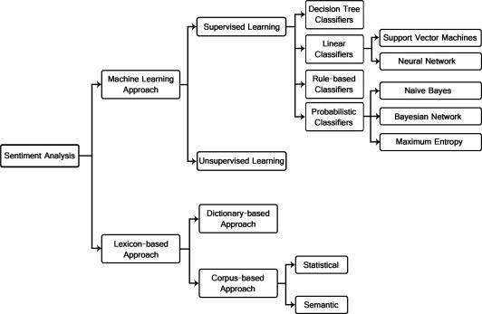
Sentiment Analysis & Machine Learning
Using machine learning techniques for text analytics has become increasingly popular due to its ability to classify sentiment across significantly larger collections of words
Lexicon-based techniques are limited by the lexicons themselves, i.e., they will have more gaps
This is particularly relevant when trying to analyze text data from social media, where you will see many words dropped from analysis because they are not matched by the lexicon

Slide 4
Project
For this project, I took a dataset from Kaggle with some 15,000 tweets using the hashtag #MeToo
Would have considered extracting the data myself, but these #MeToo tweets were from a time period from when the movement and hashtag were still especially active on Twitter
Wanted to explore hybrid methods, with machine learning approaches being used alongside lexicon-based approaches
Encountered numerous issues with the ML side of things
Deliverables are primarily focused on the lexicon-based sentiment analysis, but will go over some of the ML processes
H1: More negative sentiment from #MeToo tweets than positive

Slide 5
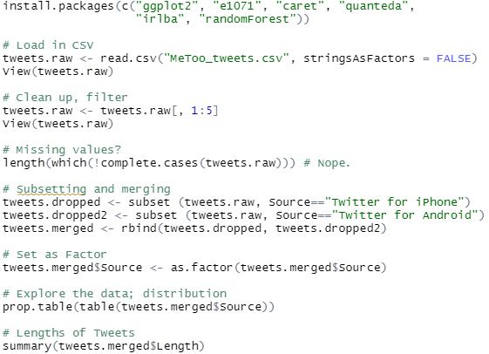

Machine Learning Process
Followed a series of videos on YouTube about ML text analytics with R on YouTube
Process begins similarly to normal text analytics, where you first load in your data and then clean it for missing data and check that your names, variables etc. are appearing and translating correctly

Slide 6
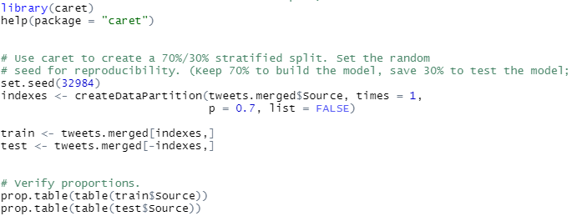
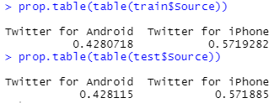
Splitting the Data
To build out the model, you ideally split your data into three parts: a training split, a validation split, and a test split
For the purposes of this project, only split the data into a training and test split at 70/30, where 30% of the data would eventually be used to “train” the 70% that would represent the eventual model

Slide 7
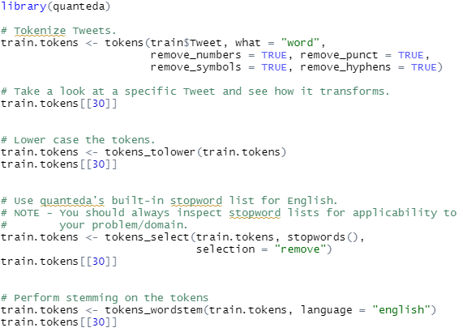
Cleaning the Data (Part 2)
The process requires that you tokenize the tweets, which simply refers to the process of splitting up sentences, paragraphs, or in this case tweets into smaller units, typically words

Slide 8
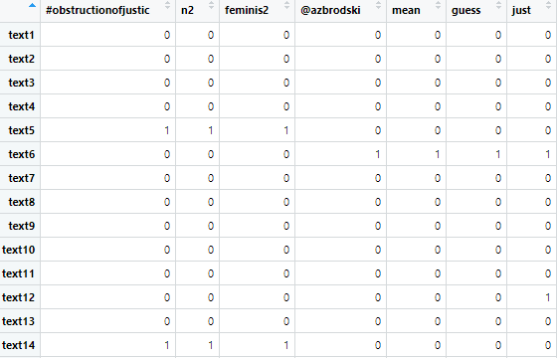
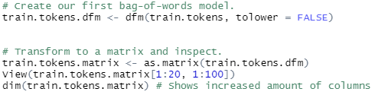
Bag-of-Words + Matrix
Next step is to develop a bag-of-words model, which is a simplified view of your words, where grammar and order is disregarded but multiples are kept
Have to transform the bag-of-words to a matrix to view it:

Slide 9
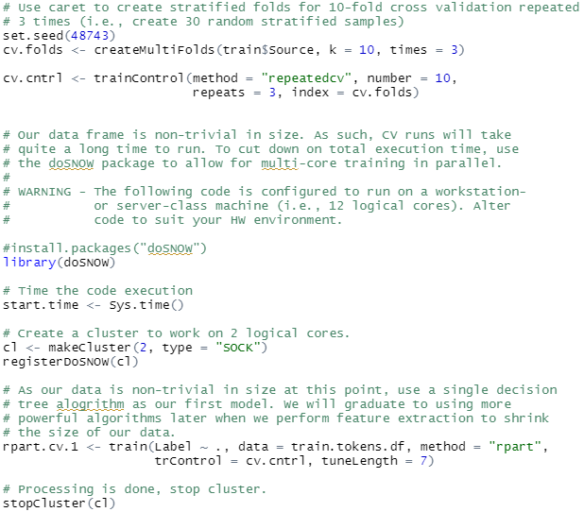
Building the Model
Uses caret for cross validation, eventually creating 30 random stratified samples
Base code initially ran on 10 logical cores. Most personal or home computers don’t have these specs, so I dropped mine down to 2 (my computer has 4 cores)
This is where failure occurred. My data (that I had substituted in during this learning process) was too large for my computer’s memory, and I couldn’t find a workaround with code

Slide 10
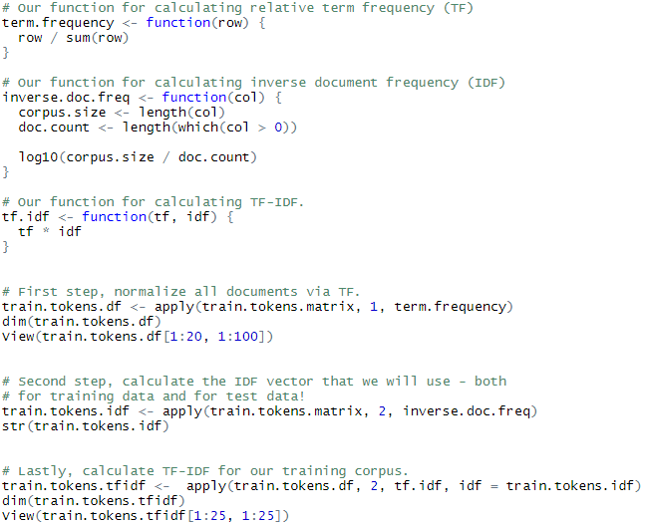
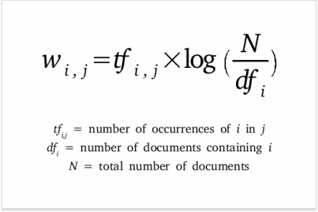
TF-IDF
Would have led to TF-IDF (term frequency – inverse document frequency) to determine how important certain words were to my corpus

Slide 11
Project Continued
Pivoting to a lexicon-based technique is necessary at this stage, cannot get the ML model to run under any circumstance
Utilizing the NRC lexicon that classifies words across positive and negative sentiment as well as a range of specific emotions
Same processes as before: clean the data, clean it again for stop words, URLs, numbers, etc., then build out a term-document matrix (TDM) and a corpus

Slide 12
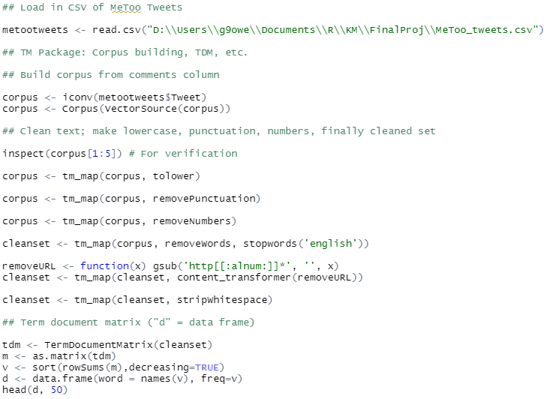
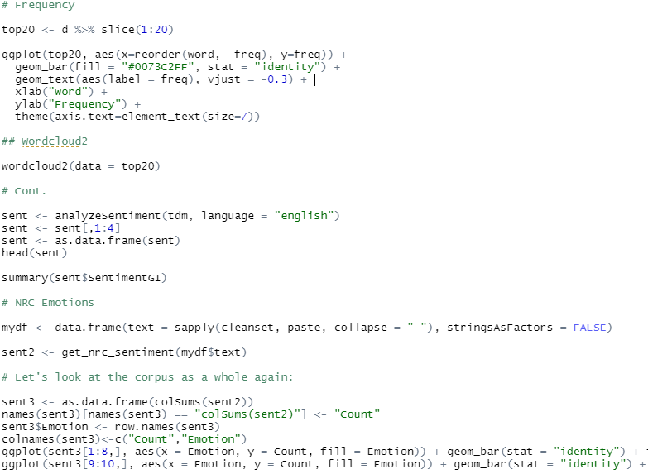
Code

Slide 13
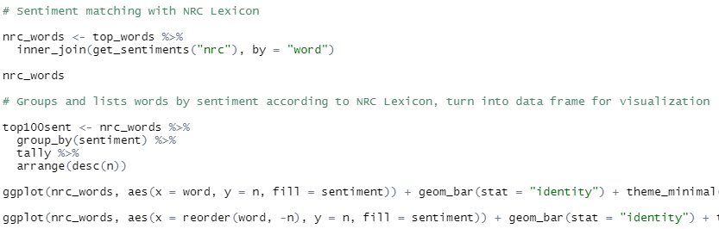
Code

Slide 14
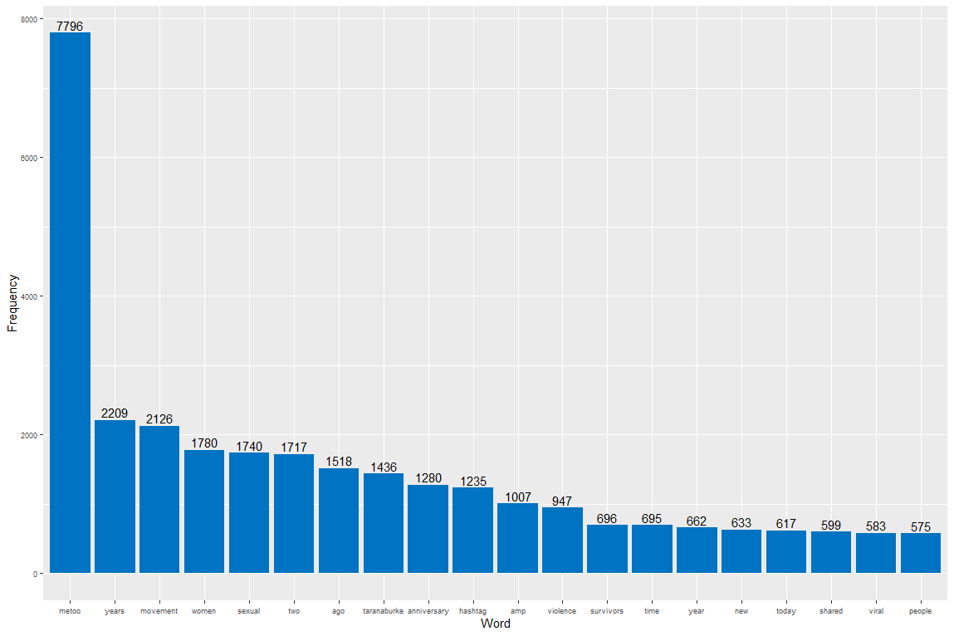
Visualizations

Slide 15
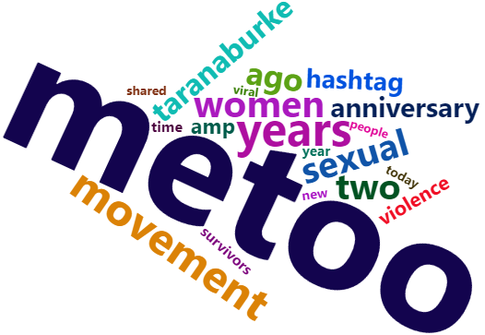
Visualizations

Slide 16
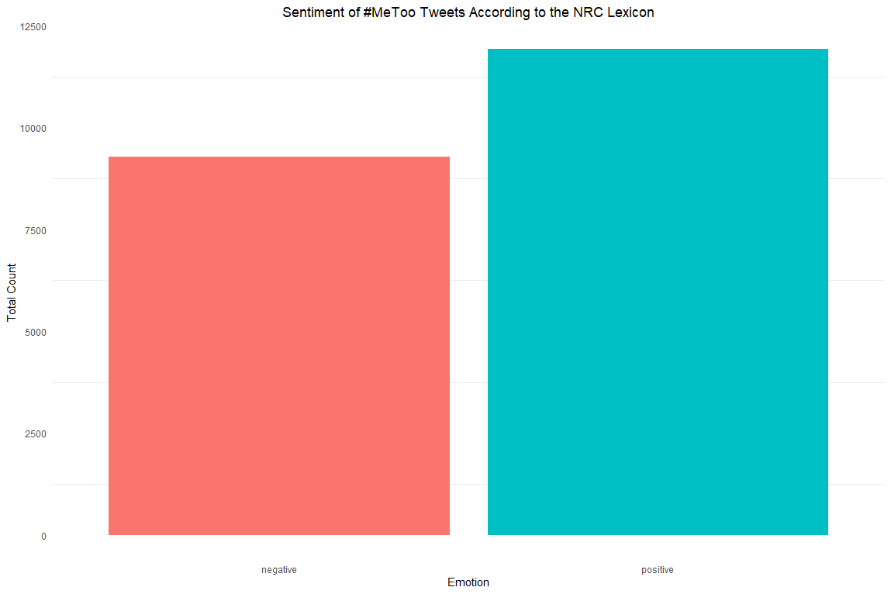
Visualizations

Slide 17
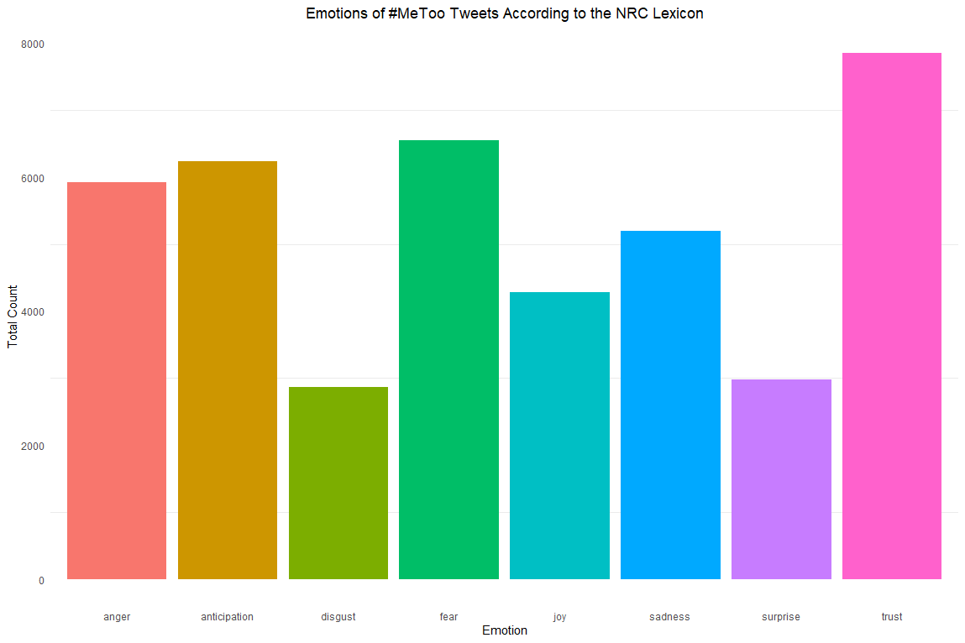
Visualizations

Slide 18
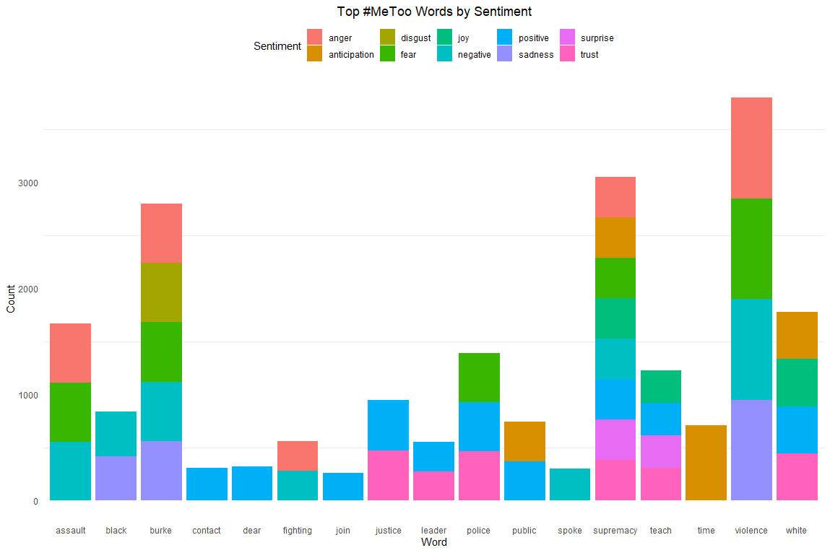
Visualizations

Slide 19
Conclusion and Considerations
Overall sentiment from the 2019 #MeToo tweets is positive, with especially high trust emotions emerging from the analysis
Limitations with lexicon-based models should be acknowledged, however, where for example words such as “black” and “white” are assigned with negative and positive sentiment, respectively
Must go over data carefully when using these lexicons as they are likely to assign sentiment incorrectly
Many words from the original top 100 list were omitted due to the lexicon not having them
ML and/or hybrid methods would be better to address these concerns and limitations, but given the constraints of this project, I was unable to make the ML model function properly after putting in a good deal of work

Slide 20
Thanks!

