Slide 1
Rating Prediction using GNN
Prakhar Gupta
MTech AI

Slide 2
Background
Matrix Factorization: Models a linear model of user and item latent factors. Limitations of MF are caused by the use of a simple and fixed inner product to estimate complex user–item interactions in the low-dimensional latent space.
Neural Collaborative Filtering: Was state of the art, suggested the use of NNs in recommender systems. Pure Collaborative filtering model without social network information for rating prediction.

Slide 3
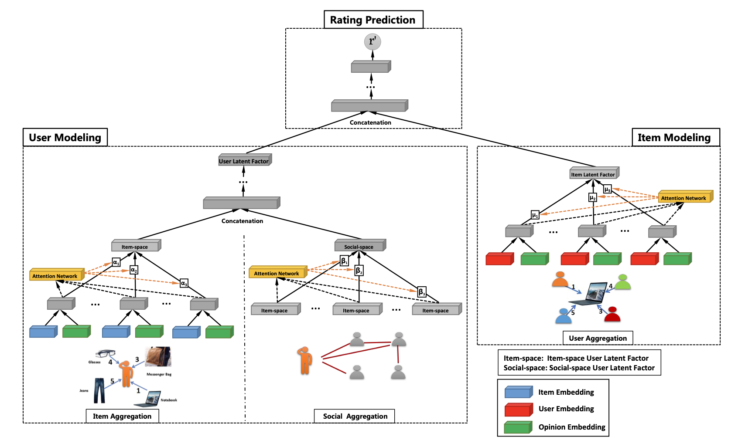
Proposed Approach

Slide 4
Technical details
CIAO datset: ~7k users with ~104k items and ~280k ratings
Training set: 60% from user-user and user-item data
Validation set: 20% from user-user and user-item data of the remaining 40%
Loss function: RMSE
Adam Optimizer (Authors used RMSProp)
Learning rate: 0.001
Early stopping with decrease in validations RMSE on 5 successive epochs
Epochs: 20
Embedding Dimension: 64 (Ablation study done by Authors indicated 64 to be most suitable)

Slide 5
Contributions (Novelty)
Implemented the Model from scratch in PyTorch.
Studied the effect of Attention layers after running with and without attention layers for all the graphs in item-space, social-space and item modelling.

Slide 6
Results & Conclusion
RMSE score (Author’s): 1.0093 in 100 epochs
RMSE score (With Attention N/w in all GNNs): 4.934 in 20 epochs
RMSE score (With Attention N/w in all GNNs): 5.209 in 20 epochs
Presented a Graph Network to model social recommendation for rating prediction. Considered both rating and social information. Jointly capture interactions and opinions in the user-item grap. Differentiated the ties strengths off social relations.

