Slide 1
GYMVERSE
Members
Trainers
The Digital Transformation of Fitness Management
A centralized relational database for organized fitness records
DATABASE MANAGEMENT SYSTEM MINI PROJECT
Project Scope: Designing a Centralized Gym Management Database
GYMVERSE
DATABASE
Team Details
Roll Number | Team Member Name
2510030006 | NYSHADAM SRIKAR
2510030246 | MALALLA SRI CHARAN
2510030412 | AKHIL SAGAR
2510030008 | GORANTLA PRANAV
2510030147 | YOGENDRA UNGARALA
Payments
Attendance
Department: [CSE] | Institution: [KLH] | Faculty Guide: [P LALITHA]
Progress
GymVerse = one connected universe of gym records
Novelty: integrates operational and fitness data in one normalized schema

Slide 2
Problem Statement
Why a gym needs a centralized relational database
Many gyms maintain records in registers, forms, or separate spreadsheets. Because these records are not connected, information becomes difficult to organize, update, verify, and retrieve.
Duplicate Member Records
Difficult Membership Tracking
Unconnected Payments
The same member information may be repeated, creating inconsistent details.
Active, expired, and renewed subscriptions are harder to identify.
Payments may not be linked correctly with members and subscriptions.
Trainer and Plan Gaps
Manual Attendance
Maintenance Problems
Trainer assignments, workouts, and diets may remain in separate records.
Visit history is difficult to search, summarize, and analyse.
Equipment condition, repairs, and service dates may be incomplete.
Manual & disconnected records
Centralized GymVerse database
Organized & connected information

Slide 3
Project Objectives
What the proposed GymVerse database is intended to achieve
Centralize Information
Reduce Duplication
Store members, trainers, plans, payments, attendance, classes, progress, and equipment together.
Avoid repeating the same information in multiple records and tables.
Track Memberships & Payments
Connect Trainers & Plans
Connect plans, subscriptions, dates, renewals, and payment history.
Relate trainers with members, workouts, diets, and progress records.
CENTRALIZED
GYM DATA
Manage Attendance & Classes
Track Progress & Diet
Store visits, schedules, capacity, bookings, and class trainers.
Maintain measurements, fitness history, nutrition targets, and meals.
Manage Equipment
Protect Data Integrity
Record availability, condition, repair history, costs, and service dates.
Use keys, relationships, constraints, and SQL for reliable retrieval.
Novelty: one normalized schema connects memberships, payments, trainers, workouts, diet, attendance, progress, classes, and maintenance.

Slide 4
Technology Stack and Feasibility
Why the proposed database is practical for a small student team and a local gym context
Database-design workflow
Requirements
ER Model
Relational Schema
Normalization
MySQL Tables
SQL Queries
Tools used
TerraER
MySQL
MySQL Workbench
SQL
Models entities, attributes, relationships, and cardinalities.
Stores tables, keys, constraints, sample records, and related data.
Creates tables, executes SQL, and inspects the schema.
Defines, updates, joins, filters, and retrieves gym records.
Project feasibility analysis
Technical Feasibility
Economic Feasibility
Operational Feasibility
Schedule Feasibility
TerraER, MySQL, Workbench, and SQL are sufficient for the full database-design scope.
The selected tools are free or available for academic use, so the project needs minimal cost.
The schema uses familiar gym records and can be understood and maintained with basic SQL knowledge.
The limited database-only scope can be completed by a small team within four weeks.

Slide 5
Expected Outcome and Societal Relevance
How the proposed database improves gym record management and supports local fitness centres
BEFORE: DISCONNECTED RECORDS
AFTER: GYMVERSE DATABASE
Centralized member records
Accurate membership tracking
One connected record for each member.
Clear plan, subscription, renewal, and expiry data.
● Repeated member details
● Unclear membership status
● Payments stored separately
● Manual attendance registers
● Scattered trainer and workout records
● Incomplete maintenance history
Organized payment history
Clear trainer assignments
Payments linked to the correct member and subscription.
Easy identification of trainer-member responsibility.
Better attendance & classes
Progress and diet history
Visits, schedules, bookings, trainers, and capacity connected.
Measurements, goals, diets, and meals stored over time.
Maintenance tracking
Faster information retrieval
Condition, repair cost, and service dates available.
SQL queries can find useful gym information quickly.
Societal relevance
Helps small and local gyms move away from paper-based records, reduce errors and repeated work, support trainers with organized member histories, and maintain safer equipment-service records.
Practical need addressed: simple, low-cost, reliable digital record organization for accessible fitness services.

Slide 6
GymVerse Database Modules
Nine groups of related entities that solve specific gym-management problems
Member Management
Membership & Payment
Trainer Management
MEMBER
MEMBERSHIP_PLAN • SUBSCRIPTION • PAYMENT
TRAINER • TRAINER_ASSIGNMENT
Stores profiles, contact details, joining date, and status.
Connects plans, dates, discounts, renewals, and payment history.
Stores trainer details and member-trainer assignments.
Workout Management
Class Management
Attendance Management
WORKOUT_PLAN • EXERCISE • WORKOUT_PLAN_EXERCISE
FITNESS_CLASS • CLASS_SCHEDULE • CLASS_BOOKING
ATTENDANCE
Organizes personalized workout plans and plan-specific exercise details.
Stores class types, sessions, trainers, capacity, and bookings.
Stores attendance date, check-in time, and check-out time.
Progress & Diet
Equipment Management
Feedback & Notifications
PROGRESS_RECORD • DIET_PLAN • DIET_MEAL
EQUIPMENT • EQUIPMENT_MAINTENANCE
FEEDBACK • NOTIFICATION
Connects measurements, progress history, nutrition targets, and meals.
Tracks equipment, condition, availability, repairs, and service history.
Stores member feedback, reminders, notices, and communication history.
All modules connect through shared keys and relationships

Slide 7
Project Plan and Implementation Timeline
Four-week database-first process from problem analysis to SQL testing
01
TASK 1
02
TASK 2
03
TASK 3
04
TASK 4
Requirement Analysis
Conceptual ER Design
Schema & Normalization
SQL Design & Testing
● Study gym record-management problems
● Define scope and data requirements
● Identify major entities and attributes
● Finalize entities and attributes
● Choose keys, relationships, and cardinalities
● Create the ER model in TerraER
● Convert entities into relations
● Resolve M:N relationships with junction tables
● Normalize the schema up to 3NF
● Create tables, keys, and constraints
● Insert a small set of sample records
● Run basic SQL queries and verify integrity
Outcome
Outcome
Outcome
Outcome
Clear understanding of what the database must manage
Conceptual representation of connected gym data
Structured relational design with reduced redundancy
Tested database structure for GymVerse
Gym problems → Data requirements → ER model → Relational schema → Normalized tables → SQL testing

Slide 8
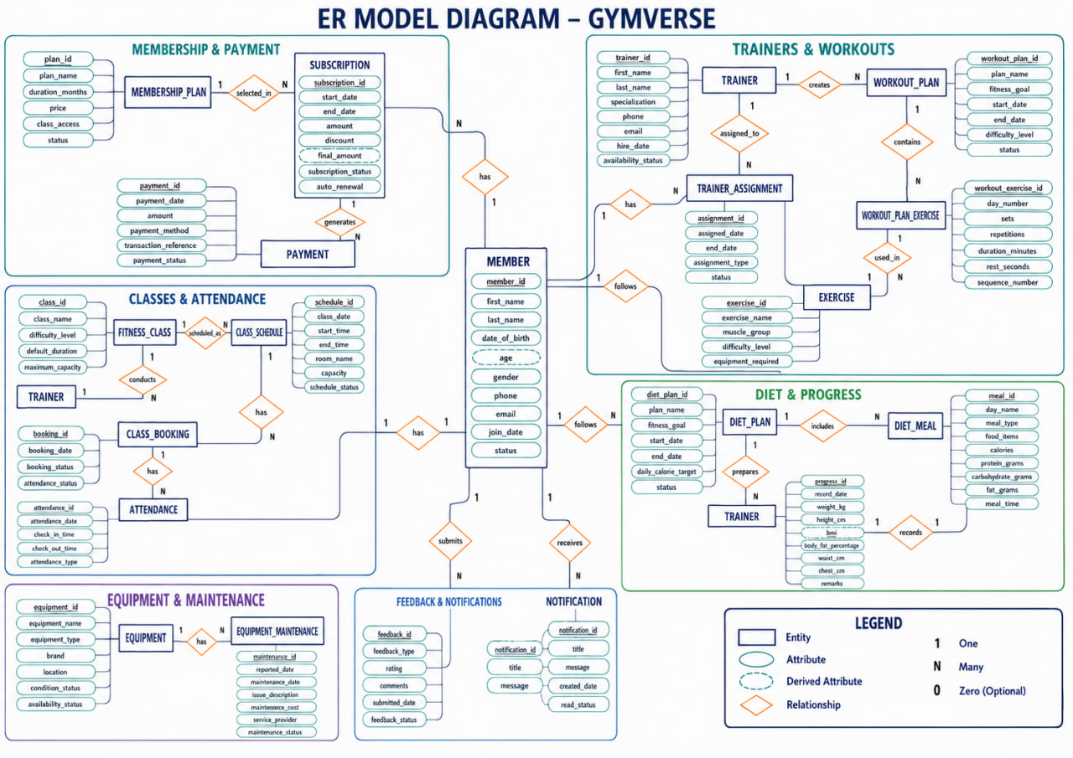
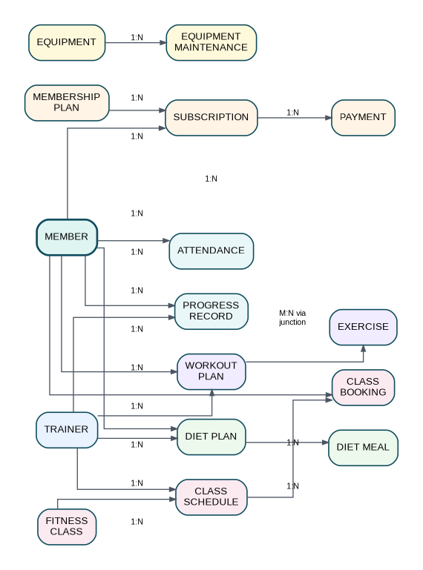
ER Model Overview — Appendix
How the main GymVerse records are connected
Key relationship rules
● A member can have many subscriptions over time.
● Each subscription selects one membership plan.
● A subscription can have multiple payment records.
● Workout–exercise M:N is resolved through WORKOUT_PLAN_EXERCISE.
● Member–class M:N is resolved through CLASS_BOOKING.
● Member–trainer M:N is resolved through TRAINER_ASSIGNMENT.
● Equipment can have many maintenance records.
Notation
1:N
One-to-many
M:N
Many-to-many
PK
Primary key
FK
Foreign key

