Slide 1


TUTOR QUEST
Under the guidance of B. Pavan sir
Team Members:
19H51A05F6- D. Sai Teja
19H51A05F7- G. Sushma
19H51A05F8- G. Pranay Kumar

Slide 2

CONTENTS
INTRODUCTION
OBJECTIVE
ABSTRACT
EXISTING SOLUTIONS
REQUIREMENTS
FLOW CHART
RESULTS
ADVANTAGES/APPLICATIONS
FUTURE SCOPE
CONCLUSION

Slide 3
INTRODUCTION
Every person has right to study and every person who has knowledge can share their knowledge and teach people without any barriers. At present since the pandemic has shook the whole world, people lost their jobs, students were dropped out of schools and colleges due to financial crisis. There are platforms for students to find an online teacher and for an educator to teach. Many online platforms are providing 1:1 instructor class but are charging very high amount and has been turning into profitable organizations rather than building a bridge between such students and teachers.

Slide 4
AIM
OBJECTIVE
To build a platform for students and organizations to find teachers.
Our main objective is to build “TUTOR QUEST” web application.
Users are only teachers, students, organizations.
Proper verification of each is done to be able to signup.

Slide 5
ABSTRACT
Due to the pandemic many of the private teachers are losing their jobs. Parents also are facing difficulties as many online platforms are providing 1:1 instructor class but are charging very high amount. Our project’s aim is to connect such Teachers and Students where they can create account on our website and create profile which includes filling in their details. Students can browse through the list of teachers according to their requirement and contact them by their email-id/phone number provided in their description. It’s not limited to students as even organizations can find teachers if needed. Our project can be created using front-end and backend technologies. We used HTML, CSS for front-end and PHP, MySQL for backend. Through this website we can connect such teachers and students which is beneficial.

Slide 6

EXISTING SOLUTIONS
Urban Pro acts as a middlemen in between students and teachers and takes commission for every class that conducted.
There are no checks for fake or real enquiry.
Students should pay them and not to the teacher. Then teachers have to follow up, for which they send automated responses to their emails.

Slide 7

High fees
More focused on marketing.
Promised refund policy if enrollment is cancelled but most of them aren't receiving the refund.

Slide 8

Assurance of getting tutor job by taking money.
Annoy customers to give 5-star rating.
Ghar pe Shiksha

Slide 9

REQUIREMENTS
The requirements of our project are:
Personal Computer
XAMPP server
VS Code Editor

Slide 10
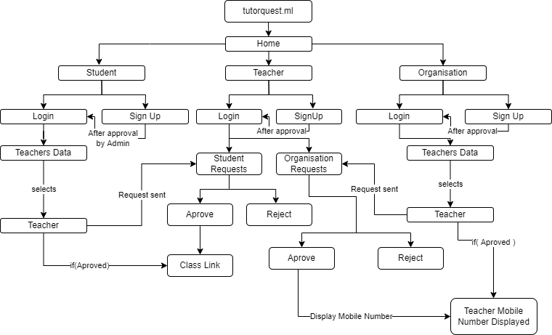
Flow Chart

Slide 11
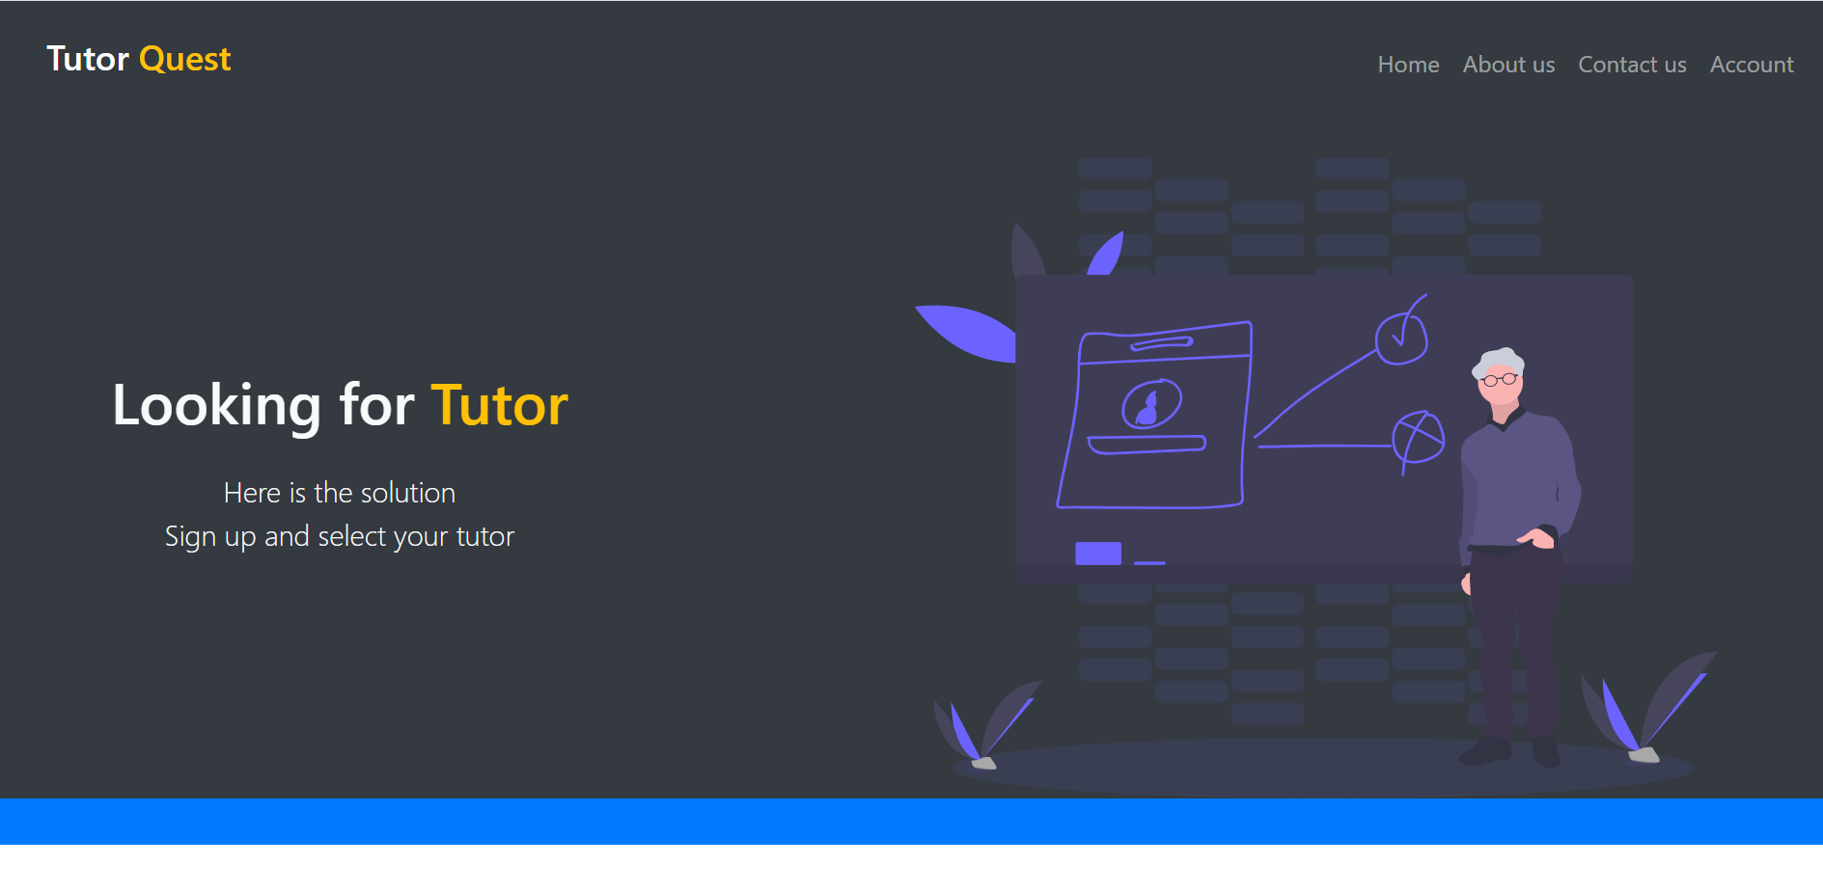
RESULTS (http://tutorquest.ml/)

Slide 12
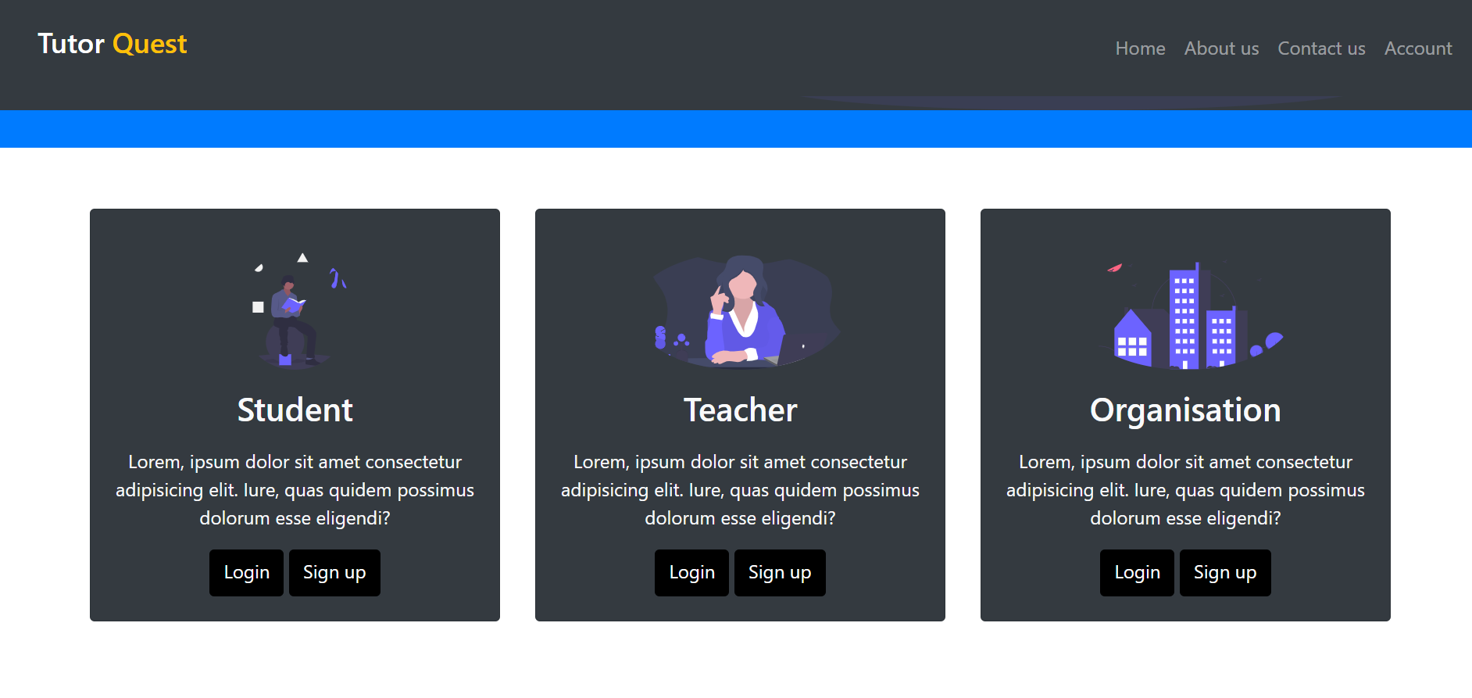

Slide 13
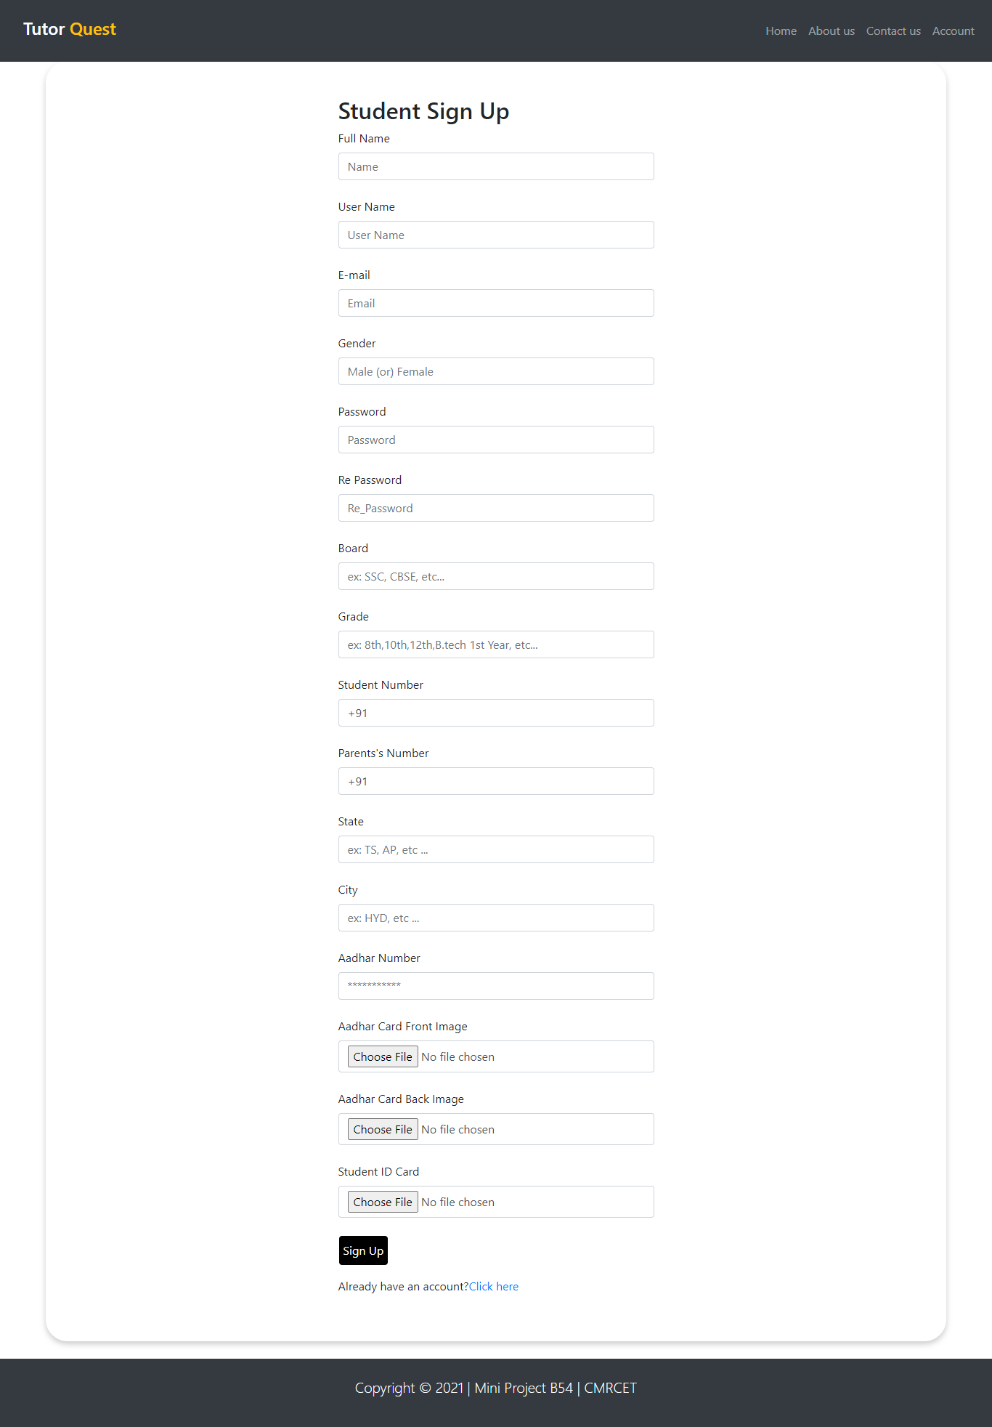
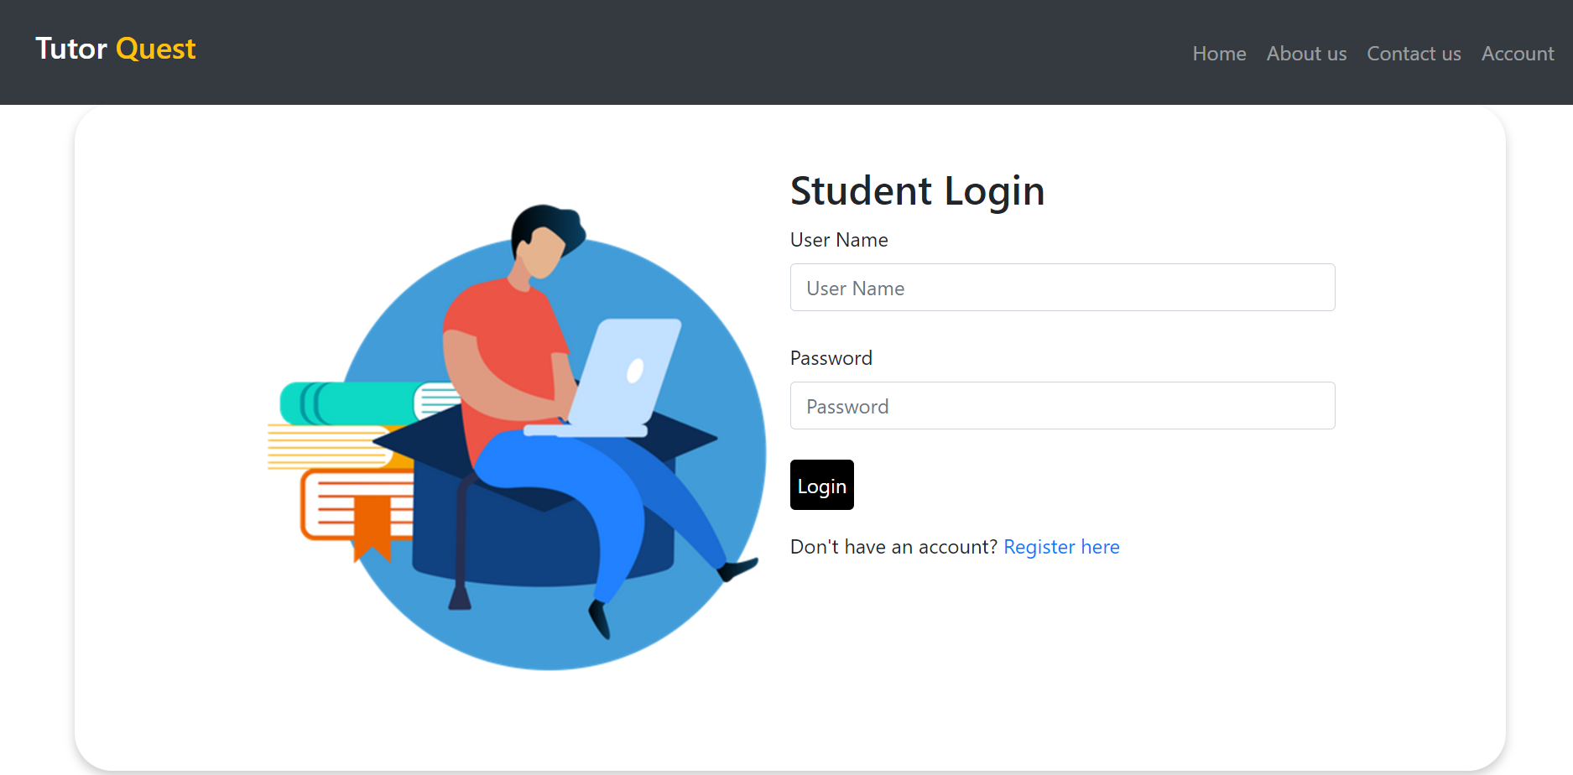

Slide 14
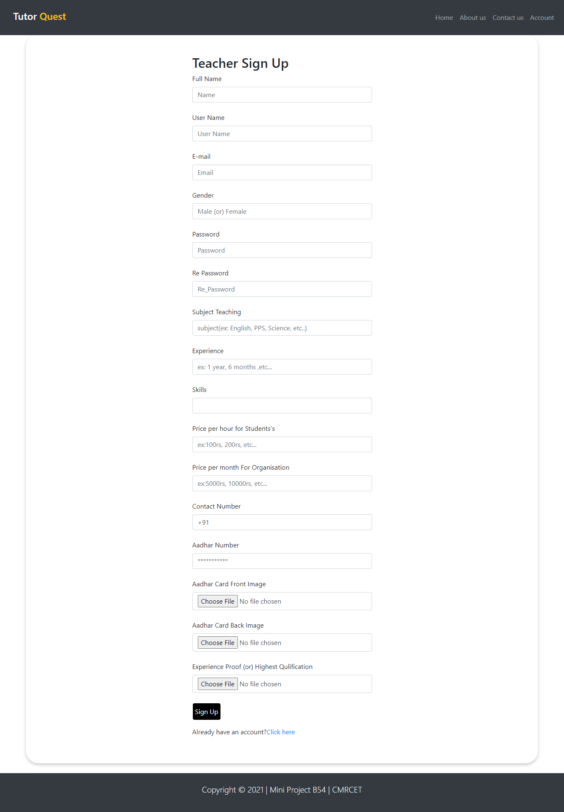
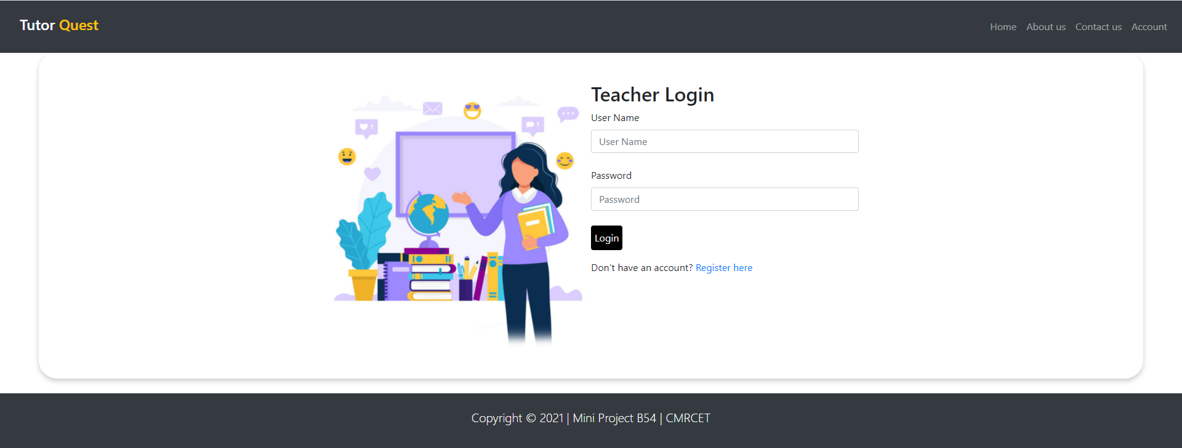

Slide 15
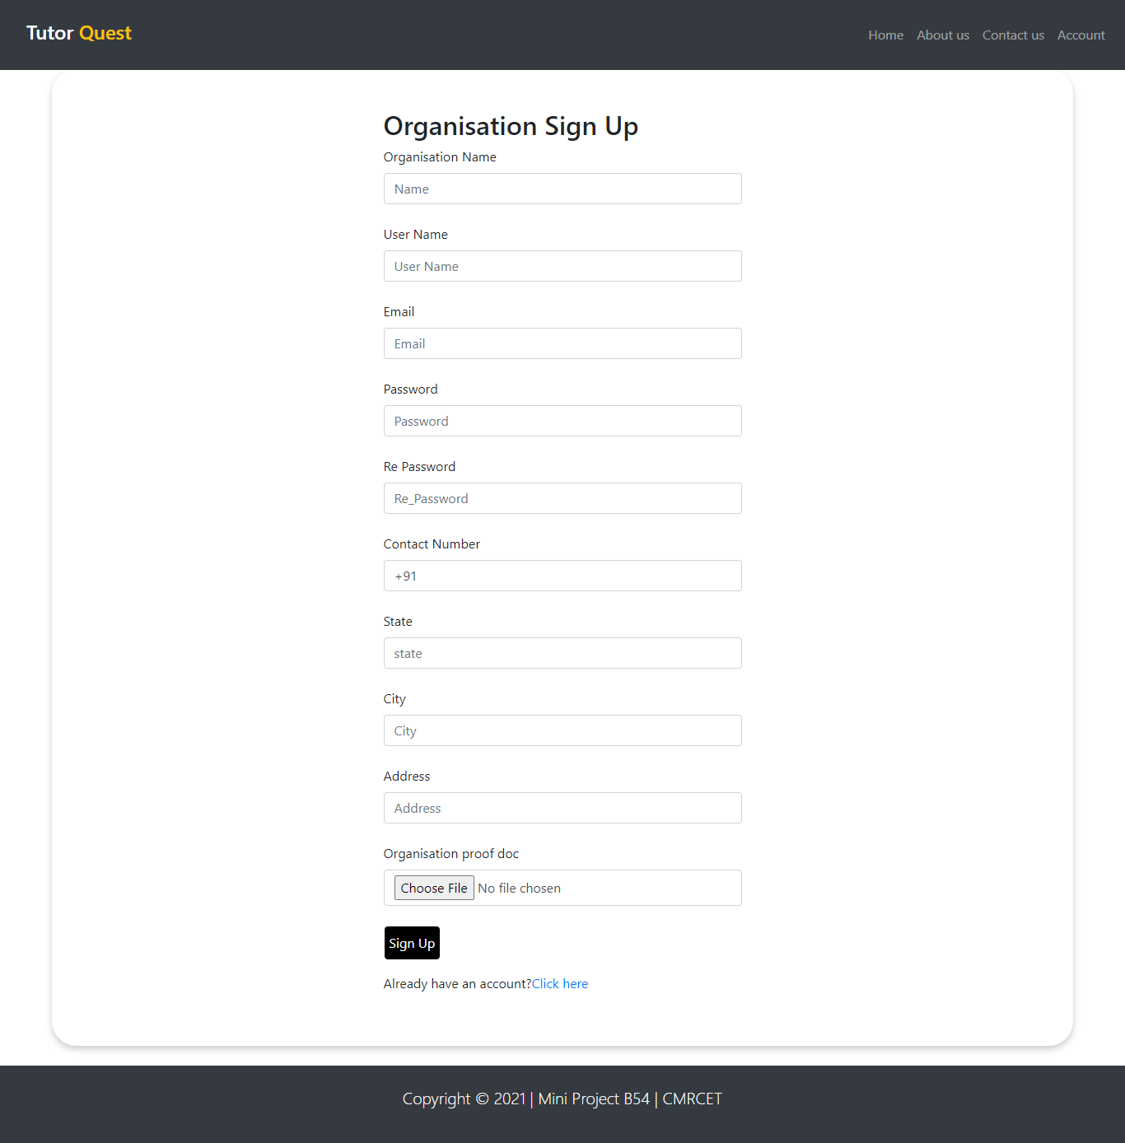
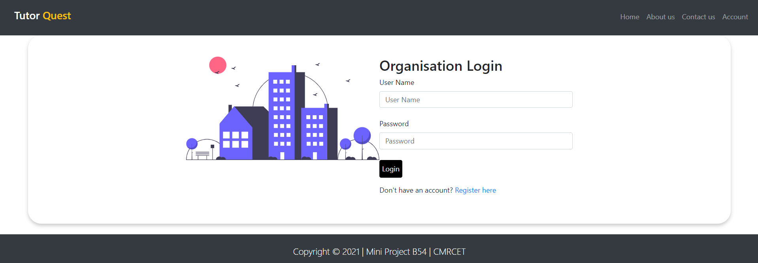

Slide 16
ADVANTAGES
Students and organizations can find tutors easily on our platform based on their requirements.
Proper verification of each user is done to ensure safety and security.
We do not take any commission from monthly tuition fee.

Slide 17
APPLICATONS:
Organizations can look for recruiting teachers from our web application.
Anyone who has talent and passion to teach and share their knowledge can register themselves on our application.
Students can take 1:1 classes.

Slide 18

FUTURE SCOPE
Try automating the verification process.
Integrating the application with it’s own video conferencing software.
Developing it further to make it scalable and reliable.

Slide 19
CONCLUSION
A platform for students who are passionate to learn new things, teachers who want to make future better by sharing their knowledge as well as making their ends meet and organization for recruiting teachers is made.

