Slide 1

Exploratory Big Data Visualization
Author: Girraj Prasad
Advisor: Dr. Feng Yu
Using an automated containerized Spark cluster

Slide 2
Agenda
Project summary
About Spark
About Docker
Problem statement
Goals
Implementation steps
Development strategy
Architecture diagrams
Results
Challenges
Future work
Conclusion
References
Repository

Slide 3


Project summary
Objective: To create an Apache Spark cluster using Docker containers and visualize big data
Apache Spark for processing large datasets in parallel
Docker for running applications in containers.
By combining these technologies, we aimed to create a scalable and portable Spark cluster that can be easily deployed on different environments.
Notes:
Objective: To create an Apache Spark cluster using Docker containers and visualize big data
Apache Spark is a distributed computing framework that enables processing of large datasets in parallel across multiple machines.
Docker is a popular platform for building, shipping, and running applications in containers.
By combining these technologies, we aimed to create a scalable and portable Spark cluster that can be easily deployed on different environments.

Slide 4
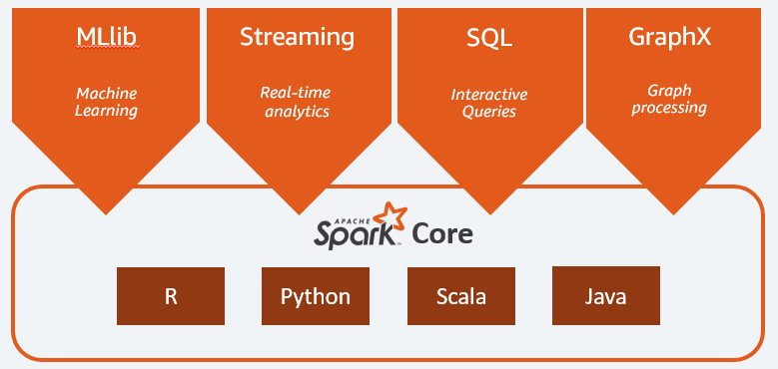
About Apache Spark
A distributed computing framework designed to process large datasets
Provides API for well-known languages
( Java, R, Python, Scala ,SQL)
In-memory processing model
Much faster (100X) than traditional big data processing frameworks like Hadoop
Image Source: http://restanalytics.com/2018-11-27-Introduction-To-Spark-A-Pyspark-Tutorial/
Notes:
Apache Spark is a distributed computing framework designed to process large datasets in parallel across multiple computers in a cluster. It is an open-source project developed by the Apache Software Foundation and is written in Scala, Java, and Python.
There are several reasons why we use Apache Spark. One of the primary reasons is its ability to handle large datasets efficiently. Spark's in-memory processing model enables it to perform much faster than traditional big data processing frameworks like Hadoop, especially when dealing with iterative algorithms and machine learning workloads. Spark also provides a rich set of libraries, such as Spark SQL, Spark Streaming, and MLlib, which make it easier to work with different types of data and perform complex data processing tasks

Slide 5

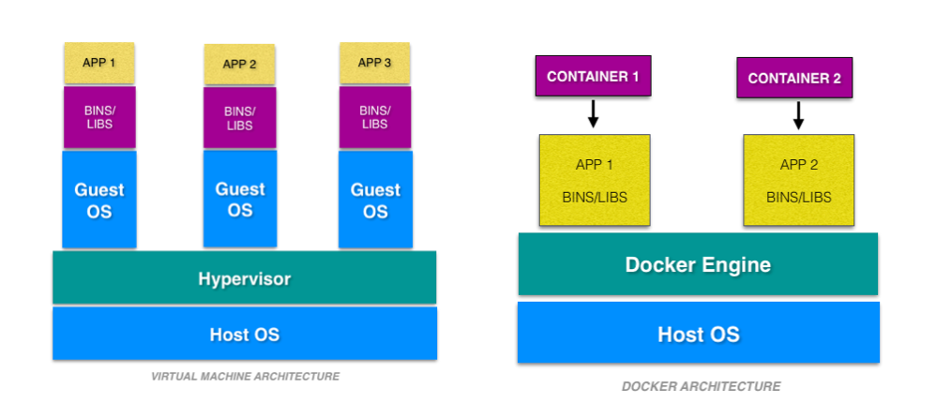
About Docker
Platform for developing, deploy, and running applications using containerization technology
Enables to create self-contained environment with all dependencies and configurations
Fast and easy deployment without any compatibility issues.
Easy to scale application horizontally by spinning up multiple containers on different machines
Lightweight and minimal use of resources compared to virtual machines
Image source: https://www.wernjie.com/wp-content/uploads
Image source: https://cloudacademy.com/
Notes:
Docker is a popular platform for developing, shipping, and running applications using containerization technology. It allows developers to create a self-contained environment for their applications, where all the necessary dependencies and configurations are included in the container. This means that the application can be easily deployed and run on any machine that has Docker installed, without worrying about compatibility issues or dependencies. Docker also makes it easy to scale your application horizontally by spinning up multiple containers on different machines. Docker containers are lightweight and use fewer resources than traditional virtual machines, which means you can run more containers on a single machine.

Slide 6
Problem Statement
Big data processing has become increasingly important in various industries
Setting up a reliable and efficient Spark cluster can be a daunting task
Deploying a Spark cluster on different environments can be challenging due to dependencies and configuration issues.
Scalability challenges
Notes:
Big data processing has become increasingly important in various industries, from finance to healthcare to retail.
Setting up a reliable and efficient Spark cluster can be a daunting task, especially for small or medium-sized enterprises that do not have dedicated IT infrastructure.
Deploying a Spark cluster on different environments, such as local machines or cloud providers, can be challenging due to dependencies and configuration issues.
Therefore, we wanted to provide a solution that simplifies the process of creating and deploying a Spark cluster, while also ensuring high performance and scalability.

Slide 7
Goals
To create a Spark cluster using Docker containers, with a focus on modularity, scalability, and ease of use.
To automate the creation of the Spark cluster by docker files ,images ,containers and services
To provide a comprehensive documentation and examples that demonstrate how to use the Spark cluster for different use cases, such as data processing, machine learning, and data visualization.

Slide 8
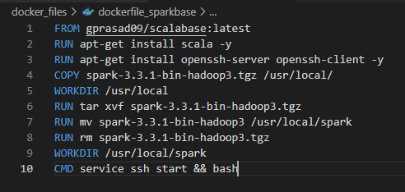
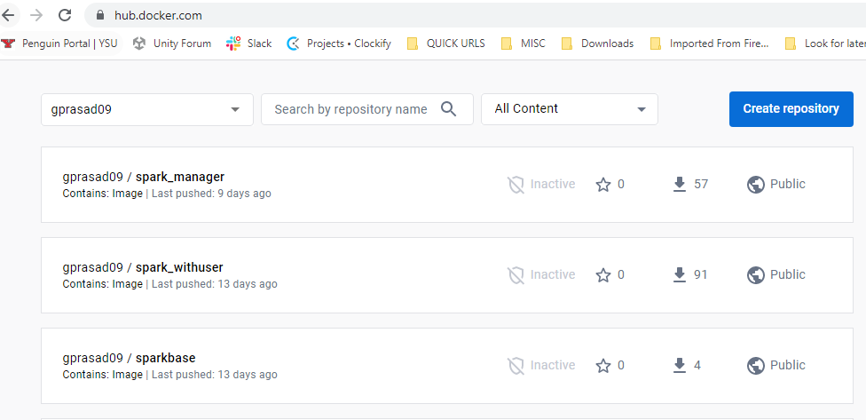
Implementation: Step(1/5)
Create docker images
Docker files
Build docker images
Base images, manager image, worker images
Config preparation
Push build images to docker hub

Slide 9
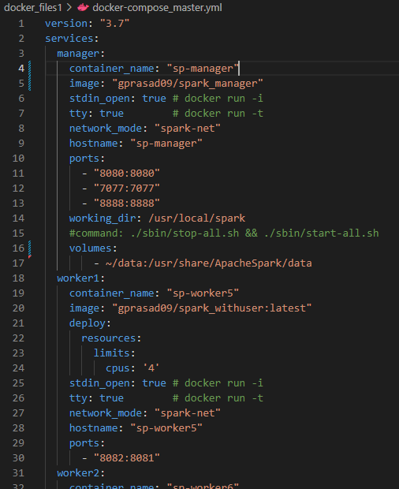
Implementation: Step (2/5)
Create docker compose file
Manager and Worker container configuration
Hostname configuration
Resource utilization (No of CPUs)
Port configuration
Data volume mapping

Slide 10

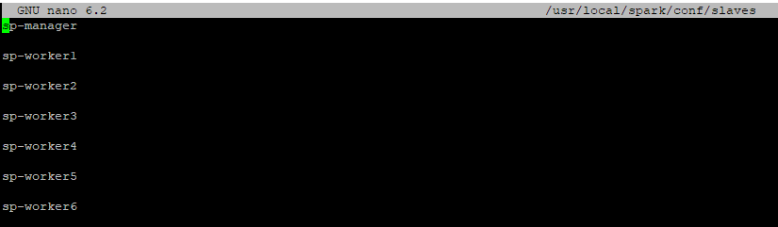
Implementation: Steps (3-5)
Build manager and worker containers
Docker swarm network
Create manager and worker containers on Swarm network
Configuration post containers creation
Master container configuration
Slaves list, Spark path
Library and tools installation such as Jupyter, matplotlib etc.
Automate cluster creation tasks
Manager and workers as docker services with docker stack
Automate configuration with shell scripts, docker images/compose

Slide 11
Development Strategy
Iteration 1: Manual execution
Manually created containers in all host machines
Manually performed configuration on containers
Built fully functional Spark cluster
Observed manual activities
Iteration 2: Partially automated
Automated container creation with docker compose
However, need to execute docker compose on each host machines
Iteration 3: Fully automated
Automated configuration by including them at docker image level
Automated containers creation across the host machines with docker stack services
Goal: One command to build all the pre-configured containers and start the Spark cluster

Slide 12
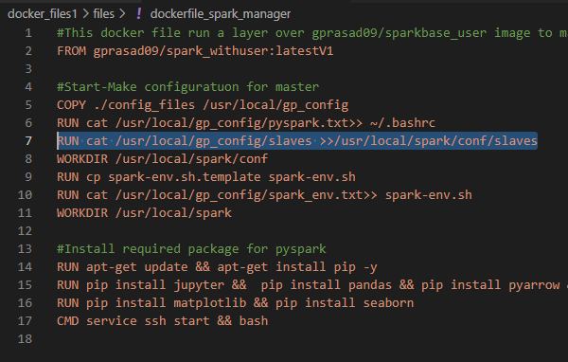
Fine-tuned docker files

Slide 13
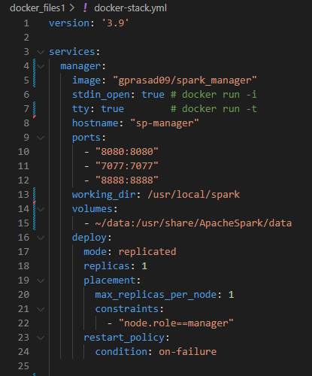
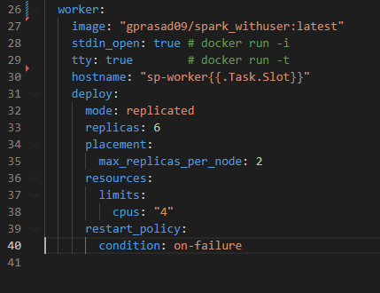
Compose files: Docker Stack

Slide 14
Typical Apache Spark Cluster
Worker1
Worker2
Worker n
Executor
Executor
Executor
Cache
Cache
Cache
Task
Task
Task
Task
Task
Task
Host 1
Host 2
Host n
Manager
SparkContext
Host m

Slide 15
Solution Architecture
Communication over Docker Swarm Network
Container 1
Worker
Container 1
Container 2
Manager
Worker
Host 2
Container 2
Worker
Container 3
Container 1
Worker
Worker
Host m
Container 2
Worker
Host 1

Slide 16
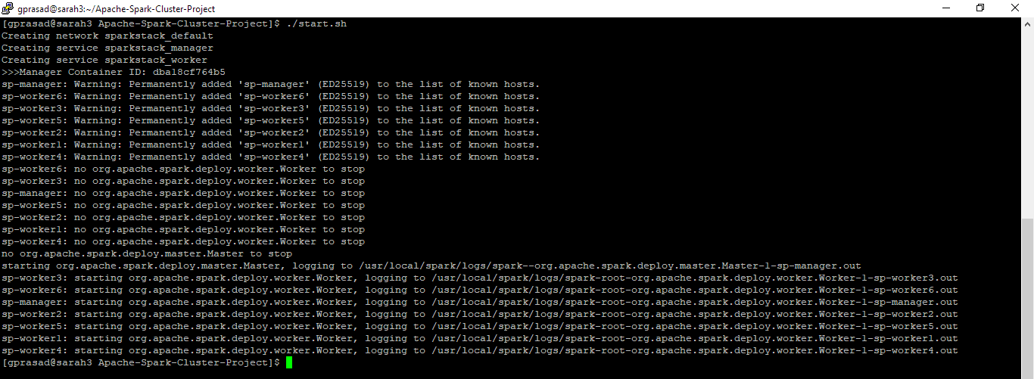
Results
Build and start cluster with one command
Create stack network
Create stack of services (containers)
Start the cluster

Slide 17
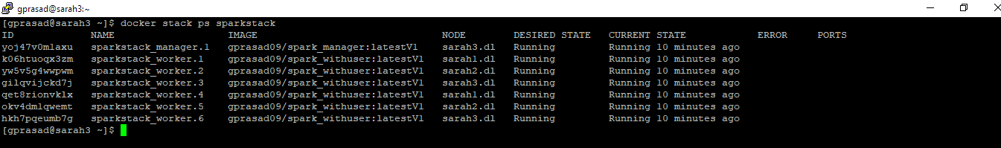
Results

Slide 18
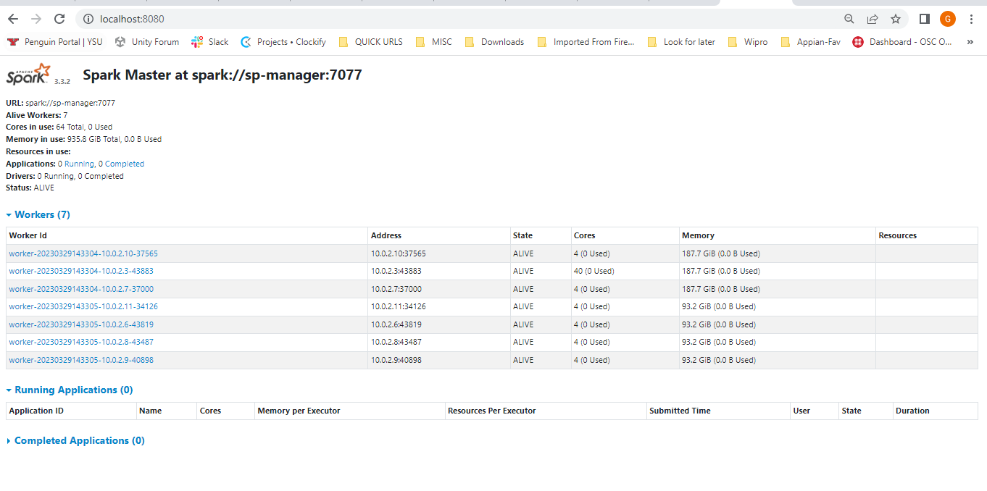
Spark UI

Slide 19
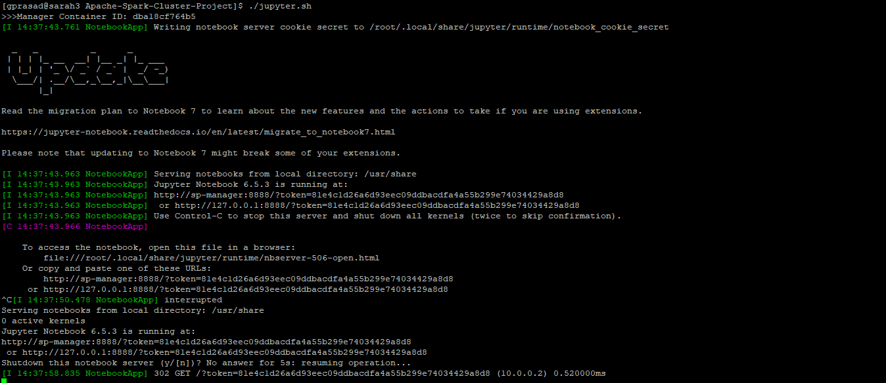
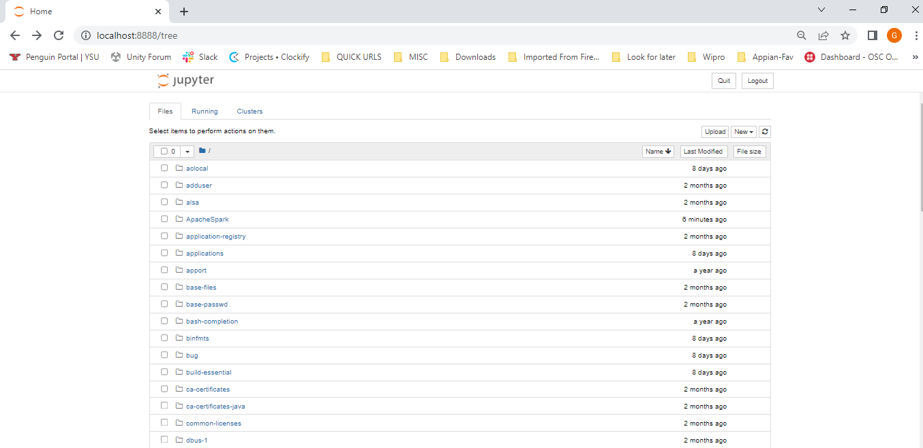
Jupyter Integration

Slide 20
Big data generation: TPC-H
TPC-H Database benchmark used to measure the performance of highly-complex decision support databases.
Tool to generate data with large volumes
Consists of a suite of queries and data sets
Capable to generate uniform as well as skewed(z value) distributed data
Generates data and creates 8 tables for a given data volume
Notes:
The TPC-H dataset provides a set of schemas to support the TPC Benchmark™ H (TPC-H). TPC-H is a database benchmark used to measure the performance of highly-complex decision support databases.

Slide 21
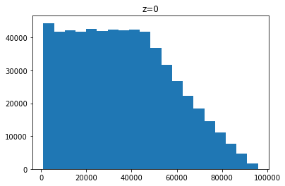
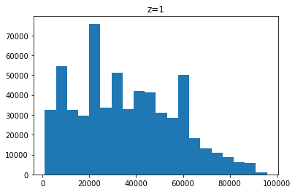
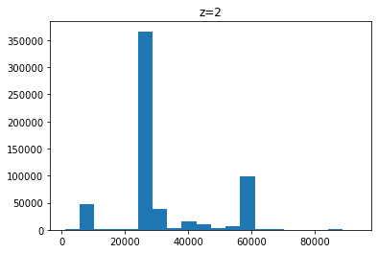
Big data visualization: TPC-H
Generated 100MB data
Visualized Lineitem table
Histogram for L_EXTENDEDPRICE

Slide 22
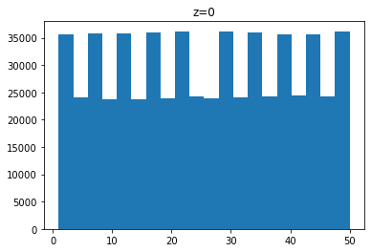
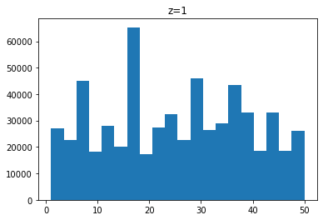
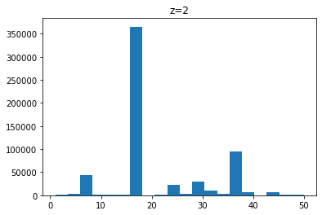
Big data visualization: TPC-H
Histogram for L_QUANTITY

Slide 23
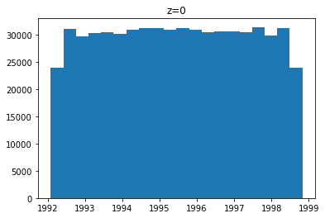
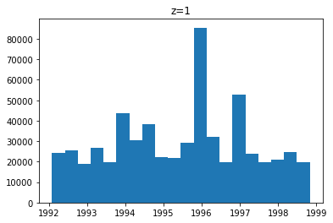
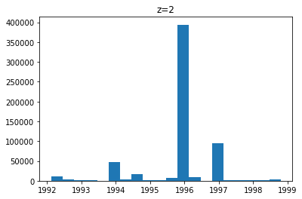
Big data visualization: TPC-H
Histogram for L_COMMITDATE

Slide 24
Challenges
Faced a steep learning curve to understand the concepts and tools involved in Spark ,Docker and Linux
Integration with additional service such as Jupyter
Controlled environments and servers
Utilized git, docker hub for file edits and sharing

Slide 25
Potential future improvements
Integration with Cloud provider
Leverage the capabilities of Kubernetes as container orchestration tool
Additional on-demand services in separate containers which can link to the cluster such as visual source code, etc.

Slide 26
Conclusion
We have successfully created an Apache Spark cluster using Docker containers, which can be easily deployed and scaled on different environments.
We have also automated the creation of the Spark cluster by fine-tuning docker files, images, services and shell scripts.
We successfully configured the resource utilization such as CPU usages by managers and workers of the cluster.
Finally, we have provided a comprehensive documentation and examples that demonstrate how to use the Spark cluster for different use cases, such as data processing, machine learning, and data visualization.
We believe that this project can be useful for anyone who needs to process big data using Spark, without the need for dedicated infrastructure or complex setups.

Slide 27
References
https://docs.docker.com/
https://spark.apache.org/docs/latest/quick-start.html
https://www.linkedin.com/pulse/setup-multi-node-hadoop-cluster-using-docker-komal-suthar/
https://github.com/YSU-Data-Lab/TPC-H-Skew
https://medium.com/sicara/get-started-pyspark-jupyter-guide-tutorial-ae2fe84f594f

Slide 28
Repository
Git Repository
https://github.com/gprasad09/Apache-Spark-Cluster-Project
Docker images
https://hub.docker.com/repositories/gprasad09

