Slide 1

Technical presentation
CSA1709- Artificial Intelligence
Presented By G Prashanth(192311366)
Guided By Dr. P Raja ram

Slide 2


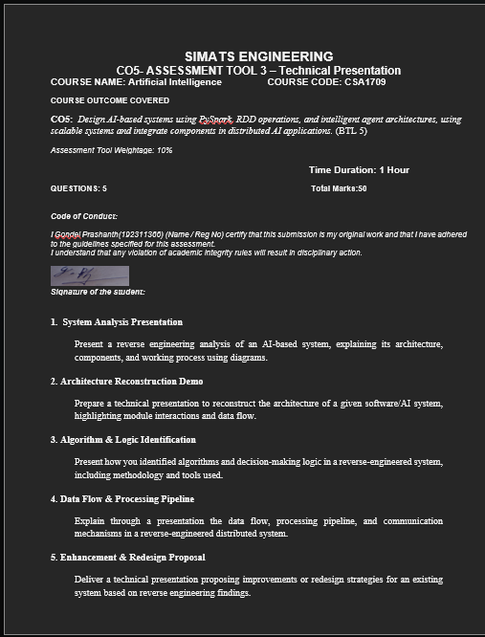

Slide 3
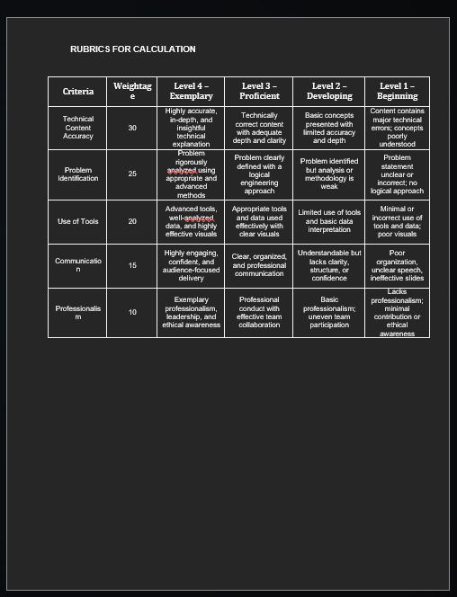

Slide 4
Introduction
Reverse engineering is the process of studying an existing system to understand its architecture, components, processing methods, and output.
In an AI-based system, reverse engineering helps identify how input data is converted into meaningful predictions.
The analysis focuses on the input, preprocessing, feature extraction, AI model, decision-making, and final output.
The selected example is an AI-based Deepfake and Face Authenticity Verification System.
The system analyzes facial information from images or videos and determines whether the content is genuine or manipulated.
1
2
3
02

Slide 5
Problem Statement
The main objective is to automatically determine whether a given facial image or video is REAL or FAKE.
Detect artificial modifications introduced by deepfake or face-manipulation techniques.
Analyze facial appearance, movement, texture, and temporal consistency.
Generate a probability or confidence score for the prediction.
Provide a final authenticity decision that can assist users or security systems.
Reduce the need for completely manual inspection of suspicious videos.
1
2
3
02

Slide 6
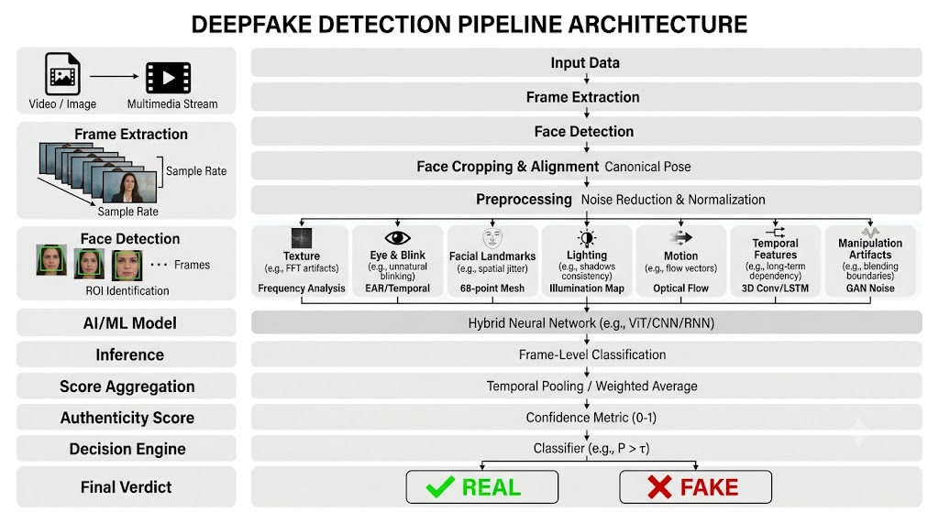
architecture
1
2
3
02

Slide 7
System Output
The final output contains the authenticity classification.
The system may display REAL or FAKE.
It can also provide a confidence or probability score.
Suspicious frames can be identified for further investigation.
Detected artifacts or features may be included in the verification report.
The output can be displayed through a web application, mobile application, or security dashboard.
The result can help a human operator make the final verification decision.
05

Slide 8
Advantages
Provides automated deepfake detection.
Reduces manual video inspection.
Can process multiple frames efficiently.
Can combine different facial features.
Can identify subtle visual inconsistencies.
Provides measurable confidence scores.
Can be integrated into online identity verification systems.
Can support cybersecurity and digital forensics.
Can potentially operate in real-time with suitable hardware and optimized models.
05

Slide 9
Conclusion
Reverse engineering allows us to understand an AI-based system by analyzing its observable behavior.
The deepfake verification system can be divided into input, preprocessing, feature extraction, AI classification, score aggregation, and decision-making stages.
The system likely analyzes both spatial features and temporal features to identify manipulated facial content.
Multiple frame predictions can be combined to produce a more reliable video-level result.
The final system provides a REAL/FAKE classification along with a confidence or authenticity score.
Such systems are increasingly useful for digital identity verification, cybersecurity, digital forensics, and online authentication.
05

Slide 10
Introduction
Architecture reconstruction is the process of analyzing an existing software or AI system to understand its internal structure.
It identifies the major modules, their responsibilities, interactions, and data flow.
The process helps understand how input data is transformed into the final output.
In this system, the architecture of an AI-based Deepfake and Face Authenticity Verification System is reconstructed.
The system uses image/video processing and AI techniques to identify whether facial content is genuine or manipulated.
The reconstructed architecture provides a clear view of how different modules work together.
1
2
3
02

Slide 11
Problem Statement
The rapid growth of AI-generated and manipulated images/videos has made it difficult to distinguish genuine facial content from deepfake content.
Deepfake videos can realistically modify a person's face, expressions, eye movements, skin texture, and facial features.
Manual verification of videos is time-consuming and may not reliably identify sophisticated manipulations.
Therefore, an AI-based Face Authenticity Verification System is required to automatically analyze images or videos.
The system should extract relevant facial features, detect manipulation artifacts, analyze frame-to-frame consistency, and classify the input as REAL or FAKE.
The system should also provide an authenticity/confidence score to support the final verification decision.
The reconstructed architecture should clearly represent the modules, interactions, and data flow involved in the verification process.
1
2
3
02

Slide 12
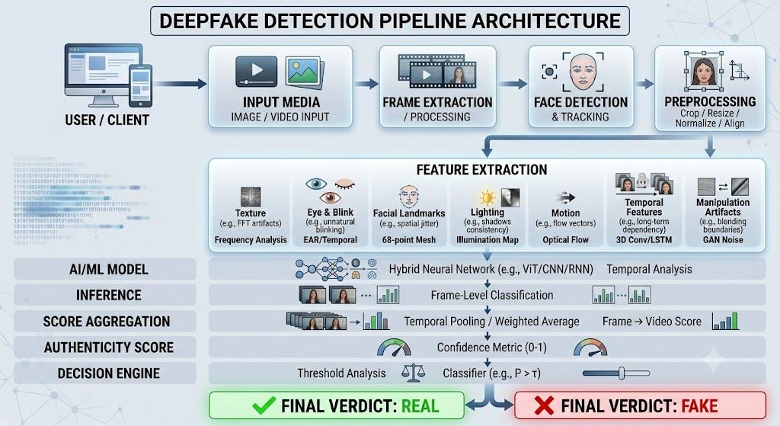
architecture
1
2
3
02

Slide 13
System Output
The system produces a final REAL / FAKE classification for the input image or video.
It generates an authenticity or confidence score indicating how strongly the system supports the prediction.
Provides frame-level prediction scores for individual video frames.
Displays detected facial artifacts and inconsistencies that may indicate manipulation.
Reports abnormalities in:
Facial texture
Eye and blink movement
Facial landmarks
Lighting consistency
Face boundaries
Temporal/frame consistency
Combines individual frame results to generate an overall video authenticity score.
The final result can be displayed through a web interface, dashboard, or verification report.
05

Slide 14
Advantages
Provides a clear understanding of the complete AI system.
Divides the system into independent and manageable modules.
Makes data flow between components easy to understand.
Supports automated deepfake detection.
Can analyze multiple frames instead of relying on a single image.
Combines different facial features for better analysis.
AI models can be improved or replaced independently.
Provides authenticity scores along with the final decision.
05

Slide 15
Conclusion
Architecture reconstruction helps identify how an existing AI system operates internally.
The reconstructed system consists of input processing, frame extraction, face detection, preprocessing, feature extraction, AI analysis, score aggregation, and decision-making.
Each module performs a specific function and passes processed information to the next module.
The AI model analyzes facial and temporal features to identify possible manipulation.
The final system produces a REAL or FAKE result with an authenticity/confidence score.
Thus, architecture reconstruction provides a clear technical understanding of the system's components, interactions, and data flow.
05

Slide 16
Introduction
Algorithm and Logic Identification is the process of analyzing a software or AI system to determine the algorithms, rules, conditions, and decision-making methods used internally.
The system is treated as a black box, where the internal source code may not be available, so its behavior is studied using inputs, outputs, logs, and repeated testing.
The main objective is to understand how the system transforms input data into a final result.
Different inputs are provided to the system and the corresponding outputs are carefully observed to identify common patterns and processing logic.
This process helps determine whether the system is using rule-based logic, machine learning, classification, regression, pattern matching, or optimization techniques.
1
2
3
02

Slide 17
Problem Statement
The major problem is to identify the hidden algorithm and decision-making logic of an existing software or AI system without depending completely on its original source code.
The system may contain multiple processing stages, making it difficult to determine which algorithm is responsible for a particular output.
Different input conditions must be tested to understand how the system reacts to normal, abnormal, and boundary cases.
Important features used by the system must be identified by observing which input values have a strong effect on the final output.
Decision rules, thresholds, conditions, confidence scores, and classification boundaries must be analyzed to reconstruct the decision-making process.
The identified algorithm must be tested against additional inputs to verify whether the reconstructed logic produces results similar to the original system.
1
2
3
02

Slide 18
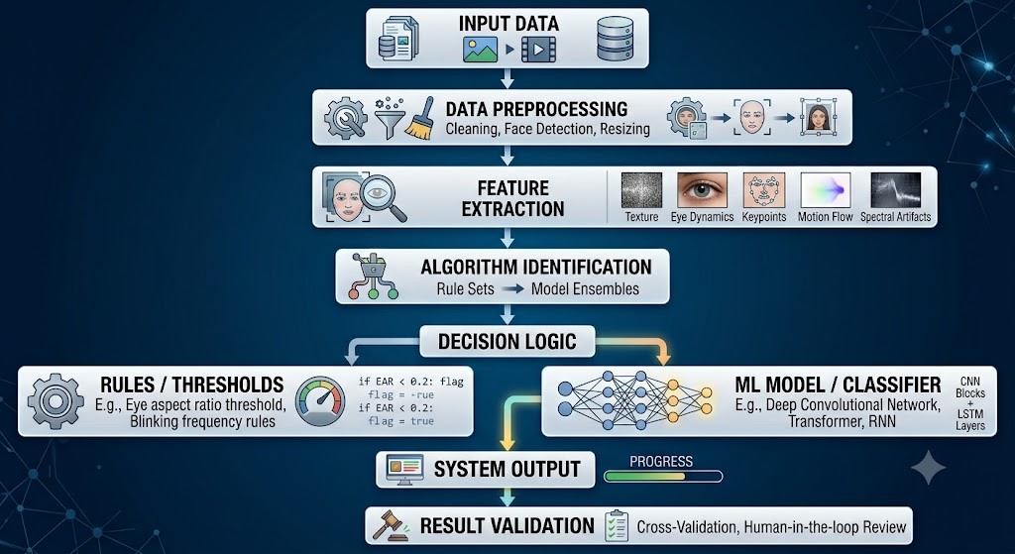
architecture
1
2
3
02

Slide 19
System Output
The system produces a final output after processing the input through preprocessing, feature extraction, algorithm execution, and decision-making stages.
The output can contain a prediction, classification, probability, confidence score, numerical value, recommendation, or final decision.
The output is analyzed together with the original input to determine which features and rules influenced the result.
Multiple outputs are compared to identify whether the system behaves consistently under different conditions.
Example:
Input: Image or data sample
Extracted Feature Score: 0.82
Model Prediction: Positive
Confidence Score: 94%
Decision: Accepted
05

Slide 20
Advantages
Helps understand the internal behavior of systems whose source code is unavailable or difficult to analyze.
Helps identify the most likely algorithm, model, rules, and decision-making techniques used by the system.
Makes it possible to reproduce the behavior of an existing system using a newly implemented algorithm.
Helps developers understand how different modules interact during data processing.
Supports debugging by identifying the stage where an incorrect decision or output is generated.
Helps identify hidden thresholds and decision boundaries that affect system results.
Supports testing and validation of AI and machine-learning systems.
Helps organizations document old or poorly documented software systems.
05

Slide 21
Conclusion
Algorithm and Logic Identification provides a systematic approach for reverse-engineering the decision-making process of a software or AI system.
By studying inputs, outputs, features, logs, patterns, thresholds, and decision boundaries, the hidden processing logic can be reconstructed.
Black-box testing and input-output analysis are especially useful when the original source code is unavailable.
Tools such as Python, Jupyter Notebook, debugging tools, and log analysis techniques help verify the identified algorithms.
The reconstructed architecture and logic can be used for system validation, debugging, documentation, maintenance, modernization, and performance improvement.
05

Slide 22
Introduction
Data Flow and Processing Pipeline explains how data moves from the source system to the final output in a reverse-engineered distributed application.
The system is analyzed by identifying how data is collected, transmitted, processed, stored, and returned.
In a distributed system, different services or modules may process different parts of the data.
Communication between these modules can occur through APIs, message queues, WebSockets, databases, or network protocols.
Reverse engineering helps reconstruct the complete data journey even when the original architecture or source code is unavailable.
1
2
3
02

Slide 23
Problem Statement
Identify where the data originates and determine the different sources providing information to the system.
Determine how data travels between different modules, servers, services, and processing components.
Identify the preprocessing operations performed before the main computation.
Determine how data is distributed among multiple processing nodes.
Identify the algorithms or services responsible for processing the received data.
Analyze how intermediate results are transferred between different components.
Identify the communication mechanisms used between distributed modules.
1
2
3
02

Slide 24
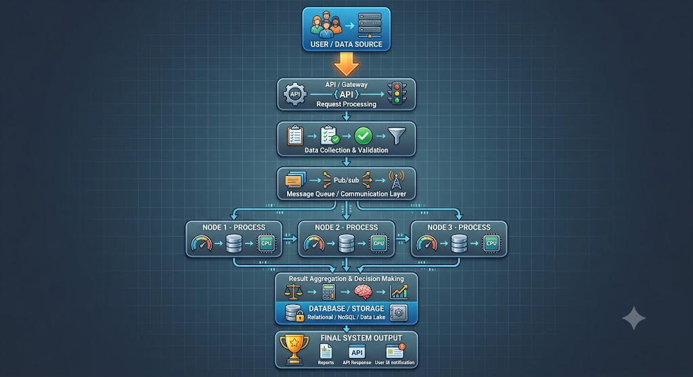
architecture
1
2
3
02

Slide 25
System Output
The system receives data from the user or external data sources and processes it through multiple distributed modules.
After preprocessing and validation, the data is distributed to different processing nodes for parallel execution.
Each processing node generates an intermediate result based on its assigned task.
The intermediate results are transferred through APIs, message queues, WebSockets, or other communication mechanisms.
A result aggregation module combines the outputs received from different processing nodes.
The final processed result is stored in the database or distributed storage system.
The completed result is then returned to the user through the application interface or API.
05

Slide 26
Advantages
Provides a clear understanding of how data travels through the distributed system.
Helps identify the responsibilities of individual processing modules.
Makes it easier to locate communication bottlenecks and processing delays.
Supports identification of APIs, queues, databases, and network communication methods.
Helps understand how large workloads are divided among multiple processing nodes.
Improves understanding of parallel and distributed processing.
Helps identify failures in data transmission and processing.
Supports system debugging and performance optimization.
Makes legacy distributed systems easier to document and maintain.
05

Slide 27
Conclusion
Data Flow and Processing Pipeline analysis provides a complete view of how information enters, moves through, and exits a distributed system.
Reverse engineering identifies the major processing stages, communication mechanisms, distributed nodes, storage systems, and final output generation.
By reconstructing the pipeline, the interaction between different modules can be clearly understood.
This analysis is useful for debugging, documentation, performance optimization, scalability, system modernization, and architecture reconstruction
05

Slide 28
Introduction
Enhancement and Redesign Proposal focuses on improving an existing software or AI system after analyzing its current architecture, algorithms, data flow, and limitations.
Reverse engineering helps identify performance issues, outdated components, security weaknesses, scalability problems, and inefficient processing.
The proposed redesign aims to make the system faster, more secure, scalable, reliable, maintainable, and easier to upgrade.
Existing functionality is preserved while inefficient modules are replaced or improved.
The redesigned architecture is based on the actual problems identified during reverse engineering
1
2
3
02

Slide 29
Problem Statement
The existing system may contain tightly coupled modules that make maintenance difficult.
Data processing may be slow because tasks are performed sequentially instead of in parallel.
Communication between modules may create unnecessary delays.
The system may have limited scalability when the number of users or requests increases.
Old algorithms may require excessive processing time or computational resources.
Database queries and storage operations may become bottlenecks.
Security mechanisms may need improvement to protect sensitive data.
Error handling and monitoring may be insufficient.
Lack of modular architecture can make future upgrades difficult.
1
2
3
02

Slide 30
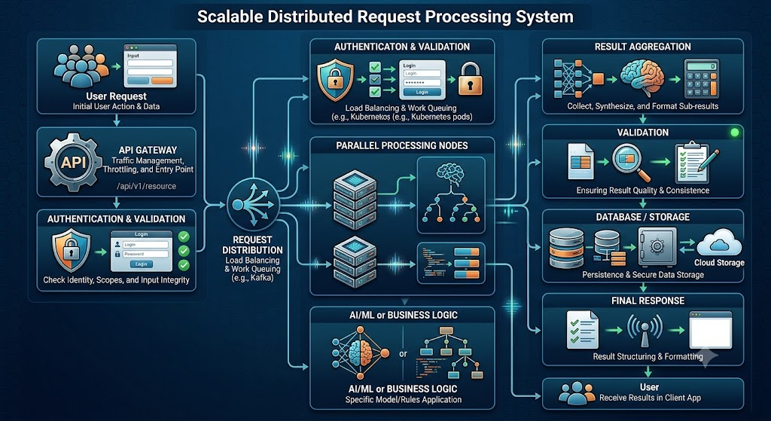
architecture
1
2
3
02

Slide 31
System Output
The redesigned system produces faster, more reliable, secure, and scalable outputs compared with the existing system.
User requests are processed through the API Gateway, validated, authenticated, and forwarded to the appropriate services.
Large tasks are divided into smaller processing jobs and distributed across multiple worker nodes.
Independent processing tasks are executed in parallel, reducing overall processing time.
Results from different services and worker nodes are collected and combined by the result-processing module.
The final result is validated before being stored in the database or distributed storage.
The processed result is then returned to the user through the web application, mobile application, or API.
05

Slide 32
Advantages
Higher Performance: Optimized algorithms and parallel processing reduce processing time.
Better Scalability: Additional servers or workers can be added when workload increases.
Improved Security: Strong authentication, encryption, and access control protect system resources.
Higher Reliability: Fault-tolerant components prevent individual failures from affecting the complete system.
Easy Maintenance: Modular components can be modified independently.
Better Monitoring: Centralized logs and performance metrics make problems easier to identify.
Future Flexibility: New algorithms, services, and AI models can be integrated without rebuilding the complete system.
05

Slide 33
Conclusion
Reverse engineering provides detailed knowledge about the existing system's architecture, algorithms, data flow, communication mechanisms, and limitations.
Based on these findings, the proposed redesign introduces modular architecture, distributed processing, optimized databases, secure communication, fault tolerance, monitoring, and scalability.
The redesigned system can provide better performance, reliability, security, maintainability, and flexibility.
The enhancement strategy also prepares the system for future technologies, increased workloads, and new AI/ML capabilities.
Therefore, the proposed redesign transforms the existing system into a more efficient, scalable, secure, and future-ready architecture.
05

