Slide 1
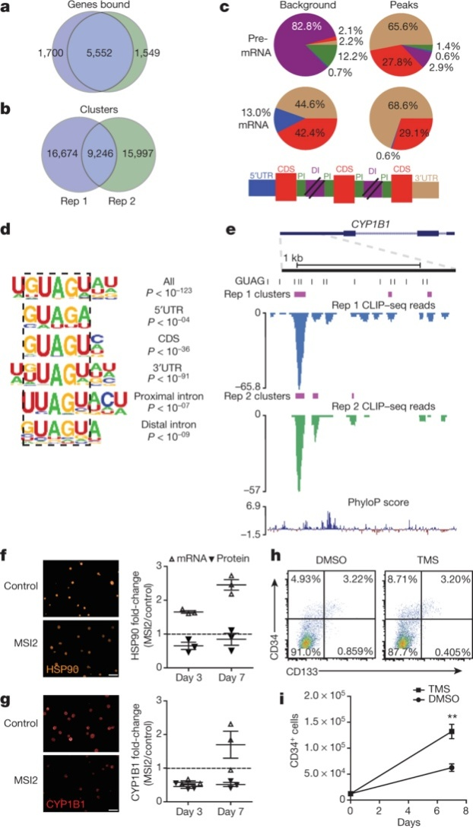
MSI2 overexpression post-transcriptionally downregulates AHR pathway components
S Rentas et al. Nature 532, 508–511 (2016) doi:10.1038/nature17665

