Slide 1
Introduction to Data-Oriented Design

Slide 2
So what is this Data-Oriented Design?

Slide 3
It’s about on shifting focus to how data is read and written

Slide 4

Why should we care?

Slide 5
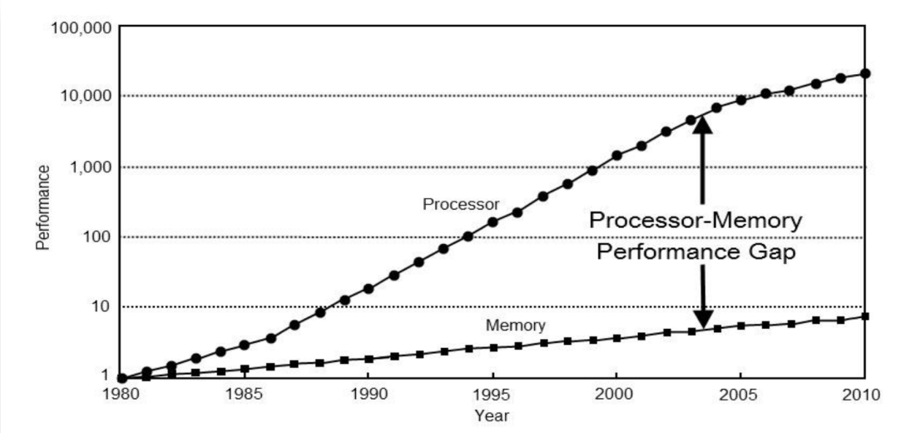
Performance

Slide 6
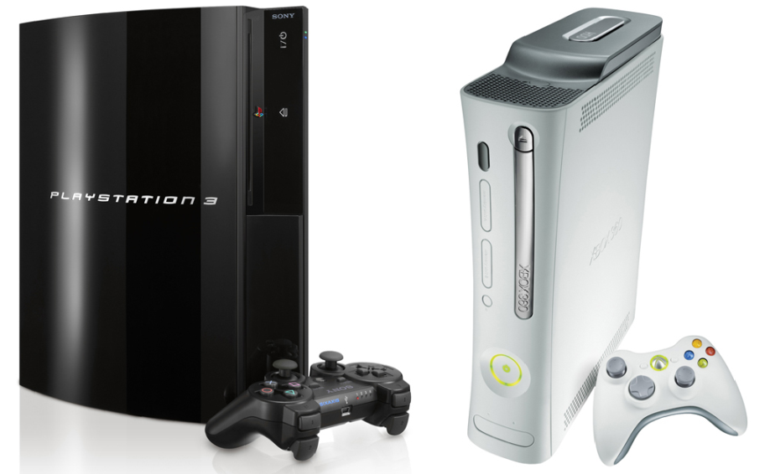
A read from memory takes ~600 cycles at 3.2 GHz

Slide 7
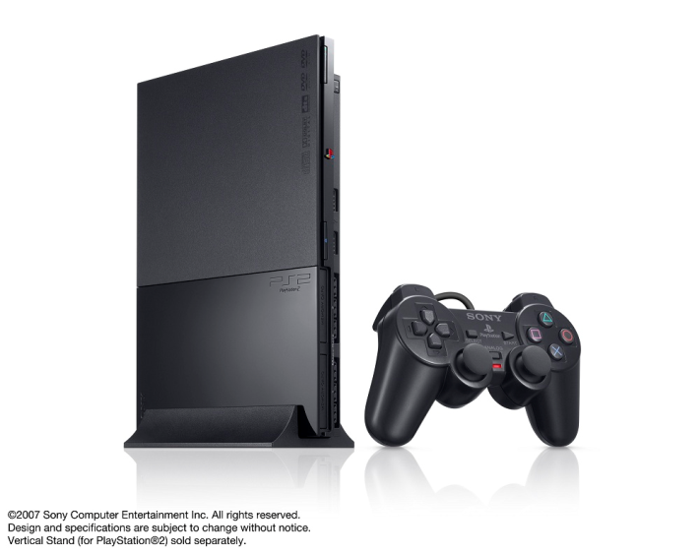
A read from memory takes 40 cycles at 300 MHz

Slide 8
Performance
Disks (Blu-ray/DVD/HDD)
:(
Main Memory
600 cycles
Latency
L2 Cache
40 cycles
L1 Cache
1 – 2 cycles
CPU / Registers

Slide 9
Multithreading
update()
Object
Object
Object
Read?
Write?
Read?
Write?
Read?
Write?
Cannot multithread without knowing how data is touched
Adding locks always protects data not code

Slide 10
Offloading to co-unit
?
SPU/GPU/APU
?
If data is unknown hard/impossible to run on co-unit

Slide 11
Better design
Data focus can lead to isolated, self-contained, interchangeable pieces of data and code
This can make it easier to test data and code in isolation

Slide 12
Example - OOD
icache-miss
class Bot
{
...
Vec3 m_position;
...
float m_mod;
...
float m_aimDirection;
...
void updateAim(Vec3 target)
{
m_aimDirection = dot3(m_position, target) * m_mod;
}
}
Unused
cached
data
data-miss
Very hard to optimize!

Slide 13
Example - OOD
Lets say we call this code 4 times (4 diffrent Bots)
void updateAim(Vec3 target)
{
m_aimDirection = dot3(m_position, target) * m_mod;
}
~20 cycles
iCache – 600
m_position – 600
m_mod - 600
aimDir – 100
iCache – 600
m_position – 600
m_mod - 600
aimDir – 100
7680
iCache – 600
m_position – 600
m_mod - 600
aimDir – 100
iCache – 600
m_position – 600
m_mod - 600
aimDir – 100

Slide 14
Example - DOD
Design ”back to front” and focus on the output data
Then add the minimal amount of data needed to do the transform to create the correct output

Slide 15
Example - DOD
void updateAims(float* aimDir,const AimingData* aim,
Vec3 target, uint count)
{
for (uint i = 0; i < count; ++i)
{
aimDir[i] = dot3(aim->positions[i],target) * aim->mod[i];
}
}
What has changed?
Only read needed inputs
Write to linear array
Loop over all the data
Actual code unchanged
Code separated

Slide 16
Example - DOD
void updateAims(float* aimDir, const AimingData* aim,
Vec3 target, uint count)
{
for (uint i = 0; i < count; ++i)
{
aimDir[i] = dot3(aim->positions[i], target) * aim->mod[i];
}
}
~20 cycles
iCache – 600
positions – 600
mod - 600
aimDir – 100
1980

Slide 17
Data layout OOD vs DOD
pos0
pos0
pos0
pos0
pos0
pos0
pos0
pos0
pos1
pos1
pos1
pos1
pos2
pos2
pos2
pos2
pos3
pos3
pos3
pos3
mod0
mod0
mod1
mod2
mod3
aimDir0
aimDir0
aimDir1
aimDir2
aimDir3
Pos1
mod1
Each color block is one
128 byte cache line
aimDir1

Slide 18
Its all about memory
Optimize for data first then code
Most code is likely bound by memory access
Not everything needs to be an object

Slide 19
Remember
We are doing games, we know our data.
Pre-format. Source data and native data doesn’t need to be the same

Slide 20
Example: Area Triggers
Source data
(Linked List)
Native Data
(Array)
position
position
position
position
count
next
position
position
position
position
position
position
position
position
position
position
position
position
position
position
position
position
position
position
next
position
position
position
position
next

Slide 21
Example: Culling System
Old System
New System
(Linear arrays and brute force)
3x faster, 1/5 code size, simpler

Slide 22
Data Oriented Design Delivers:

Slide 23
Better Performance

Slide 24
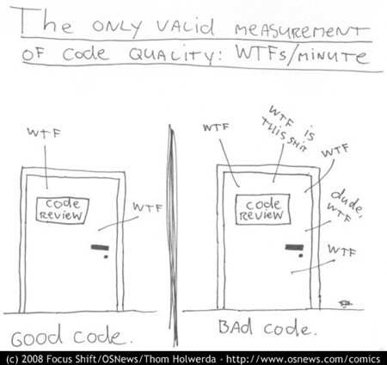
Often simpler code

Slide 25
More parallelizable code

Slide 26
Questions?

Slide 27
Links
Data-Oriented Design (Or Why You Might Be Shooting Yourself in The Foot With OOP) http://gamesfromwithin.com/data-oriented-design
Practical Examples in Data Oriented Design http://bitsquid.blogspot.com/2010/05/practical-examples-in-data-oriented.html
The Latency Elephant http://seven-degrees-of-freedom.blogspot.com/2009/10/latency-elephant.html
Pitfalls of Object Oriented Programming http://seven-degrees-of-freedom.blogspot.com/2009/12/pitfalls-of-object-oriented-programming.html
Insomniac R&D http://www.insomniacgames.com/research_dev
CellPerformance

Slide 28
Image credits
Cat image: http://icanhascheezburger.com/2007/06/24/uninterested-cat photo by: Arinn capped and submitted by: Andy
Playstation 3 and Playstation 2 Copyright to Sony Computer Entertainment
Xbox 360 Image Copyright to Microsoft
“WTF” Code quality image: Copyright by Thom Holwerda http://www.osnews.com/comics

