Slide 1
Knowledge graph augmented neural networks
Arpan Mangal(c) arpanmangal@iisc.ac.in
G P Shrivatsa Bhargav(c) bhargavs@iisc.ac.in

Slide 2
Contents
Problem statement
Prior work
Proposed method
Experiments
Results

Slide 3
Problem : Incorporating world knowledge into existing neural models
Why this is important:
Can't learn everything about a task just from training data (ex: common sense information like bench is furniture)
Some domains don't have sufficient training data. So some prior general knowledge will help
Neural models perform well on natural language tasks(classification, question answering) by themselves. Their performance is likely to increase if they are augmented with knowledge bases.

Slide 4
Prior work
“Learning beyond datasets” by Annervaz K M et al.^{[1]} The gist is :
Uses KG + input sentence encoding for classification
Embeddings for every entity and relation type is computed (DKRL)
Entities and relationships in the KG are clustered separately. Each cluster is encoded to a vector using CNNs during training.
The appropriate clusters are picked using soft attention.
The attention weighted information is combined with the encoding of input sentence to make predictions.
[1] “Learning beyond datasets” by Annervaz K M et al. https://arxiv.org/pdf/1802.05930.pdf

Slide 5
Knowledge representation
The Knowledge Graph entities/relations have to be encoded to a numerical representation for processing.
Embedding technique used: DKRL^{[2]}.
It is a KG representation technique which also takes into descriptive nature of text keeping the simple structure of TransE model. Therefore, we can retrieve relevant entities & relation and obtain the complete the fact using entity2 = entity1 + relation.
There are millions of facts in the KG. Attention mechanism over all facts wont scale. So use entity and relation clusters instead.
[2] Ruobing Xie, Zhiyuan Liu, Jia Jia, Huanbo Luan, Maosong Sun. Representation Learning of Knowledge Graphs with Entity Descriptions. The 30th AAAI Conference on Artificial Intelligence (AAAI'16).

Slide 6
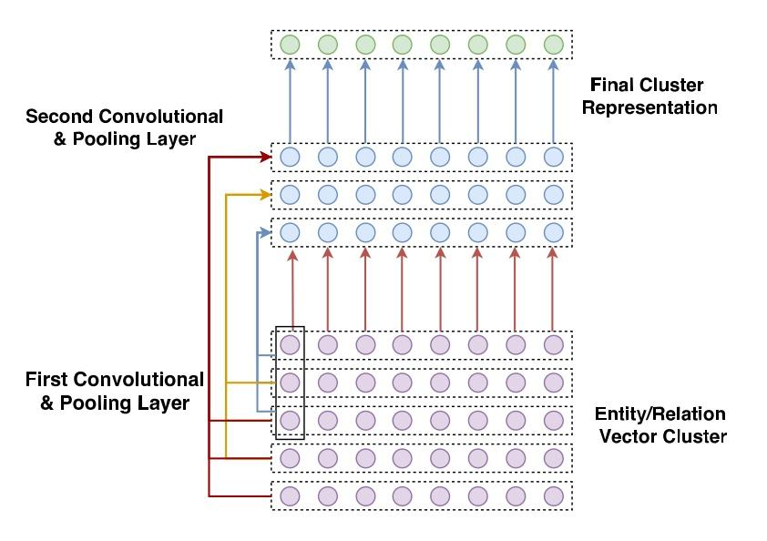
Convolution model for getting cluster representation
(Image from the paper)

Slide 7
KG augmented classifier
Input sequence
LSTM 1
Sentence encoding
LSTM 3
Entity 1
Dense layer
Prediction
LSTM 2
Relation
Entity 2
Soft attention
Soft attention
Entity representatives
Relation representatives

Slide 8
Enhancements
Clustering loses a lot of information. This makes the model unsuitable for tasks that need precise information like question answering.
The previous work uses clusters with equal sizes. No specific advantage/requirement is mentioned. The basic K-means clustering makes more sense.
Instead of clustering, shortlist entities and relations that are relevant to the task. It will keep the model scalable while making it suitable for tasks that need precision.

Slide 9
Enhancements
We propose two models:
Entity shortlists + relation clusters
Entity and relation shortlists

Slide 10
Entity shortlist + relation clusters
Input sequence
LSTM 1
Sentence encoding
LSTM 3
Entity 1
Dense layer
Prediction
LSTM 2
Relation
Entity 2
Soft attention
Soft attention
Entity shortlist
Relation representatives

Slide 11
Entity and relation shortlists
Input sequence
LSTM 1
Sentence encoding
LSTM 3
Entity 1
Dense layer
Prediction
LSTM 2
Relation
Entity 2
Soft attention
Soft attention
Entity shortlist
Relation shortlist

Slide 12
Shortlisting schemes
N-gram based entity shortlists + most frequent “common” relations
N-gram based entity shortlists + Relation shortlisting using cosine similarity

Slide 13
Entity shortlisting
Intuition: If use our document to shortlist entities, it will give us more relevant entities than clustering.
We have used n-gram match to input document and entity names.(n=1,2,3)
Entities are ranked according to the number of relationships, they participated in KG. We shortlist first K entities.
If we are not able to shortlist K, we go for n-gram match with edit distance of 1.
Otherwise, randomly repeat the shortlisted entities to make the number K (because model expects fixed size shortlists).
This implementation is based on: Denis Lukovnikov, Asja Fischer, Jens Lehmann, and Sören Auer. 2017. Neural Network-based Question Answering over Knowledge Graphs on Word and Character Level. World Wide Web (WWW '17). DOI: https://doi.org/10.1145/3038912.3052675

Slide 14
Scheme 1: Entity shortlisting + Relation Shortlisting (Most common)
Intuition: We are interested in relationships among entities which are relevant to input document. Therefore, relevant relationships should be the one which are present between these entities.
After shortlisting of 20 entities as discussed. We look for the relationships which exists between these entities. We ranked each relationships with the number of shortlisted entities taking part in it. And We extracted the 20 most common one. In case we are short of 20, we sample from already shortlisted relationships.

Slide 15
Scheme 2: Entity shortlisting + Relation shortlisting(through cosine similarity)
Intuition: Relationship names of Freebase KG, comprises of many words. Only the last part of it gives the most important information.
We take the cosine similarity between document and each relationship. Extract the best 20.

Slide 16
Experiments
We have implemented the following models:
Plain LSTM
LSTM + KG clusters (prior work)
LSTM + entity shortlist + relation clusters
LSTM + entity and relation shortlists
The models are compared in training speed and accuracy in various settings

Slide 17
Dataset
News20
Number of classes = 20(sports,religion,medicine,etc... )
Around 18k documents
Balanced class distribution
Domain overlap with freebase
Preprocessing:
The documents contain headers(like “category:religion”) and footers which easily give away the category. We have removed them so that we can assess our models in a real world scenario.

Slide 18
Knowledge graph
We have used freebase 15k
Subset of freebase
Contains information people, places and things
Contains 14904 entities, 1345 relations and 4.9M fact triplets

Slide 19
Experimental settings
We keep most of the settings fixed across the models so that the difference made by the shortlisting schemes can be studied.
Train,validate,test split = 13.5k, 1.8k, 3.3k samples respectively
KG embedding size = 50
GloVe embedding size = 300
Sequence length = 300
LSTM hidden state dimension = 200
Number of epochs = 50
Batch size = 32
Number of clusters/shortlists = 20 each for entities and relations

Slide 20
Accuracies
Model | Accuracy(full data) | Accuracy(50% data)
Plain LSTM | 62.30% | 56.31
LSTM + KG clusters (prior work) | 65.10% | 61.05
LSTM + entity shortlist, relation clusters | 67.04% | 63.97
LSTM + entity shortlist, relation shortlist(most common) | 66.80% | 64.27
LSTM + entity shortlist, relation clusters(cosine similarity) | 66.57% | 64.15
The same test and validation sets were used in both cases

Slide 21
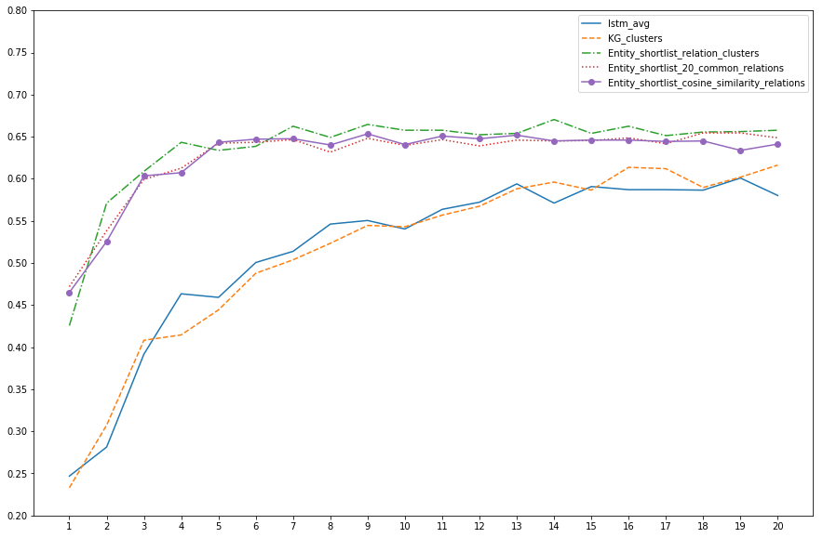
Training rate

Slide 22
Conclusions
Augmenting neural networks with world knowledge indeed gives better performance.
The knowledge augmented models work better when there isn’t enough data to train large models.
Our enhancements made the model train faster and achieve the baseline performance in less than a fourth of the number of epochs. Mainly because there is no CNN to train.
Our model’s performance degrades very less compared to the baselines when the amount of training data is reduced.

