Slide 1
INFORMATION EXTRACTION FROM QUERIES
Ed Snelson, Joaquin Quiñonero Candela, Ralf Herbrich, Thore Graepel

Slide 2
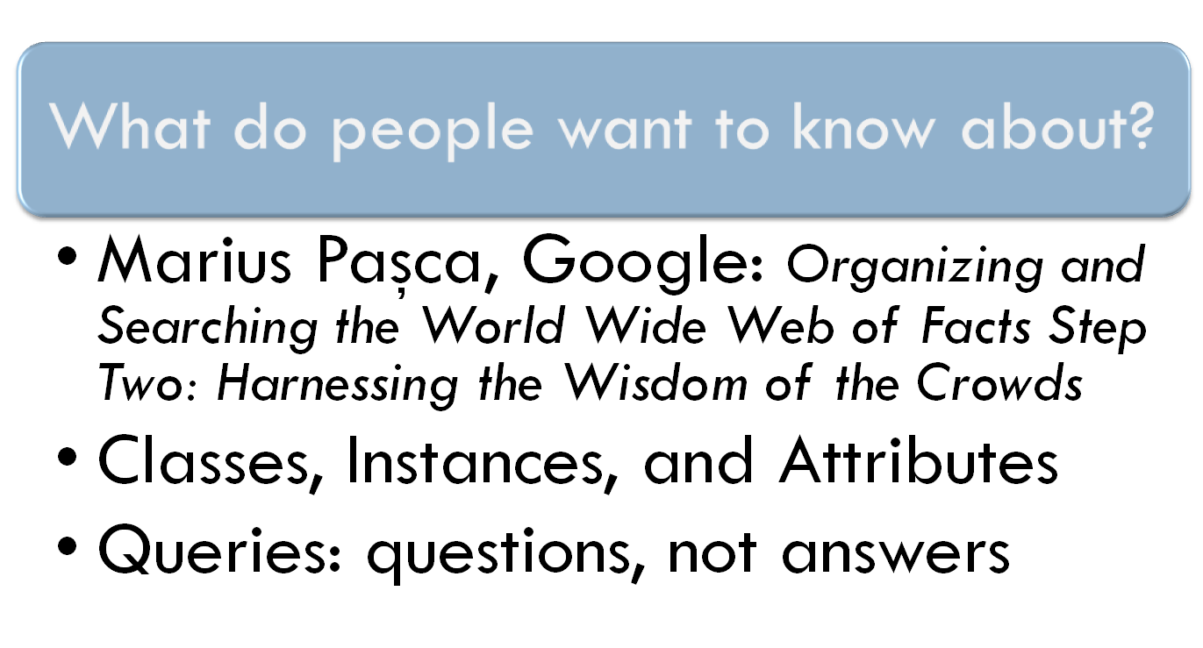
Information extraction from queries

Slide 3

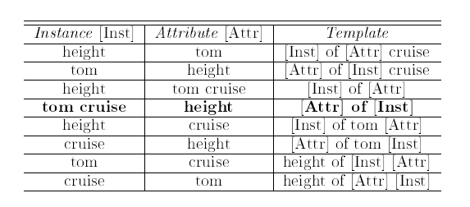
Templates

Slide 4
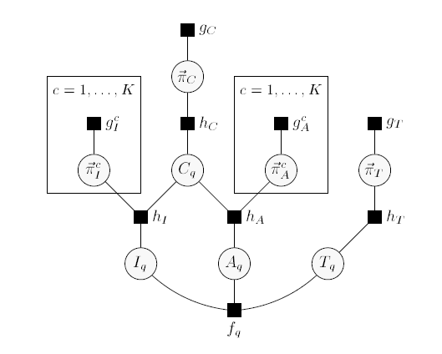
Probabilistic query modelling

Slide 5
Key details
EP message passing for inference within single query model
ADF single pass through queries
Sparse messages within query
Bootstrap from initial seed sets of instances/attributes
Directed processing of queries based on current top beliefs

Slide 6
Data
10 months, Live Search query logs
100 Million unique queries, with associated counts
Preliminary experiments on small specific subsets
e.g. 50,000 unique queries related to actors, cars and national parks

Slide 7
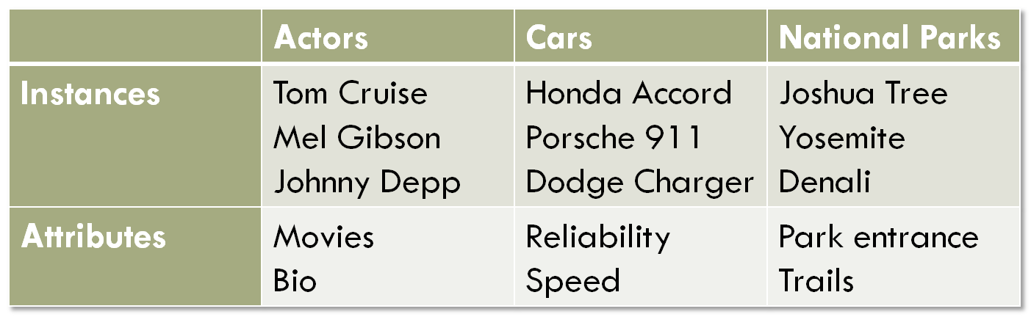
Seed lists

Slide 8
Actors
Instances | Attributes
tom cruise | movies
brad pitt | pictures
johnny depp | dealer.com
matt damon | photos
george clooney | angelina jolie
cameron diaz | nude
scarlett johansson | biography
mel gibson | news
grand canyon | height
sharon stone | wedding

Slide 9
Cars
Instances | Attributes
dealer | {Year}
honda civic | parts
honda accord | hybrid
ford mustang | dealer
dodge charger | used
toyota camry | world
ford explorer | accessories
toyota corolla | ford
ford focus | cleveland plain
dodge durango | wachovia

Slide 10
National Parks
Instances | Attributes
grand canyon | national park
yellowstone | park
yosemite | tours
redwood | lodging
denali | hotels
everglades | lodge
algonquin | west
joshua tree | skywalk
west yellowstone | gmc
shenandoah | college

Slide 11
Templates
Templates
[Inst] [Attr]
[Attr] [Inst]
{Year} [Inst] [Attr]
[Attr] of [Inst]
[Inst] and [Attr]
[Attr] and [Inst]
[Attr] in [Inst]
the [Attr] [Inst]
how [Attr] is [Inst]
[Attr] [Inst] coupe
[Attr] [Inst] parts
the [Inst] [Attr]
[Inst] 's [Attr]
[Inst] in [Attr]

Slide 12
Future improvements
Class/Attribute dependent templates
A garbage class to deal with “noise”
Reducing sensitivity to order of processing initial queries
Disambiguation, synonyms etc.
Use of part-of-speech tagger
Combination with standard hand-crafted entity extraction techniques

