Slide 1

Bayeswatch
Bayesian Disagreement

Slide 2

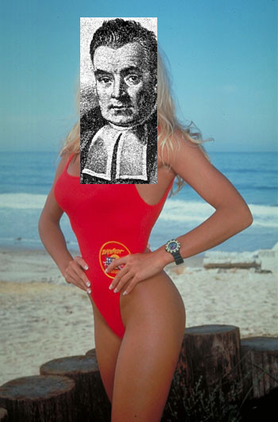
BAYESWATCH
BAYESWATCH
“Cor, I wouldn’t mind sampling from that posterior!”
IPAMGSS07, Venice Beach, LA
Notes:
David hasselhoff version? (creative commons)‏

Slide 3

BAYESWATCH
BAYESWATCH
“Cor, I wouldn’t mind sampling from that posterior!”
IPAMGSS07, Venice Beach, LA
Notes:
David hasselhoff version? (creative commons)‏

Slide 4
Summary
Subjective Bayes
Some practical anomalies of Bayesian theoretical application
Game
Meta-Bayes
Examples

Slide 5
Subjective Bayes
Fairly fundamentalist. Ramsey (Frank not Gordon). Savage Decision Theory
Cannot talk about “True Distribution”
Neal in CompAINN FAQ:
  …many people are uncomfortable with the Bayesian approach, often because they view the selection of a prior as being arbitrary and subjective. It is indeed subjective, but for this very reason it is not arbitrary. There is (in theory) just one correct prior, the one that captures your (subjective) prior beliefs. In contrast, other statistical methods are truly arbitrary, in that there are usually many methods that are equally good according to non-Bayesian criteria of goodness, with no principled way of choosing between them.
How much do we know about our belief?
“Model correctness” — Prior correctness

Slide 6
Practical Problems
Not focusing on computational problems
  How do we do the sums
Difficulty in using priors: Noddy priors.
The Bayesian Loss Issue
Naïve Model Averaging. The Netflix evidence.
The Bayesian Improvement Game
Bayesian Disagreement and Social Networking

Slide 7
Noddy Priors
Tend to compute with very simple priors
Is this good enough?
Revert to frequentist methods for “model checking”.
Posterior predictive checking (Rubin81,84, Zellner76, GelmanEtAl96)
Sensitivity analysis (Prior sensitivity Leamer78, McCulloch89, Wasserman92) and model expansion
Bayes Factors (KaasRaftery95)

Slide 8
Bayesian Loss
Start with simple prior
Get some data, update posterior, predict/act (integrating out over latent variables). Do poorly (high loss).
Some values of latent parameters lead to better predictions than others. Ignore.
Repeat. Never learn about the loss: only used in decision theory step at end.
Bayesian Fly.
Frequentist approaches often minimize expected loss (or at least empirical loss): loss plays part of “inference”.
Conditional versus generative models.

Slide 9
Naïve Model Averaging
The Netflix way.
Get N people to run whatever models they fancy.
Pick some arbitrary way of mixing the predictions together, that is mainly non-Bayesian.
Do better. Whatever.
Dumb mixing of mediocre models ~ > Clever building of big models.

Slide 10
The Bayesian Improvement Game
Jon gets some data. Builds a model. Tests it. Presents results.
Roger can do better. Builds bigger cleverer model. Runs on data. Tests it. Presents results.
Mike can do better still. Builds even bigger even cleverer model. Needs more data. Runs on all data. Tests it. Presents results.
The Monolithic Bayesian Model.

Slide 11
Related Approaches
Meta-Analysis (Multiple myopic Bayesians, Combining multiple data sources, Spiegelhalter02)
Transfer Learning (Belief that there are different related distributions in the different data sources)
Bayesian Improvement: Belief that the other person is wrong/not good enough.

Slide 12
Bayesian Disagreement and
Social Networking
Subjective Bayes: my prior is different from your prior.
We disagree.
But we talk. And we take something from other people - we don’t believe everything other people do, but can learn anyway.
Sceptical learning.

Slide 13
Why talk about these?
Building big models.
Generic modelling techniques: automated Data Miners.
A.I.
Model checking
Planning
An apology

Slide 14
Game One
NOVEMBER
DECEMBER
FEBRUARY
?*?????*
Rules: Choose one of two * positions to be revealed.
Choose one of the ? positions to bet on.

Slide 15
Game Two
Marc Toussaint’s Gaussian Process Optimisation game.

Slide 16
Inference about Inference
Have belief about the data
To choose what to do:
  Infer what data you might receive in the future given what you know so far.
  Infer how you would reason with that data when it arrives
  Work out what you would do in light of that
  Make a decision on that basis.

Slide 17
Context
This is a common issue in reinforcement learning and planning, game theory (Kearns02,Wolpert05), multi-agent learning.
But it is in fact also related what happens with most sensitivity analysis and model checking
Also related to what happens in PAC Bayesian Analysis(McAllester99,Seeger02,Langford02)
Active Learning
Meta-Bayes

Slide 18
Meta Bayes
Meta Bayes: Bayesian Reasoners as Agents
Agent: Entity that interacts with the world, reasons about it (mainly using Bayesian methods).
World: all variables of interest.
Agent: State of belief about the world. (Acts). Receives information. Updates Beliefs. Assesses utility. Standard Bayesian Stuff.
Other Agents: Different Beliefs
Meta Agent: Agent belief-state etc. part of meta-agent’s meta-world.
Meta Agent: Belief about meta-world. Receives data from world or agent or both. Updates belief…

Slide 19
Meta-Agent
Meta-agent is performing Meta-Bayesian analysis:
  Bayesian analysis of the Bayesian reasoning approaches of the first agent
Final Twist: Meta agent and agent can be same entity: Reasoning about ones own reasoning process.
Allows a specific case of counterfactual argument:
  What would we think after we have learnt from some data, given that we actually haven’t seen the data yet?

Slide 20
inference
Agent Belief
Data
Action
World

Slide 21
inference
Agent Belief
Action
World

Slide 22
inference
Meta-Agent
Metadata
Action
Agent Belief
Action
Meta-World
World

Slide 23
metadata
Metadata = information regarding beliefs derived from Bayesian inference using observations from observables.
Metadata includes derived data.
Metadata could come from different agents, using different priors/data.

Slide 24
Clarification
Meta-Posterior is different from hyper-posterior.
hyper-prior: distribution over distributions defined by a distribution over parameters.
meta-prior: distribution over distributions, potentially defined by a distribution over parameters.
hyper-posterior P_{A}(parameters|Data)
meta-posterior
P_{M}(hyper-parameters|Data)=P_{M}(hyper-parameters)

Slide 25
Gaussian Process Example
Agent: GP
Agent sees covariates X targets Y
Agent has updated belief (post GP)
Meta-agent sees covariates X
Meta-agent belief: distribution over posterior GPs.
  Meta agent knows the agent has seen targets Y, but does not know what they were.

Slide 26
Meta-Bayes
If we know x but not y it does not change our belief.
If I know YOU have received data (x,y), I know it has changed your belief...
  Hence it changes my belief about what you believe...
  Even if I only know x but not y!

Slide 27
Belief Net
Meta Agent Prior:
Belief about Data
Belief about Agent
Meta Agent Posterior:
Condition on -
Some info from A
Some info from D
M
A
A
Prior
Posterior
D

Slide 28
Example 1
Agent
Prior: Exponential Family
Sees: Data
Reason: Bayes
Meta-Agent
Prior:
Data: General parametric
form
Agent: Full knowledge
Sees: Agent posterior
Reason: Bayes

Slide 29
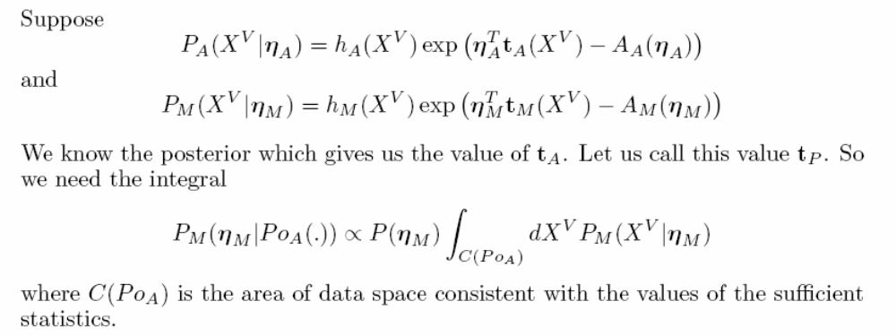
Example 1
Full knowledge of posterior gives all sufficient statistics of agent distribution.
In many cases where X^{V} are IID samples, the sample distributions for the sufficient statistics are known or can be approximated.
Otherwise we have a hard integral to do.

Slide 30
Example 1
But how much information?
Imagine if the sufficient statistics were just the mean values. Very little help in characterising the comparative quality of mixture models.
No comment about fit.
Example 2: Bayesian Empirical Loss

Slide 31
Empirical Loss/Error/Likelihood
The empirical loss, or posterior empirical error is the loss that the learnt model (i.e. posterior) would make on the original data.
Non-Bayesian: the original data is known, and has been conditioned on. Revisiting it is double counting.
Meta-Bayes: here the empirical error is just another statistic (i.e. piece of information from the meta-world) that the meta-agent can use for Bayesian computation.

Slide 32
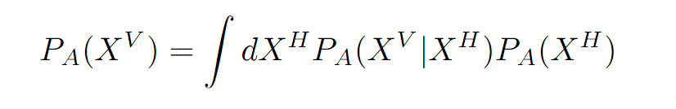
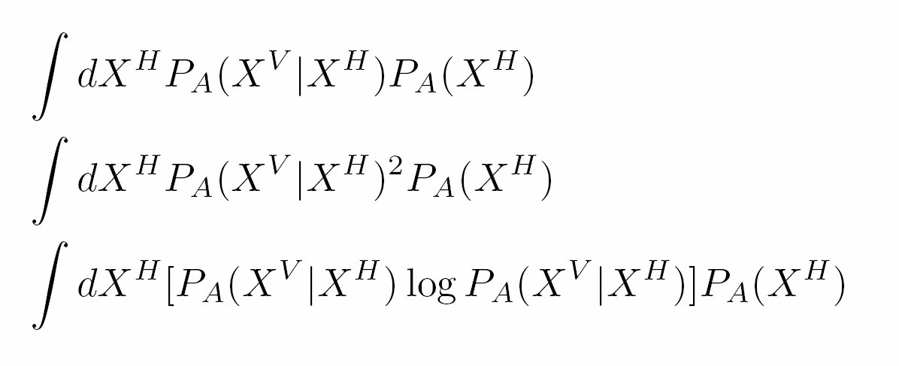
Empirical Loss/Error/Likelihood
The evidence is
The “empirical likelihood” is
The KL divergence between posterior and prior is
All together:

Slide 33
PAC Bayes
PAC Bound on true loss given empirical loss and KL divergence between posterior and prior
Meta-Bayes: empirical loss, KL divergence etc. are just information that the agent can provide to the meta-agent.
Bayesian inference given this information.
Lose the delta: we want to know when the model fails.

Slide 34
Expected Loss
What is the expected loss that the meta-agent believes the agent will incur, given the agent’s own expected loss, the empirical loss, and other information?
What is the expected loss that the meta-agent believes that the meta-agent would incur, given the agent’s expected loss, the empirical loss, and other information?

Slide 35
Meta-agent prior
Mixture of P_{A} and other general component P_{R}
Want to know the evidence for each
Cannot see data
Agent provides information.
Use P_{R}(information) as surrogate evidence for P_{R}(data).
Sample from prior P_{R}. Get agent to compute information values. Build kernel density.

Slide 36
Avoiding the Data
Agent provides various empirical statistics w.r.t agent posterior.
Can compute expected values and covariance values under P_{M} and P_{A}
Presume joint distn for values (e.g. choose statistics that should be approx Gaussian).
Hence can compute meta-agent Bayes Factors, which are also necessary for loss analyses.

Slide 37
Active Learning
Active Learning is Meta-Bayes:
  P_{M}=P_{A}
  Agent does inference
  Meta agent does inference about the agent’s future beliefs given possible choice of next data covariate.
  Meta agent chooses covariate optimally, and target is obtained and passed to agent.

Slide 38
Goals
How to learn from other agents inference.
Combining information.
Knowing what is good enough.
Computing bounds.
Building bigger better component based adaptable models to enable us to build skynet 2 and allow the machines to take over the world.

Slide 39
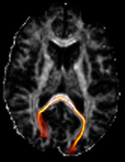
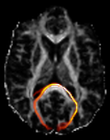
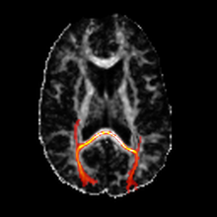
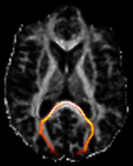
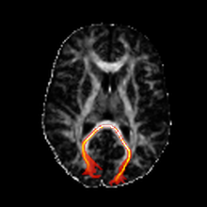

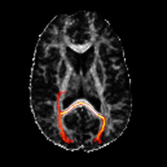
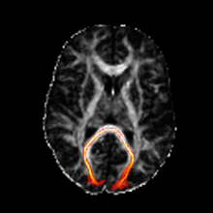
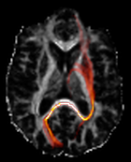
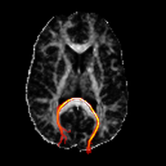
Example

Slide 40
Bayesian Resourcing
This old chestnut:
The cost of computation, and utility maximization.
Including utility of approximate inference in the inferential process.

