Slide 1
Gaussian Processes for Active Sensor Management
Alexander N. Dolia, University of Southampton
This poster is based on
A.N.Dolia, C.J.Harris, J.Shawe-Taylor, D.M.Titterington, Kernel Ellipsoidal Trimming, submitted to the Special Issue of the Journal Computational Statistics and Data Analysis on Machine Learning and Robust Data Mining. under review.
A.N.Dolia, T.De Bie, C.J.Harris, J.Shawe-Taylor, D.M.Titterington. Optimal experimental design for kernel ridge regression, and the minimum volume covering ellipsoid, Workshop on Optimal Experimental Design, Southampton, 22-26 September, 2006
Joint work with: Dr. Tijl De Bie, Katholieke Universiteit Leuven
Prof. John Shawe-Taylor, University of Southampton
Prof. Chris Harris, University of Southampton
Prof. Mike Titterington, University of Glasgow

Slide 2
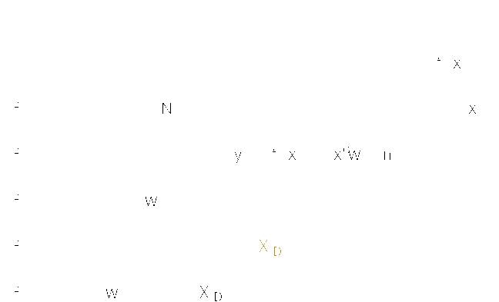
Problem Statement
Notes:
Makes sense: sensor can only be placed in certain positions

Slide 3

Optimal experiment design?

Slide 4

Optimal experiment design for RR

Slide 5

Regularized MVCE

Slide 6
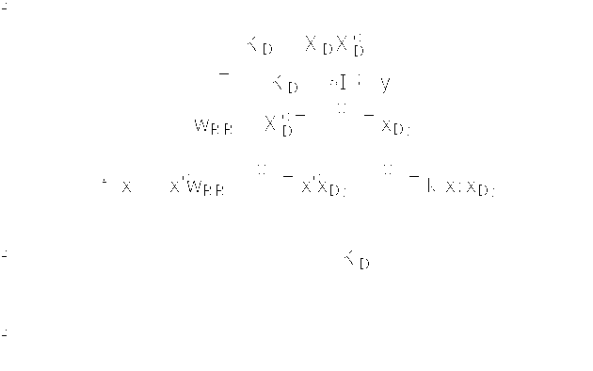
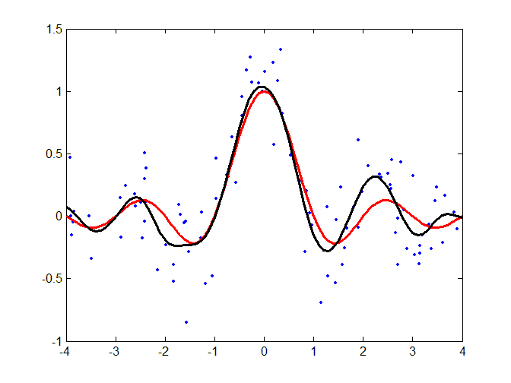
Kernel ridge regression (KRR)
Least squares
Ridge regression
Kernel RR

Slide 7

Kernel MVCE
Novelty detection
MVCE and duality
Regularized MVCE
Kernel MVCE

Slide 8





OED: summary
D-OED
MVCE
standard
regularized
kernel

Slide 9
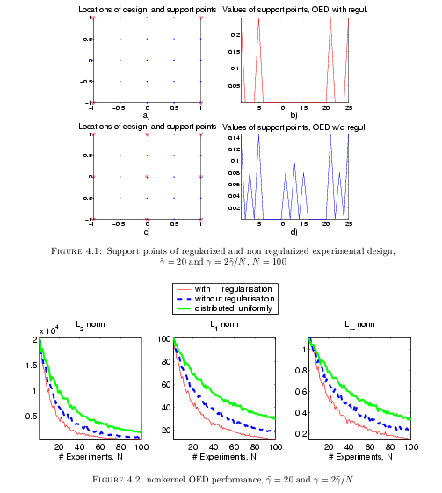
Experiment

Slide 10
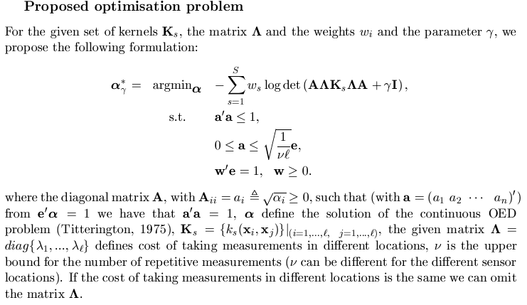
Generalised D-optimal Experimental Design

Slide 11

Conclusions

