Slide 1
GP Principal Component Analysis
Colin Fyfe
University of Paisley,
Scotland

Slide 2
Method
Non-zero mean, b^{T}x+c.
Intuitions about principal components gives target values

Slide 3
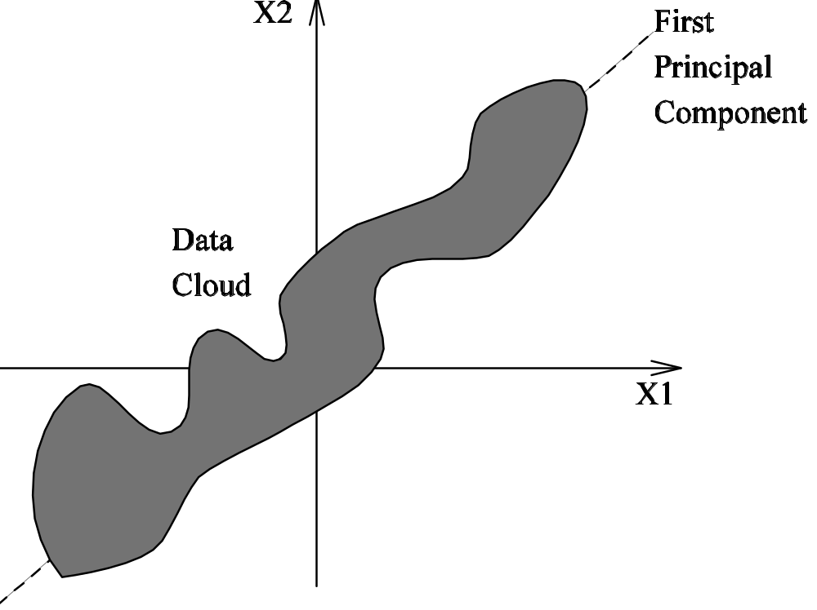
Entropy Intuition

Slide 4
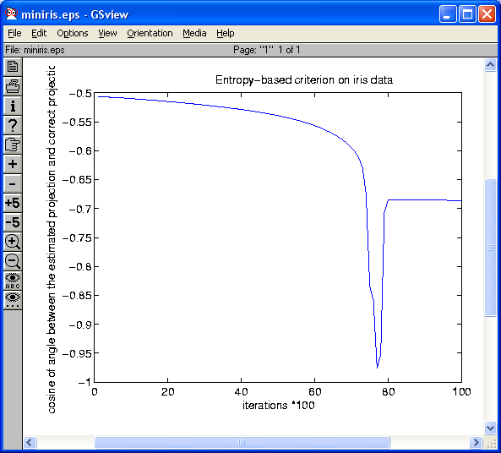
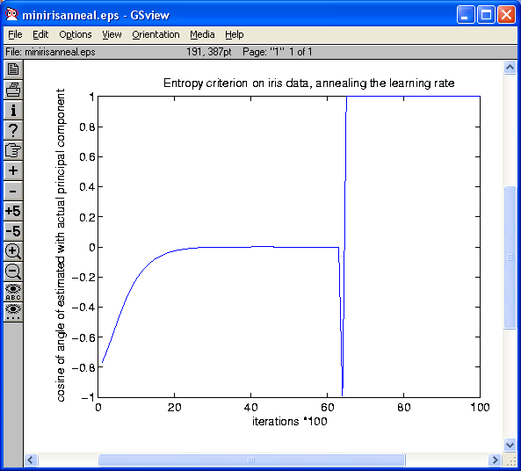
Entropy Criterion on Iris Data

Slide 5
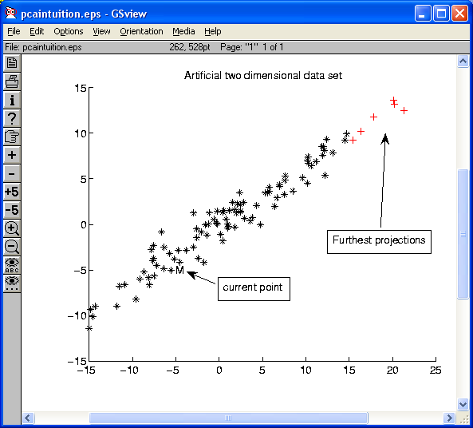
Geometric Intuition

Slide 6
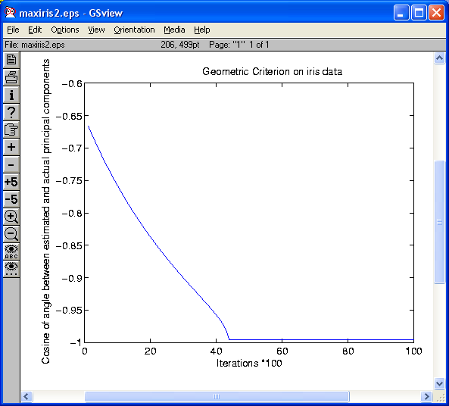
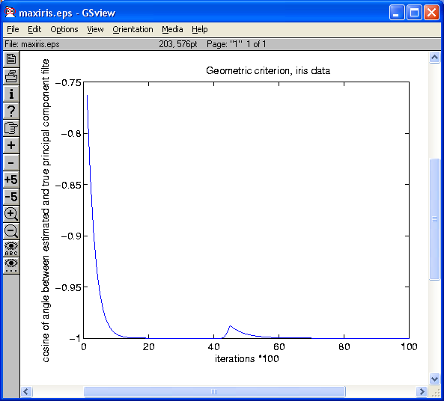
Geometric Intuition on Iris Data

Slide 7
Response to Reviewers
Relation to Kernel PCA?
  None
Why bother doing PCA with GP ?
  I am an academic

