Slide 1


Gaussian Processes for
Transcription Factor Protein Inference
Neil D. Lawrence, Guido Sanguinetti and Magnus Rattray

Slide 2
Talk plan
Biological problem
Dynamical models of gene expression
Introducing GPs in the equation
Linear and non-linear response
Results
Future extensions?

Slide 3
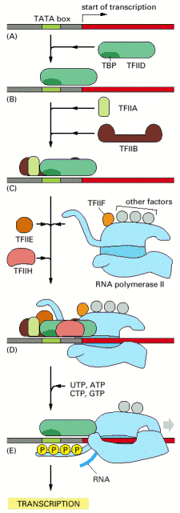
Transcription
Transcription is the process by
which the genetic information
stored in DNA is expressed as
mRNA molecules.
It is promoted or repressed by
proteins known as transcription
Factors (TFs).
TF concentrations are hard to measure.
The effect of TFs on gene expression is hard to quantify precisely.
From Alberts et al., Molecular Biology of the Cell

Slide 4
Simplified model
Consider only one transcription factor binding some target genes
TF
g1
g2
......
gN
Model in detail this simplified situation, turning hard
experimental problems into inference tasks.

Slide 5
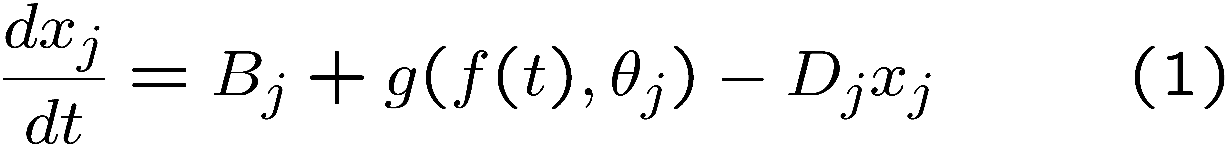
Modelling transcription
Quantitative description of transcriptional regulation can be achieved only by inference.
Assume a simplified situation where one TF regulates a few targets. Let x_{j}(t) be the mRNA concentration of gene j at time t. Then at equilibrium
Here B_{j} is the baseline expression level, D_{j} is the decay
rate of mRNA for gene j, and f(t) is the TF protein
concentration.
The function g determines the response of the gene to
the TF. Common choices for g are linear (Barenco et al.,
Gen. Biol.,2006) or Michaelis-Menten (Rogers et al.,
MASAMB, 2006).

Slide 6
Inference
Bayesian approaches have discretised the system (1) at the observed time points and treated the function values as additional parameters. Estimates of the parameters were obtained by MCMC.
Computationally expensive.
Inference limited to a few points.
Need to evaluate the production rates. This can be difficult as standard techniques (e.g. polynomial interpolation) suffer in the presence of noise.

Slide 7
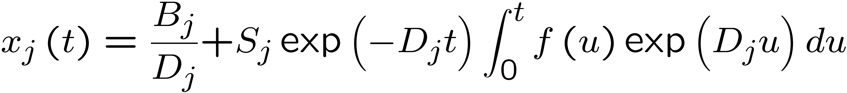
GPs for Linear response
Treat the system (1) as a continuous system placing a GP prior distribution on f.
Equation (1) can be solved in the linear case
As this is a linear operation on the function f, it
follows that the mRNA levels are also governed by
a GP.

Slide 8
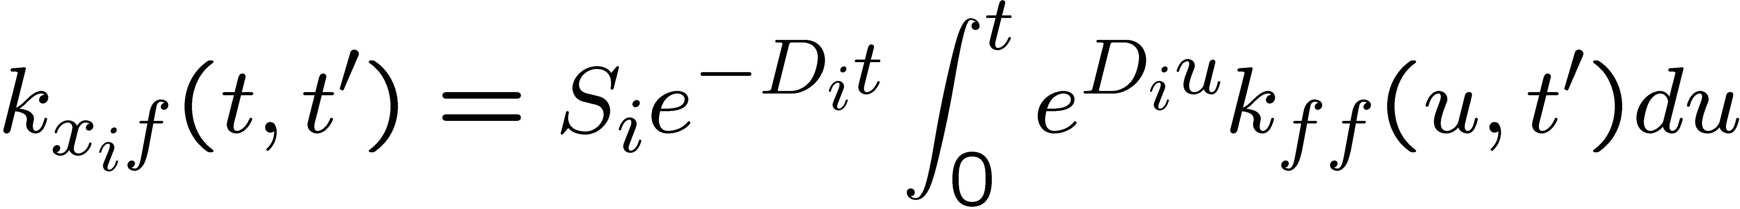
Kernel computations
If we define g_{i}(t)=∫₀^{t}f(u)e^{D}_{i}^{u}du, we get the covariance of g_{i} and g_{j} in terms of the covariance of f as
We can then compute the cross covariances between the various mRNA species and the latent function
For RBF priors, this can be computed analytically.

Slide 9
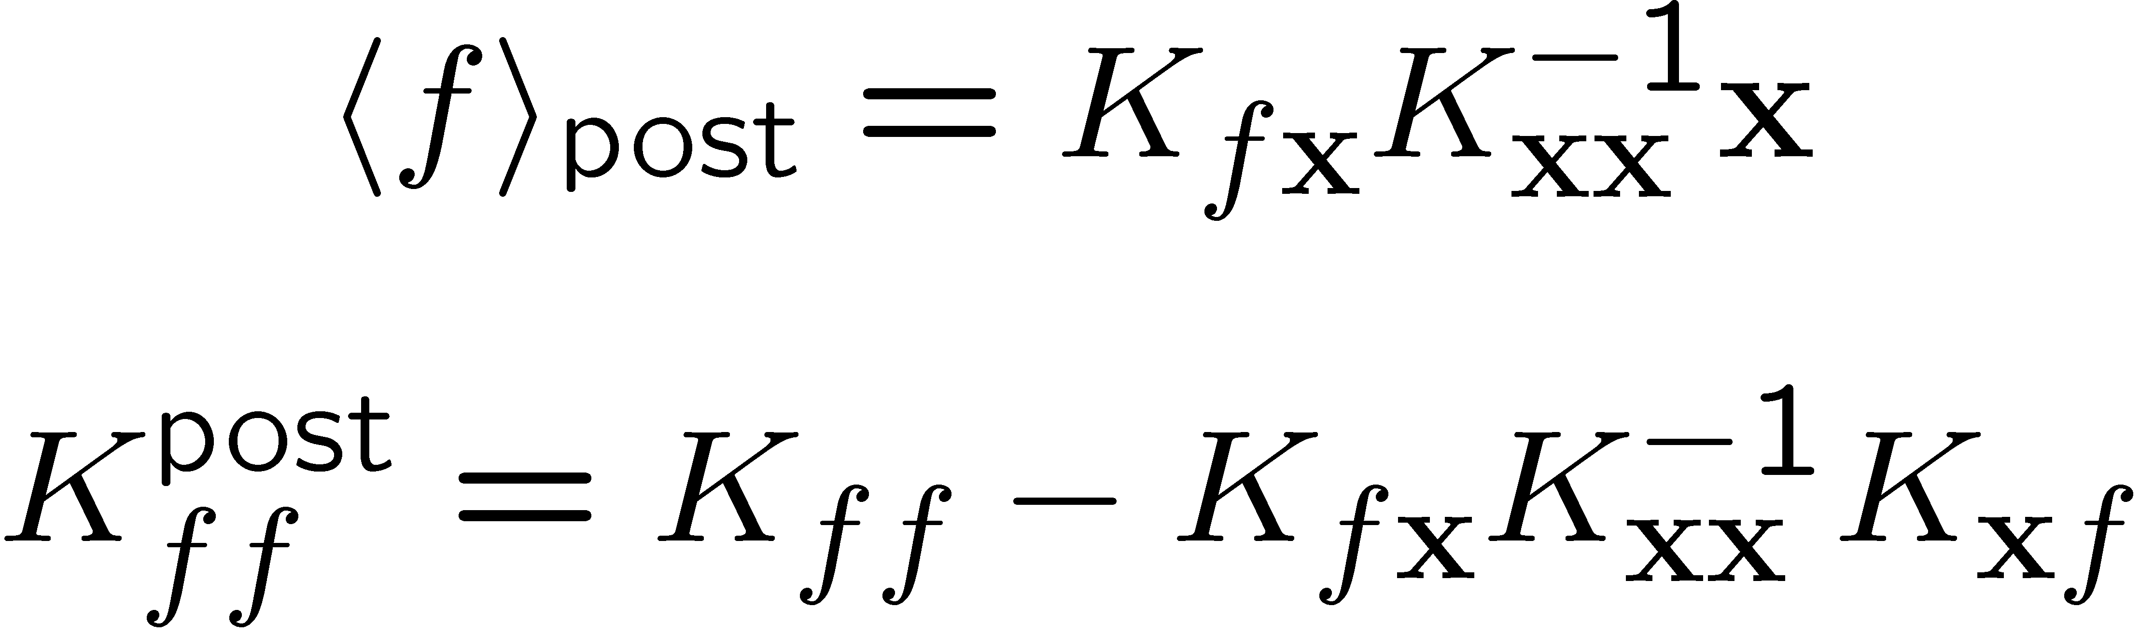
We can jointly sample from the (x,f) process.
Parameter estimation can be carried out using type II maximum likelihood.
Posterior distribution for the TF concentrations is obtained by standard GP regression

Slide 10
Nonlinear response
If the response is not a linear function (or if the prior covariance is not RBF) the inference problem is no longer exact.
MAP-Laplace estimation for the profiles is possible by functional gradient descent.
It is still possible to optimise the parameters.
Details omitted on compassionate grounds.

Slide 11
Results: data set
Used GPs to reproduce results from Barenco et al., Gen.Biol. 2006.
The task is to infer the TF concentration profile for p53, an important tumour suppressor, from the time series profile of five of its target genes.
The model parameters are the RBF inverse width, baseline expression level, decay rate and sensitivity to p53 for each gene (16 parameters)
The data consists of 6 time points on three independent cell lines (human leukemia)

Slide 12
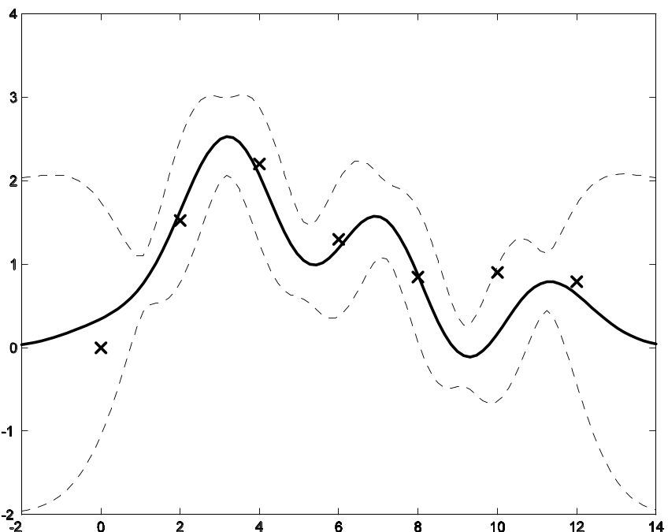
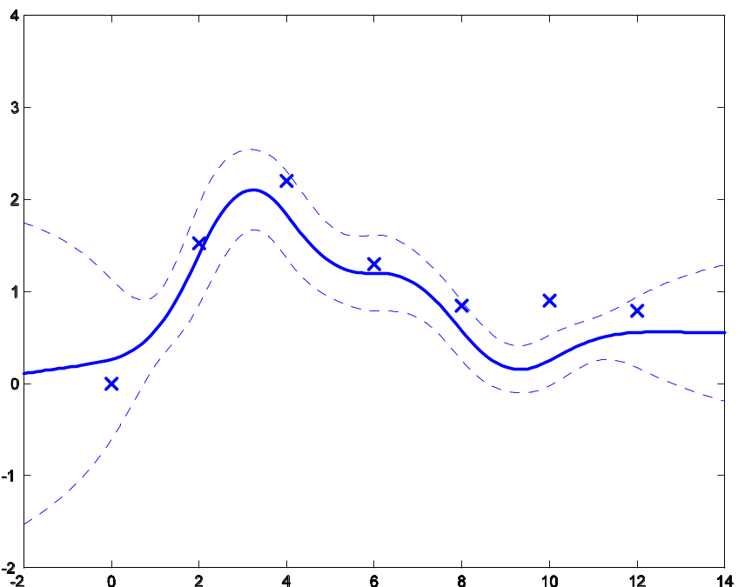
Results: linear response
Inferred TF profiles using linear response with RBF prior
(left) and MLP prior (right).

Slide 13
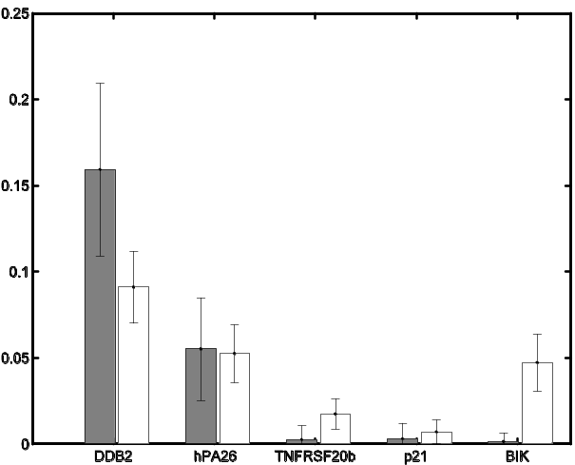
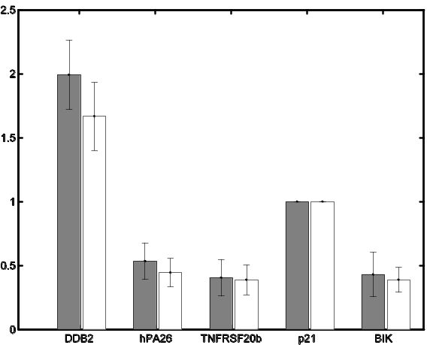
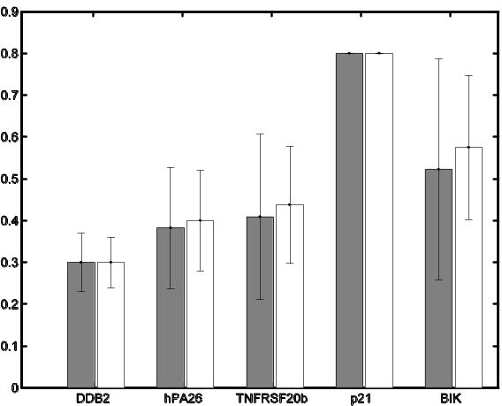
Results: parameter estimates
Sensitivities to p53
Baseline expression levels
Decay rates

Slide 14
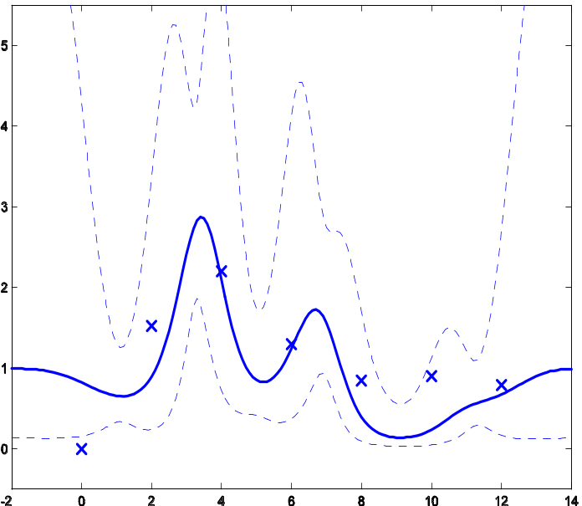
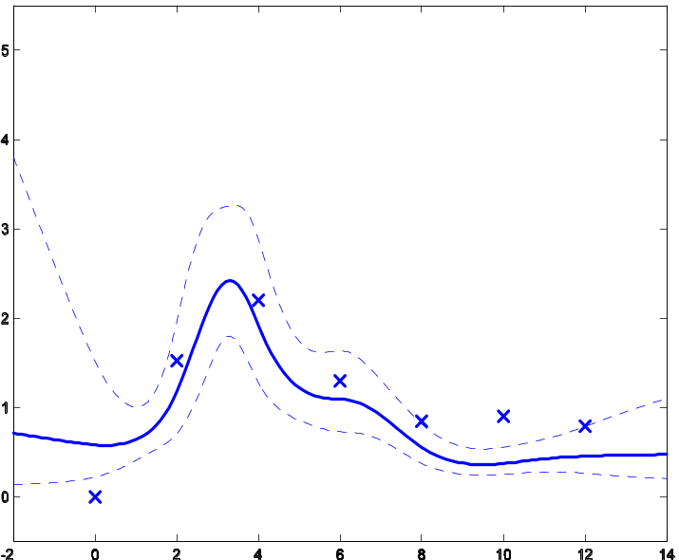
Results: non linear response
We imposed positivity of the TF concentrations by using an exponential response.
RBF prior
MLP prior

Slide 15
Future directions
Efficiency and flexibility of GPs make them ideal for inference of regulatory networks.
Include biologically relevant features such as transcriptional delays.
Extend to more than one TF, accounting for logical regulatory functions.
Extend to model spatio-temporal data.

