Slide 1
Gaussian Processes I have known
Tony O’Hagan

Slide 2
Outline
Regression
  Other GPs observed imprecisely
Quadrature
  Computer models
Challenges

Slide 3
Early days
I’ve been using GPs since 1977
I was introduced to them by Jeff Harrison when I was at Warwick
The problem I was trying to solve was design of experiments to fit regression models

Slide 4
Nonparametric regression
Observations
y = h(x)^{T}β(x) + ε
Usual regression model except coefficients vary over the x space
I used a GP prior distribution for β(.)
So the regression model deforms slowly and smoothly

Slide 5
A more general case
I generalised to nonparametric regression
The regression function is a GP
The GP is observed with error
Posterior mean smoothes through the data points
The paper I wrote was intended to solve a problem of experimental design
  using the special varying-coefficient GP
But it is only cited for the general theory

Slide 6
More GPs observed imprecisely
Since then I have used GPs extensively to represent (prior beliefs about) unknown functions
Three of these have also involved data that were indirect or imprecise observations of the GP
  Radiocarbon dating
  Elicitation
  Interpolating pollution monitoring station

Slide 7
Radiocarbon dating
Archaeologists date objects by using radioactive decay of carbon-14
The technique yields a radiocarbon age x, when the true age of the object is y
If the level of carbon-14 in the biosphere were constant, then y = x
Unfortunately, it isn't, and there is an unknown calibration curve y = f (x)
Data comprise points where y is known and x is measured by fairly accurate radiocarbon dating

Slide 8
Bayesian approach
Treat the radiocarbon calibration curve f (.) as a GP
Like nonparametric regression except different prior beliefs about the curve

Slide 9
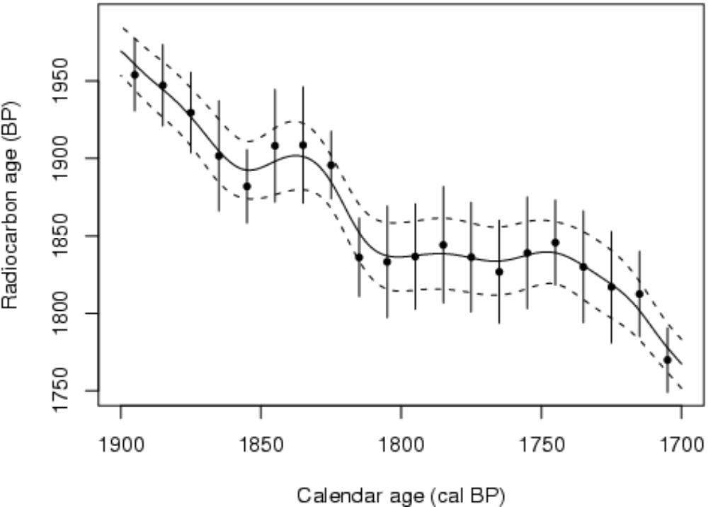
A portion of the calibration curve

Slide 10
Elicitation
We often need to elicit expert judgements about uncertain quantities
Require expert’s probability distribution
In practice, expert can only specify a few “summaries” of that distribution
  Typically a few probabilities
  Maybe mode
We fit a suitable distribution to these
  How to account for uncertainty in the fit?

Slide 11
The facilitator’s perspective
The facilitator estimates the expert’s distribution
  The expert’s density is an unknown function
  Facilitator specifies GP prior
    Generally uninformative but including beliefs about smoothness, probably unimodal, reasonably symmetric
  Expert’s statements are data
  Facilitator’s posterior provides estimate of expert’s density and specification of uncertainty
We are observing integrals of the GP
  Possibly with error

Slide 12
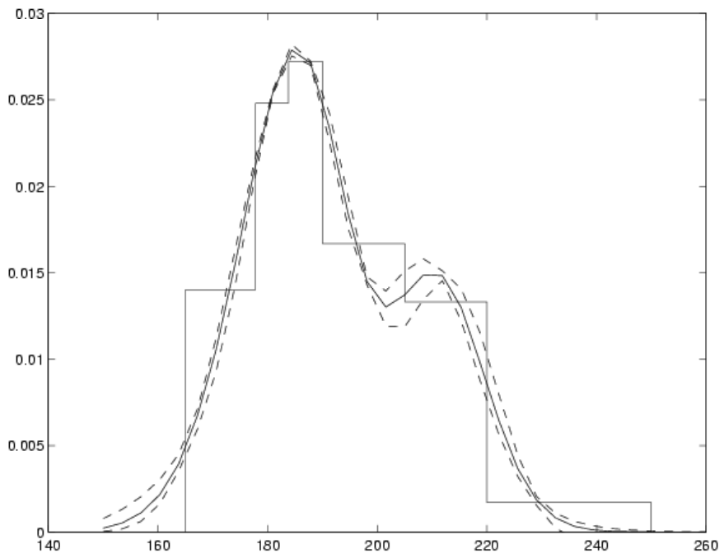
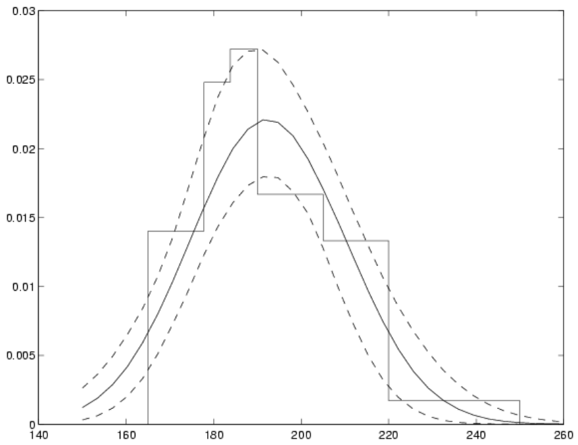
Example of elicited distribution, without and with error in expert’s judgements

Slide 13
Spatial interpolation
Monitoring stations measure atmospheric pollutants at various sites
We wish to estimate pollution at other sites by interpolating the gauged sites
So we observe f (x_{i}) at gauged sites x_{i} and want to interpolate to f (x)
Standard geostatistical methods employ kriging methods, but these typically rely on the process f (.) being stationary and isotropic
We know this is not true for this f (.)

Slide 14
Latent space methods
Sampson and Guttorp developed an approach in which the geographical locations map into locations in a latent space called D space
Corr(f (x),f (x′)) is a function not of x – x′ but of d(x) – d(x′), their distance apart in D space
They estimate d(x_{i})s by MDS, then interpolate by thin-plate splines
A Bayesian approach assigns a GP prior to the mapping d(.), avoiding the arbitrariness of MDS and splines
This is the most complex GP method so far

Slide 15
Quadrature
The second time I used GPs was for numerical integration
Problem: estimate integral of a function f (.) over some range
Data: values f (x_{i}) at some points x_{i}
Treat f (.) as an unknown function
  GP prior
  Observed without error
  Derive posterior distribution of integral

Slide 16
Uncertainty analysis
That theory was a natural answer to another problem that arose
  We have a computer model that produces output y = f (x) when given input x
  But for a particular application we do not know x precisely
  So X is a random variable, and so therefore is Y = f (X )
  We are interested in the uncertainty distribution of Y

Slide 17
Monte Carlo
The usual approach is Monte Carlo
  Sample values of x from its distribution
  Run the model for all these values to produce sample values y_{i} = f (x_{i})
  These are a sample from the uncertainty distribution of Y
Neat but impractical if it takes minutes or hours to run the model
  We can then only make a small number of runs

Slide 18
GP solution
Treat f (.) as an unknown function with GP prior distribution
Use available runs as observations without error
Make inference about the uncertainty distribution
  E.g. The mean of Y is the integral of f (x ) with respect to the distribution of X
  Use quadrature theory

Slide 19
BACCO
This had led to a wide ranging body of tools for inference about all kinds of uncertainties in computer models
All based on building the GP emulator of the model from a set of training runs
This area is known as BACCO
  Bayesian Analysis of Computer Code Outputs
Development under way in various projects

Slide 20
BACCO includes
  Uncertainty analysis
  Sensitivity analysis
  Calibration
  Data assimilation
  Model validation
  Optimisation
  Etc…

Slide 21
Challenges
There are several challenges that we face in using GPs for such applications:
  Roughness estimation and emulator validation
  Heterogeneity
  High dimensionality
  Relationships between models and between models and reality
A brief discussion of the first three follows

Slide 22
Roughness
We use almost exclusively the gaussian covariance kernel
  We are generally dealing with very smooth functions
  It makes some integrations possible analytically
  In practice the choice of kernel often makes little difference
We have a roughness parameter to estimate for each input variable

Slide 23
Roughness estimation
Accurate estimation of roughness parameters is extremely important, but difficult
  Can strongly influence emulator predictions
  But typically little information in the data
Posterior mode estimation
MCMC
Cross-validation
  Probably should use all these!

Slide 24
Emulator (GP) validation
It’s important to validate predictions from the fitted GP against extra model runs
Cross-validation also useful here
Examine large standardised errors
Choose model runs to test predictions both close to and far from existing training data

Slide 25
Heterogeneity
One way an emulator can fail is if the assumptions of continuity and stationarity of the GP fails
  Nearly always false, actually!
  Discontinuities, e.g. due to code switches
  Regions of the input space with different roughness properties
Can be identified by validation tests
Solution may be to fit different GPs on Voronoi tessellation?

Slide 26
High dimensionality
Many inputs
  Computational load increases because of many parameters to estimate and need for large number of training data points
  Model will typically only depend on a small number over input region of interest
  But finding them can be difficult!
Models can have literally thousands of inputs
  Whole spatial fields
  Time series of forcing data
  Need for dimension-reduction methods

Slide 27
Many data points
  Large matrix to invert
  With gaussian covariance it is often ill-conditioned
  Need robust approximations based on sparse matrix methods or local computations
Radiocarbon dating problem had more than 1000 data points
  Some computations possible using a moving window
  But this relies on having just one input!

Slide 28
Many real-world observations
  Calibration or data assimilation become very computationally demanding
  Time series observations on dynamic models
Exploring emulating single timesteps for dynamic models
  Reduces dimensionality
  But emulation errors accumulate in iteration of the emulator

Slide 29
Many outputs
  Can emulate each separately
  But not if there are thousands
  Again need dimension-reduction
When emulating single timestep of dynamic model, the state vector is both input and output
  Can be very high-dimensional

