Slide 1
Gaussian Process Round Table
Welcome
Neil Lawrence

Slide 2
Welcome
Welcome to the
Sheffield Gaussian Process Round Table
The NIPS Gaussian Process Preview

Slide 3
Overview
Background
Issues
Arrangements

Slide 4
Background

Slide 5
Life of Brian
Brian: Are you the Judean People's Front?
Reg: F--- off.
Brian: I didn't want to sell this stuff. It's only a job. I hate the Romans as much as anybody.
Reg:Judean People's Front. (scoffs) We're the People's Front of Judea. Judean People's front, caw.
Brian: Can I join your group?
Reg: Listen. If you really wanted to join the PFJ, you'd have to really hate the Romans.
Brian: I do.
Reg: Oh yeah? How much?
Brian: A lot!
Reg: Right. You're in. Listen. The only people we hate more than the Romans are the f---ing Judean People's Front

Slide 6
Life of a Research Student
Student: Are you Frequentist statisticians?
CKIW: F--- off.
Student: I didn't want to research this stuff. It's only a job. I hate Fuzzy Logic as much as anybody.
CKIW: Frequentist statisticians. (scoffs) We're Bayesian statisticians.
Student: Can I join your group?
CKIW: Listen. If you really wanted to join the Bayesians, you'd have to really hate Fuzzy Logic.
Student: I do.
CKIW: Oh yeah? How much?
Student: A lot!
CKIW: Right. You're in. Listen. The only thing we hate more than Fuzzy Logic is the f---ing Frequentists.

Slide 7
GPs in Machine Learning
Lessons from history.
Betamax in videos (Sony)
  Better technical specification.
  Survived as a professional format.
VHS in videos (JVC)
  Longer tapes and faster rewind in early machines.

Slide 8

SVM and GPs
We believe in GPs.
Can learn kernel parameters.
Easy to extend
  e.g. multi-task learning.

Slide 9

SVMs
SVMs offer
Naturally sparse solution.
O(Nd²) learning complexity. Typically d<<N.
A sexy, simple and ?misleading? explanation of how they work.

Slide 10
Issues

Slide 11
Issues 1
Good applications
  Applications for which Gaussian processes are particularly suited, and seem to perform better than other alternative modelling approaches.
Optimization via ML vs cross-validation
  Though in regression it seems that optimizing the marginal likelihood leads to good generalization performance, the same cannot be said for classification where at times maximizing the marginal likelihood makes the test error become worse.

Slide 12
Issues 2
Empirical comparisons
  the question is whether there exists enough (if any) well designed empirical comparisons that allow making assessments on the performance of Gaussian Processes compared to competing methods. If not, one may want to motivate the design of good empirical comparisons.
GPs and large scale datasets
  what are the most effective means of dealing with large datasets? A number of methods have been proposed, which all seem to suffer from diverse limitations (stability, ability to optimize reduced sets and hyperparameters, quality of the predictive distributions, etc)

Slide 13
Issues 3
Covariance functions:
  Stein's book "Interpolation of Spatial Data" claims that "the lengthscales" are not important, only the shape of the covariance function is. The ubiquitous squared exponential covariance function suffers from limitations (ie. it is too smooth). How much effort is yet to be devoted to investigating new covariance functions?
The non-Gaussian Case
  In classification, as well as in regression with general noise models, analytic inference is impossible, and use is made of approximations. The number and variety of these is high, and no clear consensus seems to exist on which are better than others.

Slide 14
Arrangements

Slide 15
Wireless Network
SSID: guest
WEP Key (40 bit) 69f937001c

Slide 16
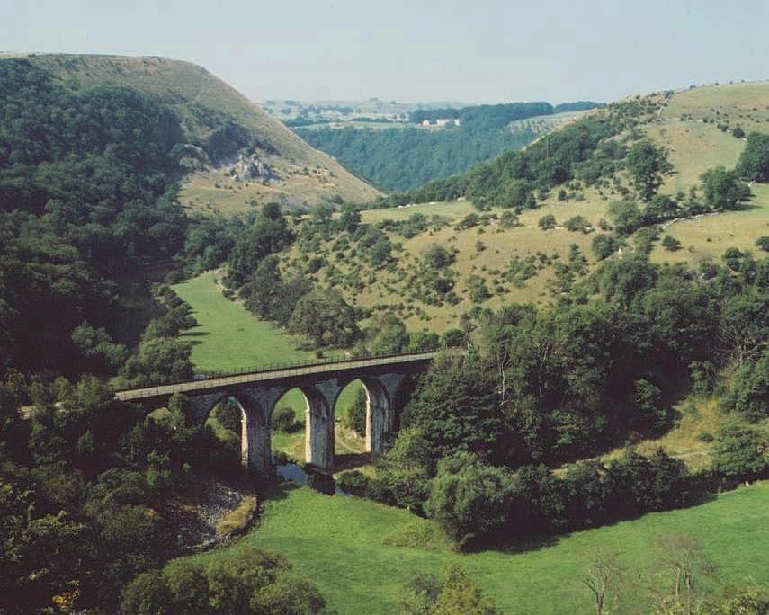
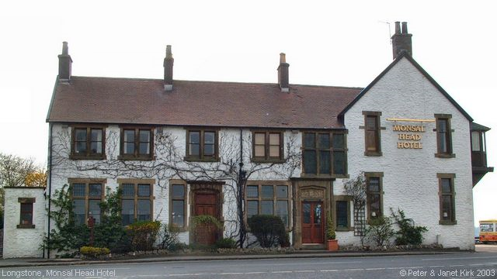
Dinner Tonight
Monsal Head Hotel 8:30 pm
Please make menu choice by end of first break …
Short walk before hand down to viaduct.

Slide 17
Lunch
Catering provided (food will be in the foyer).
Coffee … at the back.

Slide 18
Thanks to
Gillian, PASCAL, Sheffield ML group.

