Slide 1



Naveen Jindal
School of Management
Optimal Investment Strategy
Using Segmentation and Scoring Mechanism
Prepared By
Pavan Gorantla
Himaja Barla
Mudit Agrawal
Anusha Karasala
Rohit Doddapaneni
Jen-Hsin Huang
Yun-Han Liu
In Association With

Slide 2
Customer Analysis
27% of customers did 80% of transactions
37% of customers did not return to buy after 2017
14% of customers contribute above 20% margin

Slide 3
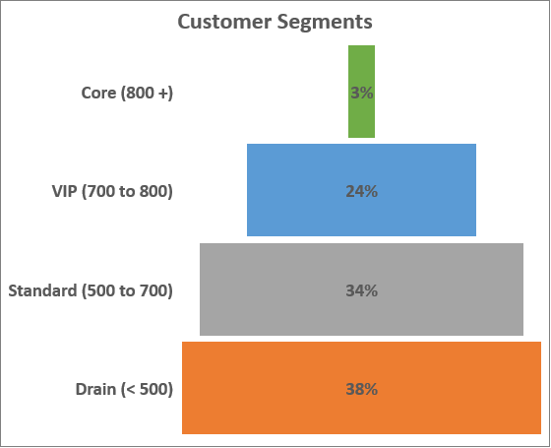
Customer Segmentation
Gross Margin ~ 20%
Avg ROI ~ 20%
Avg ROI ~ 25%
Gross Margin ~ 15%
Mean Score
Gross Margin ~10%
Avg ROI ~ 15%
Gross Margin <10%
Core: Highly valuable, drives most business VIP: Potential ones that can reach Core status Standard: Occasional shoppers, mild business Drain: No recent purchases, negative margins
A $4 million portfolio is divided based on ROI & Score calculated using weighted Recency, Frequency, Margin

Slide 4
Employee Insights
Majority of Grace’s and Jeff’s are Draining customers, need to find new customers in South and West regions. Need to invest in reach marketing, reconnect with old customers, can replace Grace with new a Sales Person.

Slide 5
Product Analysis
5% products are involved in 30% transactions
80% of inventory is in demand at the end of 2018
20% of products fetch above 30% margin

Slide 6
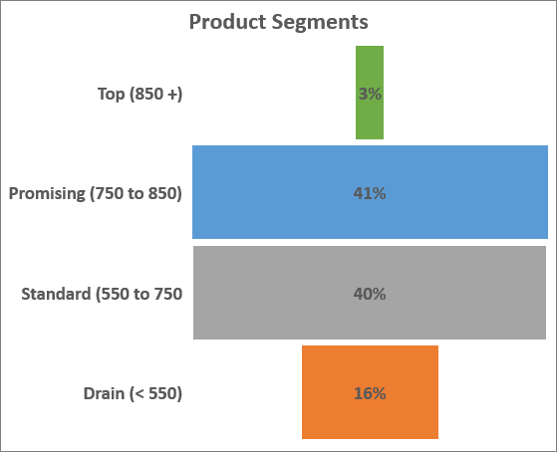
Product Segmentation
Gross Margin >30%
Avg ROI ~ 15%
Avg ROI ~ 50%
Gross Margin ~ 15%
Mean Score
Gross Margin ~ 10%
Avg ROI ~ 20%
Top: Fast moving, high in demand, high margins Promising: Decent margins, better to stock up Standard: Seasonal demand, average margins Drain: Less in demand, low and negative margins
A $4 million portfolio is divided based on ROI & Score calculated using weighted Recency, Frequency, Margin

Slide 7
Warehouse Insights
Significant portion of inventory in Warehouse 2 is stocked with slow moving and low margin products, can distribute them to Warehouse 1 freeing up space and restock Warehouse 2 with Top and Promising products.

Slide 8
Any Questions?
References
Shih, Y., Liu, C. A method for customer lifetime value ranking — Combining the analytic hierarchy process and clustering analysis. Journal of Database Marketing & Customer Strategy Management 11, 159–172 (2003). https://doi.org/10.1057/palgrave.dbm.3240216

