Slide 1



Naveen Jindal
School of Management
Customer and Product Segmentation
Using RFM Analysis and k-means Clustering
On XYZ Hardware Wholesaler Transactions
Prepared By
Pavan Gorantla
Himaja Barla
Mudit Agrawal
Anusha Karasala
Rohit Doddapaneni
Jen-Hsin Huang
Yun-Han Liu
In Association With

Slide 2
Segmentation Pyramids
Segmented Groups for Customers
Segmented Groups for Products
226 (95%) Active Customers out of 4372 Total Customers
3805 (96%) Shipped Products out of 3958 Total Products
Core (13%)
Top (12%)
Standard (26%)
Potential (21%)
Newcomers (12%)
Standard (20%)
At Risk/Lost (33%)
No Demand (17%)
Draining (16%)
Draining (30%)
We may want to invest in all customers and products from best groups (green) but they cost more than $10 million

Slide 3
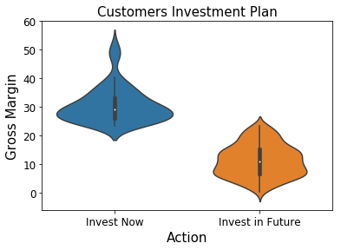
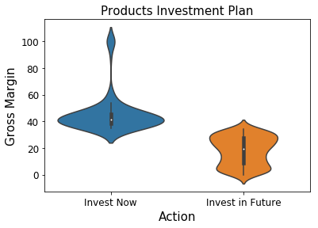
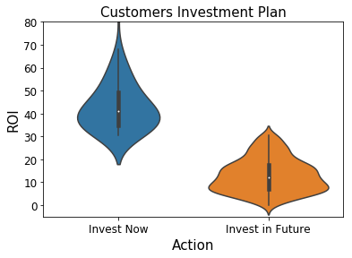
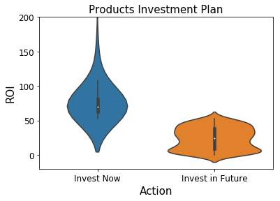
Where To Invest?
Core Customers with high Margin & ROI costing $5 million (blue)
Top Products with high Margin & ROI costing $5 million (blue)
89 Customers (2%)
35% of Total Revenue
138 Products (4%)
60% of Total Revenue
Avg Margin is 30%
Avg Margin is 40%
Newcomers
89 Customers (2%)
35% of Total Revenue
138 Products (4%)
60% of Total Revenue
Avg ROI is 45%
Avg ROI is 80%

Slide 4
RFM Analysis
RFM Analysis says if a customer or product is good or bad using 3 independent factors
Recency
When did a customer buy for the last time? Measured by: Days since Recent Purchase
When was a product sold for the last time? (Can use same for Customers and Products)
Frequency
How frequently does a customer purchase? Measured by: No. of Transactions by Customer
Which products are sold in large quantities? Measured by: Shipped Quantity of the Product
Monetary
What’s the financial gain from a customer or product?
1/7th Profit
If Customer B did 7 similar transactions or Product B is shipped 7 times, then Margin and ROI are best
Margin and ROI will become better financial metrics provided only if B has higher Frequency than A
Profit is a financial metric that is independent of Frequency (no. of transactions, quantity shipped)

Slide 5
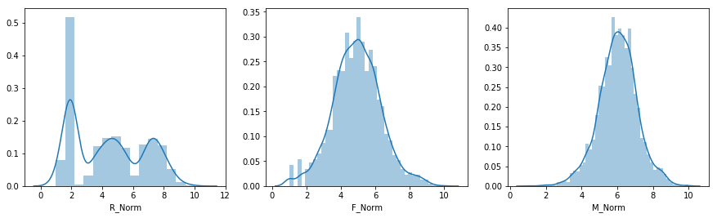
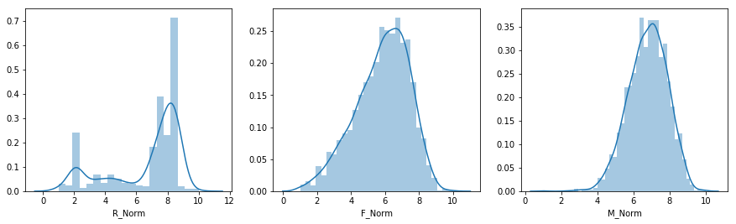
Normalization
Recency
Frequency
Profit
Customers
3 features are log transformed
Normalized to a scale of 1 to 10
1 means bad and 10 means good
Products

Slide 6
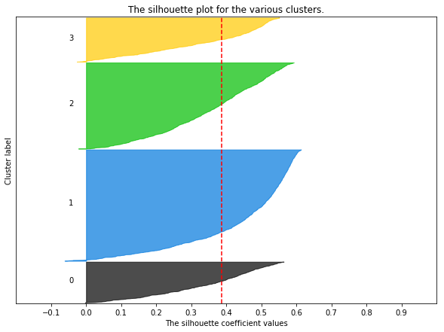
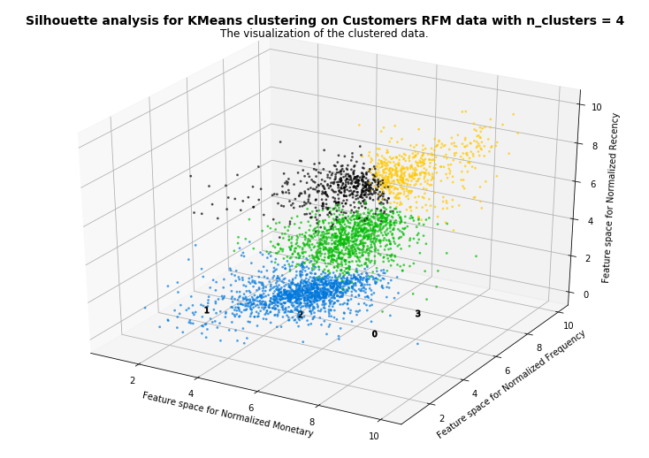
Customers Clustering
Cluster group 3 (Orange) has highest Recency, Frequency and Monetary values which we named as our Core group
Core (13%)
Core
Standard (26%)
Newcomers
Standard
At Risk/Lost (33%)
At Risk/Lost
Newcomers (16%)

Slide 7
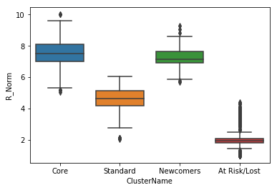
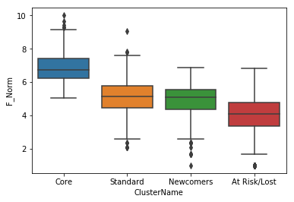
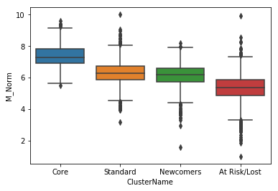
Customers Clustering
Recency
Frequency
Profit
Newcomers
Core – Very active, purchased most recently, did most transactions, high profits, best to be in regular touch
Standard – Moderately Active, purchased a quarter ago, transactions with moderate frequency, decent profits
Newcomers – Very active, started recently, competing with Standard group Customers, observe them closely
At Risk/Lost – Did transactions over an year ago, good to re-connect and negotiate for new deals and purchases

Slide 8
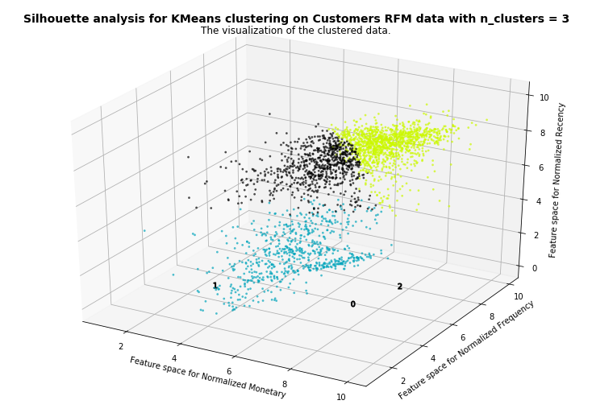
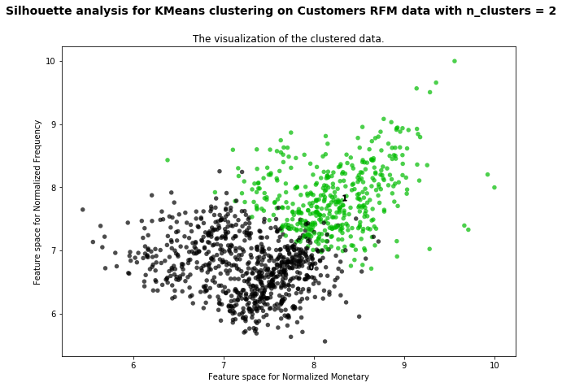
Products Clustering
Top
Top + Potential
Top
Potential
Standard
No Demand
Potential
Best Cluster (Yellow) has 1200 products, so only that cluster is further sub-divided to 2 groups giving our Top products (Green)

Slide 9
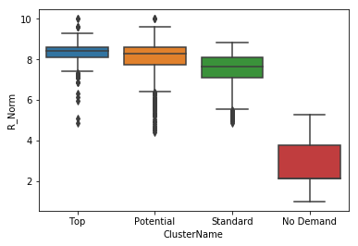
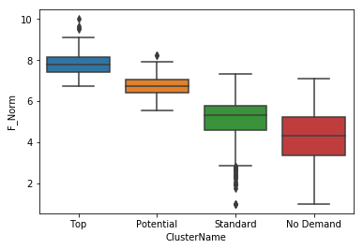
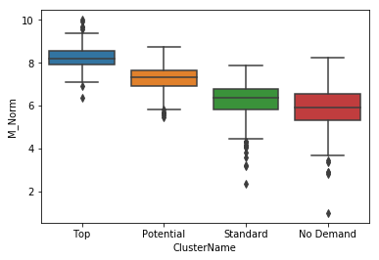
Products Clustering
Recency
Frequency
Profit
Newcomers
Top – High demand, Recently purchased, shipped in large quantities, contributed for high profits, best to invest
Potential – Second to Top group, purchased most recently, moderate quantities shipped, decent profit share
Standard – Moderately in demand, medium quantities are shipped, generated below average profits
No Demand – Products almost obsolete, bought over 1 year ago, lowest quantities shipped, lowest profit share

Slide 10
Any Questions?

