Slide 1
Order Statistics
The order statistics of a set of random variables X₁, X₂,…, X_{n} are the same random variables arranged in increasing order.
Denote by
X₍₁₎ = smallest of X₁, X₂,…, X_{n}
X₍₂₎ = 2nd smallest of X₁, X₂,…, X_{n}
X_{(n)} = largest of X₁, X₂,…, X_{n}
Note, even if X_{i}’s are independent, X_{(i)}’s can not be independent since
X₍₁₎ ≤ X₍₂₎ ≤ … ≤ X_{(n)}
Distribution of X_{i}’s and X_{(i)}’s are NOT the same.

Slide 2

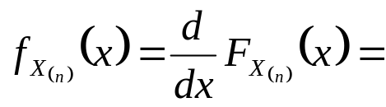
Distribution of the Largest order statistic X_{(n)}
Suppose X₁, X₂,…, X_{n} are i.i.d random variables with common distribution function F_{X}(x) and common density function f_{X}(x).
The CDF of the largest order statistic, X_{(n)}, is given by
The density function of X_{(n)} is then

Slide 3
Example
Suppose X₁, X₂,…, X_{n} are i.i.d Uniform(0,1) random variables. Find the density function of X_{(n)}.

Slide 4

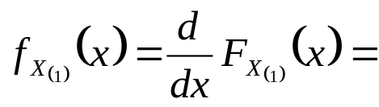
Distribution of the Smallest order statistic X₍₁₎
Suppose X₁, X₂,…, X_{n} are i.i.d random variables with common distribution function F_{X}(x) and common density function f_{X}(x).
The CDF of the smallest order statistic X₍₁₎ is given by
The density function of X₍₁₎ is then

Slide 5
Example
Suppose X₁, X₂,…, X_{n} are i.i.d Uniform(0,1) random variables. Find the density function of X₍₁₎.

Slide 6
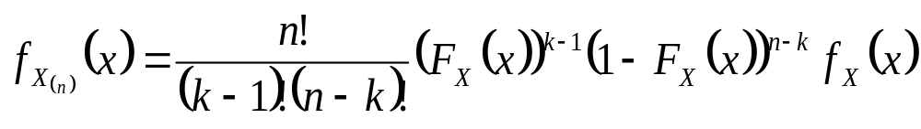
Distribution of the kth order statistic X_{(k)}
Suppose X₁, X₂,…, X_{n} are i.i.d random variables with common distribution function F_{X}(x) and common density function f_{X}(x).
The density function of X_{(k)} is

Slide 7
Example
Suppose X₁, X₂,…, X_{n} are i.i.d Uniform(0,1) random variables. Find the density function of X_{(k)}.

Slide 8
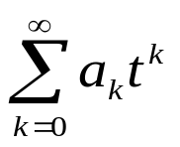
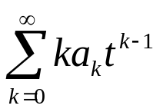
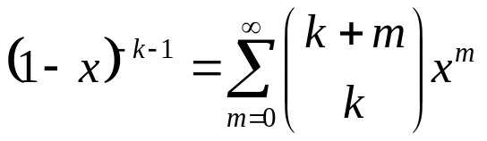
Some facts about Power Series
Consider the power series with non-negative coefficients a_{k}.
If converges for any positive value of t, say for t = r, then it
converges for all t in the interval [-r, r] and thus defines a function of t on that interval.
For any t in (-r, r), this function is differentiable at t and the series converges to the derivatives.
Example:
For k = 0, 1, 2,… and -1< x < 1 we have that
(differentiating geometric series).

Slide 9
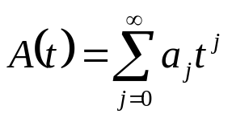
Generating Functions
For a sequence of real numbers {a_{j}} = a₀, a₁, a₂ ,…, the generating function of {a_{j}} is
if this converges for |t| < t₀ for some t₀ > 0.

Slide 10
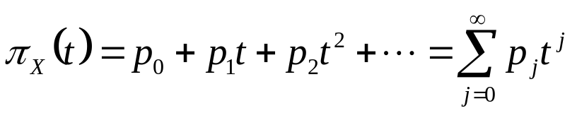
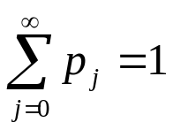

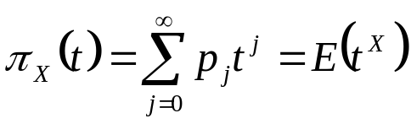
Probability Generating Functions
Suppose X is a random variable taking the values 0, 1, 2, … (or a subset of
the non-negative integers).
Let p_{j} = P(X = j) , j = 0, 1, 2, …. This is in fact a sequence p₀, p₁, p₂, …
Definition: The probability generating function of X is
Since if |t| < 1 and the pgf converges absolutely at least
for |t| < 1.
In general, π_{X}(1) = p₀ + p₁ + p₂ +… = 1.
The pgf of X is expressible as an expectation:

Slide 11
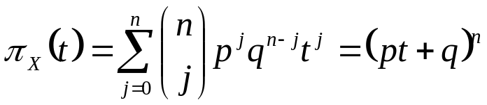
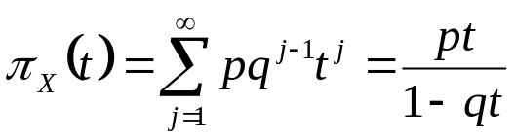
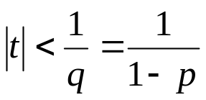
Examples
X ~ Binomial(n, p),
converges for all real t.
X ~ Geometric(p),
converges for |qt| < 1 i.e.
Note: in this case p_{j} = pq^{j} for j = 1, 2, …

Slide 12

PGF for sums of independent random variables
If X, Y are independent and Z = X+Y then,
Example
Let Y ~ Binomial(n, p). Then we can write Y = X₁+X₂+…+ X_{n} . Where X_{i}’s are i.i.d Bernoulli(p). The pgf of X_{i} is
The pgf of Y is then

Slide 13




Use of PGF to find probabilities
Theorem
Let X be a discrete random variable, whose possible values are the nonnegative integers. Assume π_{X}(t₀) < ∞ for some t₀ > 0. Then
π_{X}(0) = P(X = 0),
etc. In general,
where is the k^{th} derivative of π_{X} with respect to t.
Proof:

Slide 14
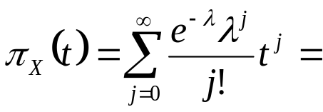
Example
Suppose X ~ Poisson(λ). The pgf of X is given by
Using this pgf we have that

Slide 15


Finding Moments from PGFs
Theorem
Let X be a discrete random variable, whose possible values are the nonnegative integers. If π_{X}(t) < ∞ for |t| < t₀ for some t₀ > 1. Then
etc. In general,
Where is the kth derivative of π_{X} with respect to t.
Note: E(X(X-1)∙∙∙(X-k+1)) is called the kth factorial moment of X.
Proof:

Slide 16
Example
Suppose X ~ Binomial(n, p). The pgf of X is
π_{X}(t) = (pt+q)^{n}.
Find the mean and the variance of X using its pgf.

Slide 17
Uniqueness Theorem for PGF
Suppose X, Y have probability generating function π_{X} and π_{Y} respectively. Then π_{X}(t) = π_{Y}(t) if and only if P(X = k) = P(Y = k) for k = 0,1,2,…
Proof:
Follow immediately from calculus theorem:
If a function is expressible as a power series at x=a, then there is only one such series.
A pgf is a power series about the origin which we know exists with radius of convergence of at least 1.

Slide 18

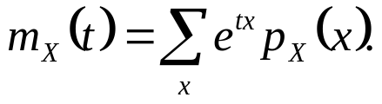
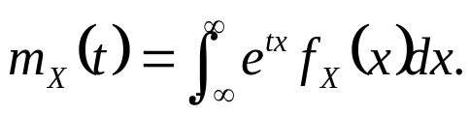
Moment Generating Functions
The moment generating function of a random variable X is
m_{X}(t) exists if m_{X}(t) < ∞ for |t| < t₀ >0
If X is discrete
If X is continuous
Note: m_{X}(t) = π_{X}(e^{t}).

Slide 19
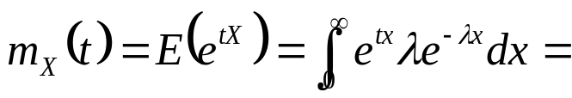
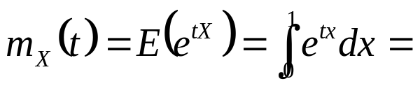
Examples
X ~ Exponential(λ). The mgf of X is
X ~ Uniform(0,1). The mgf of X is

Slide 20




Generating Moments from MGFs
Theorem
Let X be any random variable. If m_{X}(t) < ∞ for |t| < t₀ for some t₀ > 0. Then
m_{X}(0) = 1
etc. In general,
Where is the kth derivative of m_{X} with respect to t.
Proof:

Slide 21
Example
Suppose X ~ Exponential(λ). Find the mean and variance of X using its moment generating function.

Slide 22
Example
Suppose X ~ N(0,1). Find the mean and variance of X using its moment generating function.

Slide 23
Example
Suppose X ~ Binomial(n, p). Find the mean and variance of X using its moment generating function.

Slide 24

Properties of Moment Generating Functions
m_{X}(0) = 1.
If Y=a+bX, then the mgf of Y is given by
If X,Y independent and Z = X+Y then,

Slide 25
Uniqueness Theorem
If a moment generating function m_{X}(t) exists for t in an open interval containing 0, it uniquely determines the probability distribution.

Slide 26


Example
Find the mgf of X ~ N(μ,σ²) using the mgf of the standard normal random variable.
Suppose, , independent.
Find the distribution of X₁+X₂ using mgf approach.

