Slide 1
Predicting Youth Drug Use
with Tree-Based Machine Learning
Decision Trees · Random Forests · Boosting · Regression
NSDUH Youth Survey | DATA 5322 – Practical Homework 1
Paul Skentzos | Statistical Machine Learning II | Seattle University
Notes:
Welcome and thank you. Today I'm presenting my DATA 5322 Practical Homework 1 analysis of the NSDUH youth survey using tree-based machine learning. I framed the problem three ways: binary classification to predict whether a youth ever used alcohol, multi-class to predict marijuana frequency category, and regression to predict actual days per year of alcohol use. I'll cover data preparation, theory, results, and close with what I think are two genuinely important methodological insights, one about ROC curves, and one about a surprising regression result.

Slide 2
Research Questions & Dataset
National Survey on Drug Use and Health (NSDUH) — youth respondents under 18
Binary
10,561
47
Did this youth ever use alcohol?
Metric: Accuracy + ROC AUC
youth respondents
(under 18 filter)
predictor variables
selected
Multi-class
What is their marijuana use frequency?
3
5-fold
Metric: Macro F1 + Accuracy
target encodings
(binary / ordinal / numerical)
cross-validation
throughout
Regression
How many days/year do they drink alcohol?
Metric: RMSE + R²
⚠ Leakage audit performed — post-outcome variables explicitly excluded before any model fitting
Notes:
The dataset is the preprocessed NSDUH youth cohort, after restricting to respondents under 18, we have 10,561 records. I selected 47 predictor variables covering youth experience categories: school attitude, peer relationships and attitudes, parental behavior, household environment, and self-reported risk behaviors. Before any modeling I performed a leakage audit, variables that are logically downstream of substance use, like treatment history or reported consequences, were explicitly excluded. This is important for validity: we want the models to predict risk factors, not consequences. All hyperparameter tuning was done inside 5-fold GridSearchCV on the training set, with the test set held out entirely until final evaluation.

Slide 3
Methods & Theory
Five model classes · all hyperparameters tuned with Repeated 5-way validation for model tuning
Decision Tree
Random Forest
AdaBoost
Recursive binary splits minimize impurity. Interpretable baseline but high-variance, prone to overfitting deep trees.
Key params: max_depth, min_samples_leaf
Bootstrap aggregation of decorrelated trees. Averaging reduces variance. Strong on imbalanced binary targets with class weighting.
Key params: n_estimators, max_features, min_samples_leaf
Sequential learners reweight misclassified examples. Focuses later rounds on decision-boundary hard cases.
Key params: n_estimators, learning_rate
Baseline
Bagging
Boosting
Gradient Boosting
Bagging Regressor
Fits each new tree to ensemble residuals. Strongest discriminator overall; most expensive to tune.
Key params: n_estimators, learning_rate, max_depth, subsample
Bootstrap aggregation of base regressors. Reduces prediction variance without increasing bias, best regression performer here.
Key params: n_estimators, max_samples, max_features
Boosting
Regression
Metrics: Accuracy + ROC AUC (binary) · Macro F1 (multi-class) · RMSE + R² (regression)
Notes:
Five model classes appear in the homework. The decision tree is the interpretable baseline, it recursively partitions the feature space to minimize Gini impurity, but it overfits easily and is a high-variance learner. Random forests correct this by building many trees on bootstrap samples with random feature subsets, then averaging predictions, the decorrelation is what makes averaging effective. AdaBoost takes a different boosting approach: it sequentially reweights training examples so later learners focus on harder cases. Gradient boosting extends this by fitting each new tree to the residuals of the current ensemble, which is why it tends to be the strongest but slowest method. Finally, the Bagging Regressor applies bootstrap aggregation for the regression task. Throughout, I used 5-fold GridSearchCV to tune hyperparameters on training data only, and I used class_weight='balanced' for the classification tasks given the imbalanced targets.

Slide 4
Methodology
Data preparation · Feature engineering · Model training setup
Data Preparation
Modeling Setup
Dataset: 10,561 youth respondents, NSDUH 2019 (under 18 filter)
Features: 47 youth-experience + 8 demographic = 55 base features
Encoding: NEWRACE2 & COUTYP4 one-hot encoded → 63 total features; binary items recoded 1/2 → 1/0
Missing: Per-column NaN check; mode imputation for binary survey items (<8% each column)
Leakage: All substance outcome variables excluded before any model fitting
Split: 80/20 stratified train/test; test set held out until final evaluation
CV: GridSearchCV with cv=2 on training data; metric-specific scoring per problem type
Imbalance: class_weight='balanced' for classification tasks (77/23 positive rate)
Tuning: DT: max_depth · RF: + max_features, min_samples_leaf · GBM/GBR: + subsample, min_samples_split · Bagging: + max_samples
Metrics: Binary: ROC AUC · Multi-class: Macro F1 · Regression: RMSE + R²
All models trained on the same 63-feature matrix · same 80/20 split · SEED=42

Slide 5
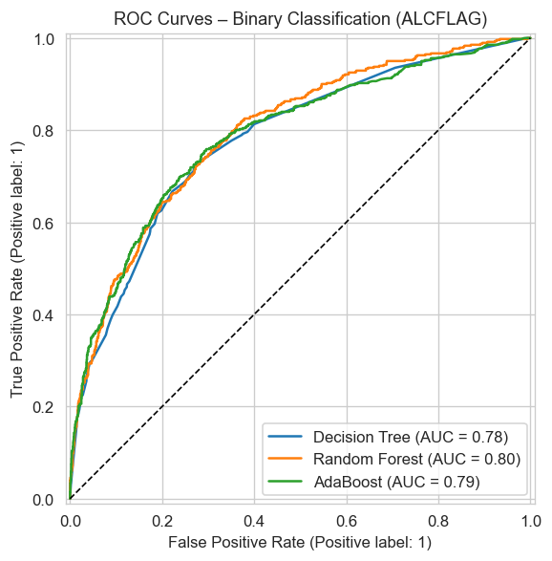
Binary Classification Results
Target: ALCFLAG — ever used alcohol (yes/no) · class_weight='balanced'
Model | Accuracy | ROC AUC
Decision Tree | 0.743 | 0.779
Random Forest | 0.752 | 0.795
AdaBoost | 0.817 | 0.788
AdaBoost leads on accuracy (0.817) but Random Forest leads on AUC (0.795) These measure different things. See next slide.
Notes:
For binary classification, predicting whether a youth ever used alcohol, both ensemble methods outperform the single decision tree on accuracy, which is expected. But look more carefully at the table: AdaBoost has the highest accuracy at 0.817, yet Random Forest has the higher ROC AUC at 0.795. Those two metrics are measuring genuinely different things, and the fact that they disagree is one of the most important methodological observations in this analysis. I'll unpack that fully on the next slide. The three curves plus the diagonal baseline illustrate the ranking differences visually.

Slide 6
ROC Curves: The Deeper Story
Why accuracy and AUC disagree and which matters more for public health screening
Accuracy = single threshold
Evaluated at cut-point 0.5. AdaBoost confidently predicts the majority class here, inflating its accuracy score.
AUC = threshold-agnostic ranking
Measures discriminative power across ALL thresholds. RF's probability estimates are better calibrated over the full range.
For screening: AUC > accuracy
In public health you choose the threshold based on intervention costs vs. missed cases. AUC measures your flexibility to do that.
"Accuracy answers: did it get it right at this threshold? AUC answers: how good is the ranking across all thresholds?"
Notes:
This is the slide I want you to take away. The ROC curve plots True Positive Rate on the y-axis against False Positive Rate on the x-axis as we sweep the classification threshold from 0 to 1. The area under that curve , AUC, summarizes discriminative ability across the entire operating range. The dotted diagonal represents a random classifier with AUC of 0.5, the further a curve bows toward the upper-left corner, the better the model. What is happening with AdaBoost? At the default threshold of 0.5, it is very aggressively predicting the majority class, youth who used alcohol, which inflates accuracy. But across other thresholds its advantage disappears, and its AUC is lower than Random Forest's. Random Forest has better-calibrated probability estimates across the full range. Why does this matter for public health? If you were deploying this model to screen youth for intervention programs, you almost certainly would not use the default 0.5 cut. You would shift the threshold depending on the relative cost of a false positive, an unnecessary intervention, versus a false negative, a missed at-risk youth. AUC tells you how much room you have to make that adjustment. This is the correct metric to optimize for this application, not accuracy.

Slide 7
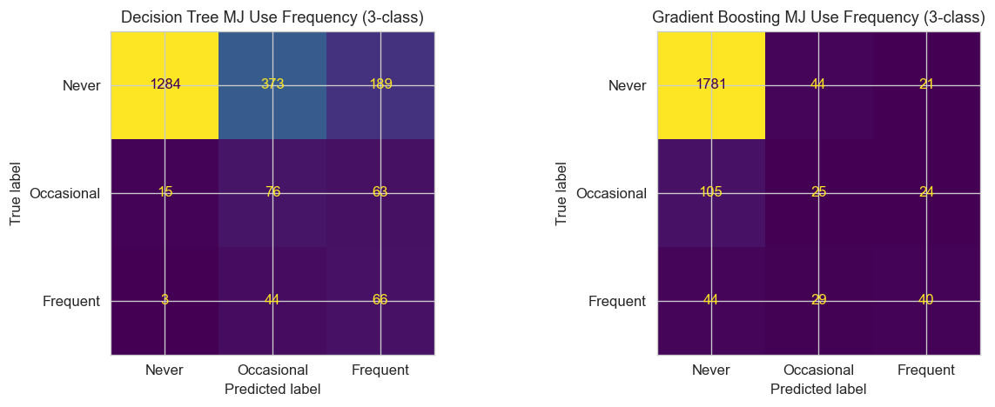
Multi-class Classification Results
Target: MRJ3CLASS — marijuana frequency · Never (0) / Occasional (1) / Frequent (2)
Model | Accuracy | Macro F1
Decision Tree | 0.675 | 0.452
Gradient Boosting | 0.874 | 0.515
Severe class imbalance: Never: n≈9,226 · Occasional: n≈769 · Frequent: n≈566
Macro F1 used, not weighted or micro, because it treats each class equally regardless of support. Essential when the rare frequent-use class is arguably the most important to detect.
Notes:
For the multi-class problem, I predicted three marijuana frequency categories. This is a severely imbalanced classification problem, the never-used class vastly outnumbers occasional and frequent users. Gradient boosting dominates the decision tree on both accuracy and macro F1. I want to specifically address the choice of macro-averaged F1: I used it because it treats each class equally regardless of how many samples it has. Weighted F1 would reward models that just nail the majority class, which is not what we want when the rare frequent-use category is arguably the most important to catch. The confusion matrices show this directly, the single decision tree essentially predicts never-used for almost all cases, while gradient boosting recovers more structure in the minority classes despite the imbalance.

Slide 8
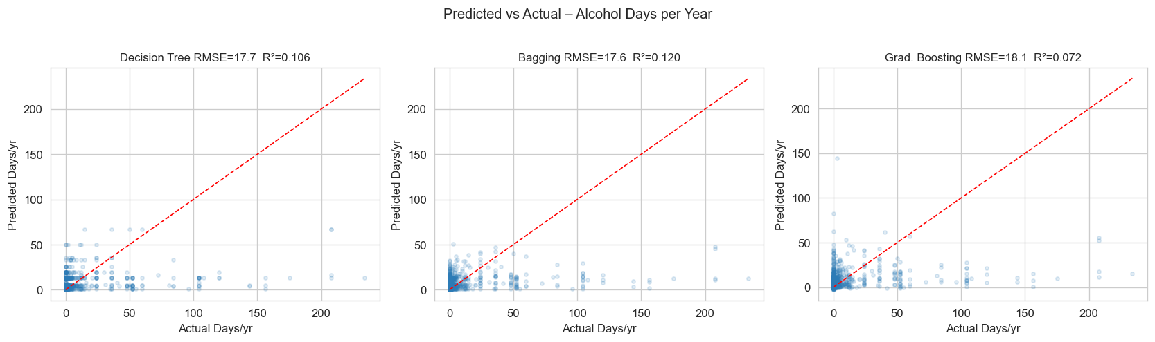
Regression Results
Target: IRALCFY — alcohol use days per year (0–365) · heavily zero-inflated
Note: Gradient Boosting underperforms Bagging on this task , the opposite of the classification result. This is reported as observed; honest reporting includes results that don't match prior expectations.
Model | RMSE | MAE | R²
Decision Tree | 17.73 | 6.00 | 0.106
Bagging | 17.59 | 5.97 | 0.120
Grad. Boosting | 18.06 | 6.02 | 0.072
R² ≈ 0.07–0.12: is this bad? Expected. IRALCFY is heavily zero-inflated (most youth: 0 days) and self-reported. Models identify real signal, but the distributional difficulty limits R².
Notes:
For the regression task, predicting actual days per year of alcohol use, Bagging is the best performer with the lowest RMSE of 17.59 and highest R² of 0.120. I want to be explicit: gradient boosting underperforms bagging here. That is the result the executed notebook produces, and it is worth saying plainly rather than glossing over. One plausible explanation is that gradient boosting's stage-wise residual fitting is less well suited to a distribution dominated by a zero mass, bagging's simple variance reduction handles that distributional quirk better. The R² values around 0.07 to 0.12 are low in absolute terms, but they are not surprising. The target variable is severely zero-inflated, the majority of youth in this sample reported zero days, and survey self-report adds substantial noise. The predicted-versus-actual scatter plots visualize this: you can see the models identifying the upward trend while struggling with the spike at zero.

Slide 9
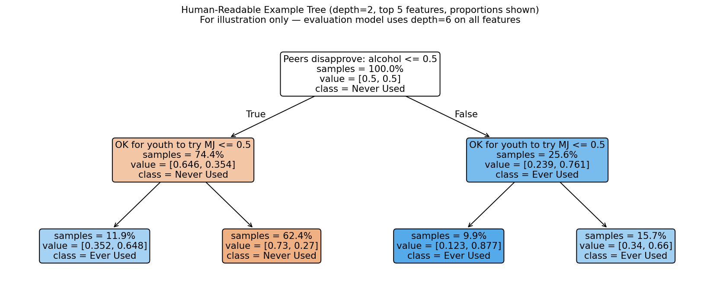
Human-Readable Example Tree
depth=2 · top 5 predictors · class proportions shown · For illustration only (not the evaluation model)

Slide 10
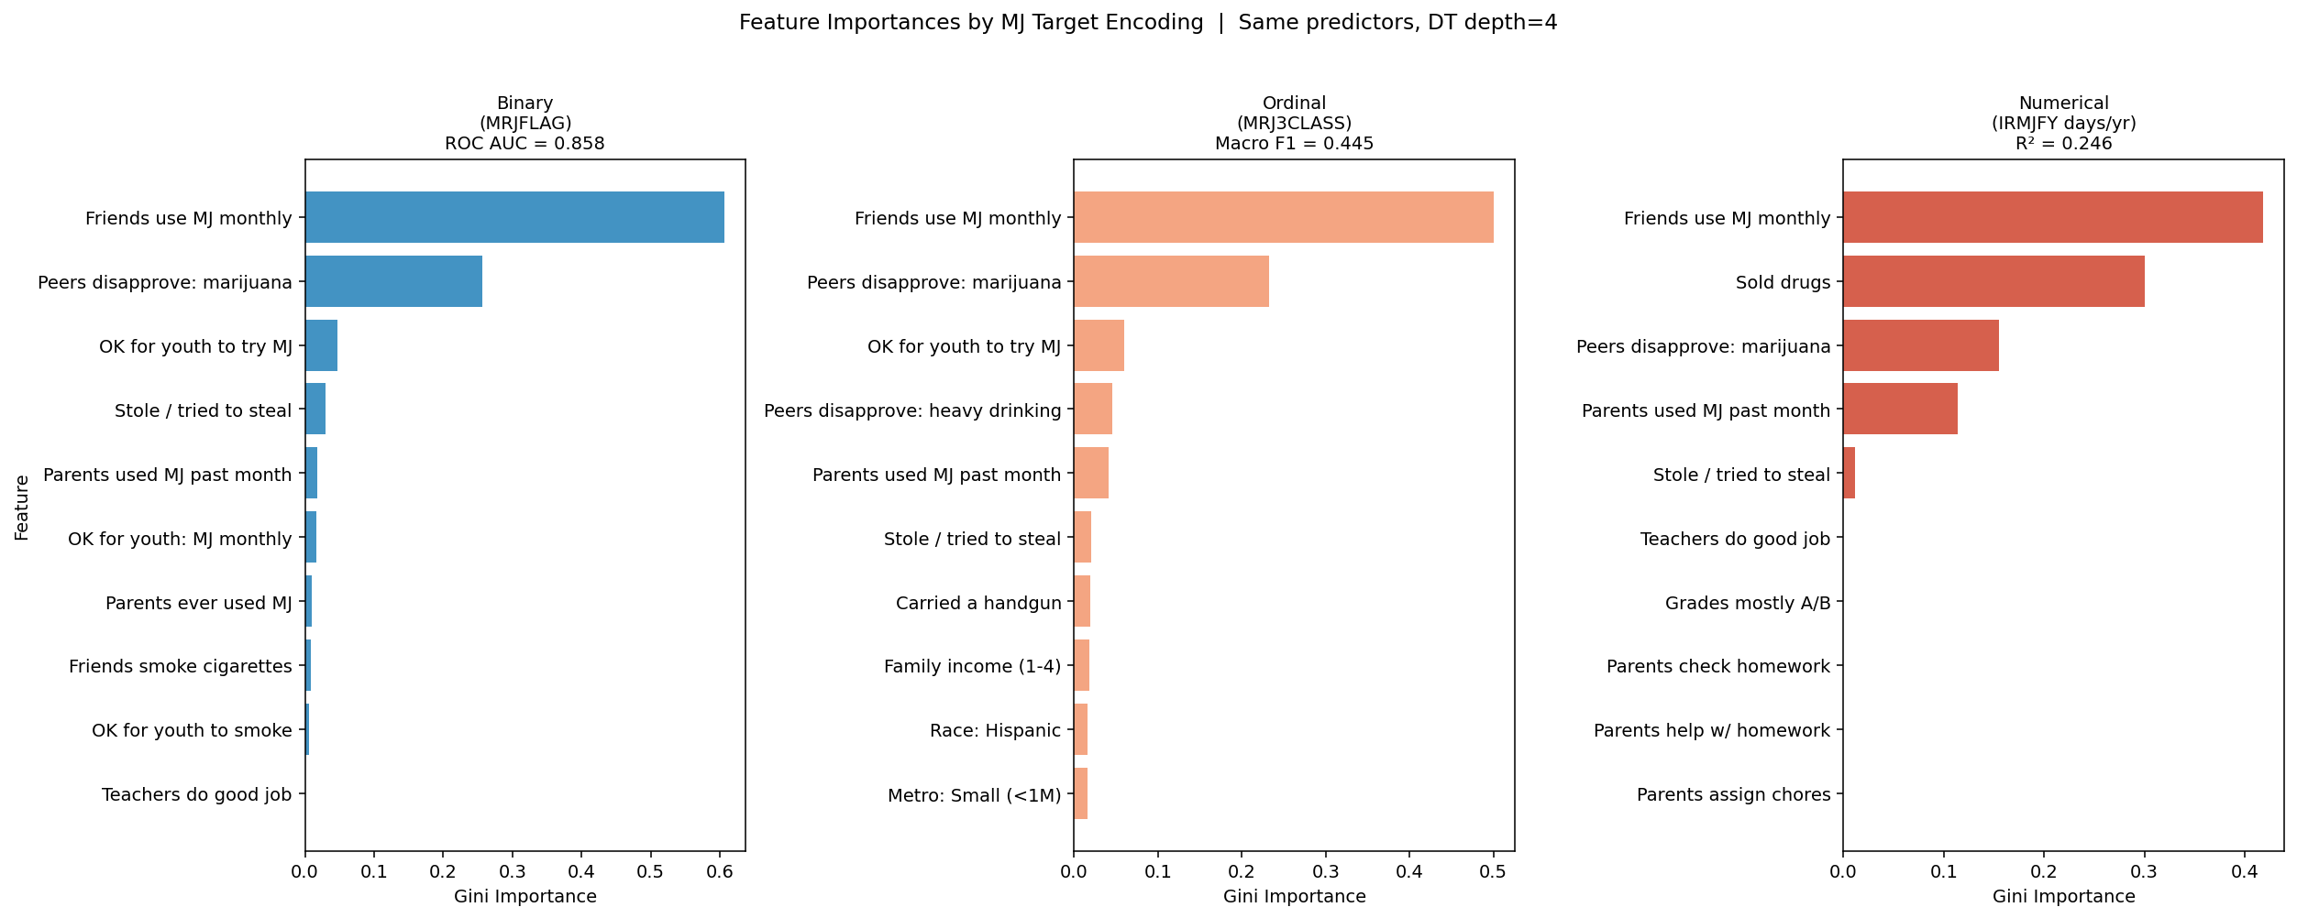
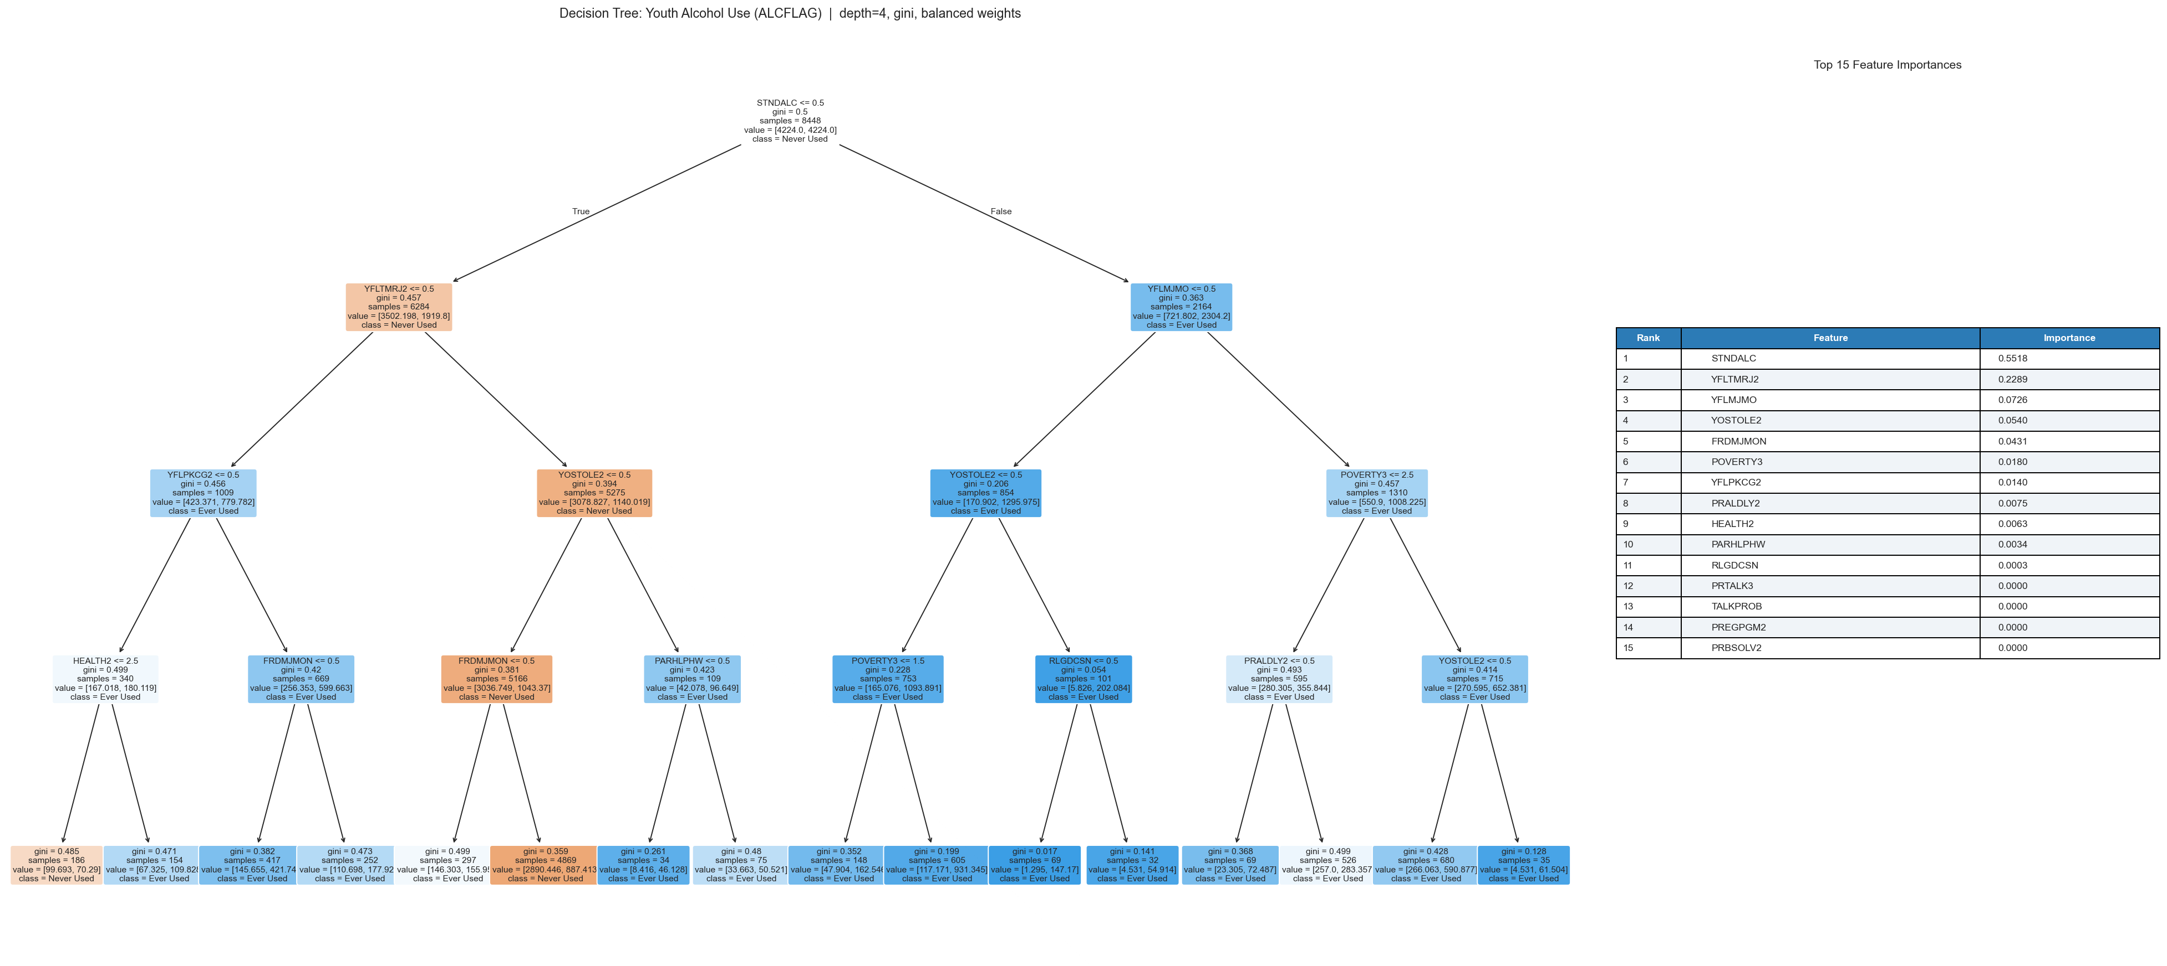
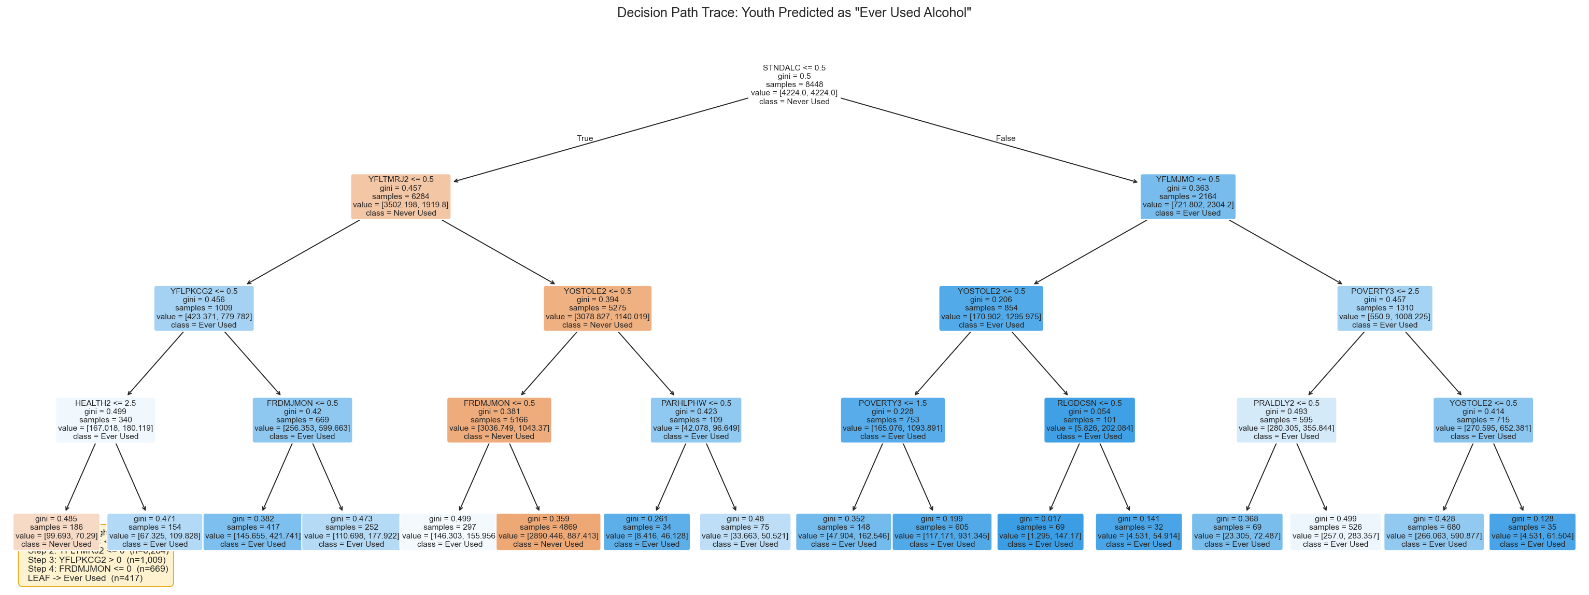
Interpretability: What the Models Tell Us
Tree + importance table · Feature importance by encoding · Interpretation differences
① Top feature: FRDMJMON
② Parental modeling
③ Encoding: Interpretation
Friends' monthly MJ use (FRDMJMON) dominates information gain across all three marijuana encoding targets..
PRALDLY2 / PRMJEVR2 appear in deeper branches, signal remains after peer norms are controlled.
Binary: predicts ever/never - simple but loses frequency information. Ordinal: distinguishes occasional vs. chronic - policy-relevant. Numerical: captures dose-response but sensitive to zero-inflation. Top feature (FRDMJMON) is consistent across all three encodings.
Notes:
The assignment specifically rewards going beyond just predictive metrics, and I included three interpretability analyses. First, the image on the left produces a tree visualization paired side-by-side with a feature importance table, this shows which features drive splits and quantifies their relative contribution. The dominant feature across all encodings is FRDMJMON: Friends' monthly MJ use. Second, the middle image traces a decision path for a specific test-set observation, I selected a youth predicted as ever-used and walked through every branch split from root to leaf, labeling threshold and direction. This gives a human-readable explanation of one prediction. Third, the image on the left produces the encoding comparison: the same underlying behavior coded as binary, ordinal, and numerical leads to different feature importance profiles. The practical takeaway is that binary encoding gives the cleanest splits but loses the distinction between occasional and chronic use, a distinction that is very important for policy design.

Slide 11
Discussion, Ethics & Limitations
Key Findings
Limitations & Ethics
Social norms dominate: STNDALC (peer disapproval) strongest predictor across all tasks
Permissive attitudes cluster: YFLTMRJ2 (thinks MJ OK) predicts alcohol use, substance attitudes generalize
Parental modeling (PRALDLY2, PRMJEVR2) has independent signal after peer norms controlled
Ensembles consistently outperform single trees, variance reduction is the mechanism
Regression R² low (~0.1), expected given zero-inflation and self-report noise
Correlation ≠ causation, feature importance does not imply a causal effect
Self-report bias: recall and social desirability effects inherent in NSDUH
Class imbalance limits minority-class precision even with balancing strategies
Flagging youth based on parental drug use raises serious equity and privacy concerns
Any deployment requires causal analysis, fairness auditing, and community stakeholder review
Public health implication: peer environment and social norms are the strongest modifiable risk factors, not demographics.
Notes:
Stepping back from the numbers to interpretation. The central finding is that social context variables, especially peer attitudes toward alcohol, dominate predictive power far more than demographic features. For public health this is meaningful: intervention strategies targeting peer norms may be more effective than demographic-targeted approaches. However, I want to be careful about the causal language here. These are associative findings from observational survey data. A variable being important in a tree does not mean intervening on it will change the outcome, we have not estimated any causal effect. The NSDUH data is self-reported, introducing recall and social desirability bias. Class imbalance limits how precisely we can predict the rare frequent-use categories. And ethically, several of the top predictors involve parental behavior, real deployment of a model that flags youth based on their parents' substance use would require serious fairness analysis and stakeholder engagement before it could be responsibly used.

Slide 12
Conclusions
Tree-based ensembles reliably outperform single decision trees across all three problem types
AUC is the right metric for binary classification here because operating threshold matters in a screening context
Bagging, not gradient boosting, produced the best regression performance on this zero-inflated target
Peer social norms (STNDALC) are the dominant predictor. The findings point toward peer-environment interventions
All findings are associative, meaning that ethical deployment requires causal analysis, fairness auditing, and stakeholder review
References: [1] SAMHSA. NSDUH 2019. [2] Pedregosa et al. sklearn (JMLR 2011). [3] Breiman. Random Forests (ML 2001). [4] Friedman. Greedy function approximation: A gradient boosting machine(AoS 2001). [5] Freund & Schapire. A decision-theoretic generalization of on-line learning and an application to boosting (JCSS 1997).
Notebook + data: https://github.com/gpskentzos/DATA5322-DrugUseAndHealthAnalysis | DATA 5322 · Practical Homework 1 | Paul Skentzos
Notes:
To close, five takeaways. First, tree-based ensembles consistently outperformed single decision trees, confirming the core theoretical prediction that variance reduction through averaging or boosting improves generalization. Second, accuracy and AUC measure different things, for a public health screening problem where the operating threshold is a design choice, AUC is the metric that matters. Third, the regression result was a genuine surprise: bagging outperformed gradient boosting, and I reported it as such rather than glossing over it. Fourth, peer social norms emerged as the dominant predictor throughout, which has concrete implications for intervention program design. And fifth, all of these findings are correlational, responsible use of models like this requires far more work before deployment. Thank you.

