Slide 1
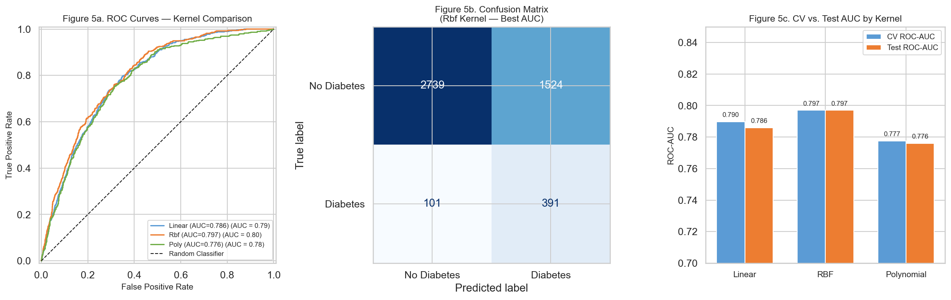
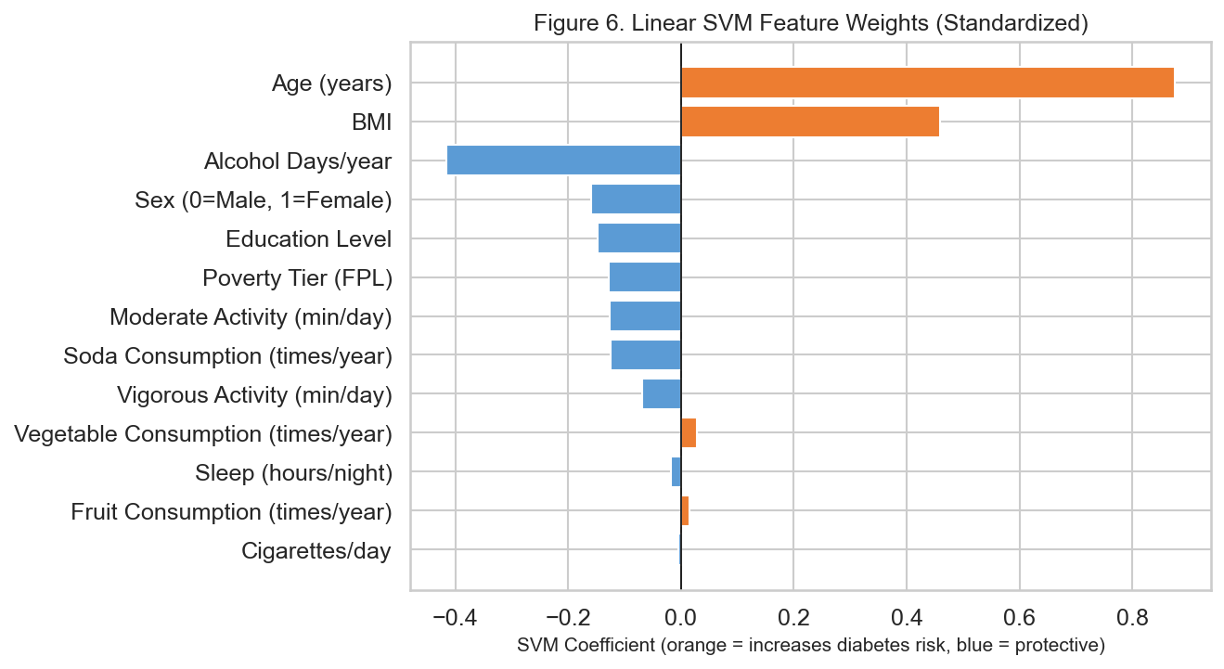
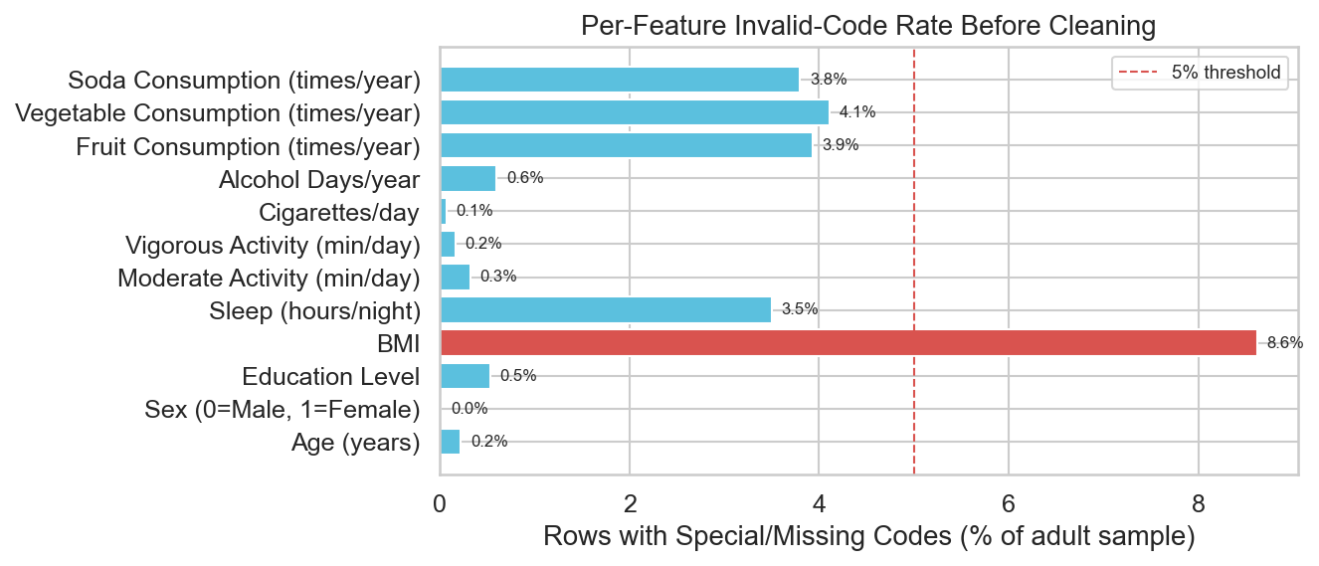
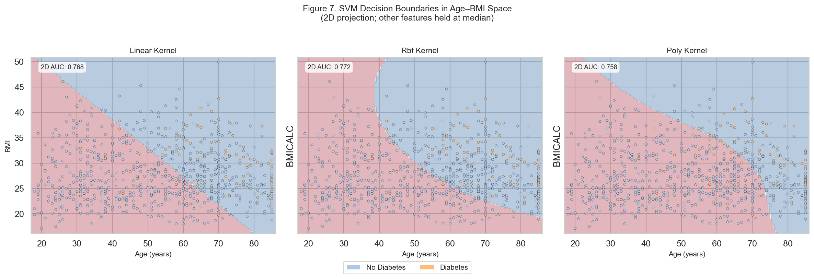
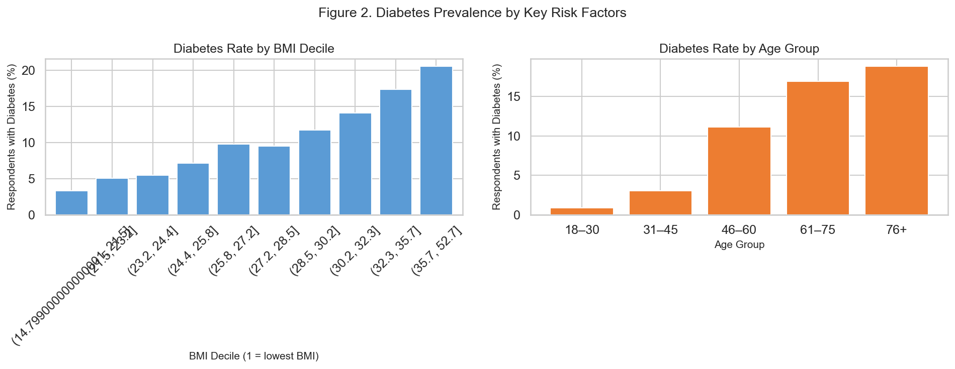
Predicting Diabetes Diagnosis in U.S. Adults
Using Support Vector Machines and NHIS 2022
DATA 5322 Statistical Machine Learning II · Seattle University · Spring 2026
https://github.com/gpskentzos/DATA5322-PredictingDiabetesDiagnosis
INTRODUCTION
THEORETICAL BACKGROUND
RESULTS
I chose this problem because diabetes risk is influenced by both biological and behavioral factors, making it a good candidate for exploring classification models like SVM.
Diabetes affects 37.3 million Americans - 28.7 million diagnosed and 8.6 million undiagnosed [1]. Early identification of at-risk individuals enables preventive intervention before clinical onset.
Research Question: Can demographic, lifestyle, and dietary survey data alone predict whether a U.S. adult has ever received a diabetes diagnosis?
Dataset: NHIS 2022 via IPUMS Health Surveys [9] - nationally representative household survey; 27,651 adult respondents; 48 health and demographic variables.
Method: Support Vector Classifier (SVC) with linear, RBF, and polynomial kernels, tuned via 5-fold stratified cross-validation.
In this project, SVM is used to determine whether these survey-based features can meaningfully separate individuals with and without a diabetes diagnosis.
Decision function: f(x) = sign(w · x + b)
Hard-Margin (linearly separable data):
Minimize ½ ‖w‖²
Subject to yᵢ(w · xᵢ + b) ≥ 1 for all i
Soft-Margin SVM (real data - allows slack ξ):
Minimize ½ ‖w‖² + C · Σ ξᵢ
Subject to yᵢ(w · xᵢ + b) ≥ 1 − ξᵢ, ξᵢ ≥ 0
C (regularization):
Small C → wide margin, more errors tolerated (↑ bias, ↓ variance)
Large C → narrow margin, fewer errors (↓ bias, ↑ variance; overfit risk)
Kernel Trick: Replaces dot products with K(xᵢ, xⱼ), mapping data to high-dimensional space implicitly.
Linear: K(xᵢ, xⱼ) = xᵢ · xⱼ
Hyperplane boundary; coefficient vector w is directly interpretable. Best when classes are approximately linearly separable.
RBF (Gaussian): K(xᵢ, xⱼ) = exp(−γ ‖xᵢ − xⱼ‖²)
γ controls influence radius. Small γ = smooth global boundary; large γ = complex local boundary (overfit risk). Most generally applicable kernel.
Polynomial: K(xᵢ, xⱼ) = (γ xᵢ · xⱼ + r)^d
Degree d controls complexity. Also tuned: γ and offset r. More expressive than linear; computationally expensive at high d.
Practical Considerations:
Features must be standardized - SVM is sensitive to feature magnitude
Training complexity: O(n²)–O(n³) for nonlinear kernels; ~O(n) for linear SVM
RBF and polynomial kernels are black-box (no direct coefficient interpretation)
class_weight='balanced' corrects class imbalance automatically
Table 1. Tuned Model Performance - Test Set (n = 4,755)
Kernel | Best CV AUC | Test AUC | Recall (Diabetes)
Linear | 0.7898 | 0.786 | 78.9%
RBF | 0.7970 | 0.797 | 79.5%
Polynomial | 0.7775 | 0.776 | 72.0%
While the RBF kernel performs best, the difference between models is relatively small, suggesting that the relationship between features and diabetes may be mostly linear.
DATA & CLEANING
Starting: 35,115 rows × 48 columns
→ Filter adults (ASTATFLG=1): 27,651 rows
→ Valid diabetes responses: 27,619 rows
→ Remove special/missing codes: 23,775 rows
13 Features Selected:
Demographic: Age, Sex, Education, Poverty tier
Body composition: BMI
Lifestyle: Sleep, Mod. activity, Vig. activity, Cigarettes/day, Alcohol days/yr
Diet: Fruit, Vegetable, and Soda frequency
Encoding:
SEX → binary 0/1 (nominal, not ordinal)
EDUC → ordinal 1–8 (non-consecutive NHIS codes remapped)
POVERTY → 3-tier ordinal (below/near/above FPL)
CIGDAYMO = 96 → 0 (non-smoker; NIU code)
ALCDAYSYR = 996 → 0 (non-drinker; NIU code)
Class balance: 89.7% no diabetes / 10.3% diabetes
Figure 4. ROC curves and confusion matrix for all three tuned kernels. RBF slightly outperforms linear on AUC.
Figure 5. Linear SVM feature weights. BMI and Age carry the largest positive weights (↑ diabetes risk); vigorous activity and education are protective.
DISCUSSION
Figure 1. Rows removed per feature during cleaning (highest: BMICALC ~8.5%).
I initially expected the non-linear kernels to significantly outperform the linear model due to potential interactions between lifestyle variables. However, the results suggest that these effects are either weak or not fully captured by the selected features.
The lower performance of the polynomial kernel may be due to overfitting or the limited benefit of higher-order interactions in this dataset.
Strongest predictors: BMI and Age dominate the linear SVM weight vector, consistent with clinical literature [2]. Obesity and aging are the primary drivers - even without lab values.
Lifestyle factors: Smoking, physical inactivity, and high soda consumption all push toward diabetes. These are modifiable - the model quantifies their relative contribution directly [5,7].
Social determinants: Education and poverty carry meaningful weights [3]. Lower income and education reflect reduced access to healthy food, physical activity infrastructure, and preventive care - structural, not merely individual, risk.
Kernel comparison: All three kernels achieve ~0.79 AUC. The linear kernel matching RBF suggests the diabetes signal in these 13 survey features is predominantly linear. Alcohol’s U-shaped true relationship [6] is one likely source of residual error.
Limitations: Self-reported data (recall bias); no clinical biomarkers (HbA1c, fasting glucose); outcome is prevalent, not incident, diagnosis.
Policy: Target screening for adults >45 with elevated BMI. Invest in physical activity and healthy food access in high-poverty communities. Smoking cessation programs reduce T2D risk by 30–40% [5].
METHODOLOGY
SVM DECISION BOUNDARY
I used ROC-AUC as the primary metric because the dataset is imbalanced, and accuracy alone would not capture performance on the minority (diabetes) class.
Train/Test Split: 80/20 stratified (19,020 train / 4,755 test); stratification preserves 10.3% prevalence.
Pipeline: StandardScaler → SVC (scaler fit on training folds only - no data leakage)
Class imbalance: class_weight='balanced' up-weights minority class by inverse frequency ratio.
GridSearchCV, 5-fold stratified CV, optimizing ROC-AUC:
Linear: C ∈ {0.01, 0.1, 1, 10}
RBF: C ∈ {0.01, 0.1, 1, 10}, γ ∈ {scale, 0.01, 0.1}
Poly: C ∈ {0.1, 1, 10}, γ = scale, degree ∈ {2, 3}
Primary metric: ROC-AUC (threshold-independent; preferred for imbalanced classes). Also report Precision, Recall, F1 for the diabetes (positive) class.
Decision boundaries for all three kernels in Age × BMI space - the two strongest predictors. Trained on a stratified subsample for visualization clarity.
Figure 2. SVM decision boundaries (linear, RBF, polynomial) in Age × BMI space. Shaded regions = predicted class; points = true labels. Diabetes = orange; No Diabetes = blue.
CONCLUSIONS
EDA: DIABETES PREVALENCE
These results suggest that survey-based SVM screening can achieve ~0.80 AUC - clinically meaningful for a lab-free tool
A linear SVM is sufficient; RBF/poly add computational cost without substantial accuracy gain
BMI, age, poverty, and education are the dominant predictors, reflecting both biological and structural drivers of diabetes
Low-cost screening from standard health survey data could support population-level early intervention in resource-limited settings
Limitations:
Self-reported data may introduce bias
No clinical bio-markers included
Cross-sectional (not predictive of future diagnosis)
Figure 3. Diabetes prevalence rises sharply with BMI decile and age group, motivating both as strong predictors.
[1] CDC. National Diabetes Statistics Report, 2022. [2] ADA. Standards of Medical Care in Diabetes - 2023. Diabetes Care, 46(S1), 2023. [3] Hill-Briggs et al. Social Determinants of Health and Diabetes. Diabetes Care, 44(1):258–279, 2021. [4] Shan et al. Sleep Duration and Risk of T2D. Diabetes Care, 38(3):529–537, 2015.
[5] CDC. Smoking and Diabetes. cdc.gov/tobacco [6] Baliunas et al. Alcohol as a Risk Factor for T2D. Diabetes Care, 32(11):2123–2132, 2009. [7] Imamura et al. Sugar-Sweetened Beverages and T2D. BMJ, 351:h3576, 2015. [8] Pedregosa et al. Scikit-learn. JMLR, 12:2825–2830, 2011. [9] Blewett LA, Rivera Drew JA, King ML, Williams KCW, Backman D, Chen A, Richards S. IPUMS Health Surveys: NHIS, Version 7.4 [dataset]. Minneapolis: IPUMS, 2024. doi:10.18128/D070.V7.4

