Slide 1
Design Project Presentation
Autonomous Floor segmentation car using Raspberry pi
Giri Prasad.S, 2019A7PS0097U

Slide 2
Project aim
To create an autonomous robot car that can navigate itself through Indoor areas, with the help of camera images and deep learning.

Slide 3
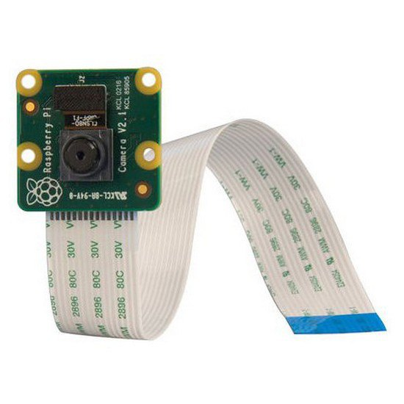
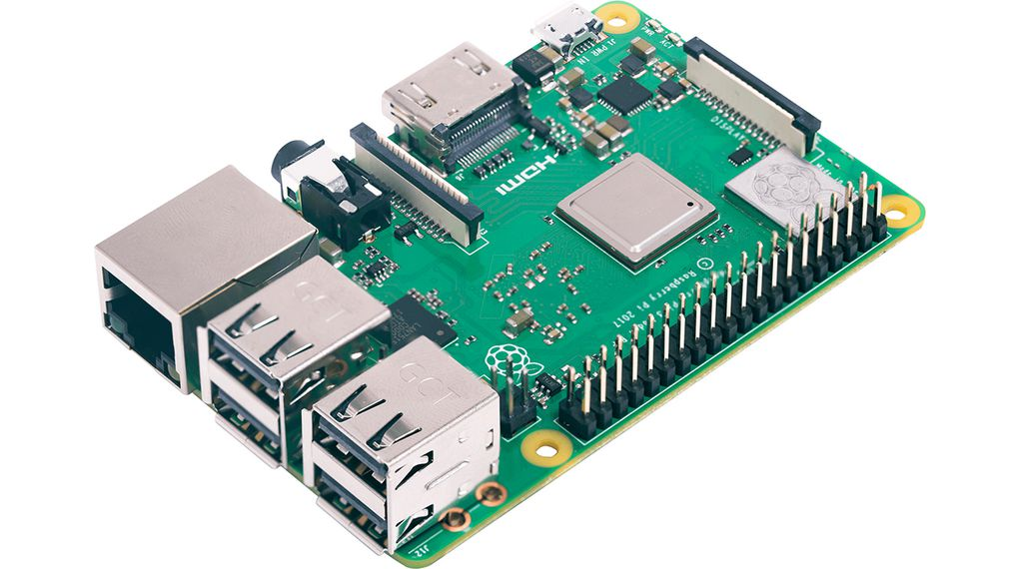
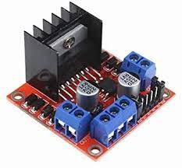
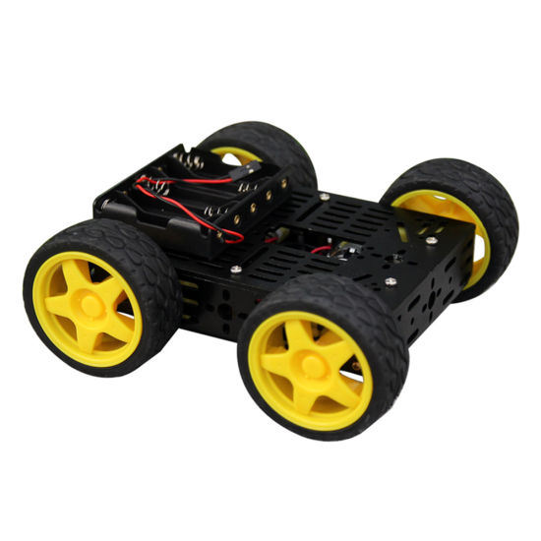
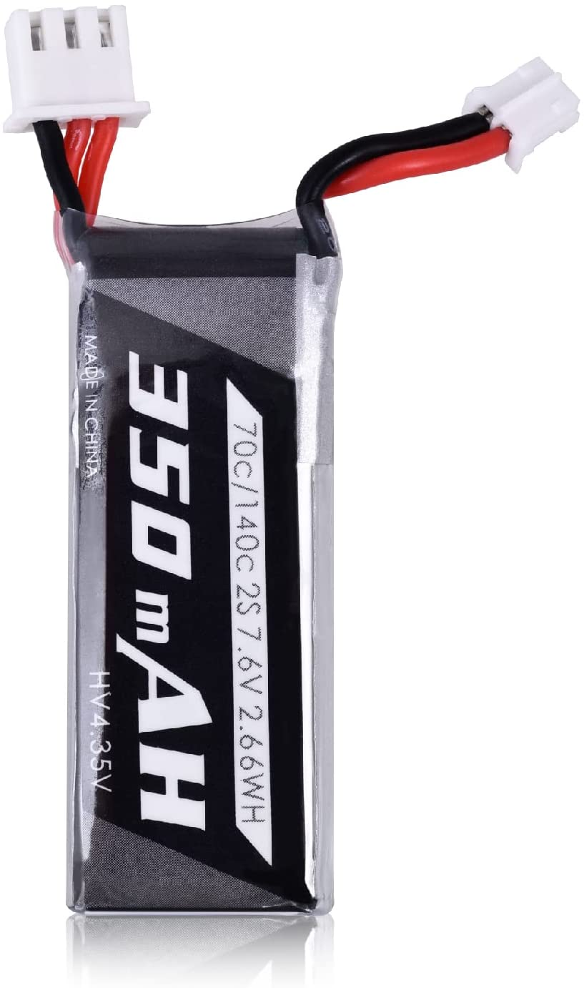
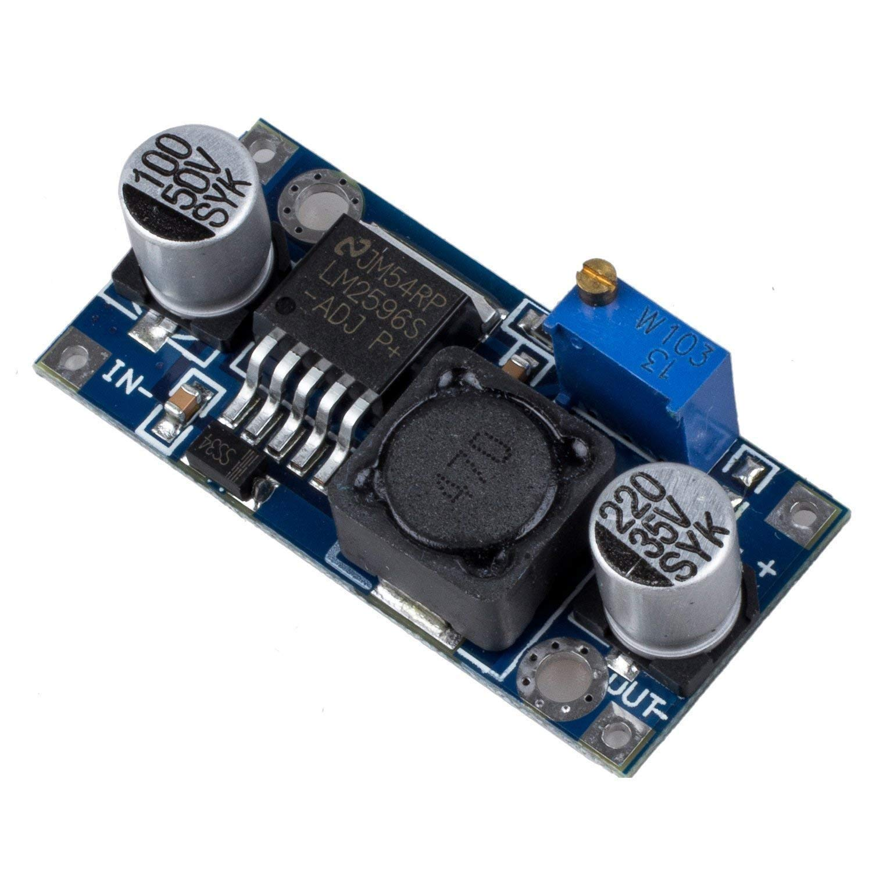
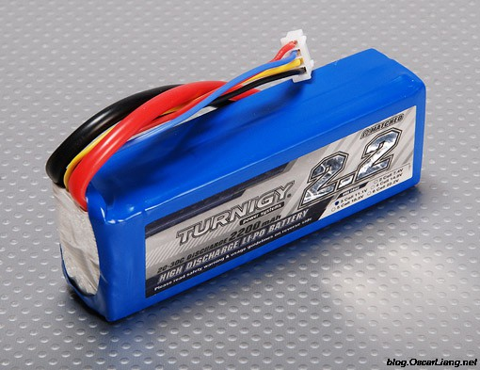
Components
Jumper wires
USB cable
Raspberry Pi3b+
L298n Motor driver
Raspberry Pi cam V2
12v battery (for motor)
7.2V battery(For raspberry Pi)
LM2596 step down voltage regulator
Dagu Robot Car Chassis

Slide 4
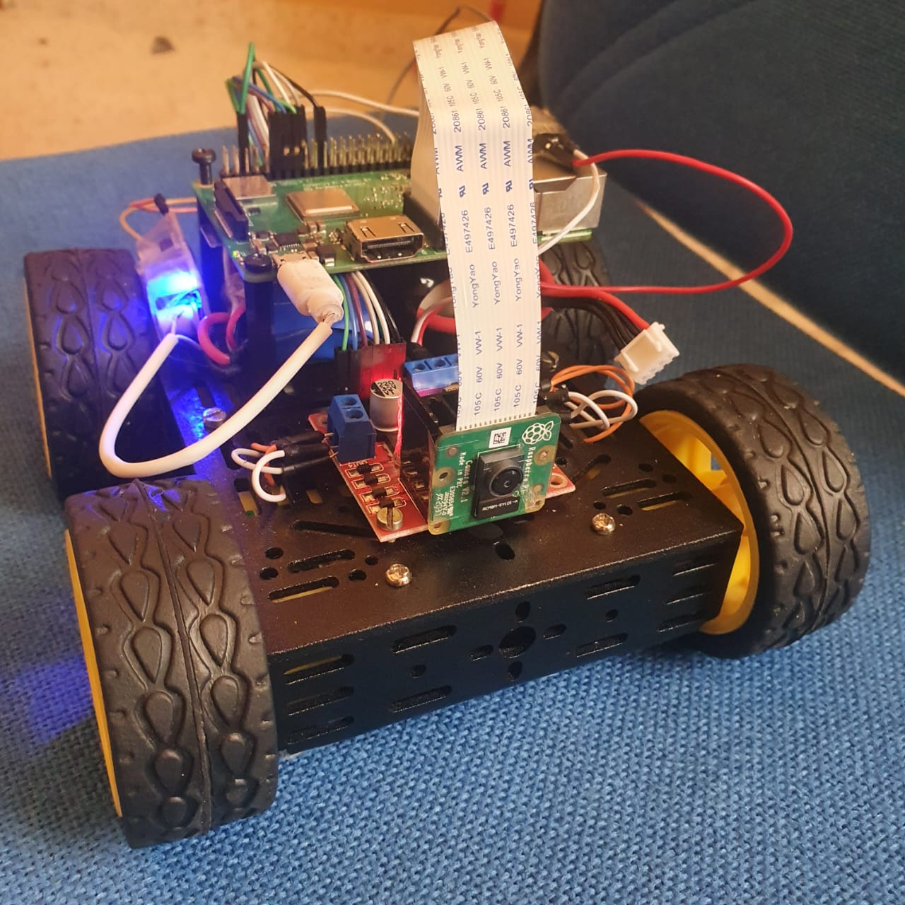
Car Front View

Slide 5
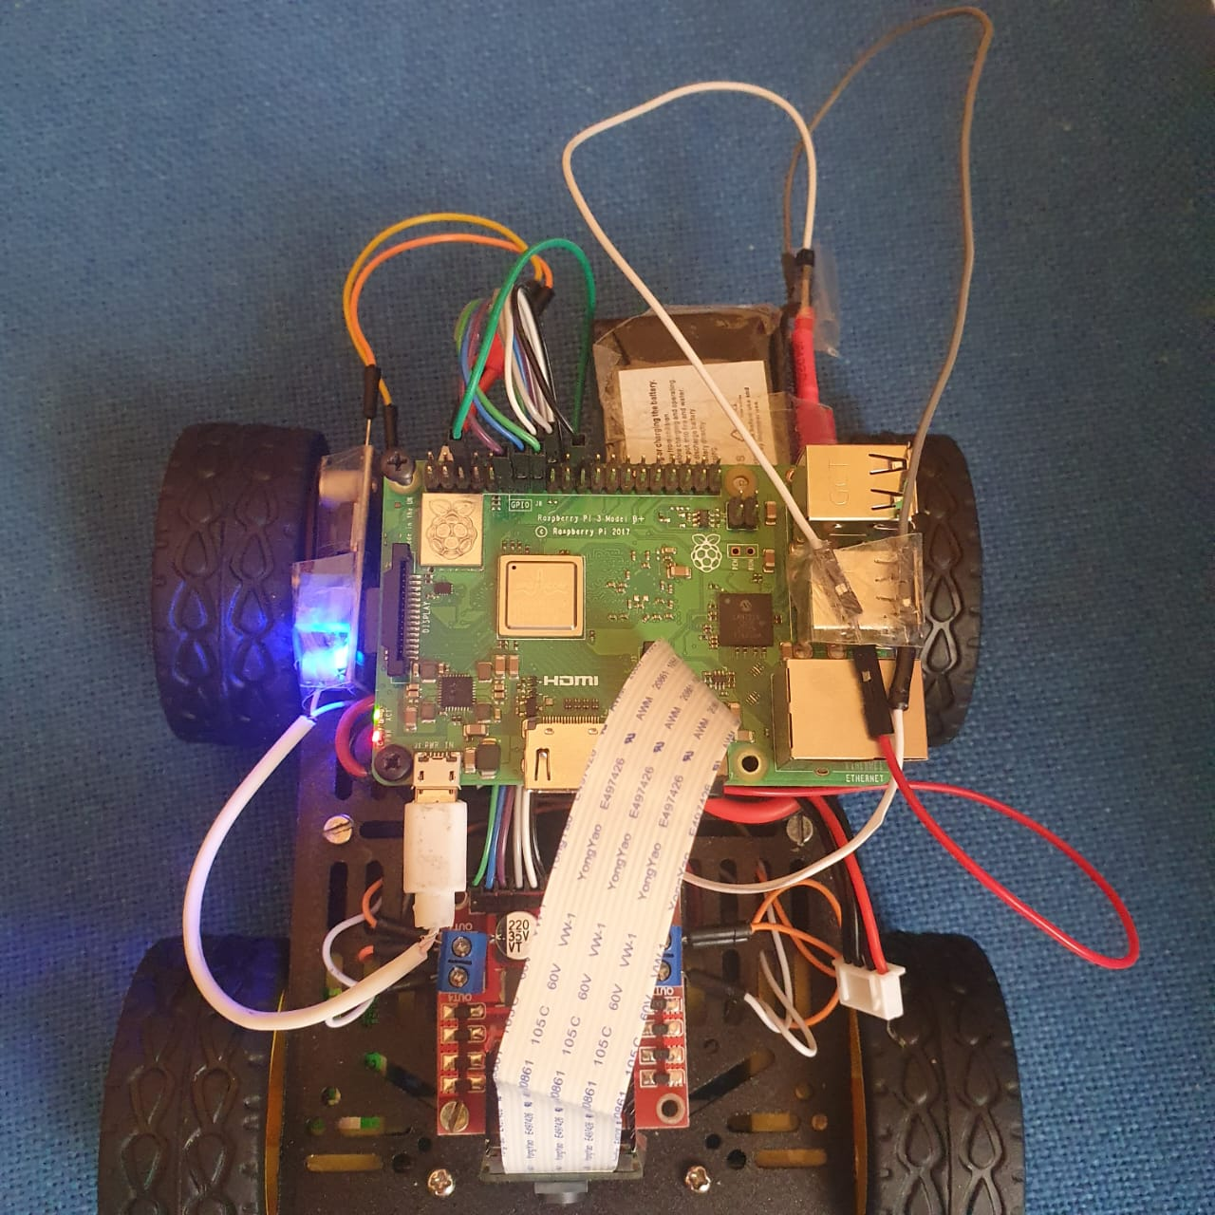
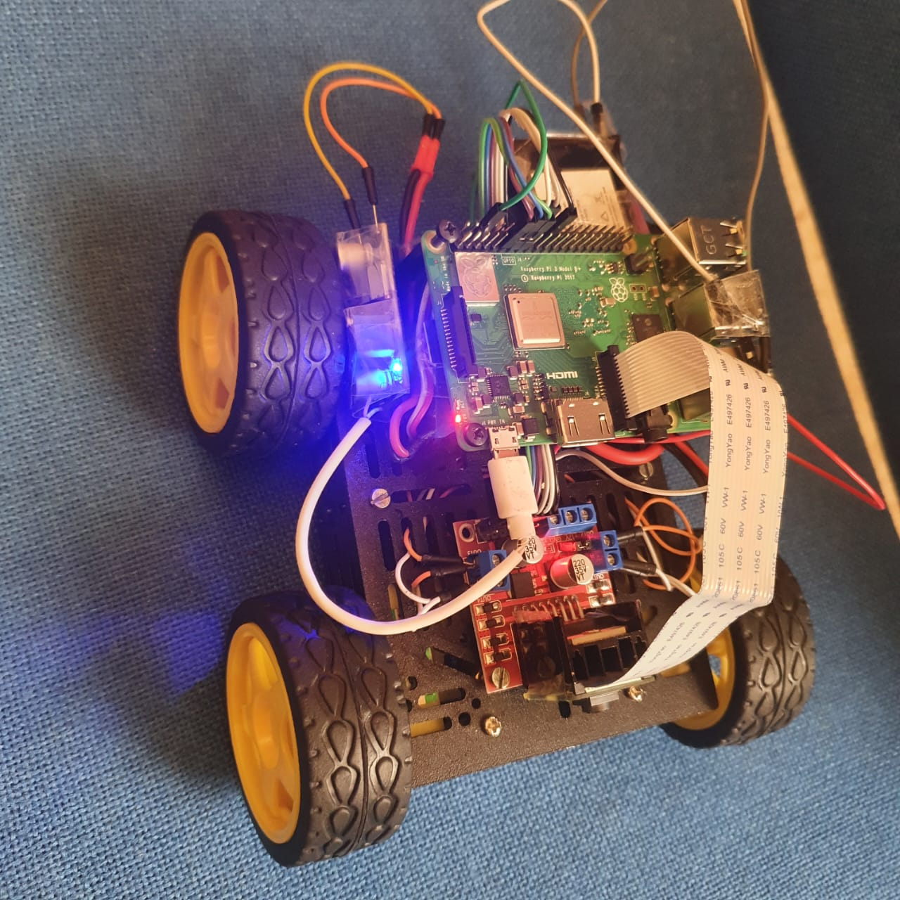
Car Top View

Slide 6
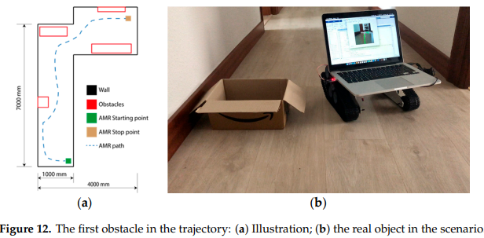
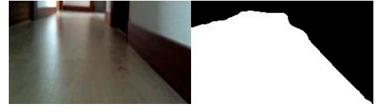
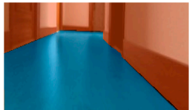
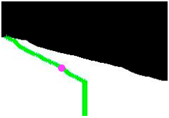
“Semantic Segmentation to Develop an Indoor Navigation System for an Autonomous Mobile Robot” by Daniel Betono, E. Zulueta, et. al.
The algorithm used: Resnet-18 based Encoder-Decoder network for Segmentation.
Unique contribution: Joining the middle points of the resultant output segmentation mask to obtain a path for the robot to follow.
Drawback: They have to use a laptop to run the neural network on the Robot car, which is cumbersome and not practical.

Slide 7
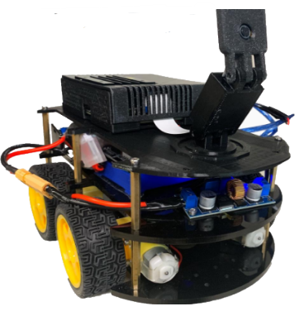
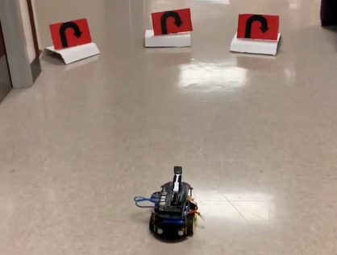
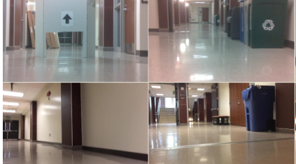
“Autonomous Vehicle Control Using a Deep Neural Network and Jetson Nano ” by Rocco Febbo, Brendan Flood, et. Al.
The algorithm used: Resnet Architecture to predict turning Left, Right, or Turn-Around.
This project uses Jetson Nano for processing along with Arduino UNO and Pi cam.
Drawback: The model they trained was not accurate at handling turns in corridors, so they had to put up signs to help the model.
Hence, the middle point method for path planning would perform better as discussed in the previous slide.

Slide 8
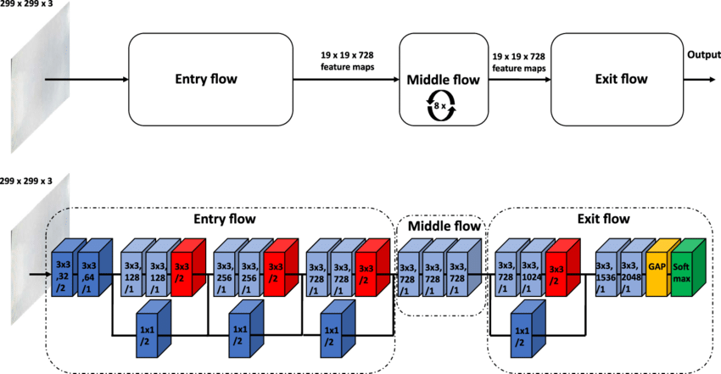
Xception Architecture
Architecture Xception, which stands for “Extreme Inception”. The Xception architecture has 36 convolutional layers forming the feature extraction base of the network.
The data first goes through the entry flow, then through the middle flow which is repeated eight times, and finally through the exit flow. Note that all Convolution and Separable Convolution layers are followed by batch normalization (not included in the diagram). All Separable Convolution layers use a depth multiplier of 1 (no depth expansion).
It runs on Raspberry Pi 4 (8GB RAM) with around 7-10 FPS.

Slide 9
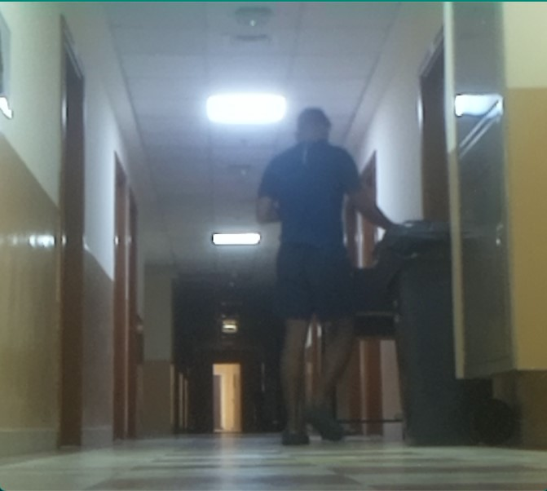
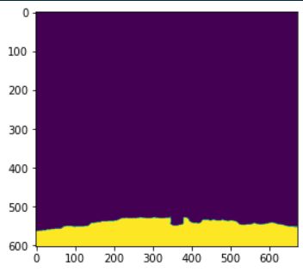
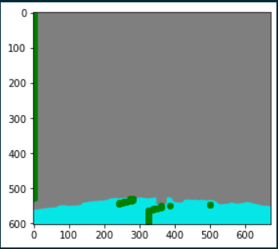
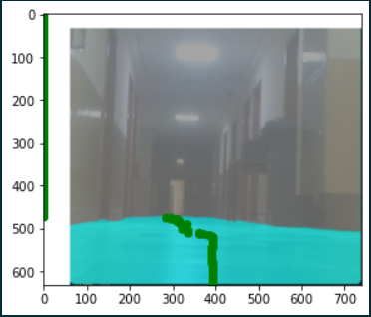
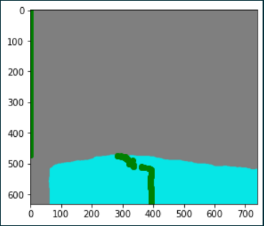
Path Planning and Floor Segmentation results

Slide 10


