Slide 1


Slide 2
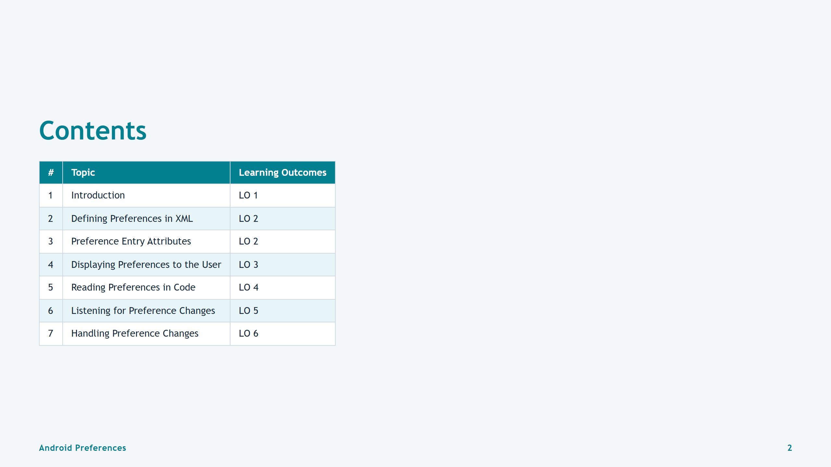
Notes:
Slide 2: Table of Contents

Slide 3
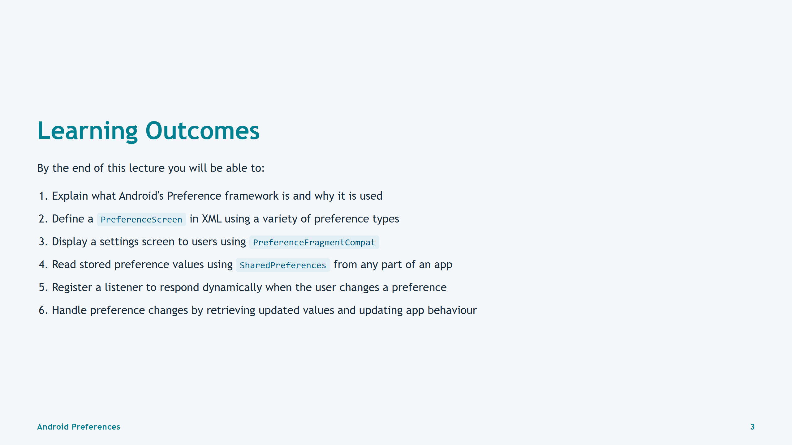
Notes:
Slide 3: Learning Outcomes

Slide 4
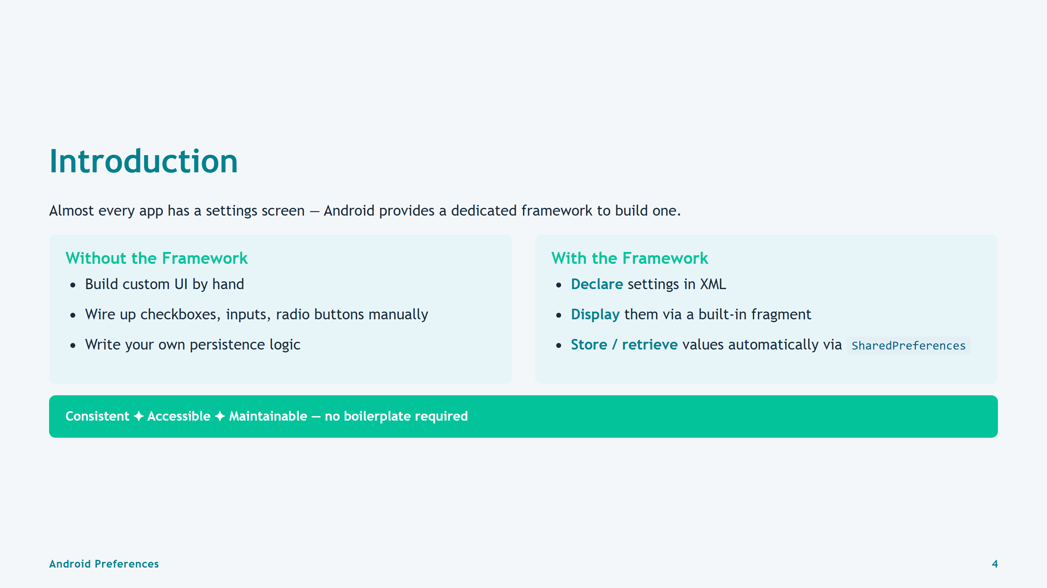
Notes:
Slide 4: Introduction

Slide 5
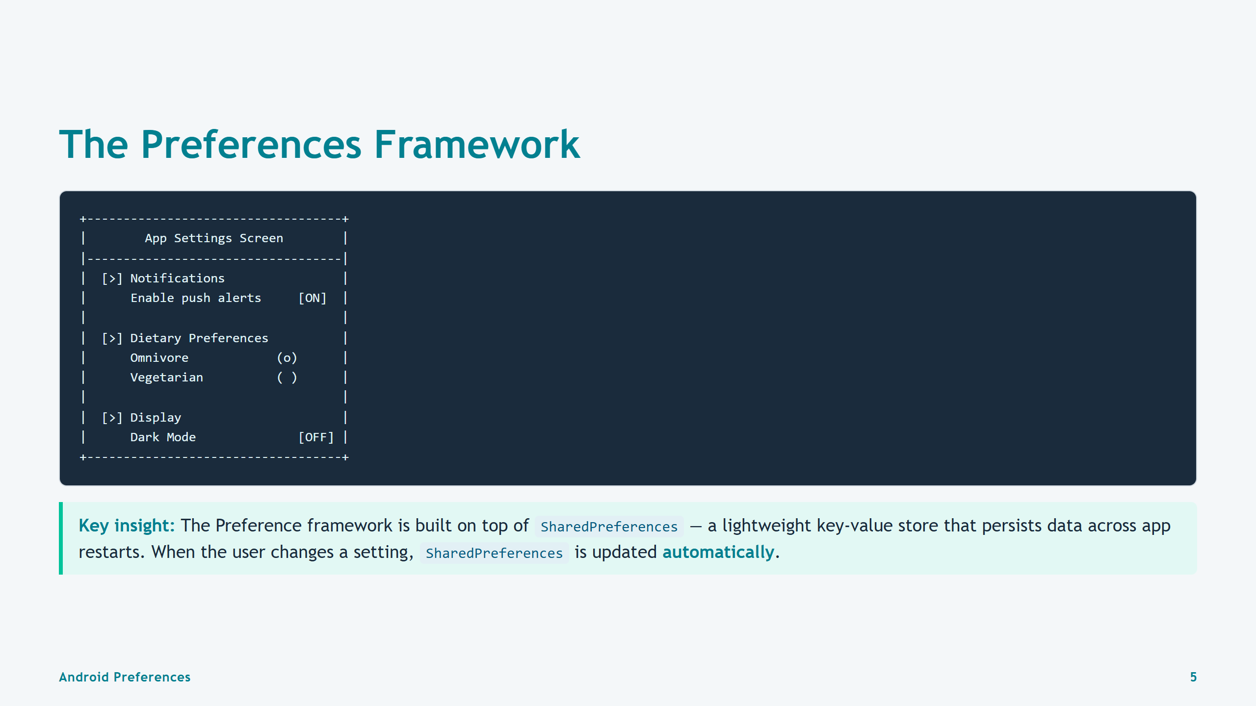
Notes:
Slide 5: Preferences Framework Overview

Slide 6


Slide 7
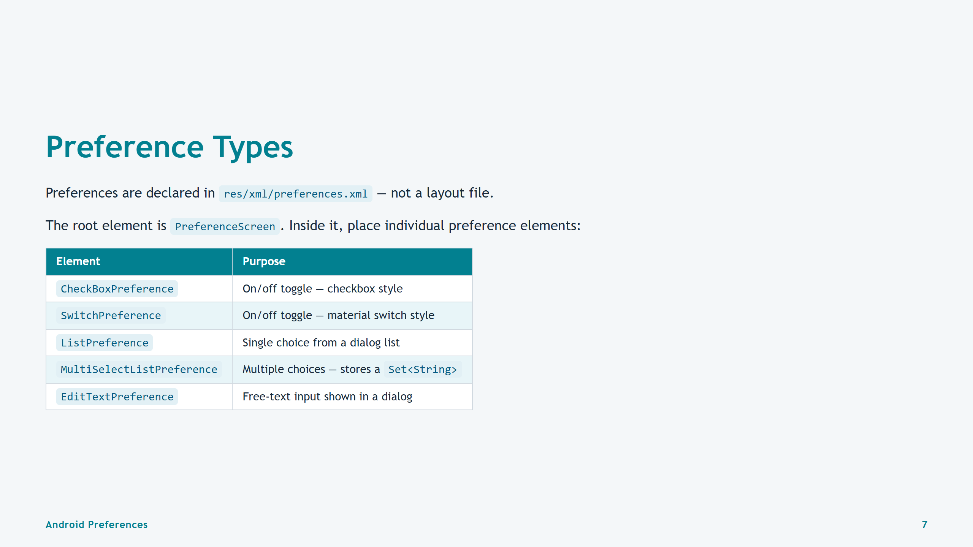
Notes:
Slide 7: Preference Types

Slide 8
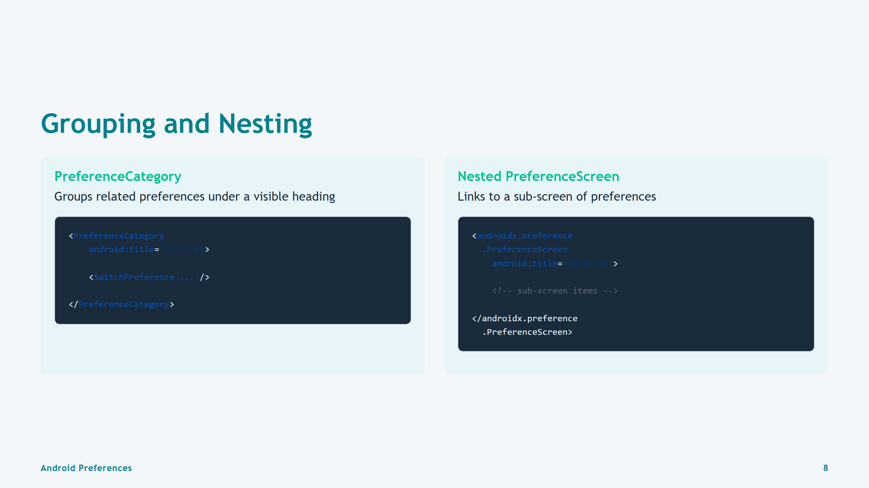
Notes:
Slide 8: Grouping and Nesting

Slide 9
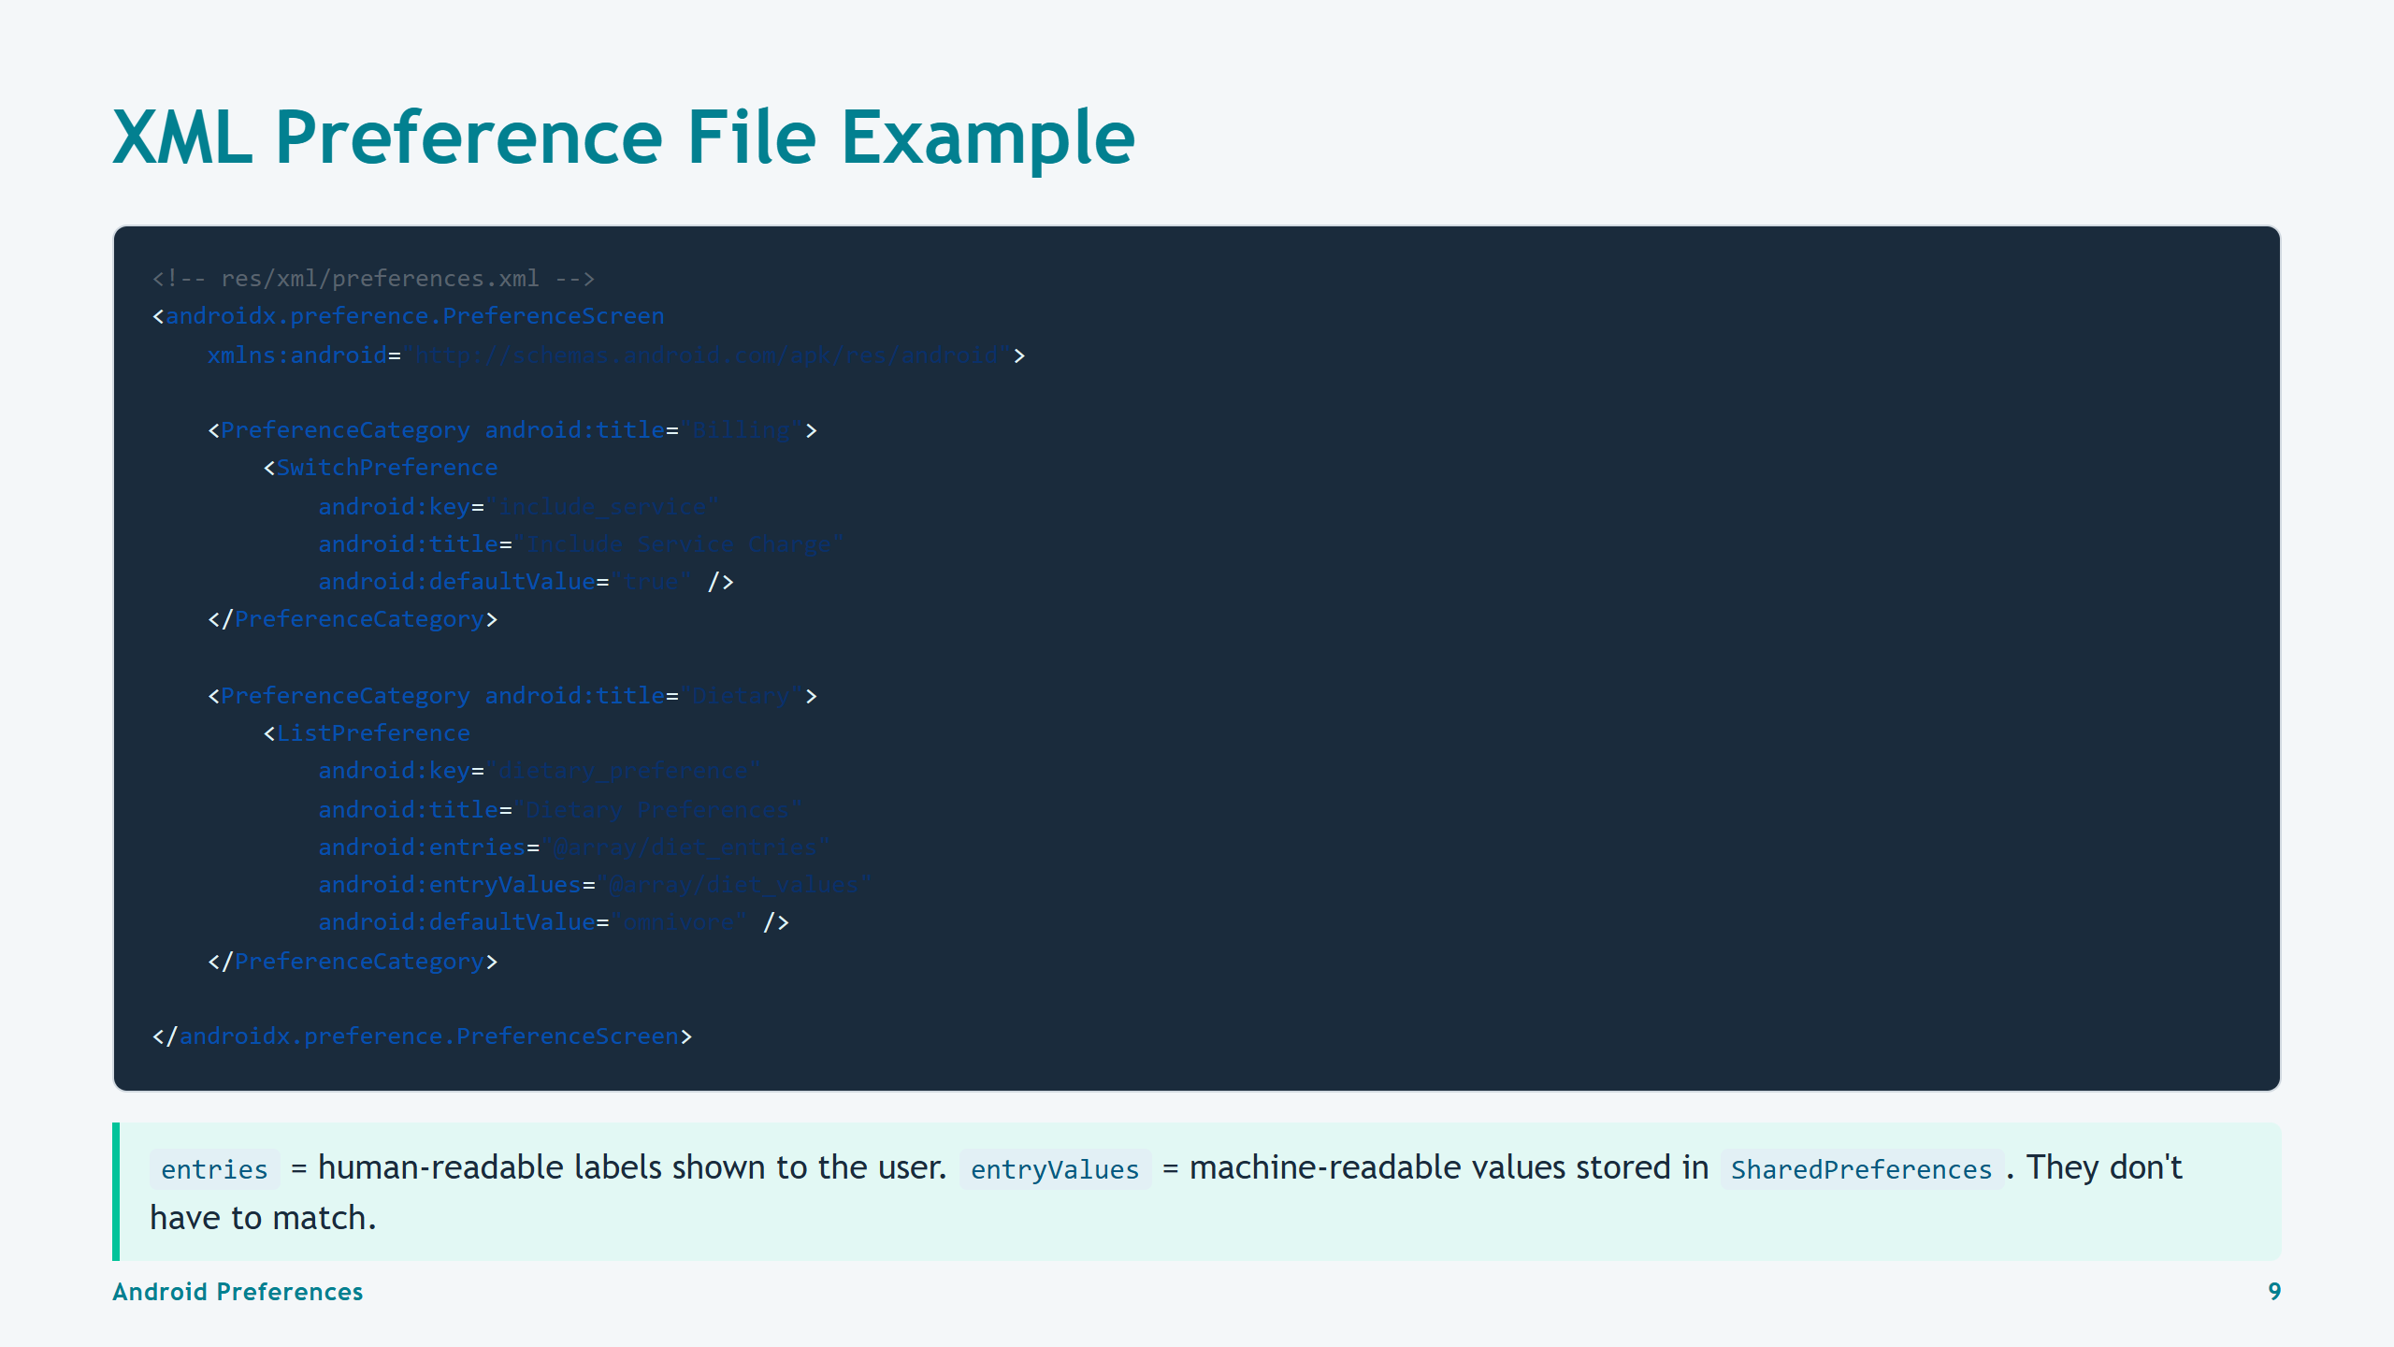
Notes:
Slide 9: XML Example

Slide 10


Slide 11
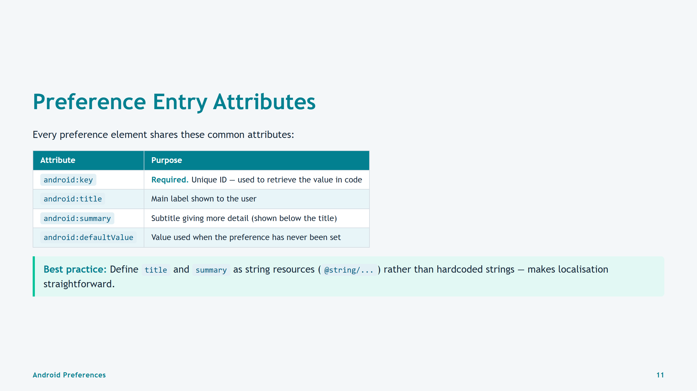
Notes:
Slide 11: Preference Entry Attributes

Slide 12
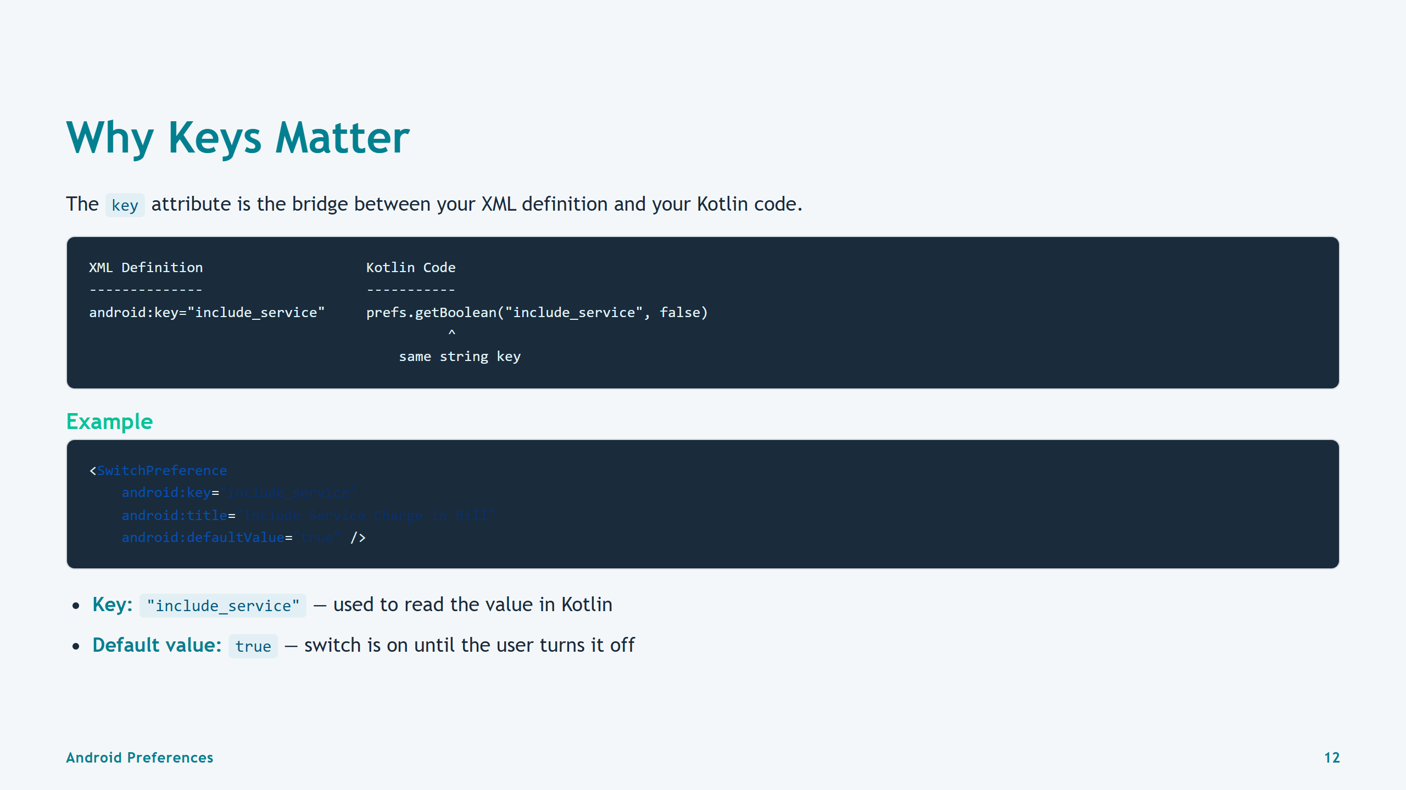
Notes:
Slide 12: Why Keys Matter

Slide 13
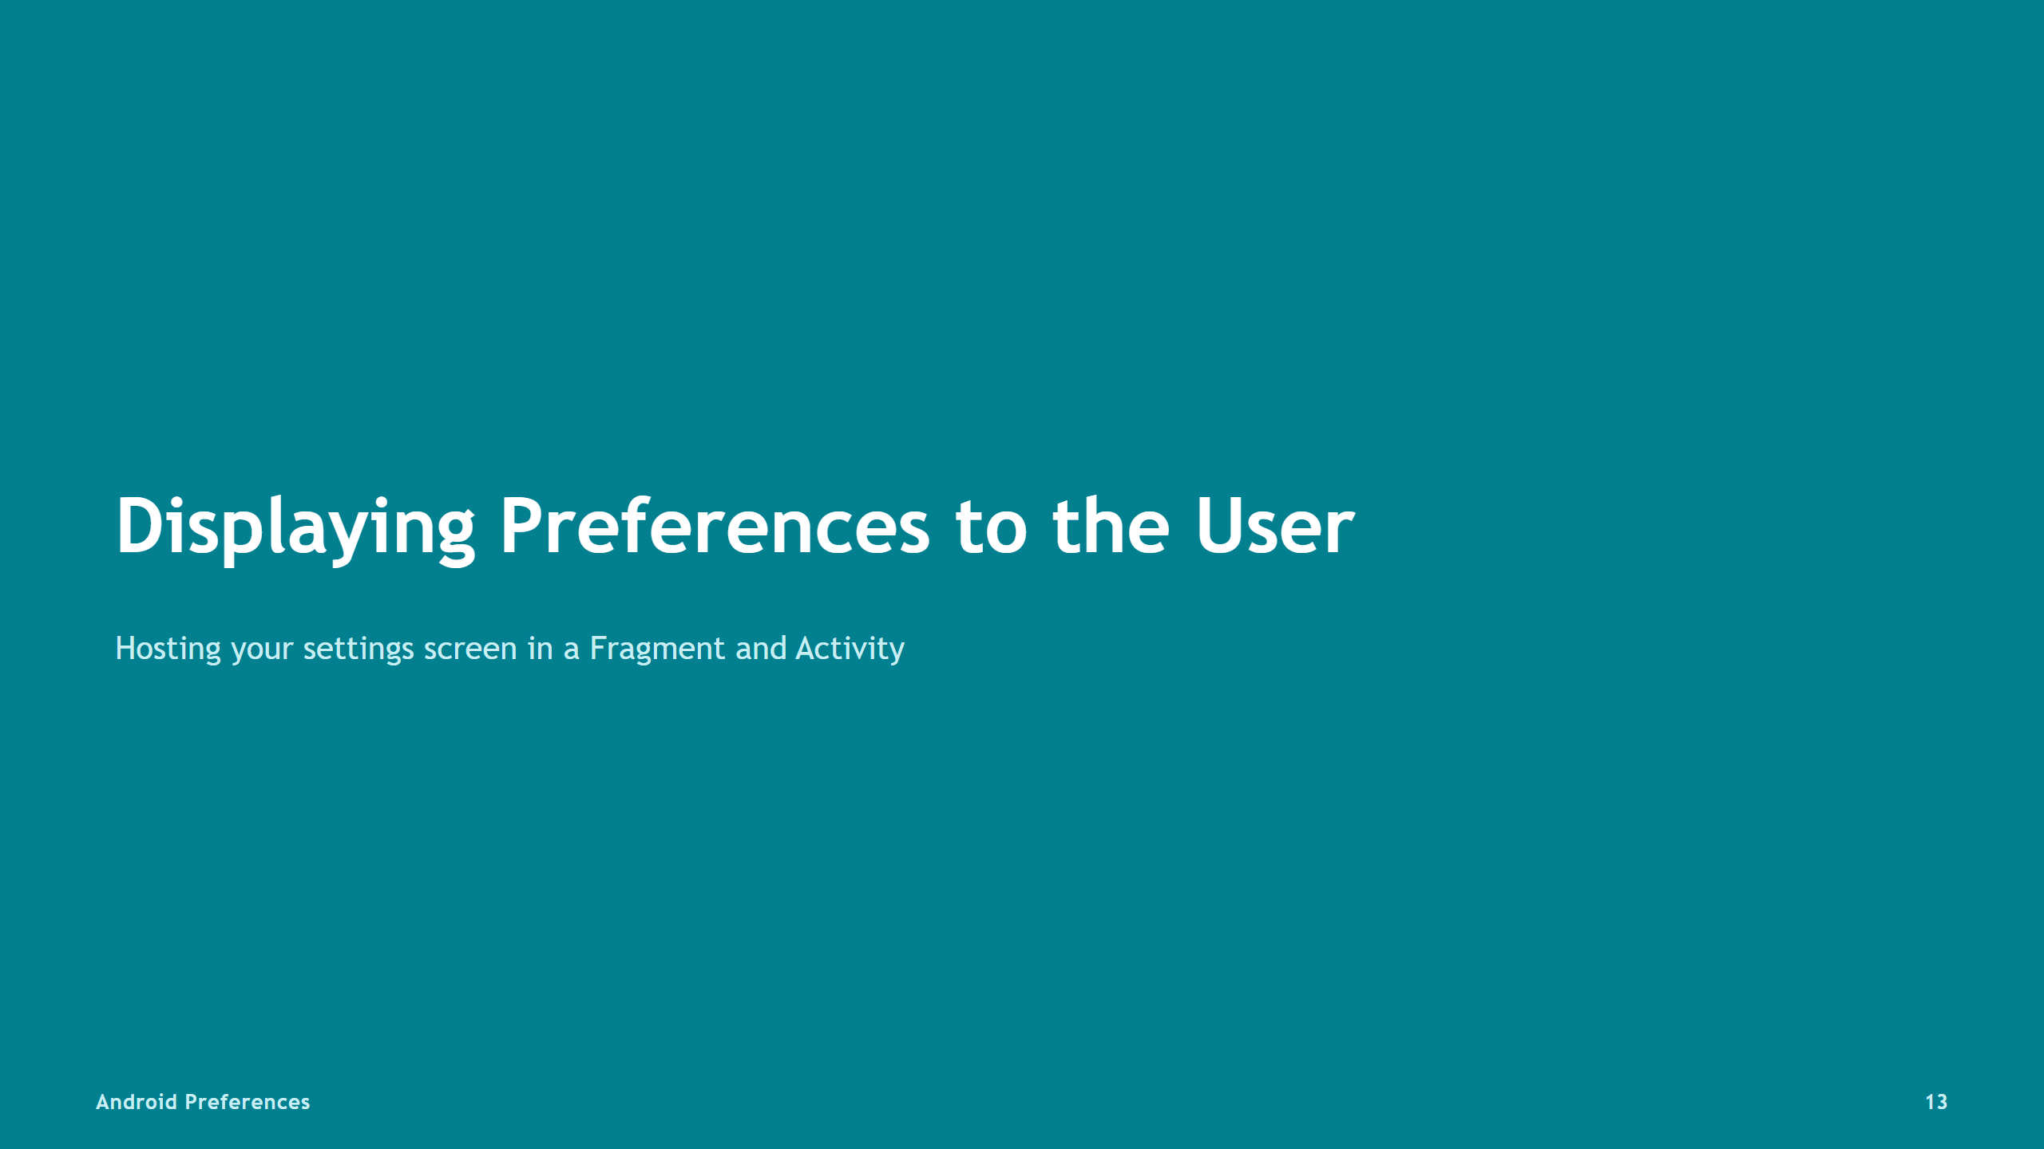

Slide 14
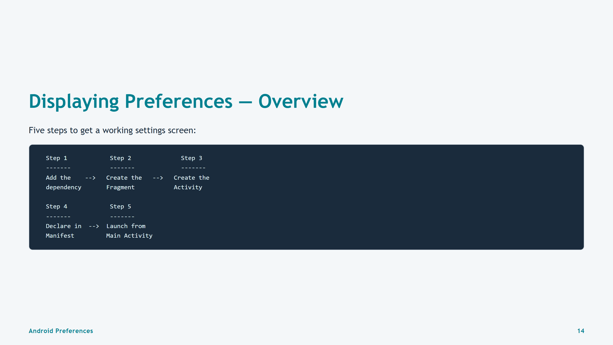
Notes:
Slide 14: 5-Step Overview

Slide 15
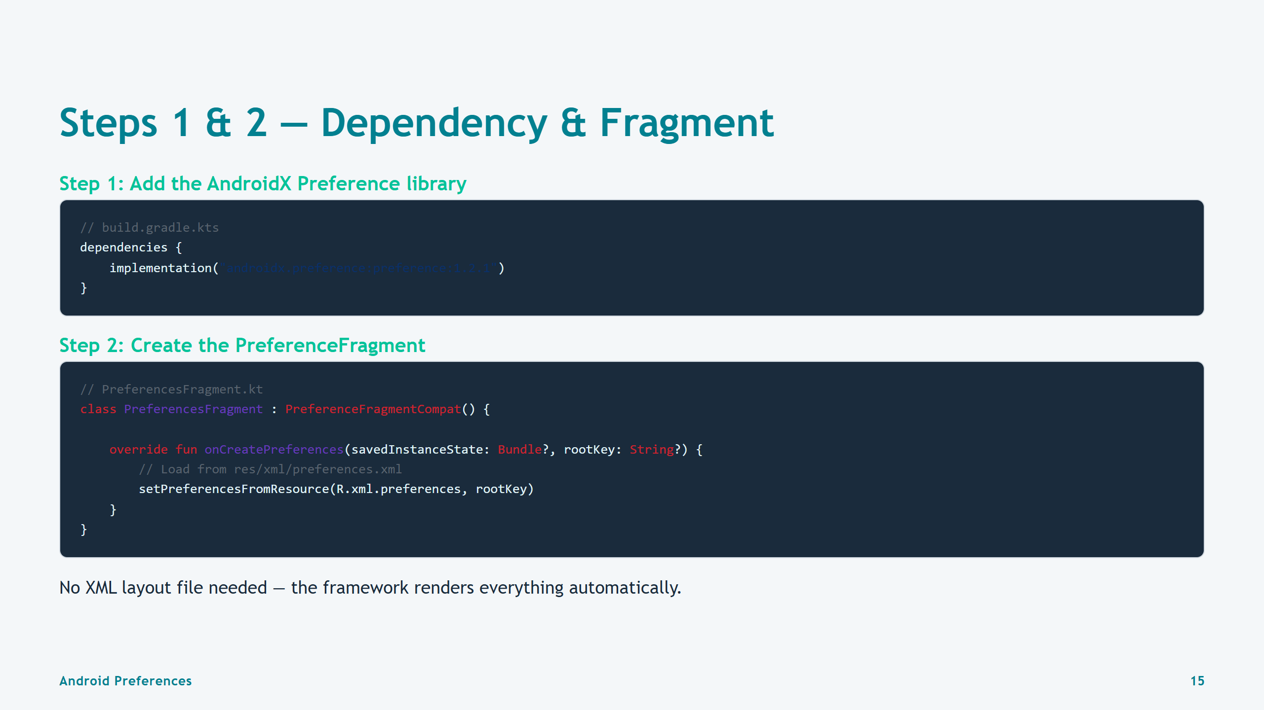
Notes:
Slide 15: Step 1 + Step 2

Slide 16
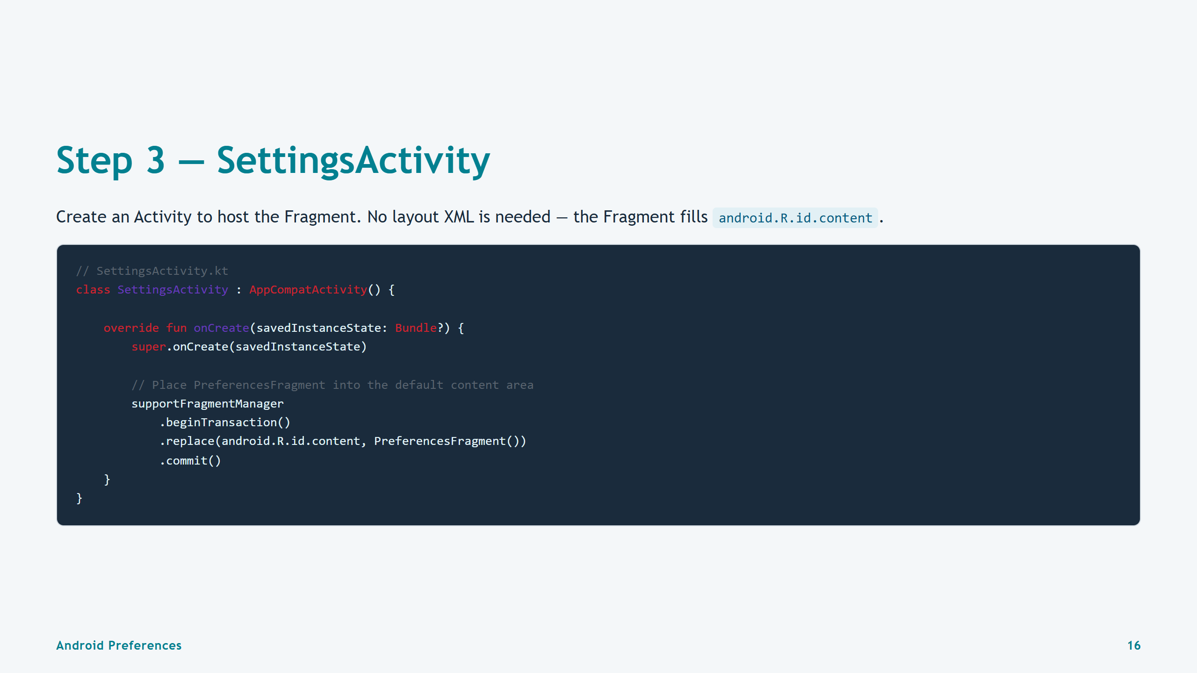
Notes:
Slide 16: Step 3 — SettingsActivity

Slide 17
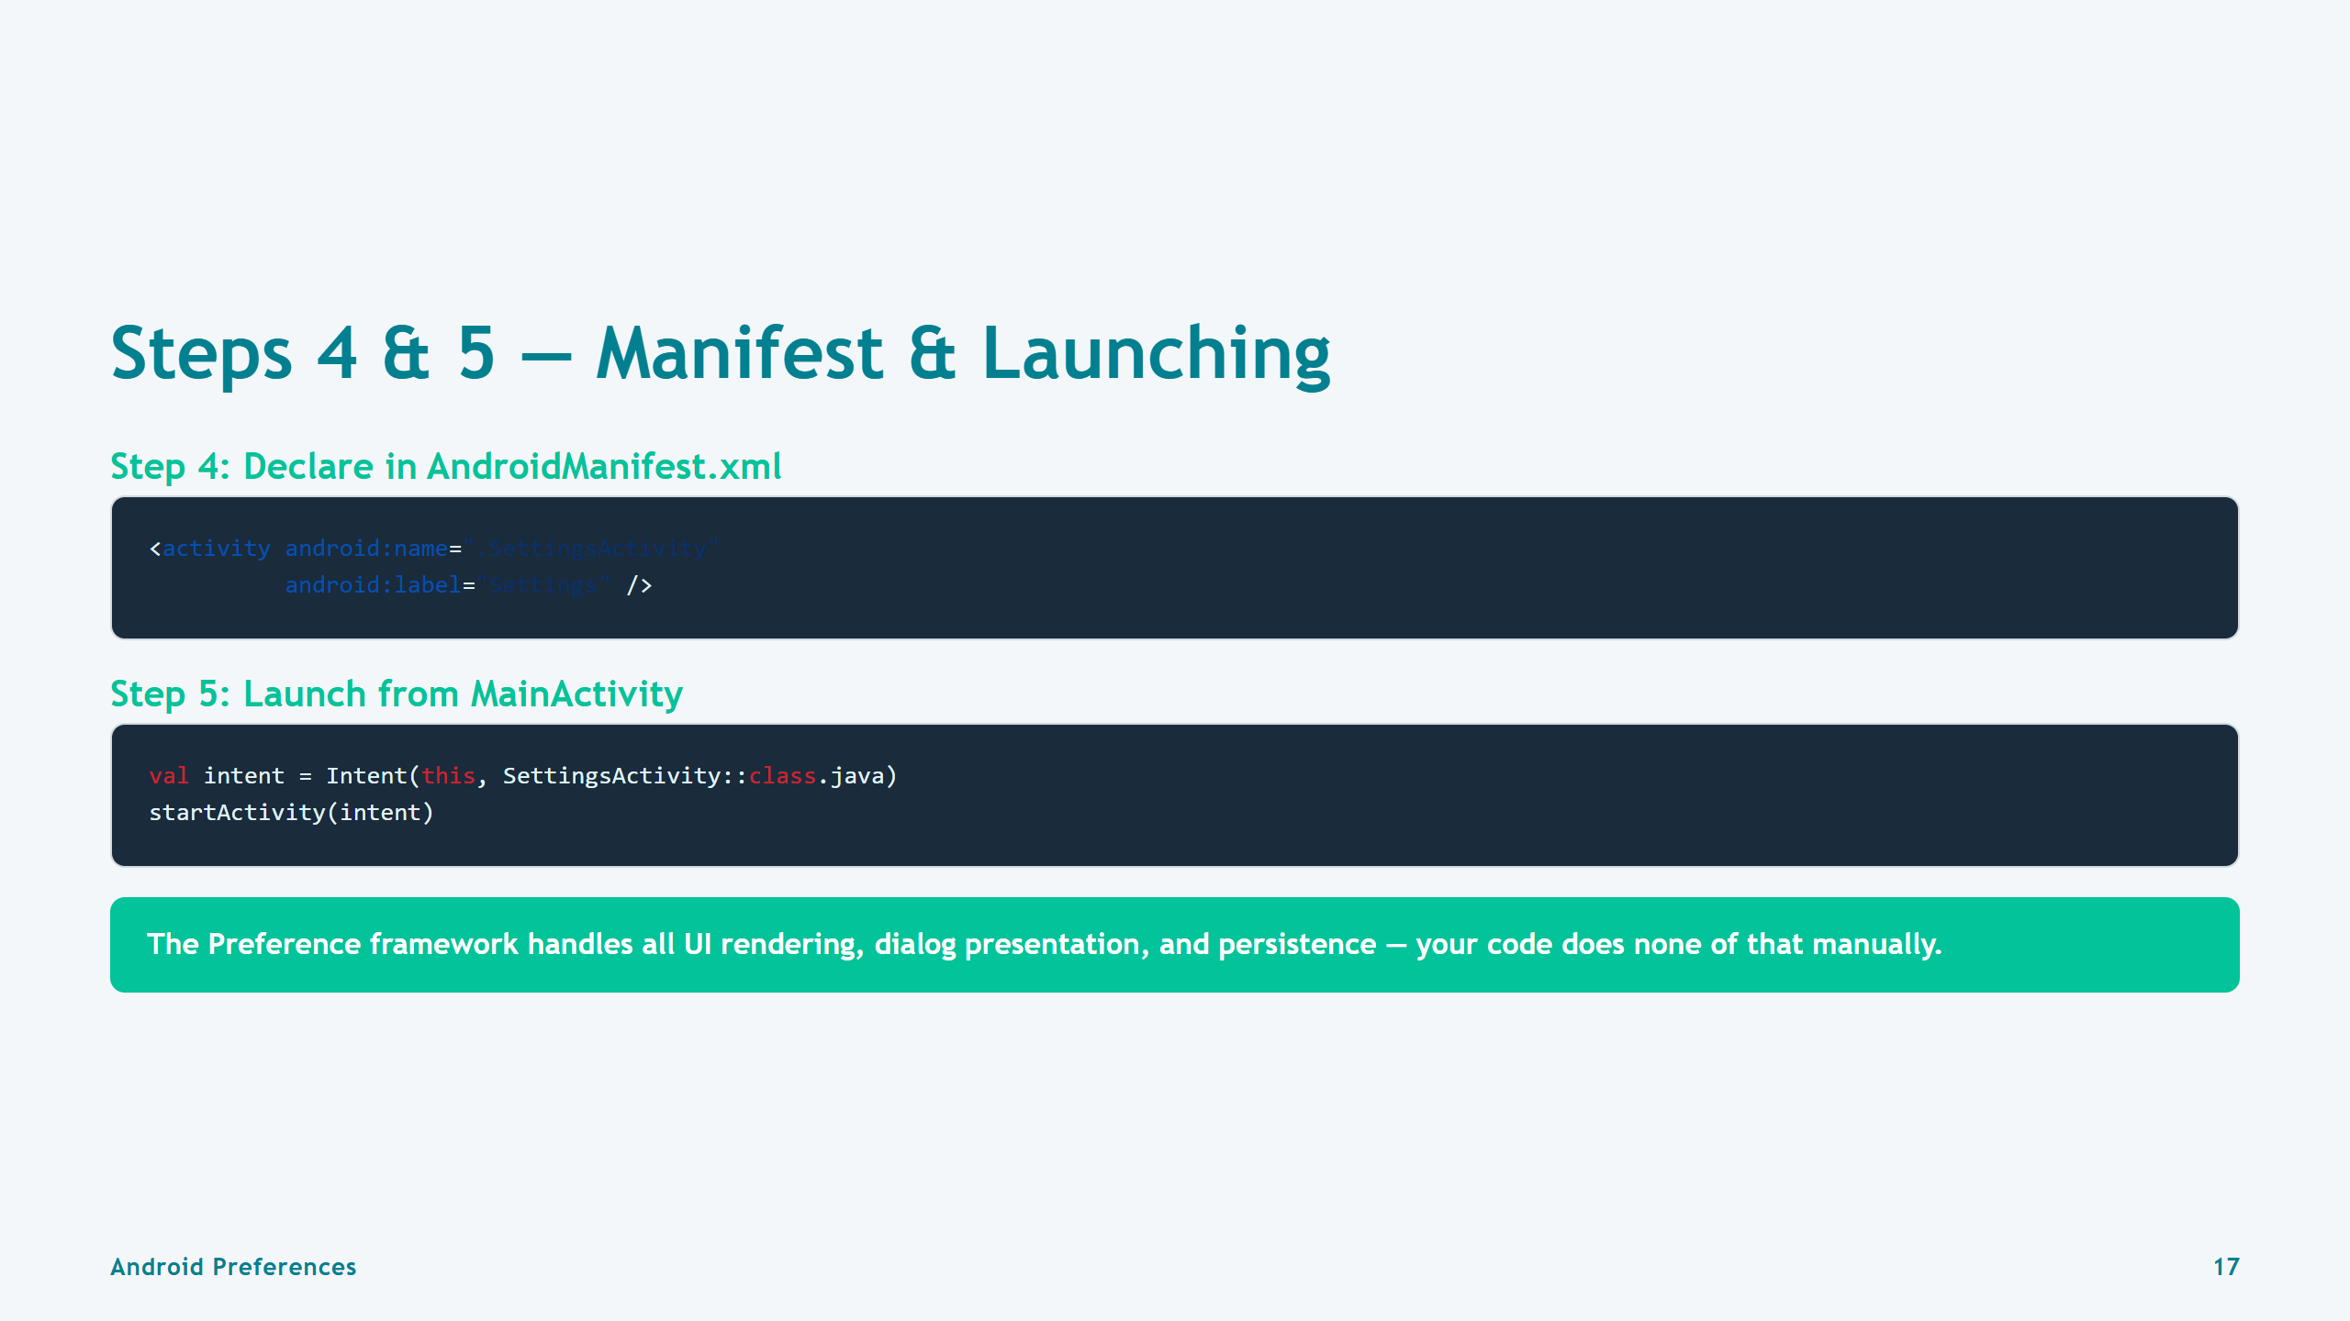
Notes:
Slide 17: Steps 4 & 5 — Manifest & Launch

Slide 18


Slide 19
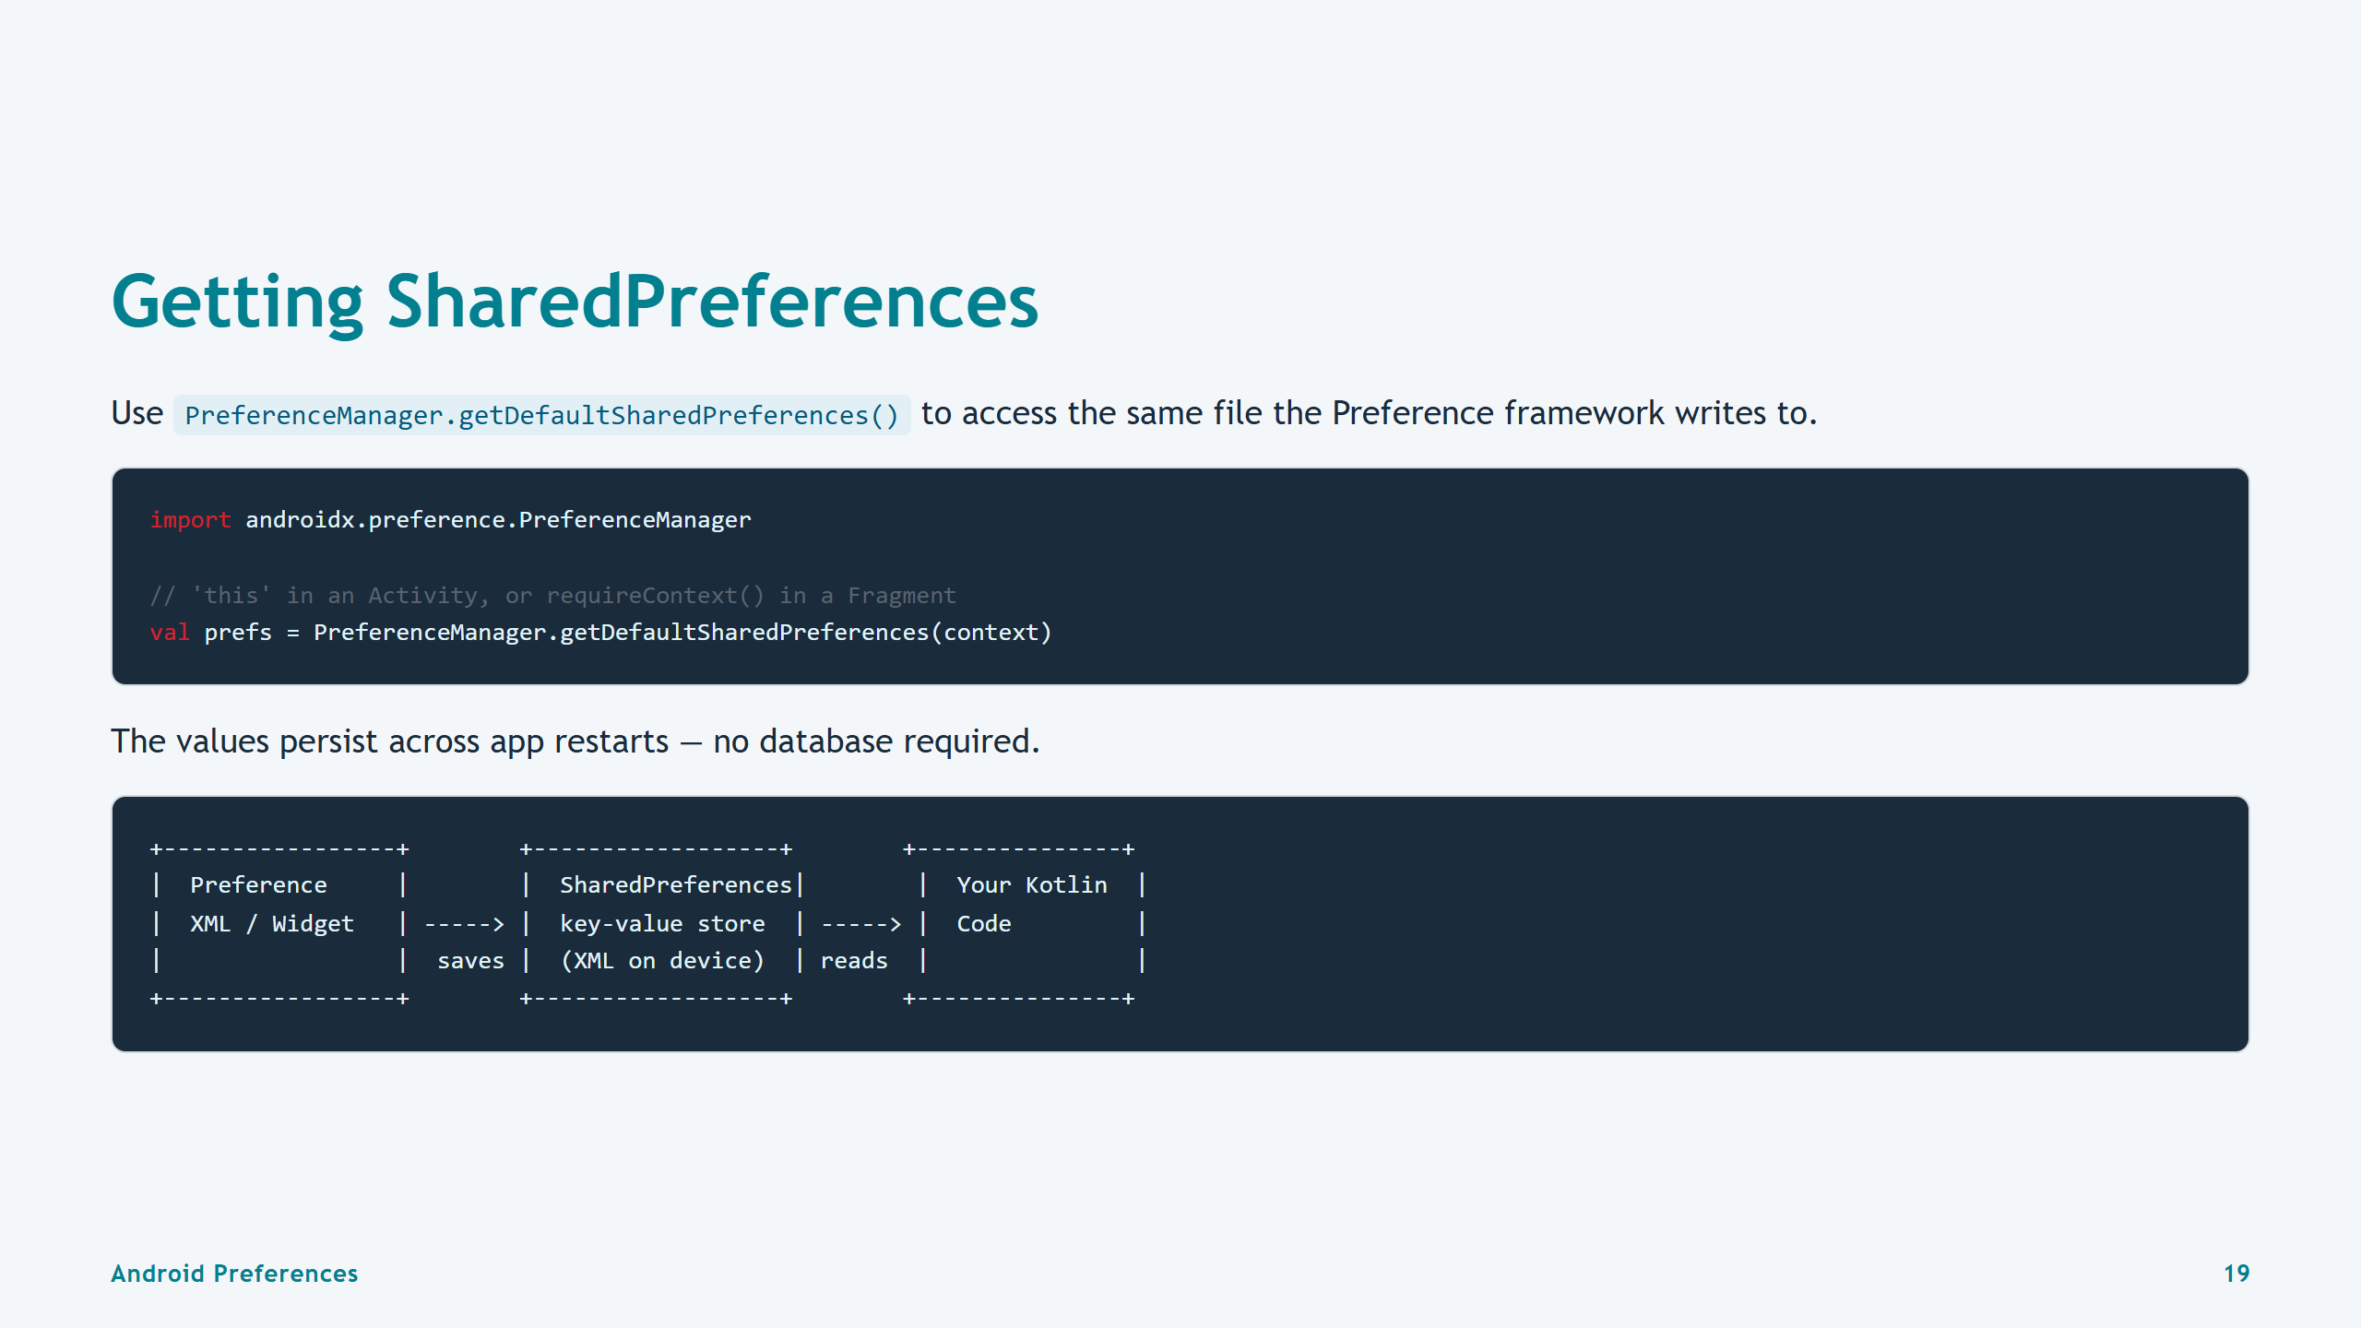
Notes:
Slide 19: Getting SharedPreferences

Slide 20
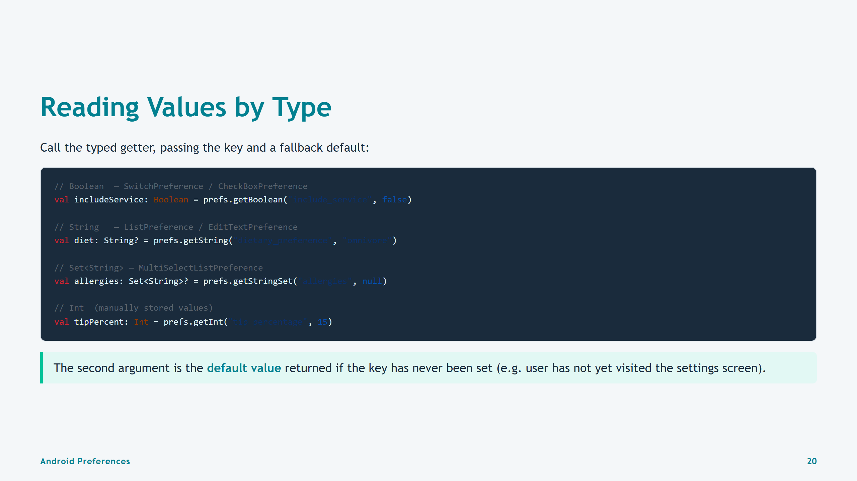
Notes:
Slide 20: Reading Values by Type

Slide 21
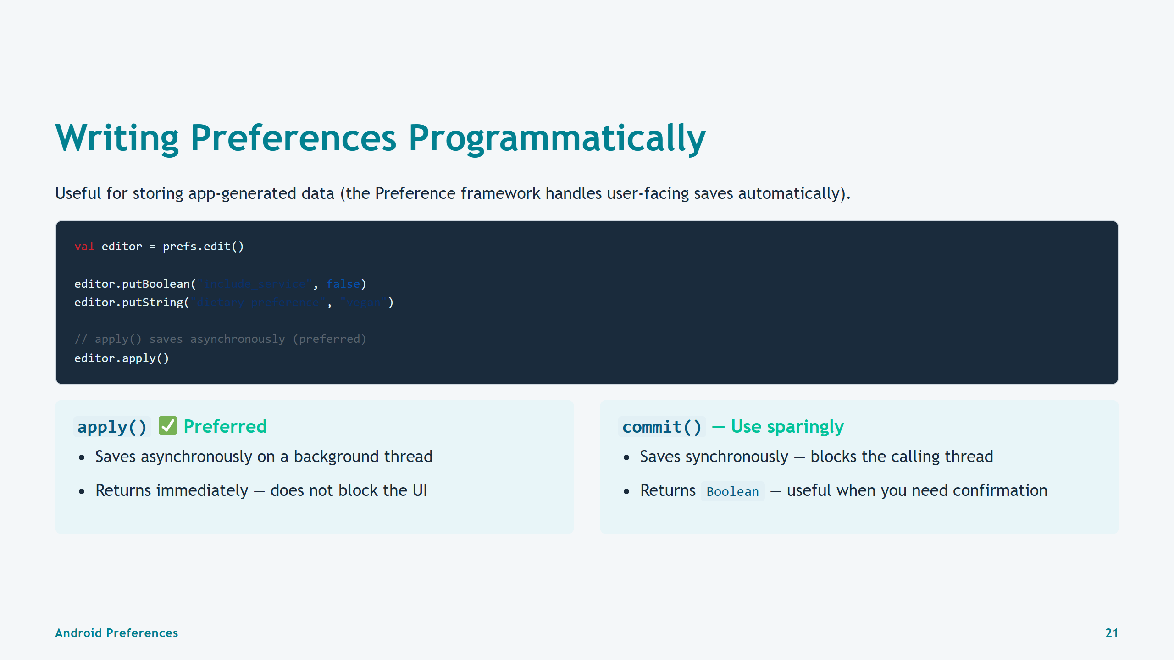
Notes:
Slide 21: Writing Programmatically

Slide 22
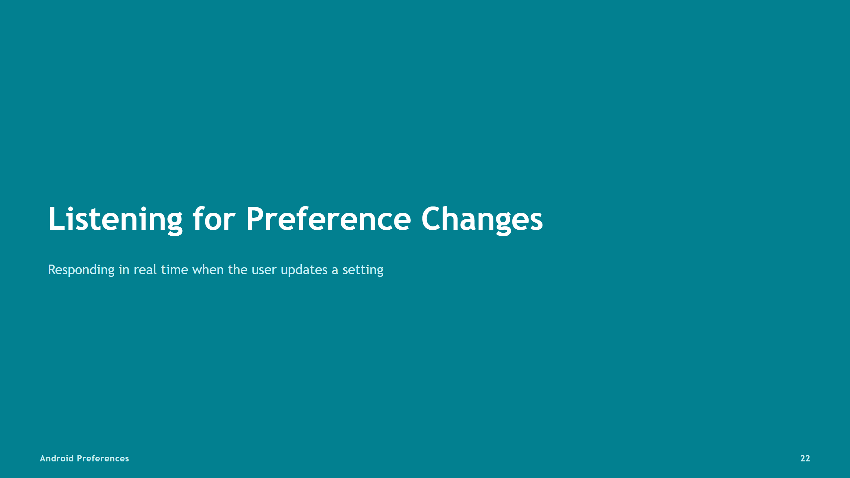

Slide 23
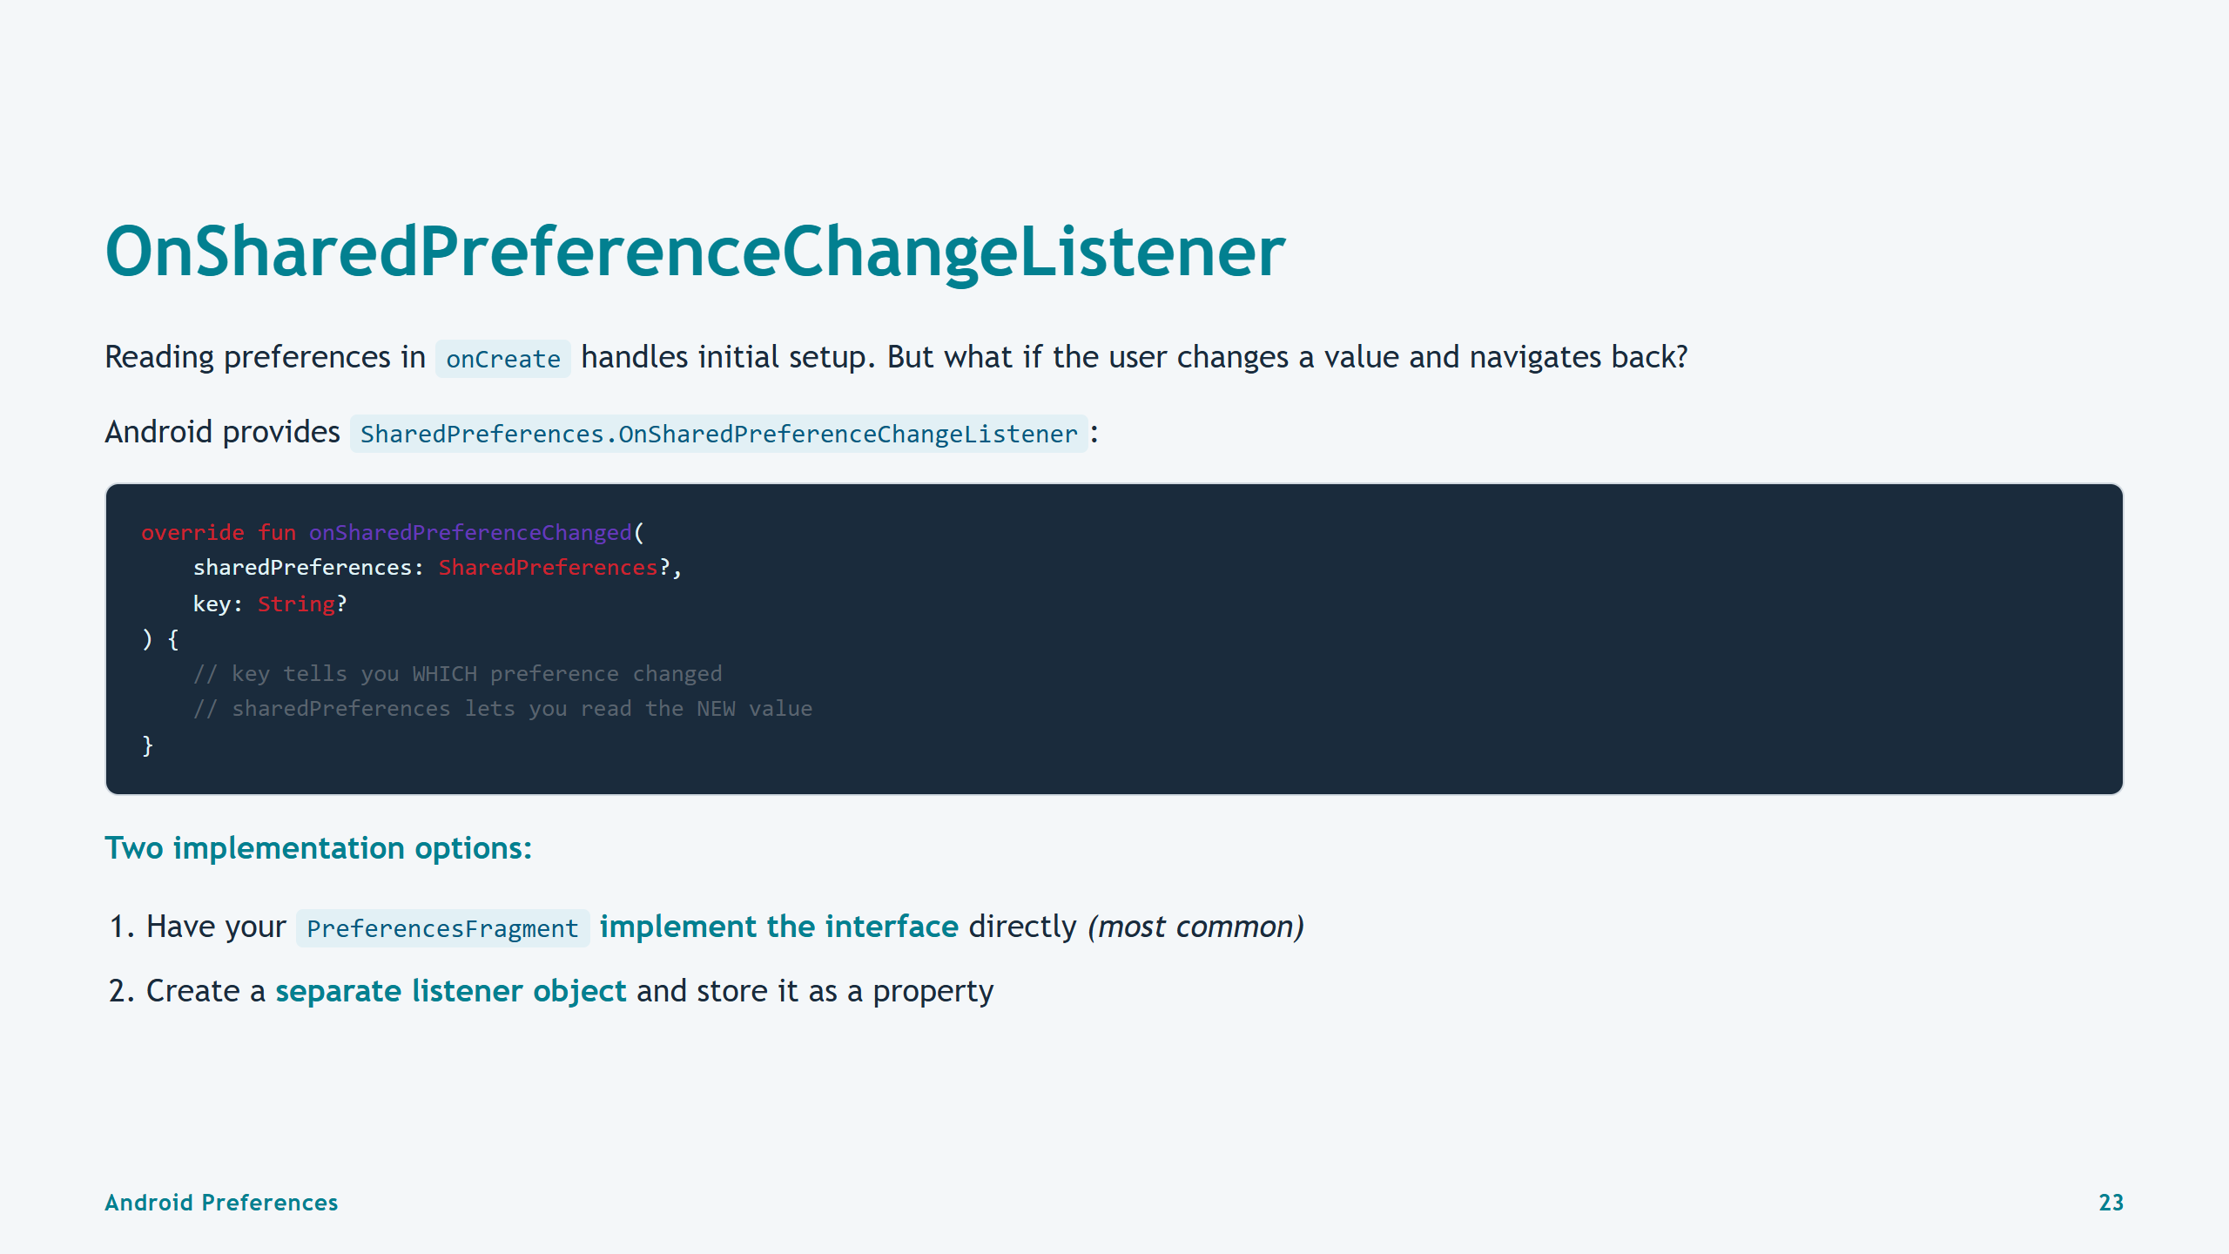
Notes:
Slide 23: OnSharedPreferenceChangeListener

Slide 24
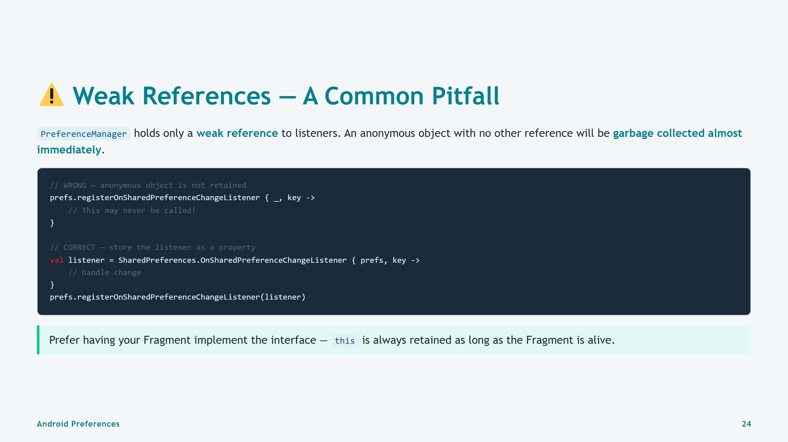
Notes:
Slide 24: Weak References Warning

Slide 25
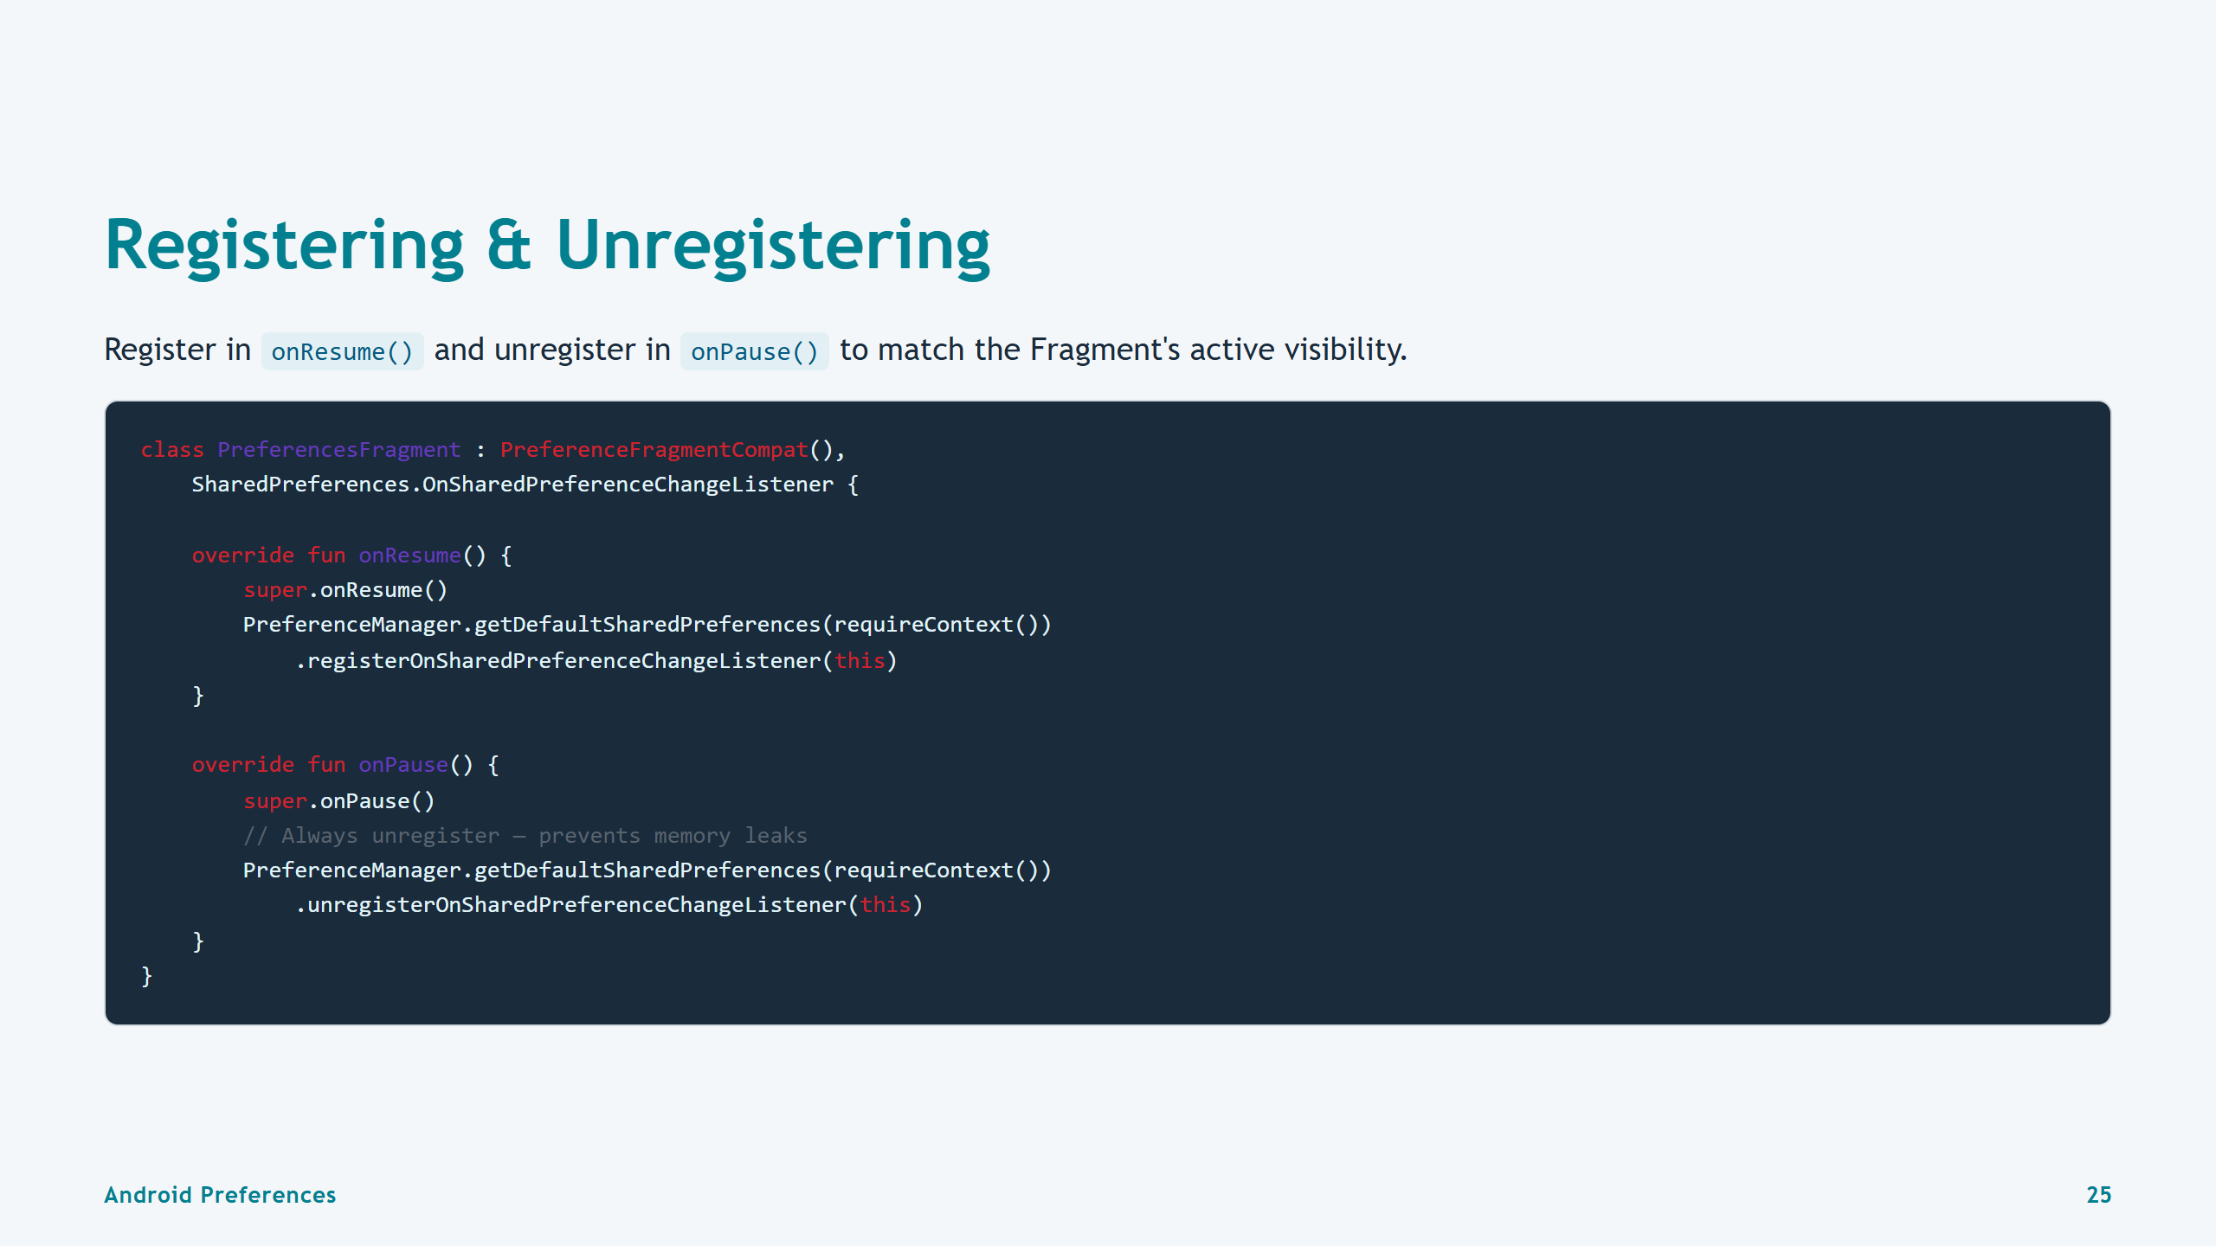
Notes:
Slide 25: Registering & Unregistering

Slide 26
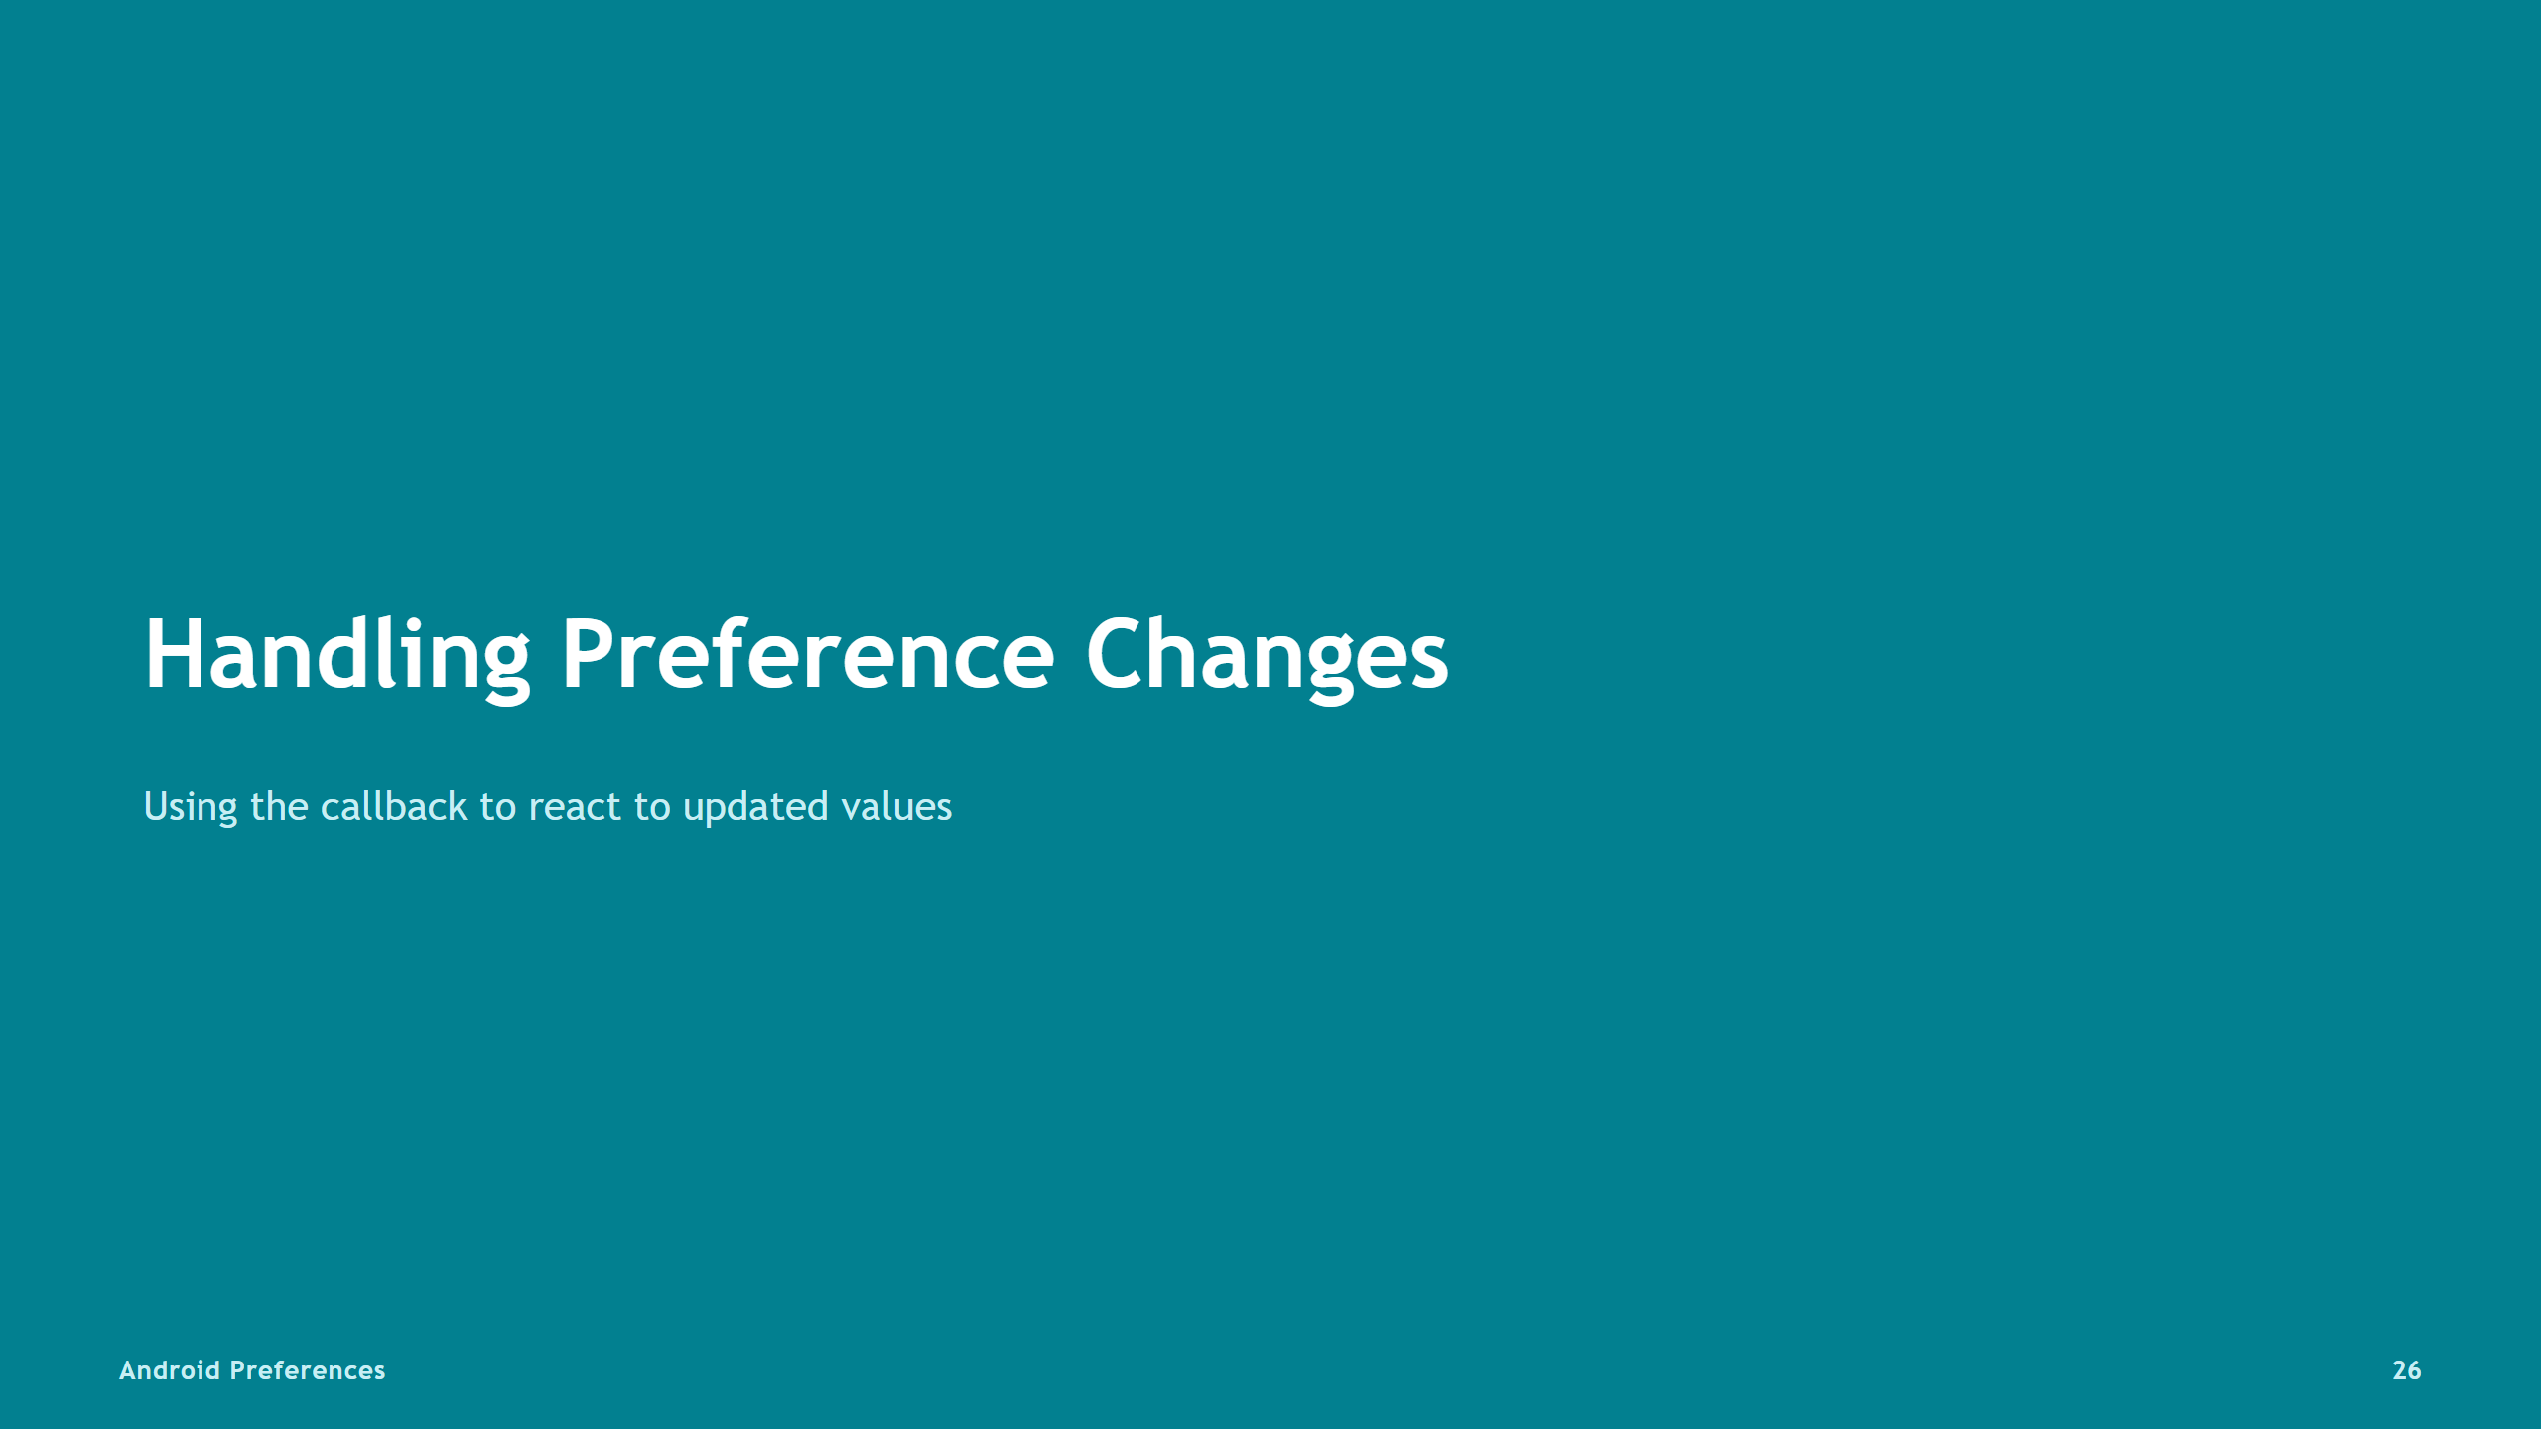

Slide 27
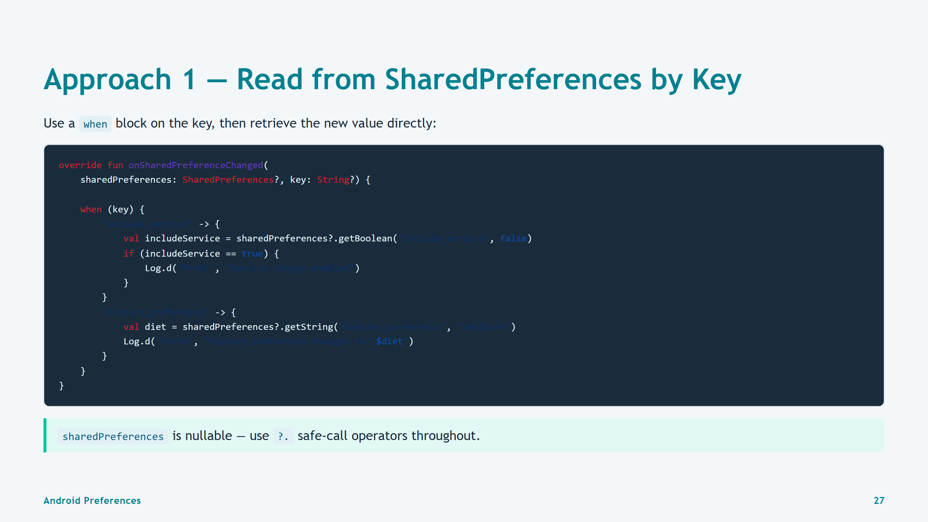
Notes:
Slide 27: Approach 1 — Read by Key

Slide 28
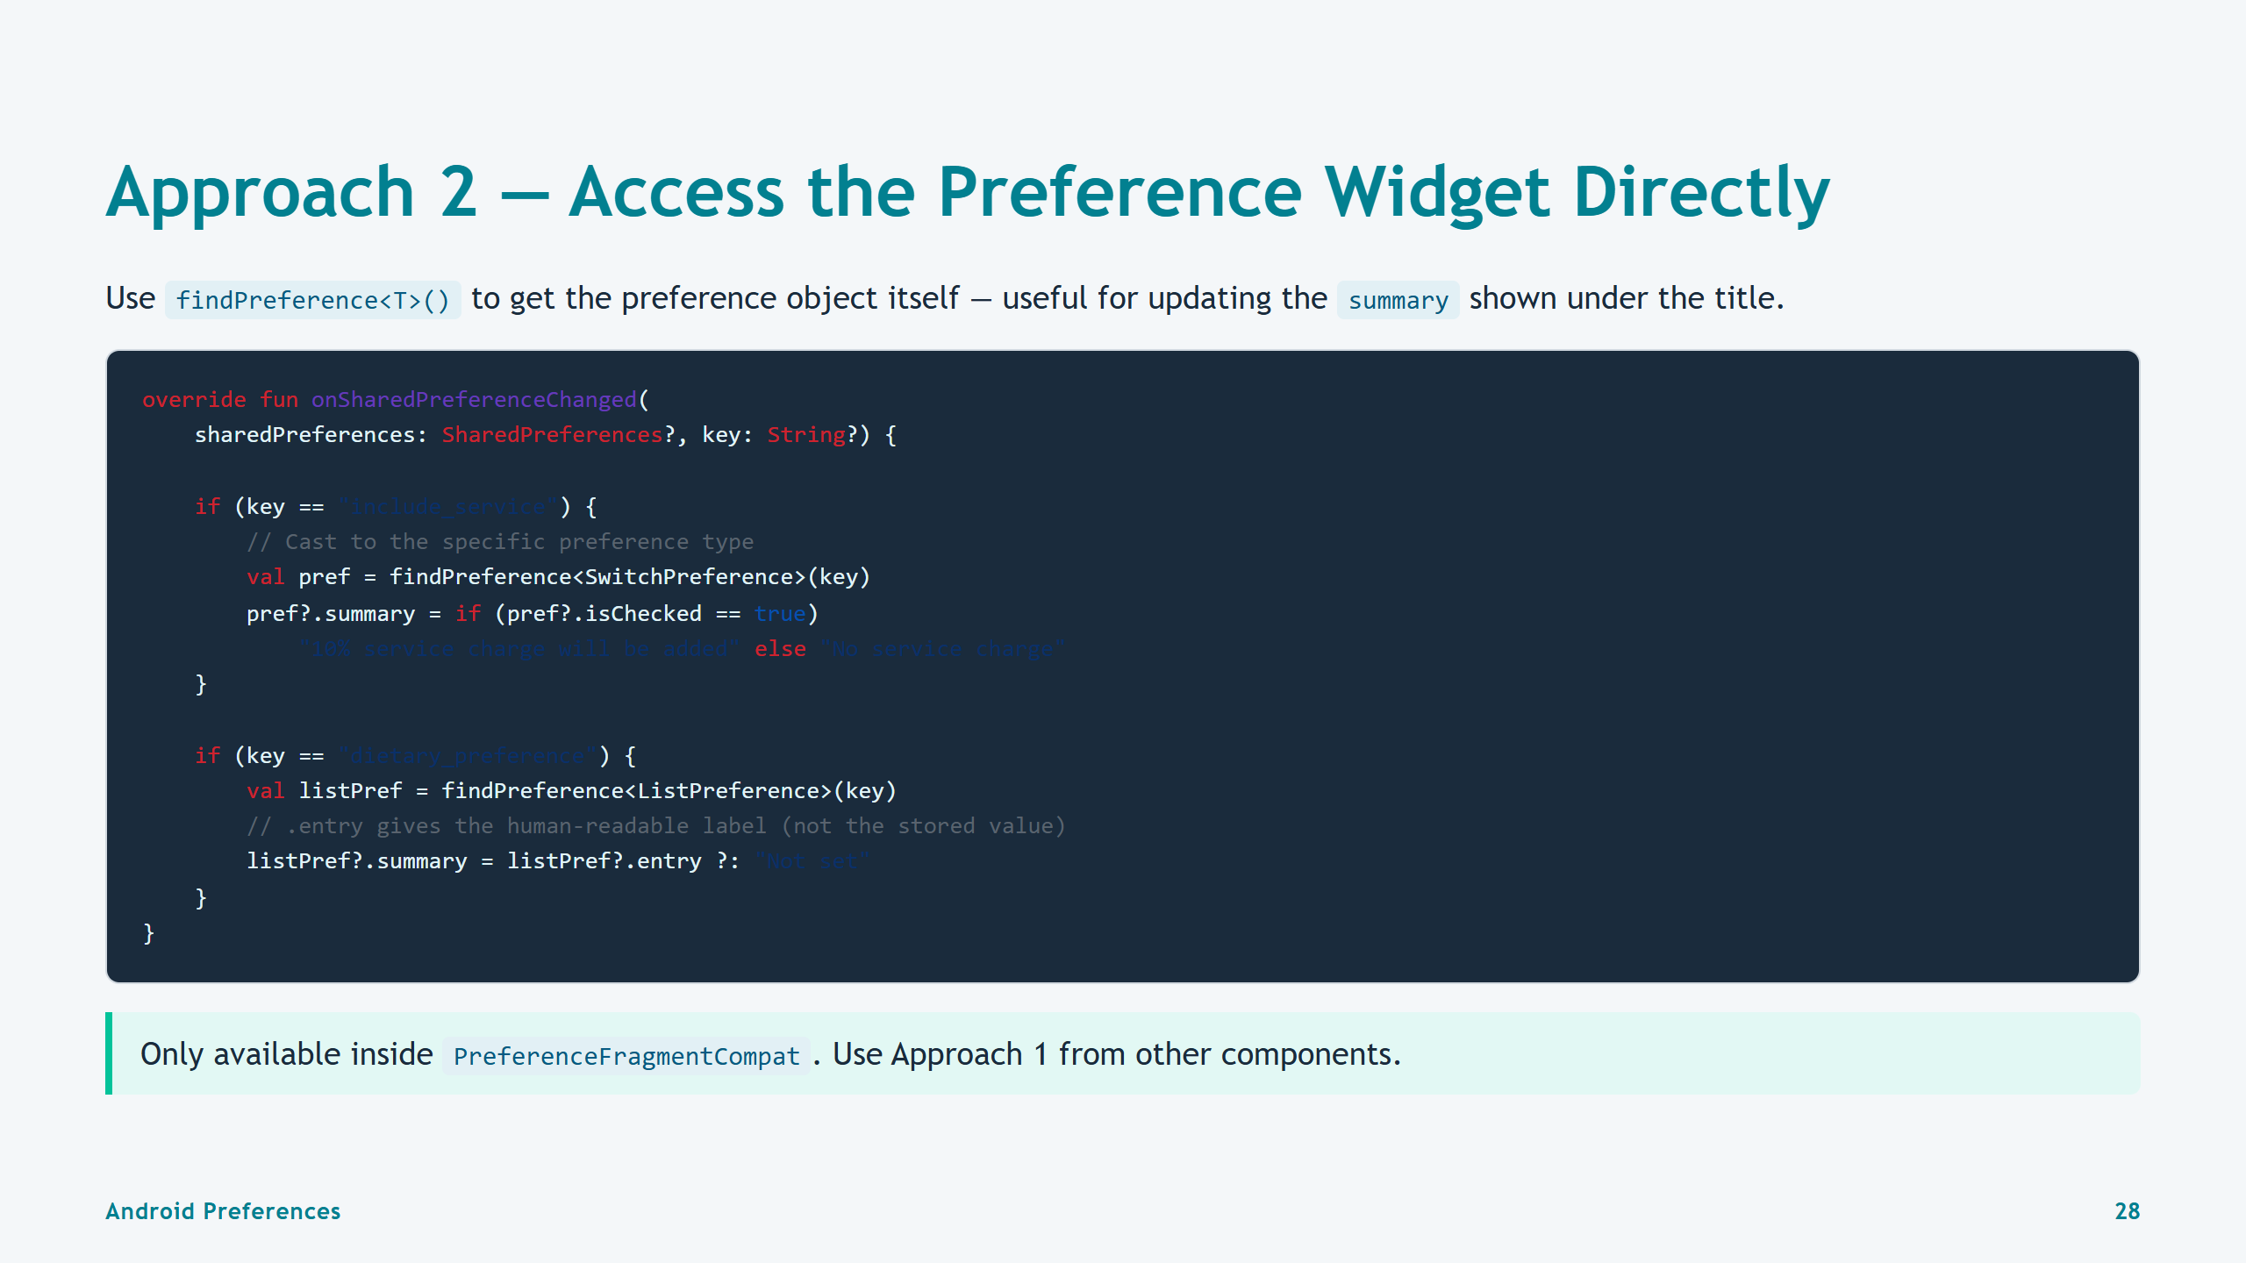
Notes:
Slide 28: Approach 2 — findPreference

Slide 29
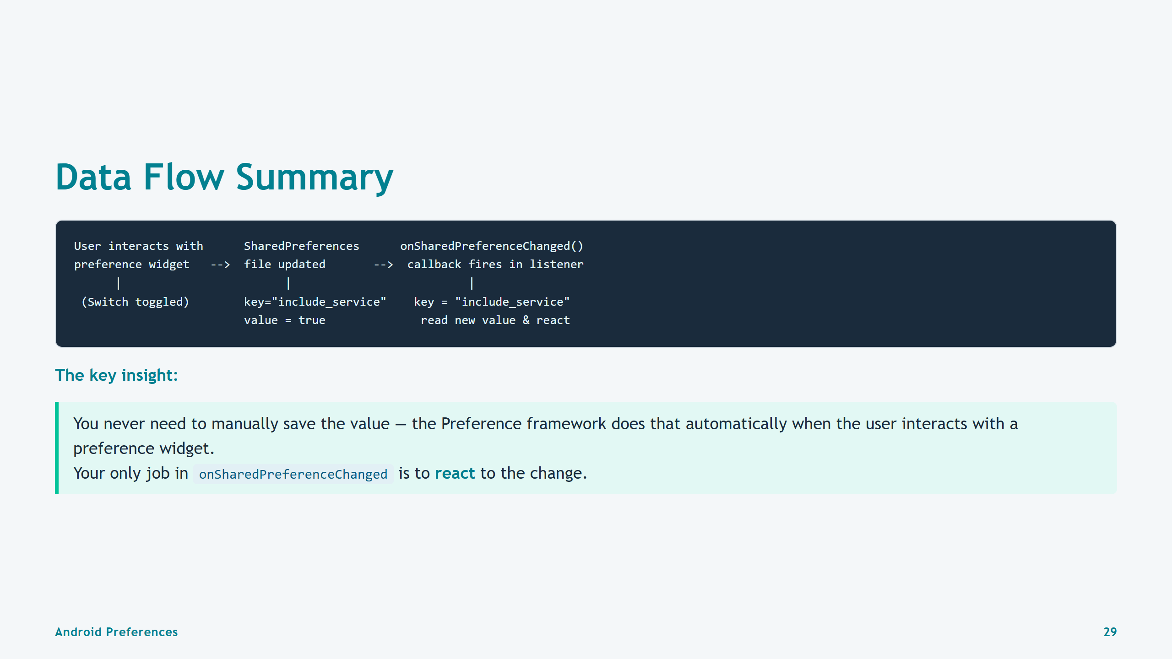
Notes:
Slide 29: Data Flow Summary

Slide 30
