Slide 1



Maximal Flow Algorithm
Group Presentation

Slide 2
Siddeshwar
Gauri
Vinayak
Devraj
Rajkumar
Group Members

Slide 3
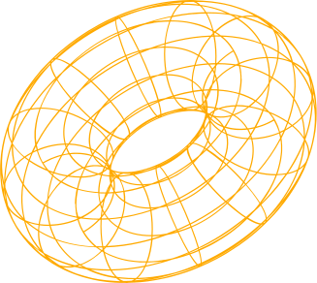
Introduction
The primary objective of this presentation is to demonstrate how maximal flow algorithm, implemented in Python, can be utilized to automate the assignment of jobs to workers based on their skill sets.

Slide 4


What is the purpose?
In today's dynamic work environments, efficiently matching job requirements with the right set of skills possessed by workers is crucial for organizational success. Manual assignment of jobs to workers in large-scale scenarios becomes impractical and time-consuming. However, leveraging computational algorithms, specifically maximal flow algorithms, can streamline this process and optimize job assignments effectively.

Slide 5
The max flow problem is a classic optimization problem in graph theory that involves finding the maximum amount of flow that can be sent through a network of pipes, channels, or other pathways, subject to capacity constraints. The problem can be used to model a wide variety of real-world situations, such as transportation systems, communication networks, and resource allocation.
Maximal Flow Algorithm

Slide 6
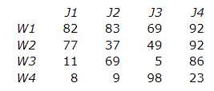
Work Assignment Problem
The assignment problem deals with assigning machines to tasks, workers to jobs, soccer players to positions, and so on. The goal is to determine the optimum assignment that, for example, minimizes the total cost or maximizes the team effectiveness. The assignment problem is a fundamental problem in the area of combinatorial optimization.

Slide 7
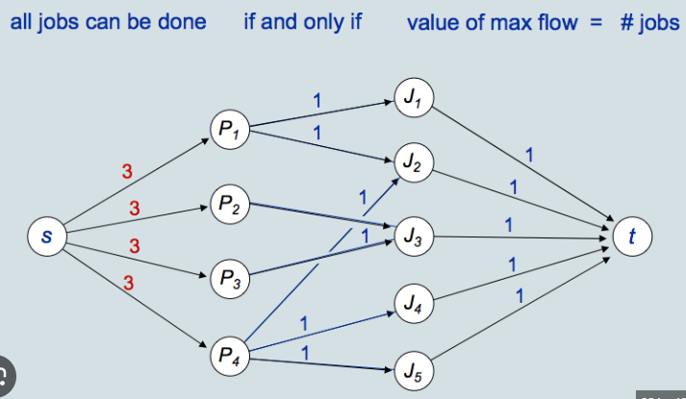

Slide 8
Modelling the problem as a flow network. Each job will be a source node, each worker will be a sink node, and the edges between them represent the skills required for the job. The capacity of each edge will represent the number of workers that can perform the job.
Using the Ford-Fulkerson algorithm to find the maximal flow in the network.
Based on the maximal flow obtained, assign jobs to workers.
Using Maximal Flow Algorithm in Work Assignment Problem

Slide 9
Implementation in Python
We used Python networkx module for all the graph related things like creating the Digraph, adding edges, and mainly for the maximum flow algorithm.
After that we needed matplotlib to display the graph generated by the networkx module and save the file

Slide 10
General outline of the code
First create the list of jobs and works
Then define the sink and source node
Add job-worker edge to the graph
Run the maximal flow algorithm
After that, iterate over the flow dictionary returned by the algorithm to match the jobs
At last display the final output

Slide 11

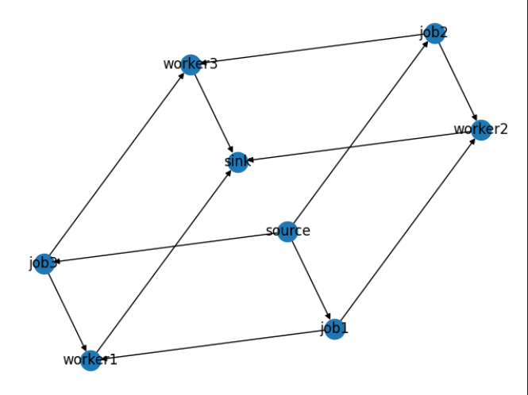
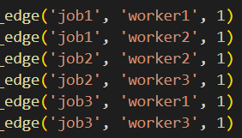

Slide 12
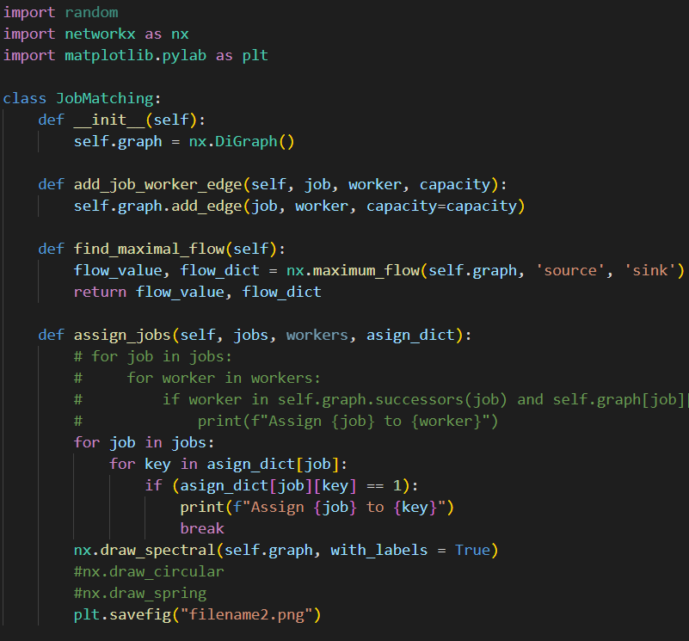
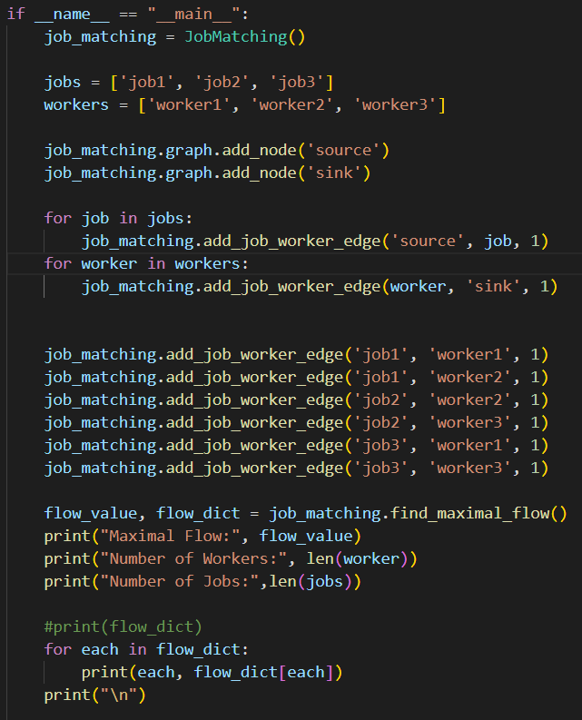
Code

Slide 13
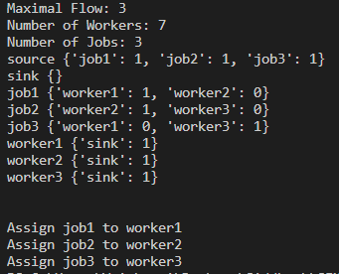
Output

Slide 14
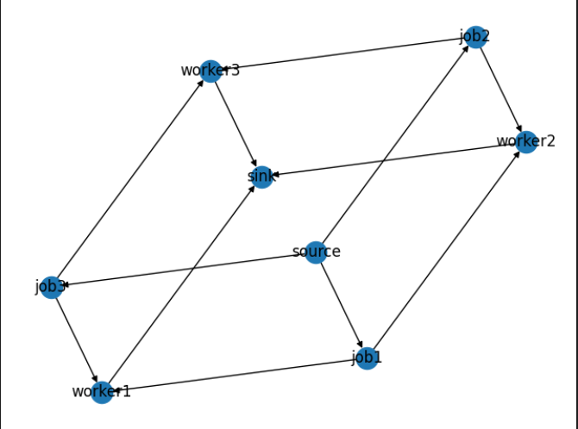
Code

Slide 15
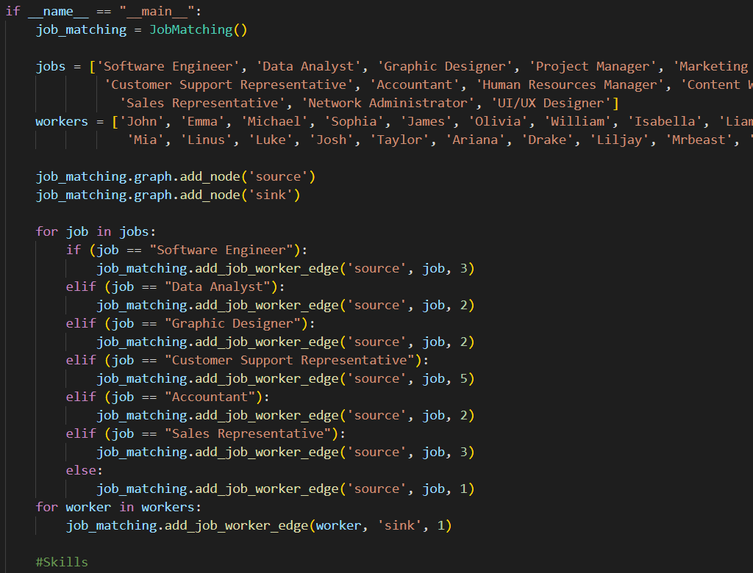
Code

Slide 16
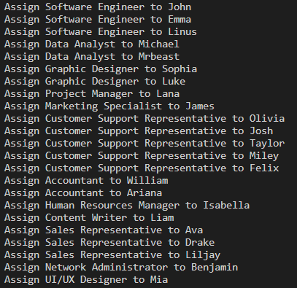
Output

Slide 17
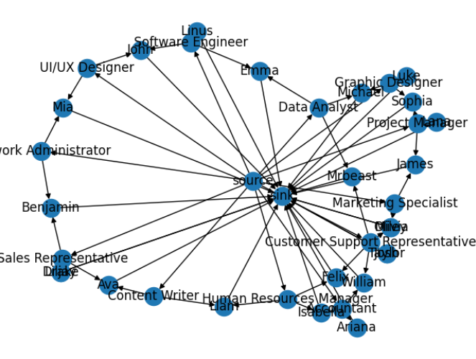
Output

Slide 18
Thanks

