Slide 1
Unit-2
Migrating into a Cloud
Prof. Rafat Parveen
rparveen@jmi.ac.in

Slide 2
Introduction
Understanding what is cloud migration?
How it can benefit your business?
What is involved in making it happen?
Best strategy to achieve a smooth transition to the cloud.

Slide 3
The global pandemic has seen more and more companies accelerate their move to the cloud.
Reinventing their offerings and becoming more cost-efficient, agile, and innovative in how they operate their businesses.

Slide 4
On-demand, self-service environment, cloud is now vital to achieving end-to-end digital transformation.
Cloud is vital to help businesses reopen, reinvent, and outmaneuver uncertaint.

Slide 5
Cloud Migration:
Cloud migration is the process of moving a company’s digital assets, services, databases, IT resources, and applications either partially, or wholly, into the cloud.
Cloud migration is also about moving from one cloud to another.

Slide 6
Companies wishing to move on from outdated and increasingly inefficient legacy infrastructures.
aging servers or potentially unreliable firewall appliances, or to abandon hardware or software solutions that are no longer operating at optimum capacity, are now turning to the cloud to experience the benefits of cloud computing.

Slide 7
Cloud migration is critical for achieving real-time and updated performance and efficiency.
The process requires careful analysis, planning and execution to ensure the cloud solution's compatibility with your business requirements.

Slide 8
lift-and-shift cloud migration capabilities, or their classic modernization services-automated language translation and conventional re-platforming.

Slide 9
Benefits of cloud migration?
Reduction in the total cost of ownership (TCO).
Faster time to delivery.
Enhanced opportunities for innovation.
Increased agility and flexibility.
Ability to innovate faster.
Easing of increasing resource demands.

Slide 10
Cond….
Better managing of increased customer expectations.
Deliver immediate business results.
Simplify IT.
Shift to everything as-a-service.
Better consumption management
Cloud scalability
Improved performance

Slide 11
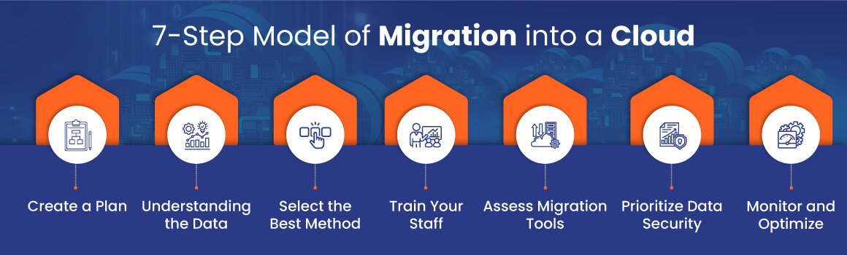
7-Step Model of Migration into a Cloud
The 7-step cloud migration model breaks down the entire migration process into seven stages: assessment, isolation, mapping, re-architecting, augmentation, validation, and optimization.

Slide 12
Step 1. Create a Plan
It minimizes risks and sets clear expectations.
It can involve bi-directional or one-way syncing with on-premises access during migration.
Companies can consider a cloud migration service provider for internal skill development.

Slide 13
Step 2. Understanding the Data
Companies need to analyze data scope and context to avoid code errors and unnecessary data transfer.
This streamlines the migration process and saves valuable time for service providers as well as companies.
companies can select the most suitable migration method.

Slide 14
Step 3. Select the Best Method
Companies can select the right cloud migration type from the following ones-
Shallow Integration (lift and shift)- This involves simply copying data and applications to the cloud.
Deep Integration- It involves decoupling resources and adjusting them before cloud integration (potentially more expensive initially but cost-saving in the long run).

Slide 15
Step 4. Train Your Staff
Cloud environments differ from on-premises infrastructure. It is, therefore, essential to train staff or outsource to experienced cloud professionals.
Alternatively, companies can retrain existing staff for in-house management. Cloud education is crucial before migration.

Slide 16
Step 5. Assess Migration Tools
It is crucial to choose the right tools for specific data types- (structured, unstructured, or semi-structured).
Advanced tools and techniques can ensure companies accomplish the data migration process smoothly.
It is better to consult the cloud service provider for assessment.

Slide 17
Step 6. Prioritize Data Security
Companies can evaluate the cloud provider's security measures and ensure compliance.
It is necessary to understand security risks and implement data protection measures like encryption thoroughly to leverage their benefits and meet compliance.

Slide 18
Step 7. Monitor and Optimize
This is a final stage that includes continuous monitoring of the cloud environment for optimal performance and quick issue resolution. Companies can opt for automated backups, disaster recovery, and scaling processes to reduce costs and maximize ROI on cloud investment.
It is advisable to consult a reputed cloud service provider to follow this 7-step model of migration into the cloud.
Silver Cloud is a renowned name among cloud migration service providers.

Slide 19
The 7 Rs Model of Migration into a Cloud.
The 7 Rs of cloud migration are a set of strategies designed to help organizations plan, execute, and optimize their migration projects.
The 7 cloud migration strategies are: rehost, relocate, replatform, refactor, repurchase, retire, and retain.
These strategies provide a roadmap for determining the best approach to moving applications and data from on-premises infrastructure to the cloud.

Slide 20
AWS introduced the 7 Rs model.
This latest iteration of the migration framework adds the Retain strategy, which recognizes that not all applications and data can or should be moved to the cloud.

Slide 21
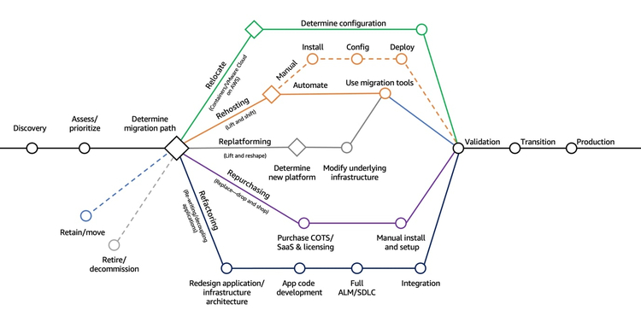
7 AWS Strategies for Migrating to the Cloud (Source: Amazon)

Slide 22
1. Rehost (“Lift and Shift”)
The rehost migration strategy involves leveraging cloud Infrastructure-as-a-Service (IaaS) offerings to redeploy workloads on a cloud instance.
The strategy allows enterprises to move an on-prem application and all its dependencies as-is to the cloud.

Slide 23
Without changing the core infrastructure, this approach allows organizations to transfer all application data and workflows to cloud services that match the workload’s existing storage, networking, and compute requirements.
Since operational and configuration constructs of workloads remain intact, the rehost strategy is also easy to perform and is suitable for enterprises .

Slide 24
2. Relocate
(“Hypervisor-Level Lift and Shift”)
Migrating workloads without impacting ongoing operations, rewriting the application source code, or acquiring new hardware.
With this strategy, an enterprise can migrate a collection of servers from an on-premises platform, such as VMware, to a cloud version of the same platform.

Slide 25
Relocating minimizes downtime and disruption since clients remain seamlessly connected during the migration process.
As this strategy doesn’t require significant changes in the configuration and architecture of workloads, it’s not necessary to retrain staff or invest in upgraded hardware.
reducing operating expenses. The strategy also makes migration costs more predictable by placing clear limits on scalability.

Slide 26
3. Replatform
(“Lift and Reshape”)
An enterprise can move an application to the cloud while employing some form of platform optimization to leverage cloud-native capabilities.
The application’s source code and core architecture remain unchanged, keeping legacy applications operational while ensuring cloud-based compliance and security.

Slide 27
The replatform migration strategy increases the flexibility, agility, and resilience of workloads while enabling cloud-native capabilities such as automation.
The strategy also saves time and migration costs since enterprises can modernize workloads without rewriting application code.

Slide 28
It allows organizations to choose components for modernization, subsequently improving application agility and maximizing ROI.
Since the application’s architecture and functionality are retained, teams don’t require extensive training to operate the migrating workloads.

Slide 29
4. Refactor
(“Re-architect”)
refactoring involves re-architecting workloads to support cloud-native capabilities from the ground up.
this strategy requires a huge investment in effort and resources, it’s considered the most future-proof migration approach.
It allows applications to support advanced capabilities such as serverless computing, autoscaling, and distributed load balancing.

Slide 30
Refactoring helps break down a monolithic application into microservices to achieve high availability and enhanced levels of automation that are often complex to achieve with in-house deployments. While rearchitecting applications for service-oriented architecture may turn out to be costly during the migration phase, a well-planned resulting framework’s operating costs are substantially lower than operating the legacy framework.

Slide 31
5. Repurchase
(“Drop and Shop”)
The repurchase migration strategy involves swapping internally administered systems for third-party managed services available from the cloud provider. Repurchasing helps teams retire legacy systems and move to a consumption-based, SaaS subscription model that ties IT costs to generated revenue. As the services are built and managed by third-party vendors, the repurchase model reduces operational efforts toward managing infrastructure for in-house teams.

Slide 32
The repurchase option also simplifies and expedites migration while reducing downtime and enhancing scalability and efficient regulatory governance. As the migration approach fully leverages cloud-native capabilities, it’s mostly leveraged for workloads that require enhanced application performance and user experience while minimizing operational overheads.

Slide 33
6. Retire
This strategy is used when terminating or downsizing applications that are no longer useful in production. In such instances, business-critical workloads that operate on inefficient legacy frameworks are retired as the first step towards the adoption of modern, cloud-native deployments.

Slide 34
7. Retain (“Revisit”)
This strategy is suitable for applications that cannot be retired and should continue to operate in their existing framework. Enterprises typically decide to retain a workload if it relies on another application that needs to be migrated first or when there’s no immediate business value in migrating the application to the cloud. As for vendor-based applications, an enterprise may also choose to retain if the service provider plans to eventually release a Software-as-a-Service (SaaS) model.

Slide 35
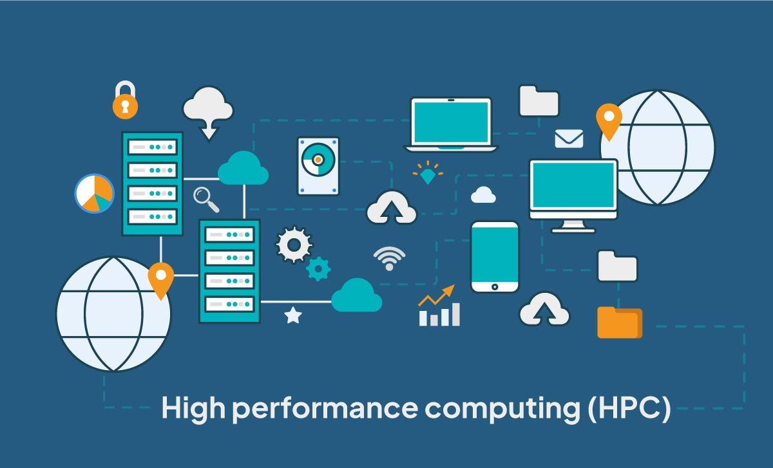
High Performance Computing

Slide 36
High performance computing (HPC) is the practice of aggregating computing resources to gain performance greater than that of a single workstation, server, or computer

Slide 37
Cond...
High Performance Computing :
Set of Computing technologies for very fast numeric simulation, modeling and data processing
Employed for specialised applications that require lot of mathematical calculations
Using computer power to execute a few applications extremely fast .

Slide 38
continued)
Definition 1
High Performance Computing (HPC) is the use of parallel processing for running advanced application programs efficiently, reliably and quickly.
A supercomputer is a system that performs at or near the currently highest operational rate for computers.
Definition 2
High Performance
Supercomputers and Computer
Computing
uses
Clusters to solve
(HPC)
advanced computation problems.

Slide 39


Evolution of Supercomputers
Supercomputer in the 1980s and 90s
  Custom-built computer systems
  Very expensive
Supercomputer after 1990s
  Build using commodity off-the-shelf” components
  Uses cluster computing techniques

Slide 40
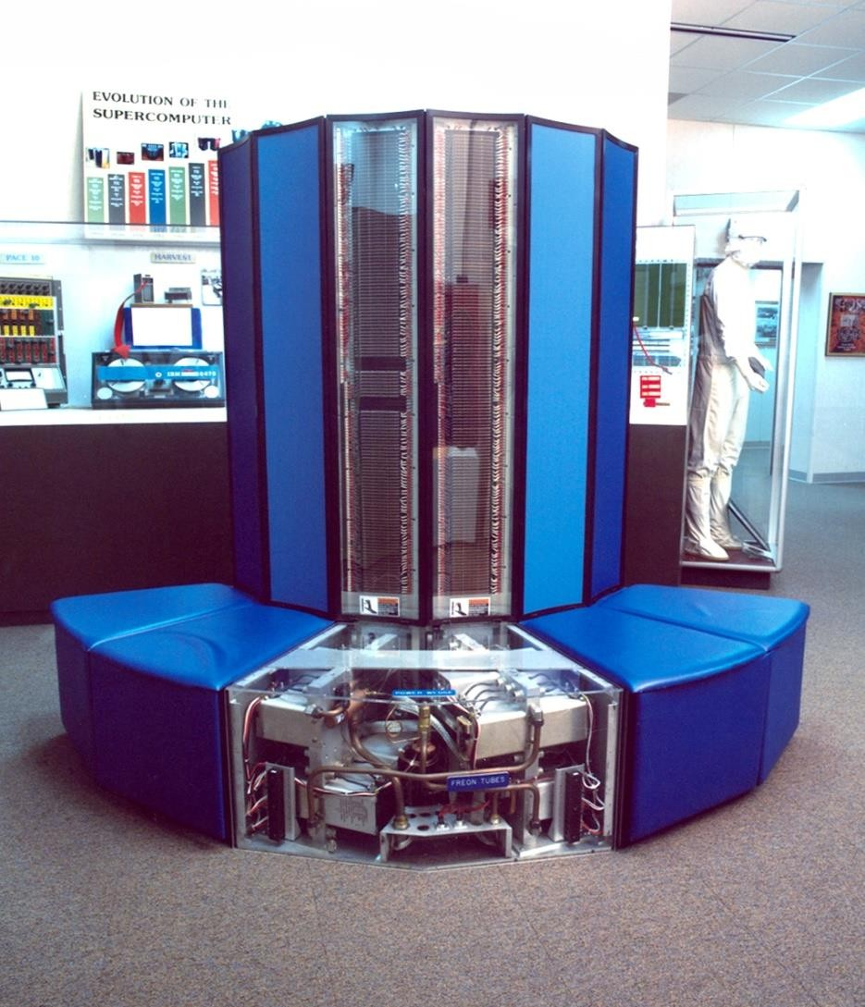
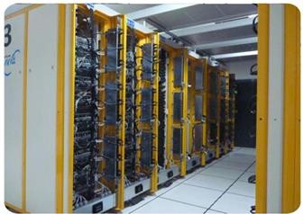
Supercomputers
Cray Supercomputer
PARAM Yuva II

Slide 41






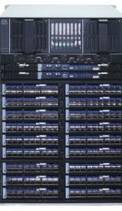
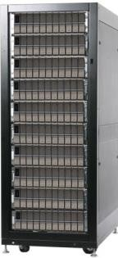
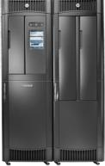
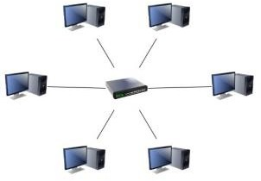
Components of Cluster
Login Nodes
Boot Servers/ Management Nodes
1GbE for
Primary Interconnect
administration
HSM/
Backup Server
Networking Gateway
Switch Fabric
Storage Acceleration
Accelerated Compute Nodes
Compute
Nodes
Tape Library/ Backup storage
Parallel File System
Local
Network

Slide 42
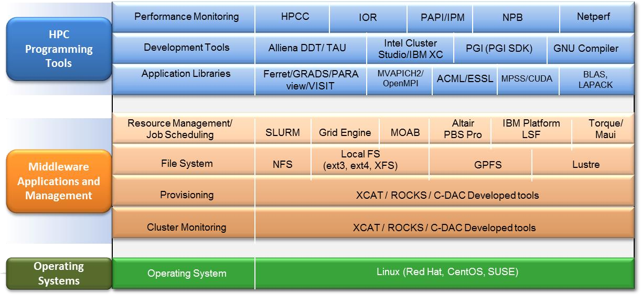
HPC Software Stack

Slide 43
Single CPU Systems
Can run a single stream of code
Performance can be improvement through
  Increasing ALU width
  Increasing clock frequency
  Making use of pipelining
  Improved compilers
But still, there is a limit to each of these techniques
  Parallel computing, provides relief

Slide 44
Why use Parallel Computing?
Overcome limitations of single CPU systems
  Sequential systems are slow
    Calculations may take days, weeks, years
    More CPUs can get job done faster
  Sequential systems are small
    Data set may not fit in memory
    More CPUs can give access to more memory
So, the advantages are
  Save time
  Solve bigger problems

Slide 45
Single Processor Parallelism
Instruction level Parallelism is achieved through
  Pipelining
  Superscaler implementation
  Multicore architecture
  Using advanced extensions

Slide 46
Types of HPC clusters
High performance computing has three main components:
1. Compute
2. Network
3. Storage
Fast disks, high-speed memory, and low-latency, high-bandwidth networking between the nodes and storage systems.

Slide 47
HPC can typically be broken down into two general design types:
Cluster computing
Distributed computing.

Slide 48
1. Cluster computing
Parallel computing is done with a collection of computers (clusters) working together, such as a connected group of servers placed closely to one another both physically and in network topology, to minimize the latency between nodes.

Slide 49
2. Distributed computing
The distributed computing model connects the computing power of multiple computers in a network that is either in a single location (often on-premises) or distributed across several locations, which may include on-premises hardware and cloud resources.

Slide 50
HPC clusters can be distinguished between
1. Homogeneous
2. Heterogeneous hardware models.
In homogenous clusters, all machines have similar performance and configuration, and are often treated as the same and interchangeable.

Slide 51
2. Heterogeneous clusters
Collection of hardware with different characteristics (high CPU core-count, GPU-accelerated, and more), and the system is best utilized when nodes are assigned tasks to best leverage their distinct advantages.

Slide 52
How do HPC jobs work?
Workloads in an HPC environment typically come in two different types:
Loosely coupled
Tightly coupled.
Loosely coupled workloads (often called parallel or high throughput jobs) consist of independent tasks that can be run at the same time across the system.
The tasks may share common storage, but they are not context-dependent and thus do not need to communicate results with each other as they are completed.

Slide 53
2. Tightly coupled workloads
consist of many small processes, each handled by different nodes in a cluster, which are dependent on each other to complete the overall task.
Tightly coupled workloads usually require low-latency networking between nodes and fast access to shared memory and storage.

Slide 54
Interprocess communication for these workloads is handled by a Message Passing Interface (MPI), using software such as OpenMPI and Intel MPI.

Slide 55

. An example of a tightly coupled workload would be weather forecasting, which involves physics-based simulation of dynamic and interdependent systems involving temperature, wind, pressure, precipitation, and more. Here, each cluster node may compute partial solutions to different weather factors, contributing to the overall forecast.

Slide 56
HPC in the cloud
HPC can be performed on-premises with dedicated equipment, in the cloud, or a hybrid of each.
HPC in the cloud offers the benefit of flexibility and scalability without having to purchase and maintain expensive dedicated supercomputers

Slide 57
HPC in the cloud provides all the necessary infrastructure needed to perform large, complex tasks such as data storage, networking solutions, specialized compute resources, security, and artificial intelligence applications.
Workloads can be performed on demand, which means that organizations can save money on equipment and time on computing cycles, only using the resources they need, when they need them.

Slide 58
Common considerations when choosing to run HPC in the cloud
Latency and bandwidth: With the amount of data running in HPC workloads, cloud providers need to provide robust networking capabilities (>100 GB/s) with low latency.
Performance: HPC in the cloud works best with providers that constantly update systems to optimize performance, especially in computer processors, storage solutions, and networking capabilities.
Sustainability: HPC is a resource intensive form of computing, requiring much more electricity than normal workloads. On-premises high performance computers can cost millions of dollars a year in energy.

Slide 59
storage: Given the size of most HPC tasks, scalable data storage is an important consideration when running HPC workloads. Cloud providers that can easily store and manage large amounts of data through Cloud Storage Filestore High Scale, have an advantage in HPC.

Slide 60
Contd...
Security: A cloud provider with a privately managed global infrastructure ensures that data and applications are the least exposed to the public internet.
Virtual private cloud (VPC) networks enable connectivity between nodes and can configure firewalls for HPC applications.
Confidential Computing features allow encryption in use, as well as encryption at rest and in flight.

Slide 61
Benefits of HPC in the cloud
Speed and performance
High performance computing can process data and tasks much faster than a single server or computer.
Tasks that could take weeks or months on a regular computing system can take hours in HPC.
Flexibility and efficiency
With HPC in the cloud, workloads can be scaled up or down depending on need. With a robust internet connection, HPC can be accessed from anywhere on the globe.

Slide 62
Cost savings
Because of the speed, flexibility, and efficiency of HPC in the cloud, organizations can save time and money on computing resources and labor hours.

Slide 63
Fault tolerance
If one node of an HPC cluster fails, the system is resilient enough that the rest of the system does not come crashing down. Given the large and complex tasks performed by HPC, fault tolerance is a big advantage.
Accelerated R&D
HPC provides an advantage to companies performing research and development by speeding up the results of data-intensive projects, such as pharmaceutical modeling, designing new machines and parts, or simulating experiments to reduce physical testing.

Slide 64
Initial cost
On-premises HPC clusters and supercomputers have high initial costs.
On-premises HPC would be out of reach for most organizations after factoring in the cost of equipment, labor, software, and configuration.
Energy consumption
The energy costs of on-premises supercomputer installations can be large. For environmentally and cost conscious companies, HPC energy consumption can be sustainable by running HPC cloud.
Maintenance
HPC runs best when on the latest generation of hardware and optimized software. Keeping an on-premises HPC cluster or supercomputer up to date to ensure optimal performance can quickly become a large and ongoing expense.

Slide 65
Why is HPC important?
The modern ecosystem is flooded with data and compute-intensive tools to analyze it.
HPC allows businesses and organizations to process all of that data in a timely manner, fueling new insights, innovations, and scientific discoveries.
This allows companies to forecast business scenarios, predict market fluctuations, and make recommendations.

Slide 66
The medical field, meanwhile, is being transformed with easy access to HPC in the cloud, helping to model potential outbreaks, decode the genome of cancerous cells, and understand how diseases evolve.

Slide 67
n short, HPC is accelerating the rate at which scientific, technological, and business progress is made, helping humanity craft a more prosperous future.

Slide 68
Related products and services
Google Cloud offers a variety of products and services to help organizations make the most of HPC in the cloud.

Slide 69
High performance computing (HPC) is used in many areas, including:
Research: HPC helps scientists find renewable energy sources, understand the universe, and create new materials.
Media and entertainment: HPC is used to create animations, render special effects, and transcode large media files.
Oil and gas: HPC is used in the oil and gas industry.

Slide 70
Healthcare: HPC helps healthcare scientists develop new drugs and treatments for rare and common diseases.
Weather and atmospheric research: HPC is used to predict and track storms.
Manufacturing: HPC is used to design new products, simulate test scenarios, and keep parts in stock.

Slide 71
Means of achieving parallelism
Implicit Parallelism
  Done by the compiler and runtime system
Explicit Parallelism
  Done by the programmer

Slide 72
Implicit Parallelism
Parallelism is exploited implicitly by the compiler and runtime system
  Automatically detects potential parallelism in the program
  Assigns the tasks for parallel execution
  Controls and synchronizes execution
(+) Frees the programmer from the details of parallel execution
(+) it is a more general and flexible solution
(-) very hard to achieve an efficient solution for many
applications

Slide 73
Explicit Parallelism
It is the programmer who has to
  Annotate the tasks for parallel execution
  Assign tasks to processors
  Control the execution and the synchronization points (+) Experienced programmers achieve very efficient
solutions for specific problems
(-) programmers are responsible for all details
(-) programmers must have deep knowledge of the computer architecture to achieve maximum performance.

Slide 74
Explicit Parallel Programming Models
Two dominant parallel programming models
Shared-variable model
Message-passing model

Slide 75
Shared Memory Model
Multiple threads operate independently but share same
memory resources
Data is not explicitly allocated
Changes in a memory location effected by one process
is visible to all other processes
Communication is implicit
Synchronization is explicit

Slide 76




HPC in Science
Space Science
Applications in Astrophysics and Astronomy
Earth Science
Applications in understanding Physical Properties of Geological Structures, Water Resource Modelling, Seismic Exploration
Atmospheric Science
Applications in Climate and
Weather Forecasting, Air Quality

Slide 77




HPC in Science
Life Science
Applications in Drug Designing, Genome Sequencing, Protein Folding
Nuclear Science
Applications in Nuclear Power, Nuclear
Medicine (cancer etc.), Defence
Nano Science
Applications in Semiconductor Physics, Microfabrication, Molecular Biology, Exploration of New Materials

Slide 78


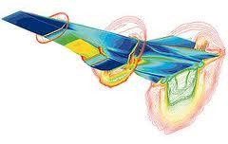


HPC in Engineering
Crash Simulation
Applications in Automobile and Mechanical Engineering
Aerodynamics Simulation & Aircraft Designing
Applications in Aeronautics and Mechanical Engineering
Structural Analysis
Applications in Civil Engineering and
Architecture

Slide 79




Multimedia and Animation
DreamWorks Animation
SKG produces all its animated movies using HPC graphic technology
Graphical Animation Application in Multimedia and Animation

Slide 80
Cloud scenarios
Benefits
scalability
simplicity
vendors
security
Limitations

Slide 81
Cloud Benefits
Cost Efficiency: Cloud computing often reduces the need for large upfront investments in hardware and software.
Pay only for the resources they use, which can lead to substantial cost savings.
Scalability and Flexibility:
Cloud services can be easily scaled up or down based on demand.
Flexibility allows businesses to handle varying workloads without having to invest in physical infrastructure.

Slide 82
Accessibility and Mobility: Cloud computing enables access to applications and data from anywhere with an internet connection. This promotes remote work and collaboration, as team members can work from different locations.
Disaster Recovery and Backup: Many cloud services include automated backup and disaster recovery options, ensuring data is regularly saved and can be restored quickly in case of failure or loss.

Slide 83
Automatic Updates: Cloud providers often handle software updates and maintenance, ensuring that users always have access to the latest features and security patches without manual intervention.
Enhanced Security: Leading cloud providers invest heavily.

Slide 84
Cloud scalability
Ability of a cloud computing environment to handle an increasing amount of workload or user demand by adjusting resources dynamically.
It's a key advantage of cloud services, allowing businesses to scale up or down based on their needs without the need for significant upfront investments in hardware or infrastructure.

Slide 85
Types of cloud scalability
Vertical Scalability (Scaling Up/Down): This involves adding more power (CPU, RAM) to an existing server or virtual machine. It’s like upgrading your computer to handle more demanding applications. This type is often used when you need to increase the capacity of a single instance.
Horizontal Scalability (Scaling Out/In): This involves adding more instances (servers or virtual machines) to distribute the load. It’s akin to adding more computers to handle a larger workload. Horizontal scaling helps manage increases in demand by distributing tasks across multiple instances.

Slide 86
Benefits of Cloud Scalability
Cost Efficiency: You pay for what you use. When demand is high, you can scale up, and when it's low, you can scale down, optimizing costs.
Flexibility: You can adapt to changing demands without major reconfigurations or investments in physical hardware.
Improved Performance: By distributing the workload or upgrading resources, you can maintain.

Slide 87
Cloud simplicity
Cloud simplicity generally refers to making cloud computing as straightforward and user-friendly as possible. It’s about removing complexity so users can focus on leveraging cloud technologies without getting bogged down by technical details. Here are some key aspects:

Slide 88
User-Friendly Interfaces: Simplified dashboards and management tools that are easy to navigate.
Automated Scaling: Automatically adjusting resources based on demand without manual intervention
Easy Integration: Streamlined processes for connecting different services and applications.

Slide 89
Cost Transparency: Clear and straightforward pricing models to avoid unexpected costs.
Simplified Security: Easy-to-implement security features and controls to protect data without needing deep knowledge.
Managed Services: Offering pre-configured services that handle common tasks and maintenance.

Slide 90
Cloud vendors
Cloud vendors provide cloud computing services, which include everything from virtual machines and storage to complex machine learning and data analytics platforms.

Slide 91
Major cloud vendors include:
Amazon Web Services (AWS) - Known for its extensive range of services and global reach. AWS offers everything from computing power and storage to machine learning and artificial intelligence tools.
Microsoft Azure - Microsoft's cloud platform, which integrates well with Microsoft products and services. Azure offers services for computing, analytics, storage, and networking.

Slide 92
Cont...
Google Cloud Platform (GCP) - Google's cloud services, which are known for their strong offerings in data analytics, machine learning, and artificial intelligence.
IBM Cloud - Offers a range of cloud computing services including infrastructure as a service (IaaS), platform as a service (PaaS), and software as a service (SaaS), with a focus on AI and enterprise solutions.

Slide 93
Oracle Cloud - Provides a range of cloud services including database, applications, and infrastructure. Oracle Cloud is known for its enterprise database solutions.
Alibaba Cloud - The leading cloud provider in China, offering a wide range of cloud computing services including data storage, computing, and networking.

Slide 94
Salesforce - Known primarily for its customer relationship management (CRM) software, Salesforce also provides a cloud platform for application development and analytics.
IBM Cloud - Provides a range of cloud computing services, including AI and data analytics, with a focus on enterprise solutions.

Slide 95
Cloud security
Cloud security is a broad and evolving field that focuses on protecting data, applications, and systems within cloud computing environments.
It involves implementing strategies, policies, and technologies to safeguard against a range of threats and vulnerabilities.

Slide 96
Data Protection: Ensuring that data is encrypted both in transit and at rest to prevent unauthorized access. This also includes managing encryption keys securely.
Identity and Access Management (IAM): Controlling who can access cloud resources and what actions they can perform. This often involves multi-factor authentication (MFA) and least privilege access principles.

Slide 97
Compliance and Governance: Adhering to regulations and standards such as GDPR, HIPAA, or SOC 2. It involves implementing policies and procedures to ensure compliance and conducting regular audits.
Network Security: Protecting data as it travels across the network. This can include using firewalls, intrusion detection systems (IDS), and virtual private networks (VPNs).

Slide 98
Incident Response: Having a plan in place to detect, respond to, and recover from security incidents. This includes monitoring for unusual activity and having protocols for addressing breaches.
Vulnerability Management: Regularly scanning for and addressing security vulnerabilities in cloud infrastructure and applications.

Slide 99
Backup and Recovery: Implementing strategies to ensure that data can be restored in the event of loss or corruption. This involves regular backups and having a disaster recovery plan.
Shared Responsibility Model: Understanding that in cloud environments, security responsibilities are shared between the cloud service provider and the customer.
The provider typically handles the security of the cloud infrastructure, while the customer is responsible for securing their own data and applications.

Slide 100
Security Policies and Training: Establishing and enforcing security policies and providing training to ensure that users understand and follow best security practices.

Slide 101
Cloud computing has revolutionized the way we handle data and applications, but it's not without its limitations. Here are some of the

Slide 102
Key challenges and limitations associated with cloud services:
Cost Management: While cloud services offer flexibility and scalability, costs can quickly add up, especially if resources are not managed efficiently. Unexpected high usage can lead to significant bills.
Security and Privacy: Storing sensitive data on the cloud raises concerns about data security and privacy.
While cloud providers implement robust security measures, vulnerabilities and breaches can still occur. Compliance with regulations can be challenging.

Slide 103
Downtime and Reliability: Cloud services are generally reliable, but they are not immune to outages or downtime.
Service disruptions can impact business operations, and while providers often offer Service Level Agreements (SLAs), they may not fully cover the impact of outages.
Performance Issues: Cloud performance can be affected by various factors, including network latency, resource contention, and the performance of the cloud provider’s infrastructure

Slide 104
Vendor Lock-In: Moving applications and data between different cloud providers can be complex and costly due to differences in services, APIs, and data formats. This can create dependency on a single provider.
Limited Control and Flexibility: Cloud users have less control over the underlying

