Slide 1
Data Security and Management in the Cloud
Unit-4

Slide 2
Security - Basic Components
Confidentiality
  Keeping data and resources hidden
Integrity
  Data integrity (integrity)
  Origin integrity (authentication)
Availability
  Enabling access to data and resources

Slide 3
Security Attacks
Any action that compromises the security of
information.
Four types of attack:
  Interruption
  Interception
  Modification
4. Fabrication
Basic model:
D
Destination
S
Source

Slide 4
Security Attacks (contd.)
S
D
Interruption:
  Attack on availability
S
D
Interception:
  Attack on confidentiality
I

Slide 5
Security Attacks
S
D
Modification:
  Attack on integrity
I
D
S
Fabrication:
  Attack on authenticity
I

Slide 6
Classes of Threats
Disclosure
  Snooping-to look around secretly and without permission in order to find out information, etc
Deception
  Modification, spoofing(Spoofing is a sort of fraud in which someone or something forges the sender’s identity and poses as a reputable source, business, colleague, or other trusted contact in order to obtain personal information, acquire money, spread malware, or steal data.,
  repudiation of origin, denial of receipt
Disruption
  Modification
Usurpation
  Modification, spoofing, delay, denial of service

Slide 7
Policies and Mechanisms
Policy says what is, and is not, allowed
  This defines “security” for the site/system/etc.
Mechanisms enforce policies
Composition of policies
  If policies conflict, discrepancies may create security vulnerabilities

Slide 8
Goals of Security
Prevention
  Prevent attackers from violating security policy
Detection
  Detect attackers’ violation of security policy
Recovery
  Stop attack, assess and repair damage
  Continue to function correctly even if attack succeeds

Slide 9
Trust and Assumptions
Underlie all aspects of security
Policies
  Unambiguously(clearly) partition system states
  Correctly capture security requirements
Mechanisms
  Assumed to enforce policy
  Support mechanisms work correctly

Slide 10


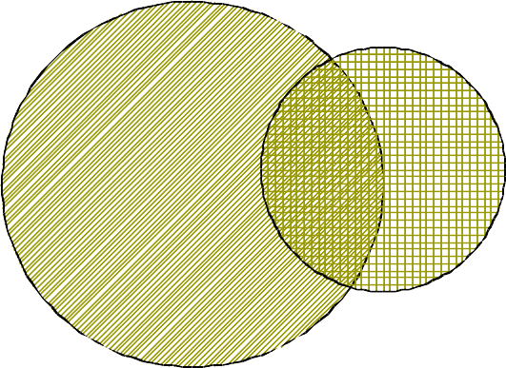

Types of Mechanisms
secure
precise
broad
set of reachable states
set of secure states

Slide 11
Assurance
Specification
  Requirements analysis
  Statement of desired functionality
Design
  How system will meet specification
Implementation
  Programs/systems that carry out design

Slide 12
Operational Issues
Cost-Benefit Analysis
  Is it cheaper to prevent or recover?
Risk Analysis
  Should we protect something?
  How much should we protect this thing?
Laws and Customs
  Are desired security measures illegal?
  Will people do them?

Slide 13
Human Issues
Organizational Problems
  Power and responsibility
  Financial benefits
People problems
  Outsiders and insiders
  Social engineering

Slide 14
Passive and Active Attacks
Passive attacks
( passive attacks attempt to steal or monitor sensitive data )
  Obtain information that is being transmitted
(eavesdropping).
  Two types:
    Release of message contents:- It may be desirable to prevent the opponent from learning the contents of the transmission.
    Traffic analysis:- The opponent can determine the location and identity of communicating hosts, and observe the frequency and length of messages being exchanged.
  Very difficult to detect.

Slide 15
Active attacks
(attempt to modify, destroy or disrupt network or system resources )
  Involve some modification of the data stream or the creation of a false stream.
  Four categories:
    Masquerade:- One entity pretends to be a different entity.
    Replay:- Passive capture of a data unit and its subsequent
retransmission to produce an unauthorized effect.
    Modification:- Some portion of a legitimate message is altered.
    Denial of service:- Prevents the normal use of
communication facilities.

Slide 16
Role of Security
A security infrastructure provides:
  Confidentiality – protection against loss of privacy
  Integrity – protection against data alteration/ corruption
  Availability – protection against denial of service
  Authentication – identification of legitimate users
  Authorization – determination of whether or not an
operation is allowed by a certain user
  Non-repudiation – ability to trace what happened, & prevent denial of actions
  Safety – protection against tampering, damage & theft

Slide 17
Security Services
Confidentiality (privacy)
Authentication (who created or sent the data)
Integrity (has not been altered)
Non-repudiation (the order is final)
Access control (prevent misuse of resources)
Availability (permanence, non-erasure)
  Denial of Service Attacks
  Virus that deletes files

Slide 18
Types of Attack
Social engineering/phishing
Physical break-ins, theft, and curb shopping
Password attacks
Buffer overflows
Command injection
Denial of service
Exploitation of faulty application logic
Snooping
Packet manipulation or fabrication
Backdoors

Slide 19
Network Security…
Network security works like this:
  Determine network security policy
  Implement network security policy
  Reconnaissance (preliminary survey to gain information)
  Vulnerability scanning
  Penetration testing
  Post-attack investigation

Slide 20
Step 1: Determine Security Policy
A security policy is a full security roadmap
  Usage policy for networks, servers, etc.
  User training about password sharing, password strength, social engineering, privacy, etc.
  Privacy policy for all maintained data
  A schedule for updates, audits, etc.
The network design should reflect this policy
  The placement/protection of database/file servers
  The location of demilitarized zones (DMZs)
  The placement and rules of firewalls
  The deployment of intrusion detection systems (IDSs)

Slide 21
Step 2: Implement Security Policy
Implementing a security policy includes:
  Installing and configuring firewalls
    iptables is a common free firewall configuration for Linux
    Rules for incoming packets should be created
      These rules should drop packets by default
    Rules for outgoing packets may be created
      This depends on your security policy
  Installing and configuring IDSes
    snort is a free and upgradeable IDS for several platforms
    Most IDSs send alerts to log files regularly
    Serious events can trigger paging, E-Mail, telephone

Slide 22
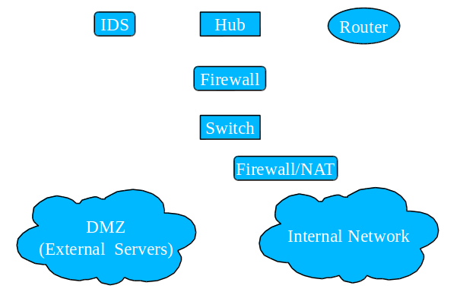
Step 2: Implement Security Policy

Slide 23
Step 2: Implement Security Policy
Firewall
  Applies filtering rules to packets passing through it
  Comes in three major types:
    Packet filter – Filters by destination IP, port or protocol
    Stateful – Records information about ongoing TCP sessions, and ensures out-of- session packets are discarded
    Application proxy – Acts as a proxy for a specific application, and scans all layers
for malicious data
Intrusion Detection System (IDS)
  Scans the incoming messages, and creates alerts when suspected scans/attacks are in progress
Honeypot/honeynet (e.g. honeyd)
  Simulates a decoy host (or network) with services

Slide 24
Step 3: Reconnaissance
First, we learn about the network
  IP addresses of hosts on the network
  Identify key servers with critical data
  Services running on those hosts/servers
  Vulnerabilities on those services
Two forms: passive and active
  Passive reconnaissance is undetectable
  Active reconnaissance is often detectable by IDS

Slide 25
Step 4: Vulnerability Scanning
We now have a list of hosts and services
  We can now target these services for attacks
Many scanners will detect vulnerabilities (e.g. nessus)
  These scanners produce a risk report
Other scanners will allow you to exploit them (e.g. metasploit)
  These scanners find ways in, and allow you to choose the payload to use (e.g. obtain a root shell, download a package)
  The payload is the code that runs once inside
The best scanners are updateable
  For new vulnerabilities, install/write new plug-ins
  e.g. Nessus Attack Scripting Language (NASL)

Slide 26
Step 5: Penetration Testing
We have identified vulnerabilities
  Now, we can exploit them to gain access
  Using frameworks (e.g. metasploit), this is as simple as selecting a payload to execute
  Otherwise, we manufacture an exploit
We may also have to try to find new vulnerabilities
  This involves writing code or testing functions accepting user input

Slide 27
Step 6: Post-Attack Investigation
Forensics of Attacks
This process is heavily guided by laws
  Also, this is normally done by a third party
Retain chain of evidence
  The evidence in this case is the data on the host
  The log files of the compromised host hold the footsteps and
fingerprints of the attacker
  Every minute with that host must be accounted for
  For legal reasons, you should examine a low-level copy of the disk and not modify the original

Slide 28
Cloud Computing
Cloud computing is a new computing paradigm, involving data and/or computation outsourcing, with
  Infinite and elastic resource scalability
  On demand “just-in-time” provisioning
  No upfront cost … pay-as-you-go
Use as much or as less you need, use only when you want, and pay only what you use

Slide 29
Economic Advantages of Cloud Computing
For consumers:
  No upfront commitment in buying/leasing hardware
  Can scale usage according to demand
  Minimizing start-up costs
    Small scale companies and startups can reduce CAPEX (Capital Expenditure)
For providers:
  Increased utilization of datacenter resources

Slide 30


Why aren’t Everyone using Cloud?
Clouds are still subject to traditional data confidentiality, integrity, availability, and privacy issues, plus some additional attacks

Slide 31
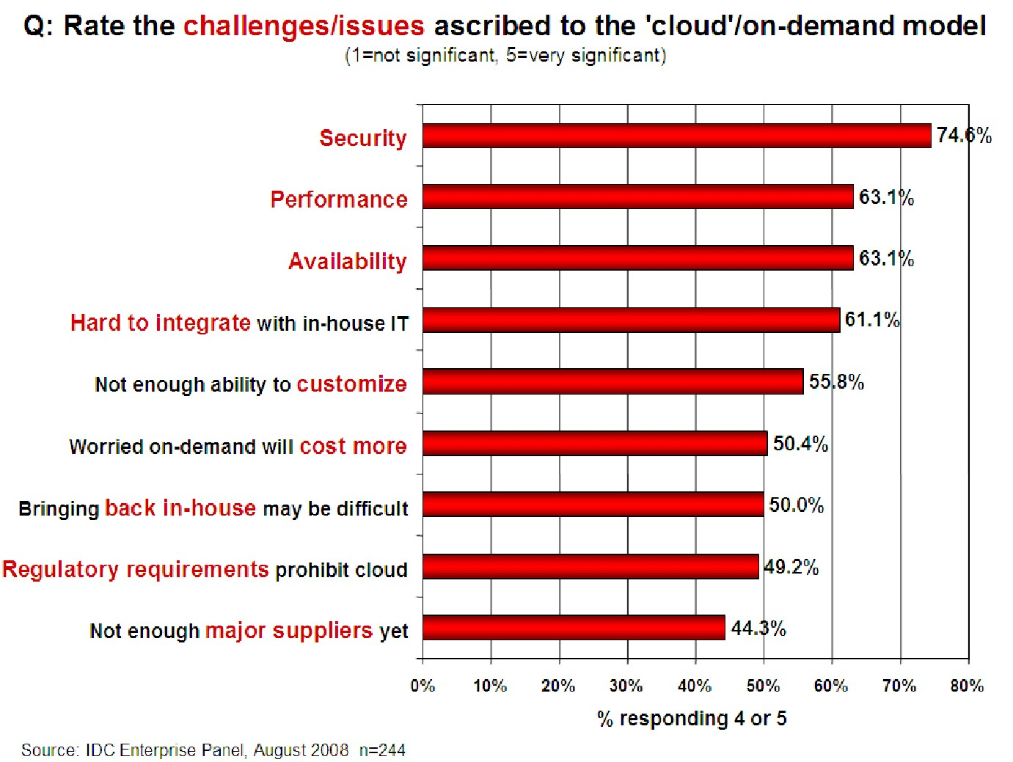
Concern…

Slide 32
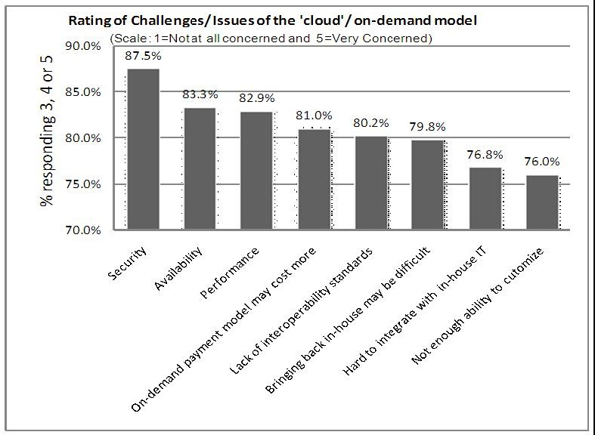
Survey on Potential Cloud Barriers
Source: IDC Ranking Security Challenges

Slide 33
Why Cloud Computing brings New Threats?
Traditional system security mostly means keeping attackers out
The attacker needs to either compromise the authentication/access control system, or impersonate existing users
But cloud allows co-tenancy: Multiple independent users share the same physical infrastructure
– An attacker can legitimately be in the same physical machine as the target
Customer’s lack of control over his own data and application.
Reputation fate-sharing

Slide 34
Security Stack
IaaS: entire infrastructure from facilities to hardware
PaaS: application, middleware, database, messaging supported by IaaS
  Customer-side system administrator manages the same with provider handling platform, infrastructure security
SaaS: self contained operating environment: content, presentation, apps, management
  Service levels, security, governance, compliance, liability, expectations of the customer & provider are contractually defined
Increase in Customer’s Security Responsibility
Increase in Provider’s Security
Responsibility

Slide 35
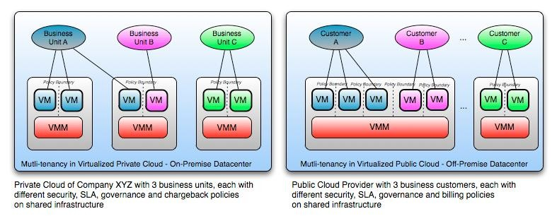
Sample Clouds
Source: “Security Guidance for Critical Areas of Focus in Cloud Computing” v2.1, p.18

Slide 36
Gartner’s Seven Cloud Computing Security Risks
Gartner:
  http://www.gartner.com/technology/about.jsp
  Cloud computing has “unique attributes that require risk assessment in areas such as data integrity, recovery and privacy, and an evaluation of legal issues in areas such as e-
discovery, regulatory compliance and auditing,” Gartner says
Security Risks
  Privileged User Access
  Regulatory Compliance & Audit
  Data Location
  Data Segregation
  Recovery
  Investigative Support
  Long-term Viability

Slide 37
Privileged User Access
Sensitive data processed outside the enterprise brings with it an inherent
level of risk
Outsourced services bypass the “physical, logical and personnel controls” of traditional in-house deployments.
Get as much information as you can about the people who manage your data
“Ask providers to supply specific information on the hiring and oversight of privileged administrators, and the controls over their access,” Gartner says.

Slide 38
Regulatory Compliance & Audit
Traditional service providers are subjected to external audits and security certifications.
Cloud computing providers who refuse to undergo this scrutiny are “signaling that
customers can only use them for the most trivial functions,” according to Gartner.
Shared infrastructure – isolation of user-specific log
No customer-side auditing facility
Difficult to audit data held outside organization in a cloud
– Forensics also made difficult since now clients don’t maintain data locally
Trusted third-party auditor?

Slide 39
Data Location
Hosting of data, jurisdiction?
Data centers: located at geographically dispersed locations
Different jurisdiction & regulations
  Laws for cross border data flows
Legal implications
  Who is responsible for complying with regulations (e.g., SOX, HIPAA, etc.)?
  If cloud provider subcontracts to third party clouds, will the data still be secure?
13

Slide 40
Data Segregation
Data in the cloud is typically in a shared environment alongside data from other
customers.
Encryption is effective but isn’t a cure-all. “Find out what is done to segregate data at rest,” Gartner advises.
Encrypt data in transit, needs to be decrypted at the time of processing
  Possibility of interception
Secure key store
  Protect encryption keys
  Limit access to key stores
  Key backup & recoverability
The cloud provider should provide evidence that encryption schemes were designed and tested by experienced specialists.
“Encryption accidents can make data totally unusable, and even normal encryption can complicate availability,” Gartner says.

Slide 41
Recovery
Even if you don’t know where your data is, a cloud provider should tell you what will happen to your data and service in case of a disaster.
“Any offering that does not replicate the data and application infrastructure across multiple sites is vulnerable to a total failure,” Gartner says. Ask your provider if it has “the ability to do a complete restoration, and how long it will take.”
Recovery Point Objective (RPO): The maximum amount of data that will be lost following an interruption or disaster.
Recovery Time Objective (RTO): The period of time allowed for recovery i.e., the time that is
allowed to elapse between the disaster and the activation of the secondary site.
Backup frequency
Fault tolerance
  Replication: mirroring/sharing data over disks which are located in separate physical locations to maintain consistency
  Redundancy: duplication of critical components of a system with the intention of increasing reliability of the system, usually in the case of a backup or fail-safe.

Slide 42
Investigative Support
Investigating inappropriate or illegal activity may be impossible in cloud computing
Monitoring
– To eliminate the conflict of interest between the provider and the consumer, a neural third-party organization is the best solution to monitor performance.
Gartner warns. “Cloud services are especially difficult to investigate, because logging and data for multiple customers may be co-located and may also be spread across an ever-changing set of hosts and data centers.”
16

Slide 43
Long-term Viability
“Ask potential providers how you would get your data back and if it would be in a format that you could import into a replacement application,” Gartner says.
When to switch cloud providers ?
  Contract price increase
  Provider bankruptcy
  Provider service shutdown
  Decrease in service quality
  Business dispute
Problem: vendor lock-in
17

Slide 44
Other Cloud Security Issues…
Virtualization
Access Control & Identity Management
Application Security
Data Life Cycle Management

Slide 45
Virtualization
Components:
  Virtual machine (VM)
  Virtual machine manager (VMM) or hypervisor
Two types:
  Full virtualization: VMs run on hypervisor that interacts with the hardware
  Para virtualization: VMs interact with the host OS.
Major functionality: resource isolation
Hypervisor vulnerabilities:
  Shared clipboard technology– transferring malicious programs from VMs to
host

Slide 46
Virtualization (contd…)
Hypervisor vulnerabilities:
  Keystroke logging: Some VM technologies enable the logging of keystrokes and screen updates to be passed across virtual terminals in the virtual machine, writing to host files and permitting the monitoring of encrypted terminal connections inside the VM.
  Virtual machine backdoors: covert communication channel
  ARP Poisoning: redirect packets going to or from the other VM.
Hypervisor Risks
  Rogue hypervisor rootkits
    Initiate a ‘rogue’ hypervisor
    Hide itself from normal malware detection systems
    Create a covert channel to dump unauthorized code

Slide 47
Virtualization (contd…)
Hypervisor Risks
  External modification to the hypervisor
    Poorly protected or designed hypervisor: source of attack
    May be subjected to direct modification by the external intruder
  VM escape
    Improper configuration of VM
    Allows malicious code to completely bypass the virtual environment, and obtain full root or kernel access to the physical host
    Some vulnerable virtual machine applications: Vmchat, VMftp, Vmcat etc.
  Denial-of-service risk
Threats:
  Unauthorized access to virtual resources – loss of confidentiality, integrity, availability

Slide 48
Access Control & Identity Management
Access control: similar to traditional in-house IT network
Proper access control: to address CIA tenets of information security
Prevention of identity theft – major challenge
  Privacy issues raised via massive data mining
    Cloud now stores data from a lot of clients, and can run data mining algorithms to get large amounts of information on clients
Identity Management (IDM) – authenticate users and services
based on credentials and characteristics

Slide 49
Application Security
Cloud applications – Web service based
Similar attacks:
  Injection attacks: introduce malicious code to change the course of execution
  XML Signature Element Wrapping: By this attack, the original body of an XML message is moved to a newly inserted wrapping element inside the SOAP header, and a new body is created.
  Cross-Site Scripting (XSS): XSS enables attackers to inject client-side script into Web pages viewed by other users to bypass access controls.
  Flooding: Attacker sending huge amount of request to a certain service and causing denial of
service.
  DNS poisoning and phishing: browser-based security issues
  Metadata (WSDL) spoofing attacks: Such attack involves malicious reengineering of Web Services’ metadata description
Insecure communication channel
23

Slide 50
Data Life Cycle Management
Data security
  Confidentiality:
    Will the sensitive data stored on a cloud remain confidential?
    Will cloud compromise leak confidential client data (i.e., fear of loss of
control over data)
    Will the cloud provider itself be honest and won’t peek into the data?
  Integrity:
    How do I know that the cloud provider is doing the computations correctly?
    How do I ensure that the cloud provider really stored my data without
tampering with it?

Slide 51
Data Life Cycle Management (contd.)
Availability
  Will critical systems go down at the client, if the provider is attacked in a Denial of Service attack?
  What happens if cloud provider goes out of business?
Data Location
  All copies, backups stored only at location allowed by contract, SLA and/or regulation
Archive
Access latency

Slide 52
Research Article
Research Paper:
  Hey, You, Get Off of My Cloud! Exploring Information Leakage in Third-Party Compute Clouds. by Thomas Ristenpart, Eran Tromer, Hovav Shacham, and Stefan Savage. In Proceedings of CCS 2009, pages 199–212. ACM Press, Nov. 2009.
  First work on cloud cartography
    Attack launched against commercially available “real” cloud (Amazon EC2)
    Claims up to 40% success in co-residence with target VM

Slide 53
New Risks in Cloud
Trust and dependence
  Establishing new trust relationship between customer and cloud provider
  Customers must trust their cloud providers to respect the privacy of their data
and integrity of their computations
Security (multi-tenancy)
  Threats from other customers due to the subtleties of how physical resources can be transparently shared between virtual machines (VMs)
3

Slide 54
Multi-tenancy
Multiplexing VMs of disjoint customers upon the same physical hardware
  Your machine is placed on the same server with other customers
  Problem: you don’t have the control to prevent your instance from being co-resident with an adversary
New risks
  Side-channels exploitation
    Cross-VM information leakage due to sharing of physical resource (e.g., CPU’s data caches)
    Has the potential to extract RSA & AES secret keys
  Vulnerable VM isolation mechanisms
    Via a vulnerability that allows an “escape” to the hypervisor
  Lack of control who you’re sharing server space
4

Slide 55
Attack Model
Motivation
  To study practicality of mounting cross-VM attacks in existing third-party compute clouds
Experiments have been carried out on real IaaS cloud service provider (Amazon EC2)
Two steps of attack:
  Placement: adversary arranging to place its malicious VM on the same physical machine as that of
the target customer
  Extraction: extract confidential information via side channel attack
5

Slide 56
Threat Model
Assumptions of the threat model:
  Provider and infrastructure to be trusted
  Do not consider attacks that rely on subverting administrator functions
  Do not exploit vulnerabilities of the virtual machine monitor and/or other software
  Adversaries: non-providers-affiliated malicious parties
  Victims: users running confidentiality-requiring services in the cloud
Focus on new cloud-related capabilities of the attacker and implicitly expanding the attack surface
6

Slide 57
Threat Model (contd…)
Like any customer, the malicious party can run and control many
instances in the cloud
  Maximum of 20 instances can be run parallel using an Amazon EC2 account
Attacker’s instance might be placed on the same physical hardware as potential victims
Attack might manipulate shared physical resources to learn otherwise confidential information
Two kinds of attack may take place:
  Attack on some known hosted service
  Attacking a particular victim’s service
7

Slide 58
Addresses the Following…
Q1: Can one determine where in the cloud infrastructure an instance is
located?
Q2: Can one easily determine if two instances are co-resident on the same physical machine?
Q3: Can an adversary launch instances that will be co-resident with other
user’s instances?
Q4: Can an adversary exploit cross-VM information leakage once co- resident?
8

Slide 59
Amazon EC2 Service
Scalable, pay-as-you-go compute capacity in the cloud
Customers can run different operating systems within a virtual machine
Three degrees of freedom: instance-type, region, availability zone
Different computing options (instances) available
  m1.small, c1. medium: 32-bit architecture
  m1.large, m1.xlarge, c1.xlarge: 64-bit architecture
Different regions available
  US, EU, Asia
Regions split into availability zones
  In US: East (Virginia), West (Oregon), West (Northern California)
  Infrastructures with separate power and network connectivity
Customers randomly assigned to physical machines based on their instance, region, and availability zone choices
9

Slide 60
Amazon EC2 Service (contd…)
Xen hypervisor
  Domain0 (Dom0): privileged virtual machine
    Manages guest images
    Provisions physical resources
    Access control rights
    Configured to route packets for its guest images and reports itself as a hop in traceroutes.
  When an instance is launched, it is assigned to a single physical machine for its lifetime
Each instance is assigned internal and external IP addresses and domain names
  External IP: public IPv4 address [IP: 75.101.210.100/domain name: ec2-75-101-210-100.compute-1.amazonaws.com]
  Internal IP: RFC 1918 private address [IP: 10.252.146.52/domain name: domU-12-31-38-00-8D-C6.compute-1.internal]
Within the cloud, both domain names resolve to the internal IP address
Outside the cloud, external name is mapped to the external IP address
10

Slide 61
Q1: Cloud Cartography
Instance placing is not disclosed by Amazon but is needed to launch co- residency attack
Map the EC2 service to understand where potential targets are located in the cloud
Determine instance creation parameters needed to attempt establishing co-
residence of an adversarial instance
Hypothesis: different availability zones and instance types correspond to different IP address ranges
11

Slide 62
Network Probing
Identify public servers hosted in EC2 and verify co-residence
Open-source tools have been used to probe ports (80 and 443)
  nmap – perform TCP connect probes (attempt to complete a 3-way hand-shake between a source and target)
  hping – perform TCP SYN traceroutes, which iteratively sends TCP SYN packets with increasing TTLs, until no ACK is received
  wget – used to retrieve web pages
External probe: probe originating from a system outside EC2 and has an EC2 instance as
destination
Internal probe: originates from an EC2 instance, and has destination another EC2 instance
Given an external IP address, DNS resolution queries are used to determine:
  External name
  Internal IP address
12

Slide 63
Survey Public Servers on EC2
Goal: to enable identification of the instance type and availability zone of one or more potential targets
WHOIS: used to identify distinct IP address prefixes associated with EC2
EC2 public IPs: /17, /18, /19 prefixes
  57344 IP addresses
Use external probes to find responsive IPs:
  Performed TCP connect probe on port 80
    11315 responsive IPs
  Followed up with wget on port 80
    9558 responsive IPs
  Performed a TCP scan on port 443
    8375 responsive IPs
Used DNS lookup service
  Translate each public IP address that responded to either the port 80 or 443 scan into an internal EC2 address
  14054 unique internal IPs obtained
13

Slide 64
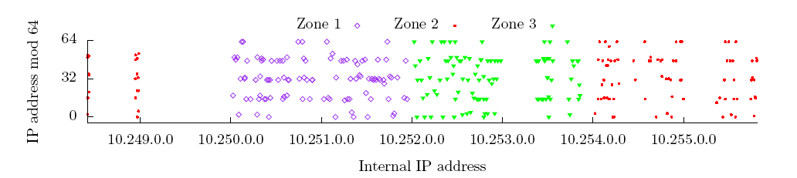
Instance Placement Parameters
EC2’s internal address space is cleanly partitioned between availability zones
  Three availability zone; five instance-type/zone
  20 instances launched for each of the 15 availability zone/instance type pairs from a particular account (Say, Account A)
Samples from each zone are assigned IP addresses from disjoint portions of the observed internal address space
Assumption: internal IP addresses are statically assigned to physical machines
  To ease out IP routing
Availability zones use separate physical infrastructure
14

Slide 65
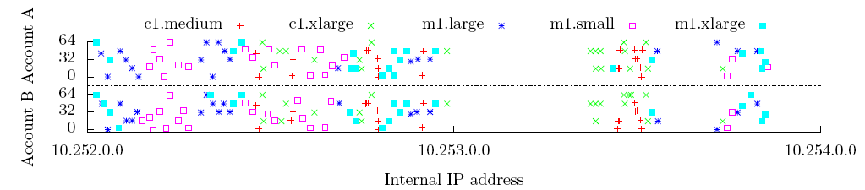
Instance Placement Parameters (contd…)
100 instances have been launched in Zone 3 using two different accounts: A & B (39 hours after terminating the Account A instances)
Of 100 Account A Zone 3 instances
  92 had unique /24 prefixes
  Four /24 prefixes had two instances each
Of 100 Account B Zone 3 instances
  88 had unique /24 prefixes
  Six of the /24 prefixes had two instances each
A single /24 had both an m1.large and m1.xlarge instance
Of 100 Account B IP’s, 55 were repeats of IP addresses assigned to instances for Account A
15

Slide 66
Q2: Determining Co-residence
Network-based co-residency checks: instances are likely to be co-
resident if they have-
  Matching Dom0 IP address: determine an uncontrolled instance’s Dom0 IP by
performing a TCP SYN traceroute to it from another instance and inspect the last hop
  Small packet round-trip times: 10 probes were performed and the average is taken
  Numerically close internal IP addresses (e.g., within 7): the same Dom0 IP will be
shared by instances with contiguous sequence of internal IP addresses
16

Slide 67
Verifying Co-residency Check
If two (under self-control) instances can successfully transmit via the covert channel, then they are co-resident, otherwise not
Experiment: hard-disk-based covert channel
  To send a 1, sender reads from random locations on a shared volume, to send a 0 sender does nothing
  Receiver times reading from a fixed location on the disk: longer read times mean a 1 is set, shorter a 0
3 m1.small EC2 accounts: control, victim, probe
  2 control instances in each of 3 availability zones, 20 victim and 20 probe instances in Zone 3
Determine Dom0 address for each instance
For each ordered pair (A, B) of 40 instances, perform co-residency checks
After 3 independent trials, 31 (potentially) co-resident pairs have been identified - 62 ordered pairs
5 bit message from A to B was successfully sent for 60 out of 62 ordered pairs
17

Slide 68
Effective Co-residency Check
For checking co-residence with target instances:
  Compare internal IP addresses to see if they are close
  If yes, perform a TCP SYN traceroute to an open port on the target and see if there is only a single hop (Dom0 IP)
    Check requires sending (at most) two TCP SYN packets
– No full TCP connection is established
    Very “quiet” check (little communication with the victim)
18

Slide 69
Q3: Causing Co-residence
Two strategies to achieve “good” coverage (co-residence with a good fraction of target set)
  Brute-force placement:
    run numerous probe instances over a long period of time and see how many targets one can achieve co-residence with.
    For co-residency check, the probe performed a wget on port 80 to ensure the target was still serving web pages
    Of the 1686 target victims, the brute-force probes achieved co-residency with 141 victim servers (8.4% coverage)
    Even a naïve strategy can successfully achieve co-residence against a not-so-small fraction of targets
  Target recently launched instances:
    take advantage of the tendency of EC2 to assign fresh instances to small set of machines
19

Slide 70
Leveraging Placement Locality
Placement locality
  Instances launched simultaneously from same account do not run on the same physical machine
  Sequential placement locality: exists when two instances run sequentially (the first terminated before launching the second) are often assigned to the same machine
  Parallel placement locality: exists when two instances run (from distinct accounts) at roughly the same time are often assigned to the same machine.
Instance flooding: launch lots of instances in parallel in the appropriate availability zone
and of the appropriate type
20

Slide 71
Leveraging Placement Locality (contd…)
Experiment
  Single victim instance is launched
  Attacker launches 20 instances within 5 minutes
  Perform co-residence check
  40% of the time the attacker launching just 20 probes achieves co-residence against a specific target instance
21

Slide 72
Q4: Exploiting Co-residence
Cross-VM attacks can allow for information leakage
How can we exploit the shared infrastructure?
  Gain information about the resource usage of other instances
  Create and use covert channels to intentionally leak information from one instance to
another
  Some applications of this covert channel are:
    Co-residence detection
    Surreptitious detection of the rate of web traffic a co-resident site receives
    Timing keystrokes by an honest user of a co-resident instance
22

Slide 73
Exploiting Co-residence (contd…)
Measuring cache usage
  Time-shared cache allows an attacker to measure when other instances are experiencing computational load
  Load measurement: allocate a contiguous buffer B of b bytes, s is cache line size (in bytes)
    Prime: read B at s-byte offsets in order to ensure that it is cached.
    Trigger: busy-loop until CPU’s cycle counter jumps by a large value
    Probe: measure the time it takes to again read B at s-byte offset
  Cache-based covert channel:
    Sender idles to transmit a 0 and frantically accesses memory to transmit a 1
    Receiver accesses a memory block and observes the access latencies
    High latencies are indicative that “1” is transmitted
23

Slide 74
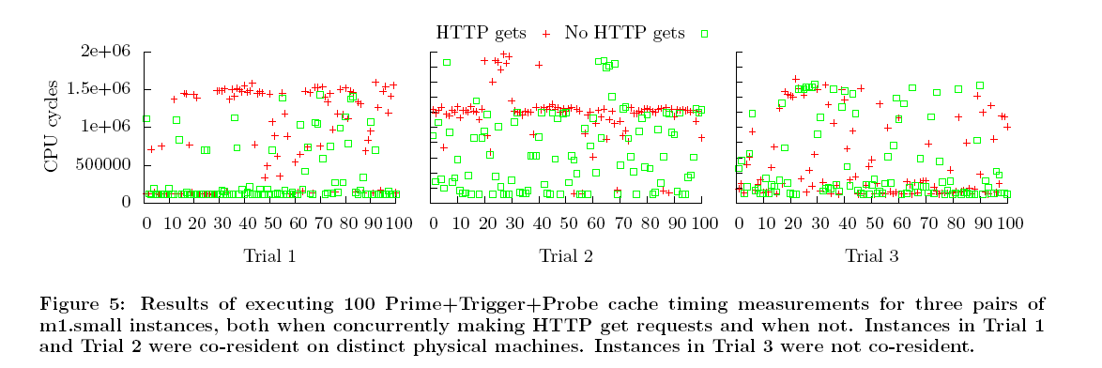
Exploiting Co-residence (contd…)
Load-based co-residence check
Co-residence check can be done without network- base technique
Adversary can actively cause load variation due to a publicly-accessible service running on the target
Use a priori knowledge about load variation
Induce computational load (lots of HTTP requests) and observe the differences in load samples
Instances in Trial 1 and Trial 2 were co-resident on distinct physical machines; instances in Trial 3 were not co-
resident
24

Slide 75
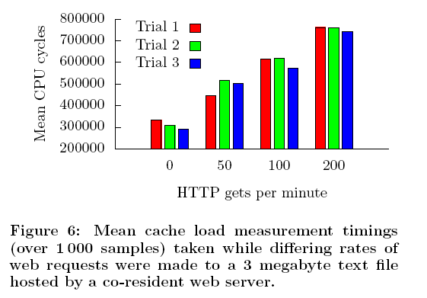
Exploiting Co-residence (contd…)
Estimating traffic rates
  Load measurement might provide a method for estimating the number of visitors to a co-resident web
server
  It might not be a public information and could be damaging
  Perform 1000 cache load measurements in which
    no HTTP requests are sent
    HTTP requests sent at a rate of (i) 50 per minute, (ii) 100 per minute, (iii) 200 per minutes
25

Slide 76
Exploiting Co-residence (contd…)
Keystroke timing attack
  The goal is to measure the time between keystrokes made by a victim typing a password (or other sensitive information)
  Malicious VM can observe keystroke timing in real time via cache-based load
measurements
  Inter-keystroke times if properly measures can be used to perform recovery of the password
  In an otherwise idle machine, a spike in load corresponds to a letter being typed
into the co-resident VM’s terminal
  Attacker does not directly learn exactly which keys are pressed, the attained timing resolution suffices to conduct the password-recovery attacks on SSH sessions
26

Slide 77
Preventive Measures
Mapping
  Use a randomized scheme to allocate IP addresses
  Block some tools (nmap, traceroute)
Co-residence checks
  Prevent identification of Dom0
Co-location
  Not allow co-residence at all
    Beneficial for cloud user
    Not efficient for cloud provider
Information leakage via side-channel
  No solution
27

Slide 78
Summary
New risks from cloud computing
Shared physical infrastructure may and most likely will cause problems
– Exploiting software vulnerabilities not addressed here
Practical attack performed
Some countermeasures proposed
28

Slide 79
Security Issues in Cloud Computing
Unique security features:
  Co-tenancy
  Lack of control on outsourced data and application
General concerns among cloud customers [Liu’11]:
  Inadequate policies and practices
  Insufficient security controls
Customers use cloud services to serve their clients
Need to establish trust relationships
Beneficial to both stakeholders
2

Slide 80
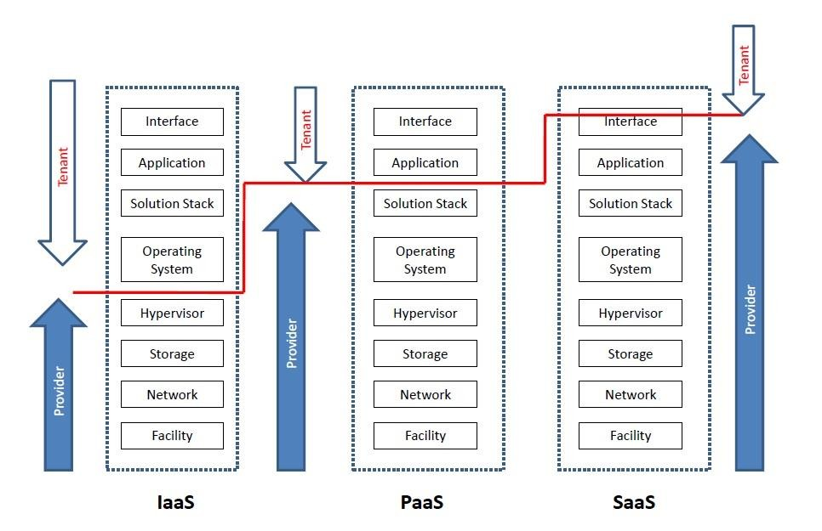
Security Responsibilities
3

Slide 81
SaaS Cloud-based Collaboration
APIs for sharing resources/information
  Service consumer(customers): human users, applications, organizations/domains,
etc.
  Service provider: SaaS cloud vendor
SaaS cloud-centric collaboration: valuable and essential
  Data sharing
  Problems handled: inter-disciplinary approach
Common concerns:
  Integrity of data, shared across multiple users, may be compromised
  Choosing an “ideal” vendor
Nirnay Ghosh, Securing Loosely-coupled Collaborations in a SaaS Cloud through Risk Estimation and Access Conflict Mediation, PhD
Thesis, IIT Kharagpur, 2016
4

Slide 82
SaaS Cloud-based Collaboration
Types of collaboration in multi-domain/cloud systems:
  Tightly-coupled or federated
  Loosely-coupled
Challenges: securing loosely-coupled collaborations in cloud environment
  Security mechanisms: mainly proposed for tightly-coupled systems
  Restrictions in the existing authentication/authorization
mechanisms in clouds
5

Slide 83
Motivations and Challenges
SaaS cloud delivery model: maximum lack of control
No active data streams/audit trails/outage report
  Security: Major concern in the usage of cloud services
Broad scope: address security issues in SaaS clouds
Cloud marketplace: rapid growth due to recent advancements
Availability of multiple service providers
  Choosing SPs from SLA guarantees: not reliable
    Inconsistency in service level guarantees
    Non-standard clauses and technical specifications
Focus: selecting an “ideal” SaaS cloud provider and address the security issues
6

Slide 84
Motivations and Challenges
Online collaboration: popular
Security issue: unauthorized disclosure of sensitive information
  Focus: selecting an ideal SaaS cloud provider and secure the collaboration service offered by it
Relevance in today’s context: loosely-coupled collaboration
  Dynamic data/information sharing
Final goal (problem statement): selecting an ideal SaaS cloud provider and securing the loosely-coupled collaboration in its environment
7

Slide 85
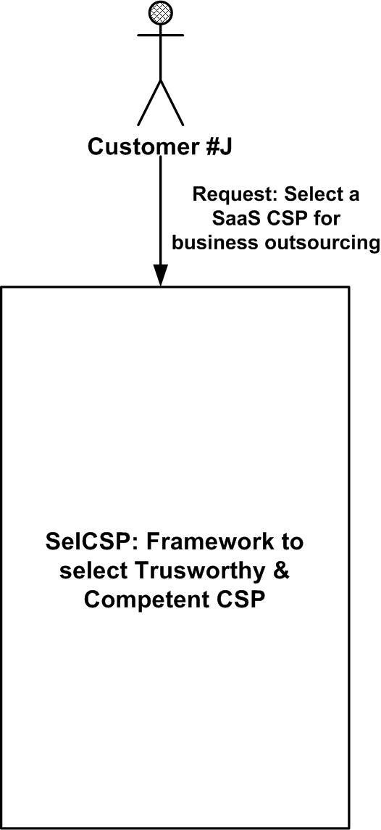
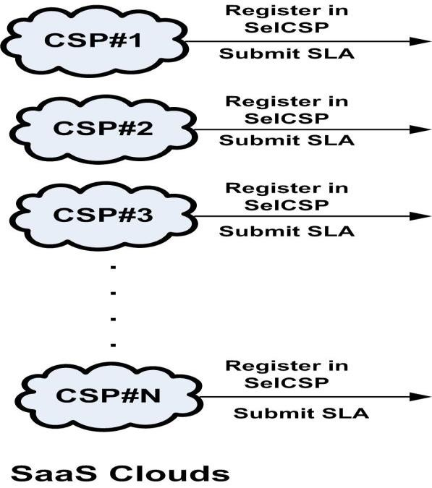
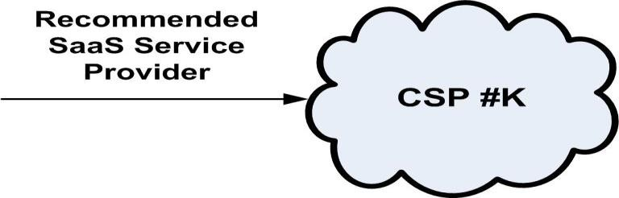
Objective - I
A framework (SelCSP) for selecting a trustworthy and competent collaboration service provider.
9/20/2017

Slide 86
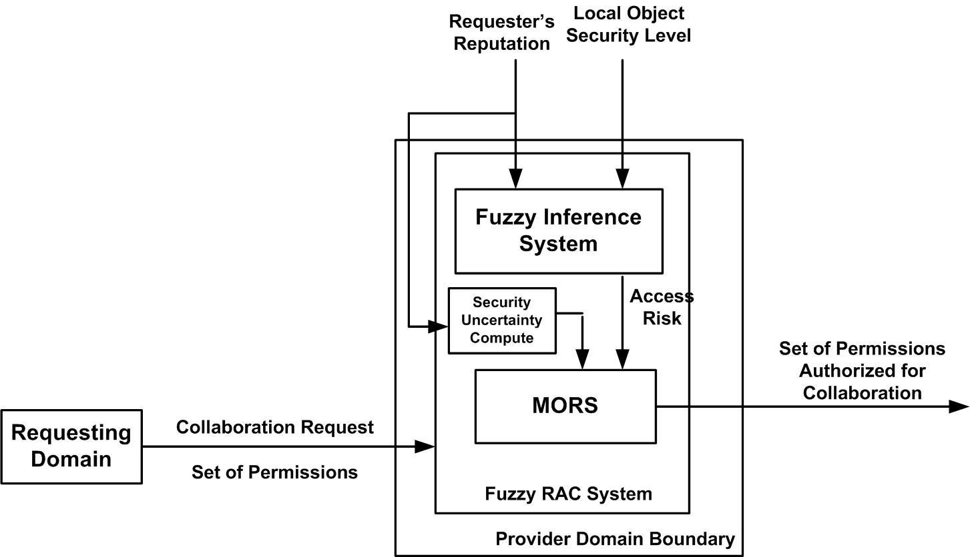
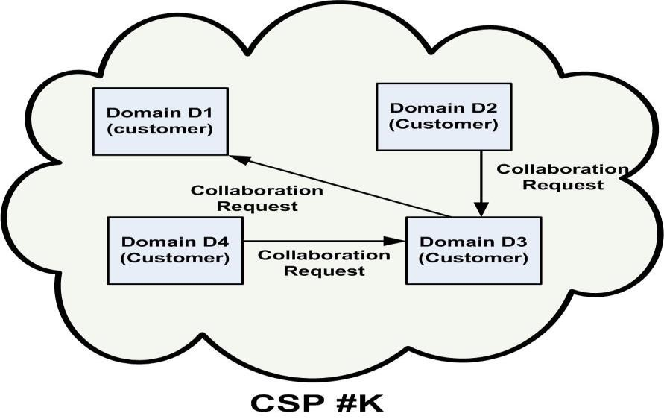
Objective - II
Select requests (for accessing local resources) from anonymous users, such that both access risk and security uncertainty due to information sharing are kept low.

Slide 87
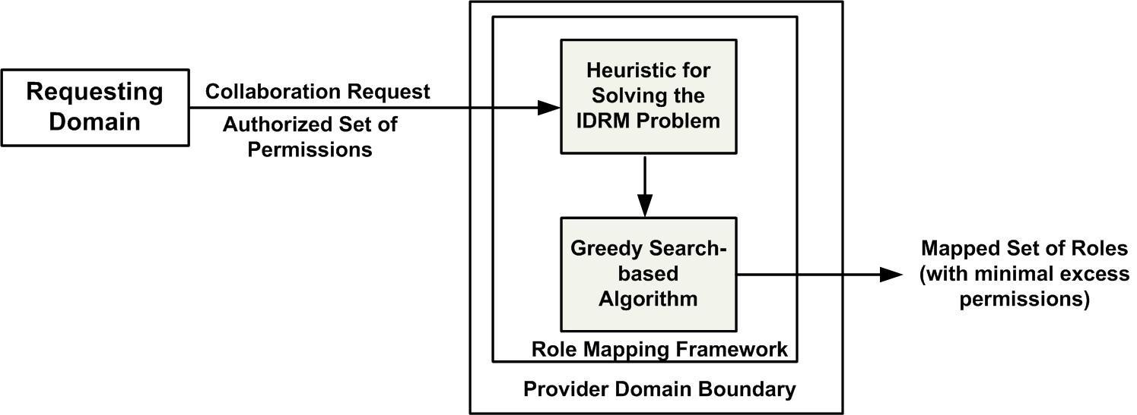
Objective - III
Formulate a heuristic for solving the IDRM problem, such that minimal excess privilege is granted

Slide 88
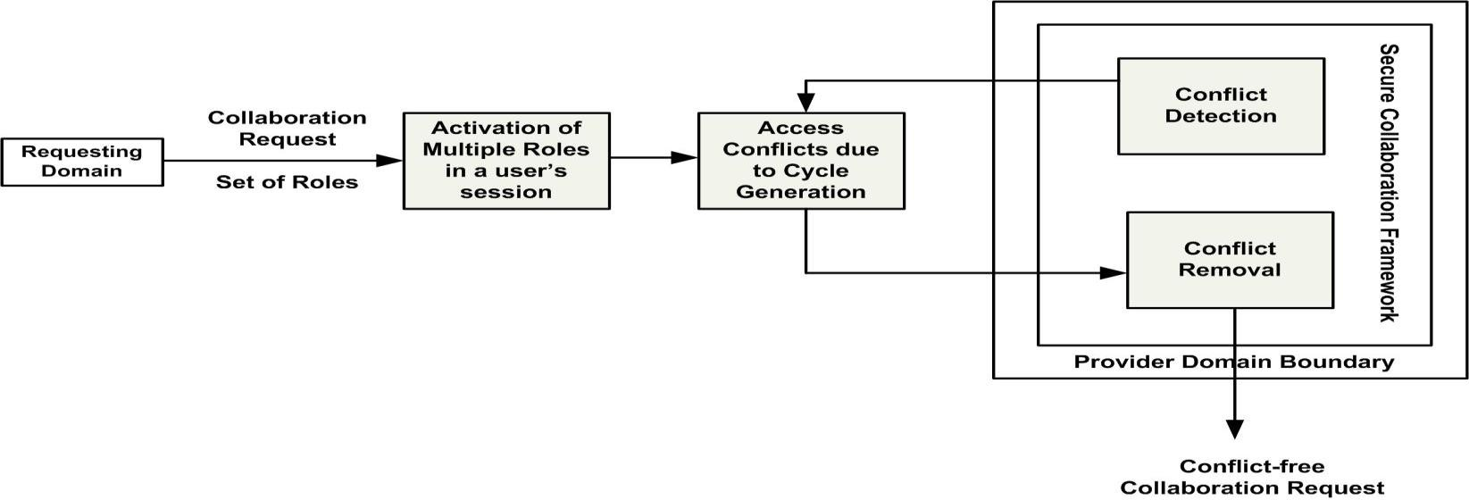
Objective - IV
A distributed secure collaboration framework, which uses only local information to dynamically detect and remove access conflicts.

Slide 89
Selection of Trustworthy and Competent SaaS Cloud Provider for Collaboration

Slide 90
Trust Models in Cloud
Challenges
  Most of the reported works have not presented mathematical formulation or validation of their trust and risk models
  Web service selection [Liu’04][Garg’13] based on QoS and trust are
available
    Select resources (e.g. services, products, etc.) by modeling their performance
Objective: Model trust/reputation/competence of service provider

Slide 91
Service Level Agreement (SLA) for Clouds
Challenges:
  Majority of the cloud providers guarantee “availability” of services
  Consumers not only demand availability guarantee but also other performance related assurances which are equally business critical
  Present day cloud SLAs contain non-standard clauses regarding assurances and compensations following a violation[Habib’11]
Objective: Establish a standard set of parameters for cloud SLAs, since it reduces the perception of risk in outsourced services

Slide 92
Recommending Access Requests from Anonymous Users for Authorization

Slide 93
Risk-based Access Control (RAC)
RAC: Gives access to subjects even though they lack proper permissions
  Goal: balance between access risk and security uncertainty due to information
sharing
  Flexible compared to binary MLS
Challenges
  Computing security uncertainty: not addressed
  Authorization in existing RAC system: based on risk threshold and operational
need.
    Operational need: not quantified.
    Discards many requests which potentially maximizes information sharing

Slide 94
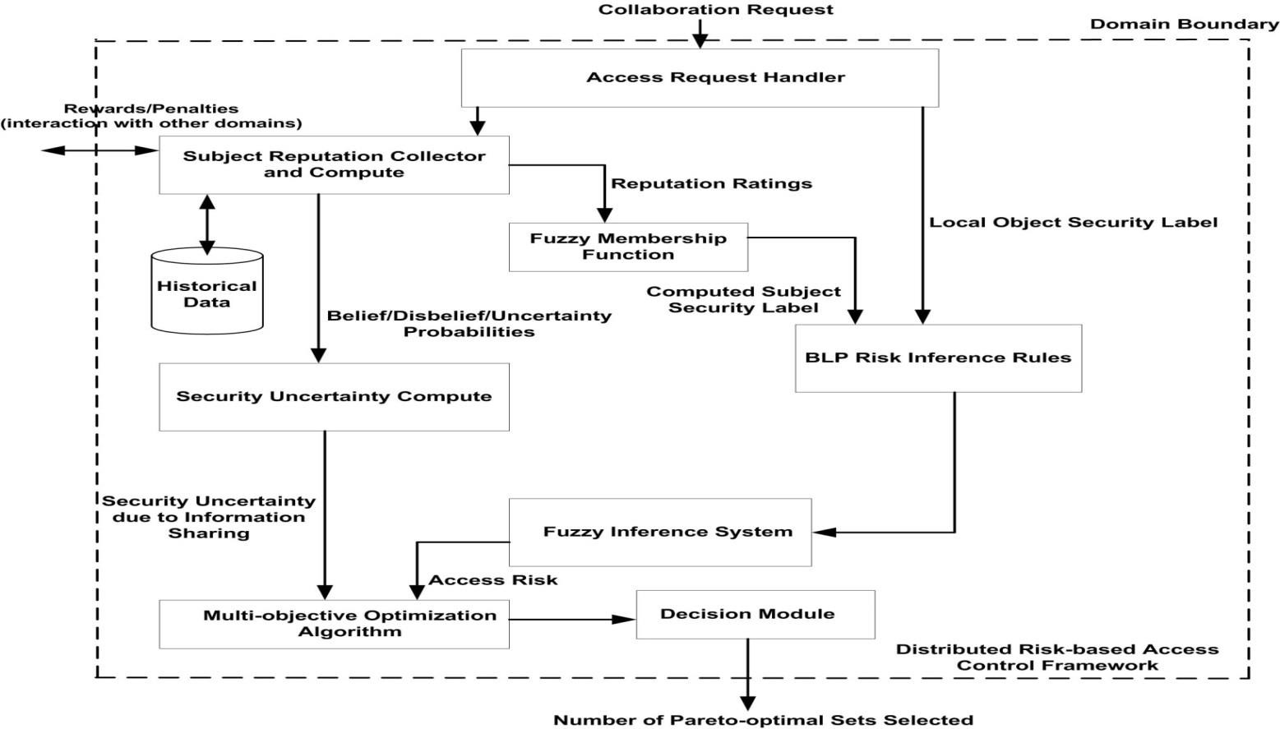
Distributed RAC using Fuzzy Inference System

Slide 95
Mapping of Authorized Permissions into Local Roles

Slide 96
Inter-Domain Role Mapping (IDRM)
Finds a minimal set of role which encompasses the requested permission set.
  No polynomial time solution
  Greedy search-based heuristics: suboptimal solutions
Challenges:
  There may exist multiple minimal role sets
  There may not exist any role set which exactly maps all permissions
Two variants of IDRM proposed: IDRM-safety, IDRM-availability
Objective: formulate a novel heuristic to generate better solution for the IDRM-
availability problem.
Minimize the number of additional permissions

Slide 97
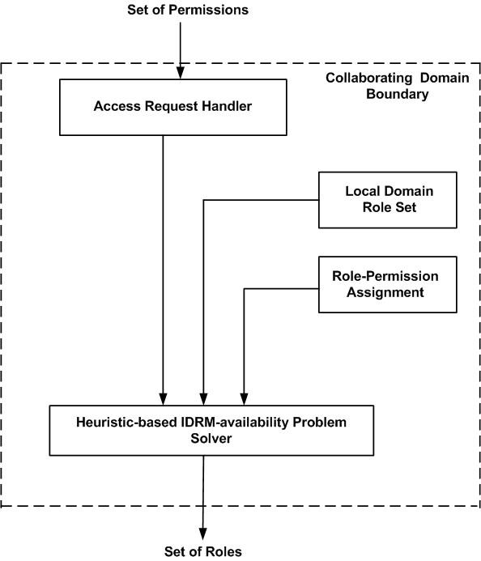
Distributed Role Mapping Framework
Distributed Role Mapping Framework

Slide 98
Dynamic Detection and Removal of Access Policy Conflicts

Slide 99
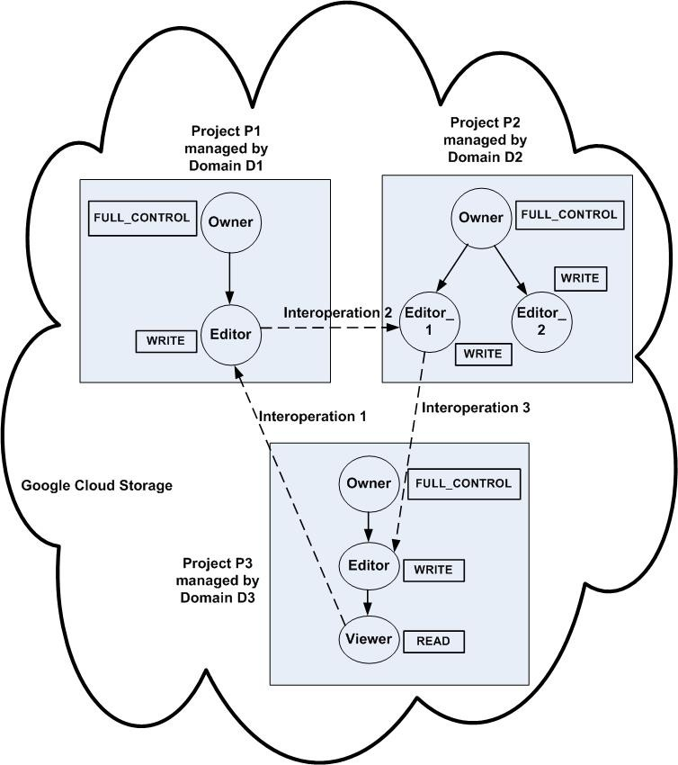
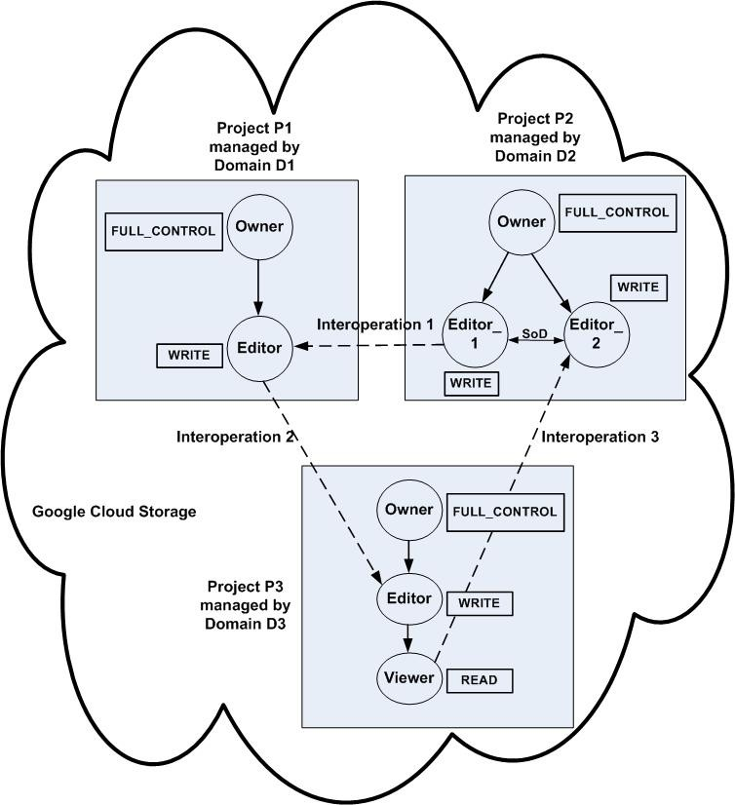
Access Conflicts
Cyclic Inheritance Conflict
Violation of SoD Constraint

Slide 100
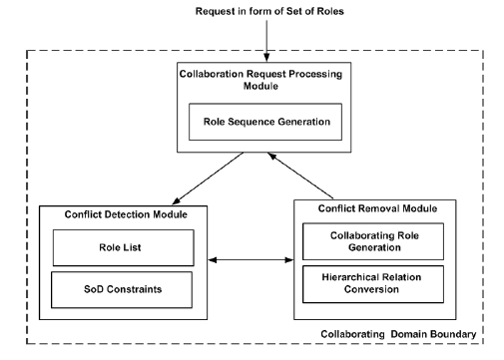
Objective
Dynamic detection of conflicts to address security issue
Removal of conflicts to address availability issue
Proposed: distributed secure collaboration framework
Role Sequence Generation
Interoperation request: pair of entry (from requesting domain), exit (from providing domain) roles
Role sequence: ordered succession of entry and exit roles
Role cycle:
  Safe role cycle
  Unsafe role cycle
Distributed Secure Collaboration Framework

Slide 101
Conflict Detection
Detection of inheritance conflict
  Necessary condition: at least one exit role
  Sufficient condition: current entry role is senior to at least one exit role
Detection of SoD constraint violation
  Necessary condition: at least one exit role
  Sufficient condition: current entry role and at least one exit role forms
conflicting pair

Slide 102
Conflict Removal
Cyclic Inheritance
Two cases arise:
  Exactly matched role set exists
    RBAC hybrid hierarchy
– I-hierarchy, A-hierarchy, IA-hierarchy
    Replacing IA-relation with A-relation between exit role in previous domain and entry role in current domain
  No-exactly matched role set exists
    Introduce a virtual role

Slide 103
Conflict Removal
SoD Constraint Violation
Two cases: similar to removal of inheritance conflict
  Additional constraint: identifying conflicting permission between collaborating role and entry role in current domain
  Conflicting permission
    Objects are similar
    Hierarchical relation exists between access modes
Remove conflicting permission from permission set of collaborating role

Slide 104
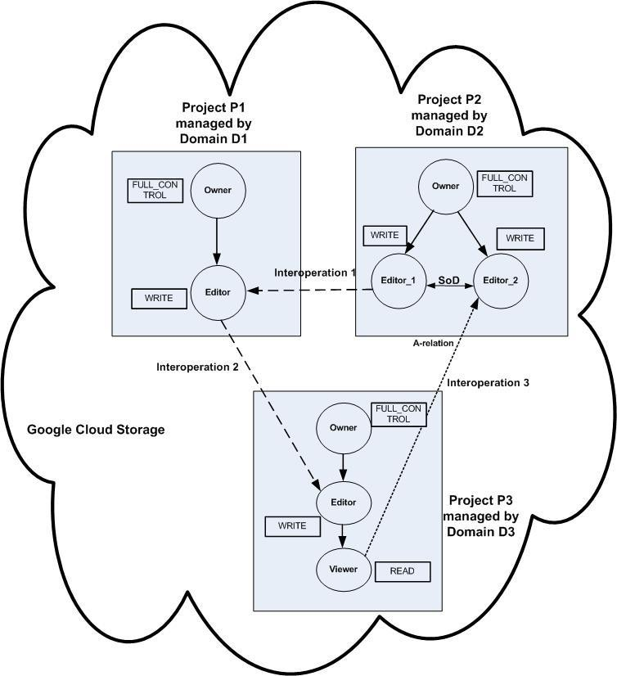
Conflict Removal
SoD Constraint Violation: SoD Conflict Removal Rule for Exactly Matched Role

