Slide 1
SWIGGY · DPDP ACT 2023 · PRODUCT CASE
Swiggy asks for all your data with one tap. DPDP says that consent is invalid.
Focus: the onboarding consent experience — the first legal touchpoint where personal-data collection is authorized.
THE PROBLEM
EVIDENCE LEDGER
Swiggy's onboarding bundles essential delivery data (phone, address) with optional behavioural data (location, marketing, analytics) behind a single 'Accept All'. DPDP Act, Section 6 requires consent that is free, specific, informed, unconditional and affirmative — bundling is none of these.
~24M+
Monthly active users
THE SOLUTION — SWIGGY SARAL
₹250 cr
Swiggy SARAL: unbundled consent buckets, just-in-time micro-notices, a multilingual plain-language layer, an immutable Consent Ledger, and a children's-data gateway.
Max DPDP penalty
~68% of digital natives
1 Unbundled buckets
2 Just-in-time notices
Value data transparency
3 Multilingual
4 Consent Ledger
5 Kids gateway
None (S.9 gap)
DECISION ASK Approve resourcing + Phase-1 A/B launch to make consent valid without breaking onboarding.
Children's-data gate today
PM — Data & Privacy · 04 July 2026
Swiggy × DPDP · 01 / 10
Notes:
Open with the regulatory countdown. This is a product-architecture problem, not a legal checkbox. Bundled consent is a ticking time bomb for both trust and law.

Slide 2
THE USER
Three people, one broken consent moment
The person whose data is at stake — and why the current flow fails each of them.
Priya, 28 · Bangalore
Ramesh, 42 · Tier-2
Ananya, 16 · Student
Privacy-conscious urban diner
Low-literacy, trust-first
Digital-native minor (child user)
Context: Lunch 3×/week; Instamart on weekends.
Context: First smartphone; weekend family dinners; speaks Kannada.
Context: Snacks after tuition; parent pays via UPI.
Mental model: Gets that Swiggy needs address + phone. Doesn't get why it tracks location when closed, or sends Dineout emails after biryani.
Mental model: Doesn't read policies; taps 'OK' to reach food faster.
Mental model: Unaware her location + browsing is collected; guardian has no visibility.
Attitude: Shares for clear value; hates dark patterns.
Attitude: Trusts by default; needs protecting from rapid-tap habit.
Attitude: N/A — duty of protection is on the platform (S.9).
If we fail: Churns to Zomato.
If we fail: Silent churn.
If we fail: ₹250 cr tier + guardian uninstall.
PAIN POINTS TODAY
WHY IT MATTERS
— Consent fatigue — 4,000-word policy → abandon or blind-accept
— Dark-pattern anxiety — pre-ticked box, 'agree to continue'
— Vernacular gap — English-only excludes 60%+ users
— No memory — can't recall or revoke consent
— Parental blindspot — no mechanism for minors
For Priya, bad consent UX = switch. For Ramesh = silent churn. For Ananya's parent = uninstall + social post.
User · Segmentation · Pain points
Swiggy × DPDP · 02 / 10
Notes:
Picture Priya tapping Accept All at 1:15 PM with a meeting in 5 minutes. Zero patience. Any friction = drop-off; any deception = trust erosion.

Slide 3
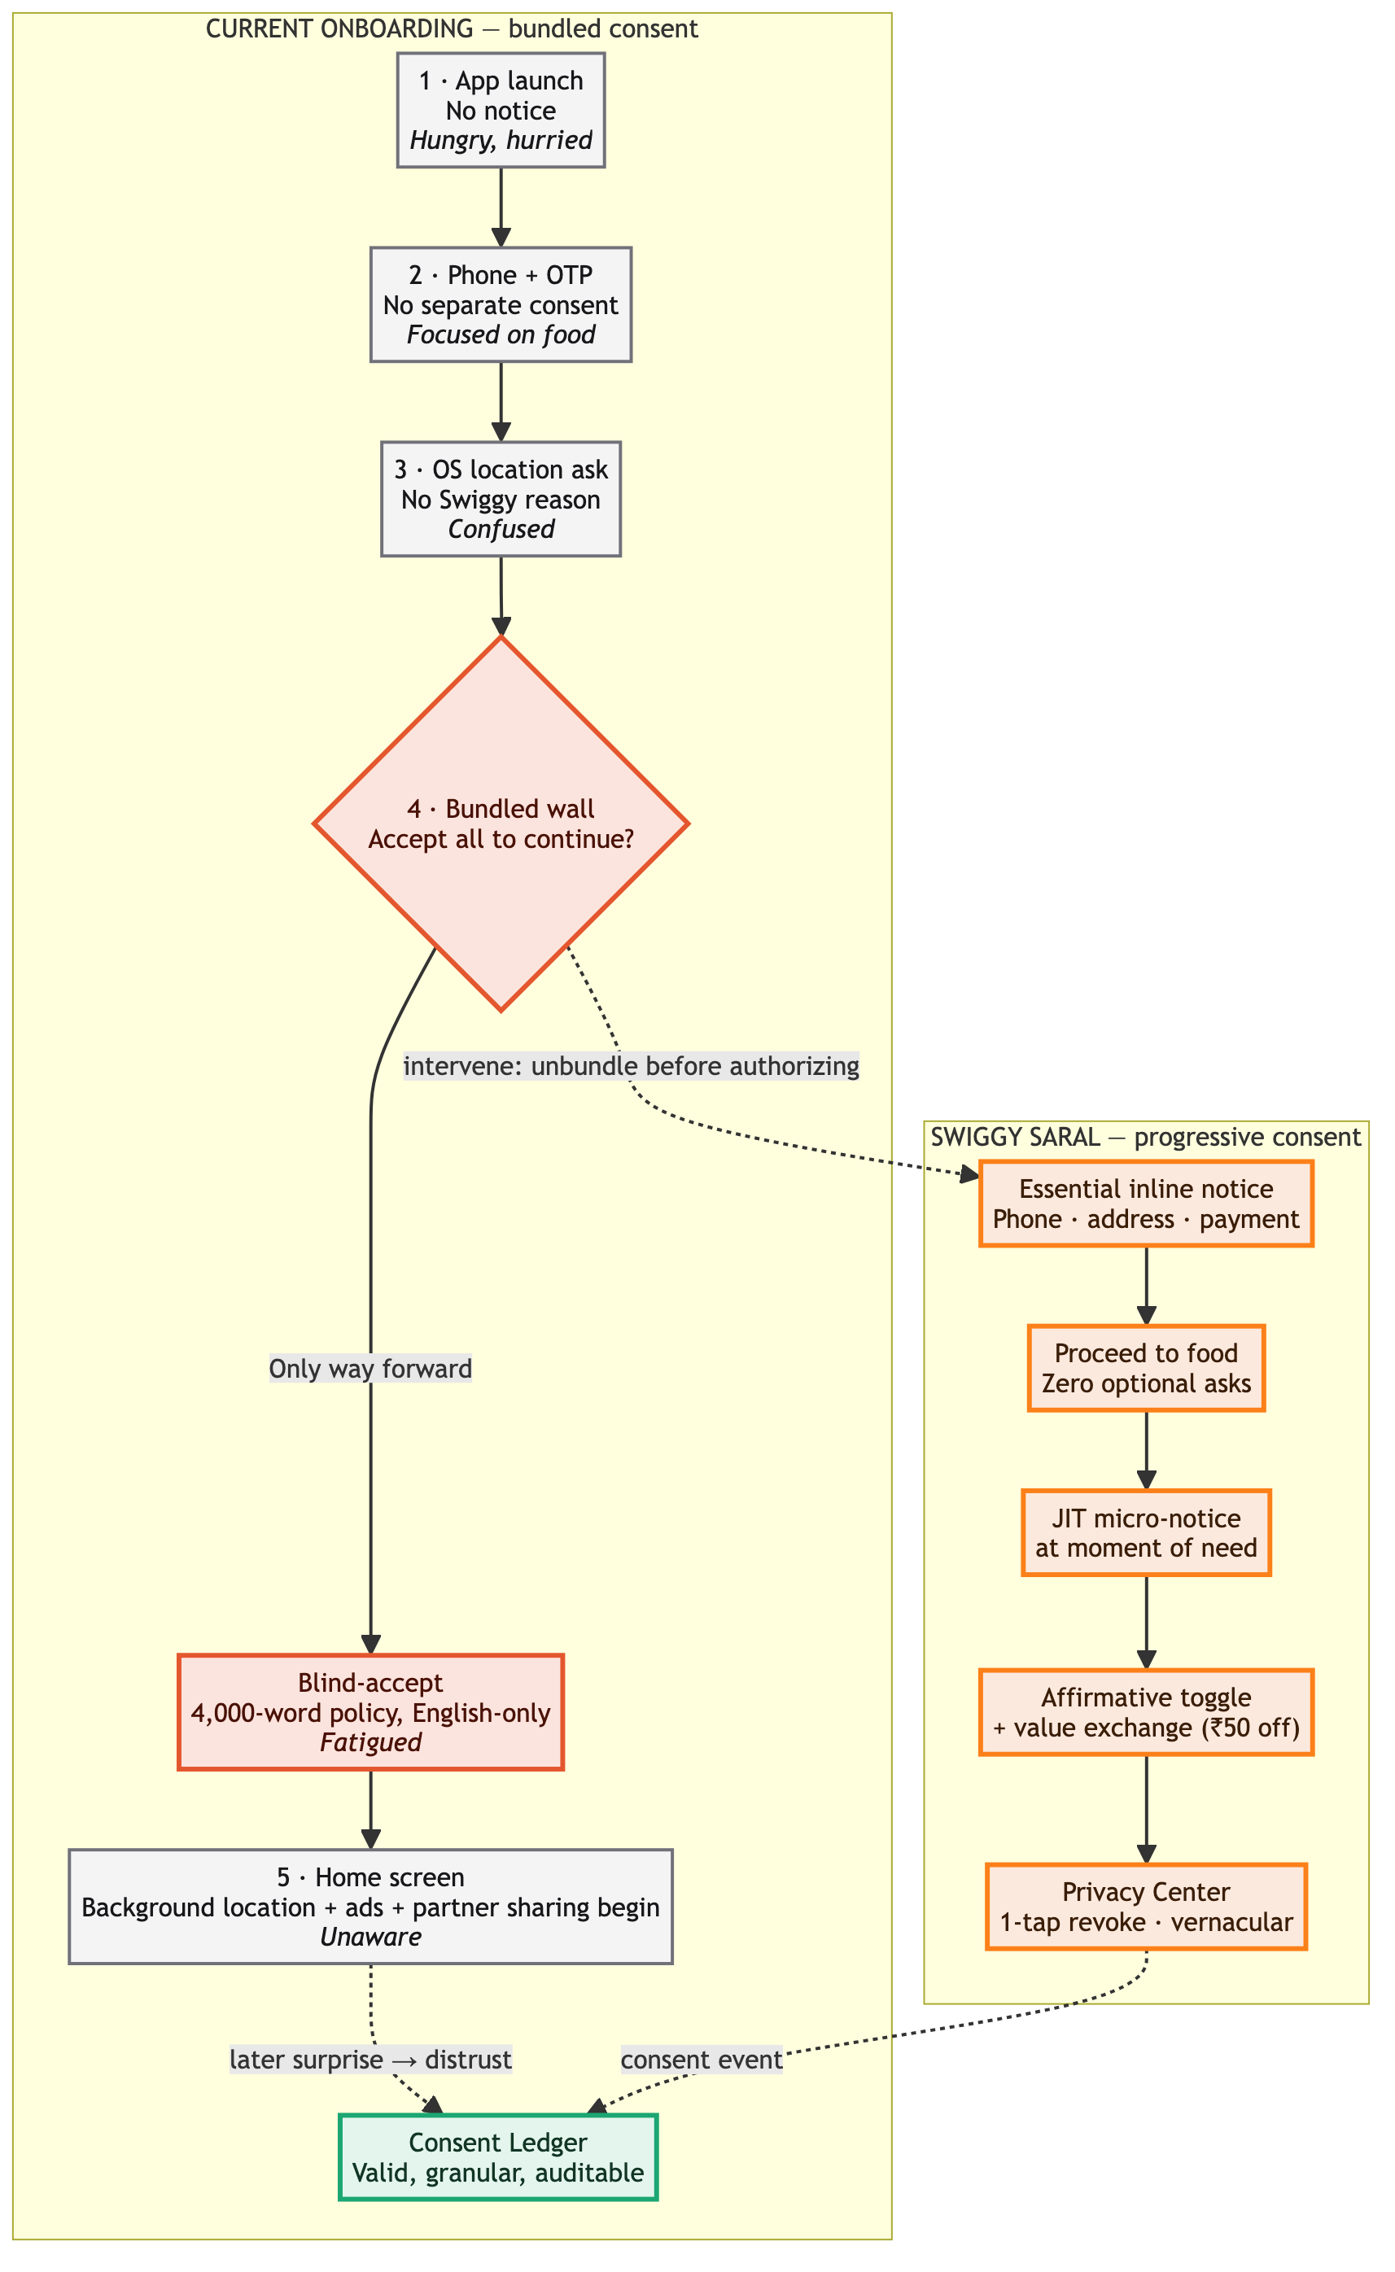
CURRENT EXPERIENCE
The 'wall of text' onboarding breaks the law before the first order
How Swiggy collects data today (stated assumptions) and where it fails DPDP.
WHERE IT FAILS DPDP
DPDP principle | Current state | Sev
Free & unconditional (S.6) | Can't proceed without accepting all | Critical
Specific & informed (S.6) | One statement covers 12+ activities | Critical
Children's data (S.9) | No age gate, no parental flow | Critical
Affirmative action (S.6) | Pre-ticked marketing box | High
Purpose limitation (S.5) | OTP phone reused for marketing | High
Right to withdraw (S.7) | Email-only, no in-app control | High
Data minimisation (S.4) | 24/7 background location | Medium
FRICTION & RISK POINTS
Legal: DPB show-cause on enforcement
Conversion: ~18% drop at Terms wall (Tier-2/3)
Trust: privacy = #2 complaint (Swiggy One)
Competitive: Zomato piloting granular toggles
Current state → gap analysis
Swiggy × DPDP · 03 / 10
Notes:
Pause at the bundled wall — that's where we lose users and break the law. Background location starts before any order.

Slide 4
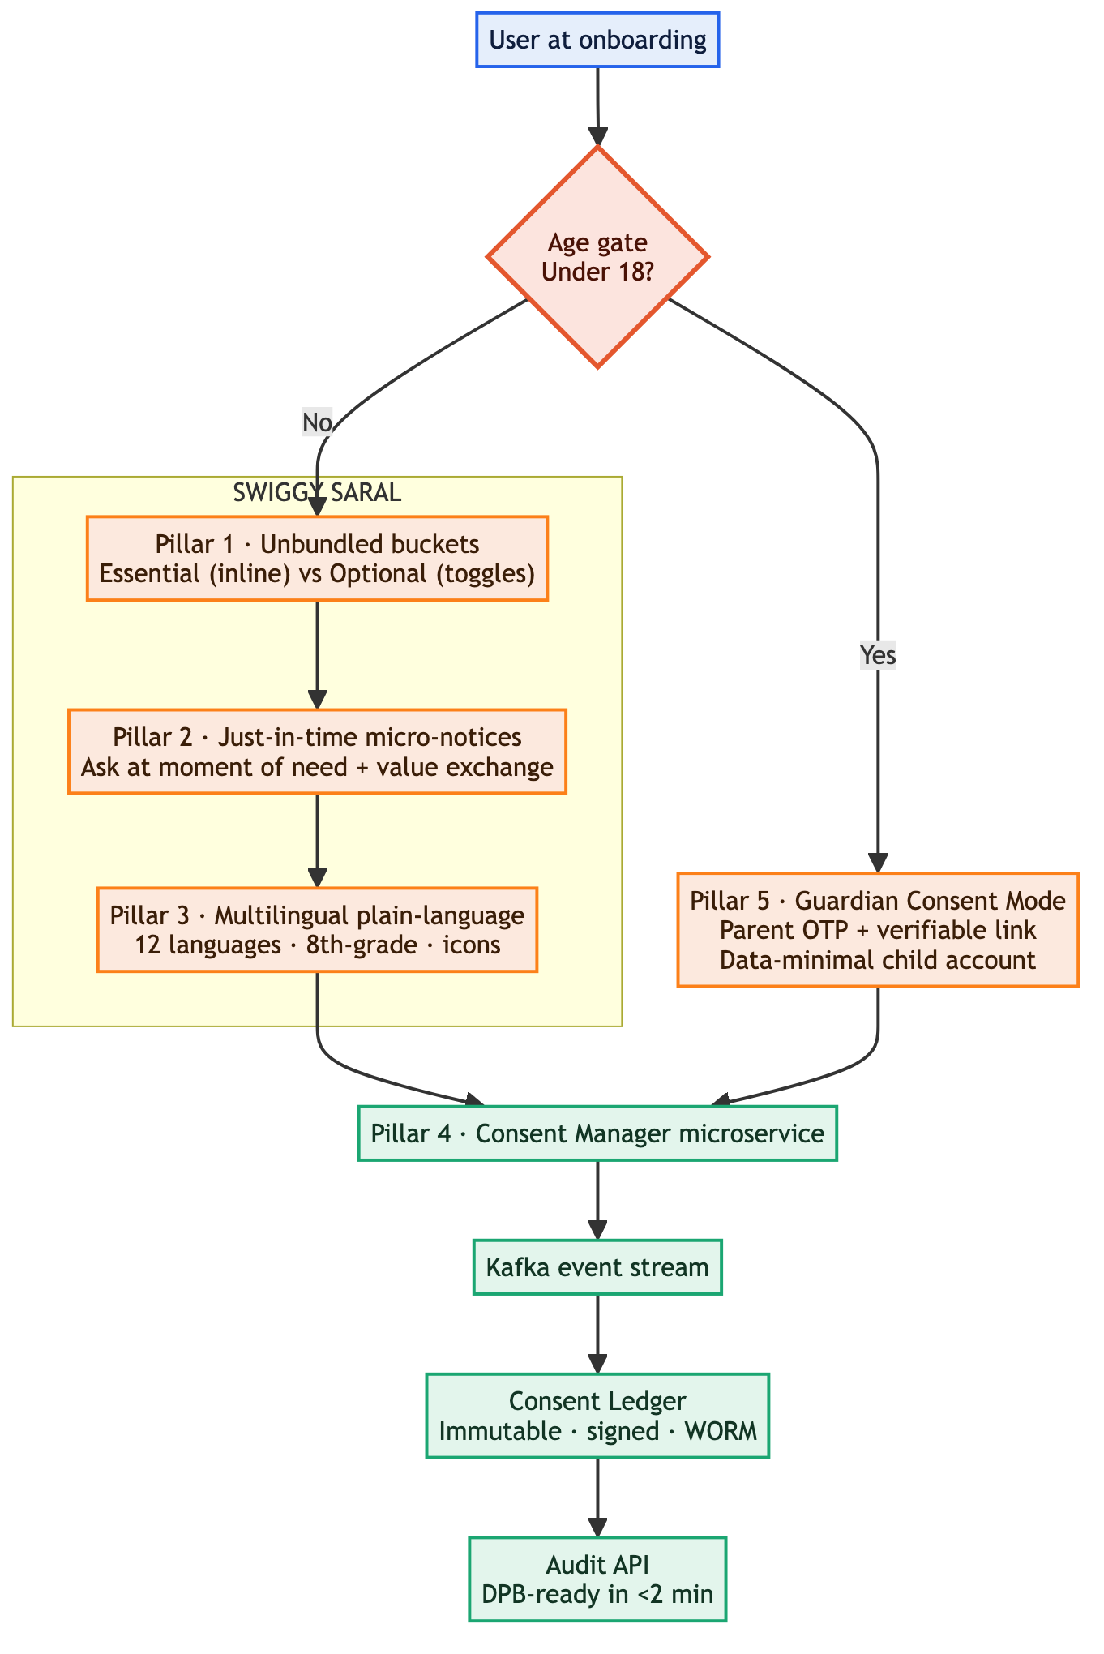
PROPOSED SOLUTION
Swiggy SARAL — consent as a product feature, not a legal tax
Simple · Accessible · Rational · Actionable · Legal. From all-or-nothing to just-in-time, just-enough, just-for-now.
FIVE PILLARS
1 · Unbundled buckets
2 · Just-in-time notices
Essential (inline, no opt-out) vs Optional (granular, un-ticked toggles).
Ask at the moment of need + value exchange (₹50 off for WhatsApp alerts).
3 · Multilingual plain-language
4 · Consent Ledger
12 languages, 8th-grade reading level, icon per data category.
Immutable signed log; DPB-auditable in <2 min. Kafka → WORM → Audit API.
5 · Children's gateway
Age gate → Guardian Consent Mode; child account runs data-minimal.
WHY NOT THE ALTERNATIVES
Alternative | Rejected because
Single-page granular checklist at signup | ~18% drop-off; violates low-patience context
Post-first-order consent prompt | Loses new-user personalization window
OS permissions only | Fails DPDP purpose-specific notice
Third-party consent plug-in | Vendor lock-in; weak vernacular UX
Solution architecture
Swiggy × DPDP · 04 / 10
Notes:
SARAL re-architects how Swiggy treats user autonomy. Ledger = insurance. JIT = conversion strategy. Children's gateway = legal shield.

Slide 5
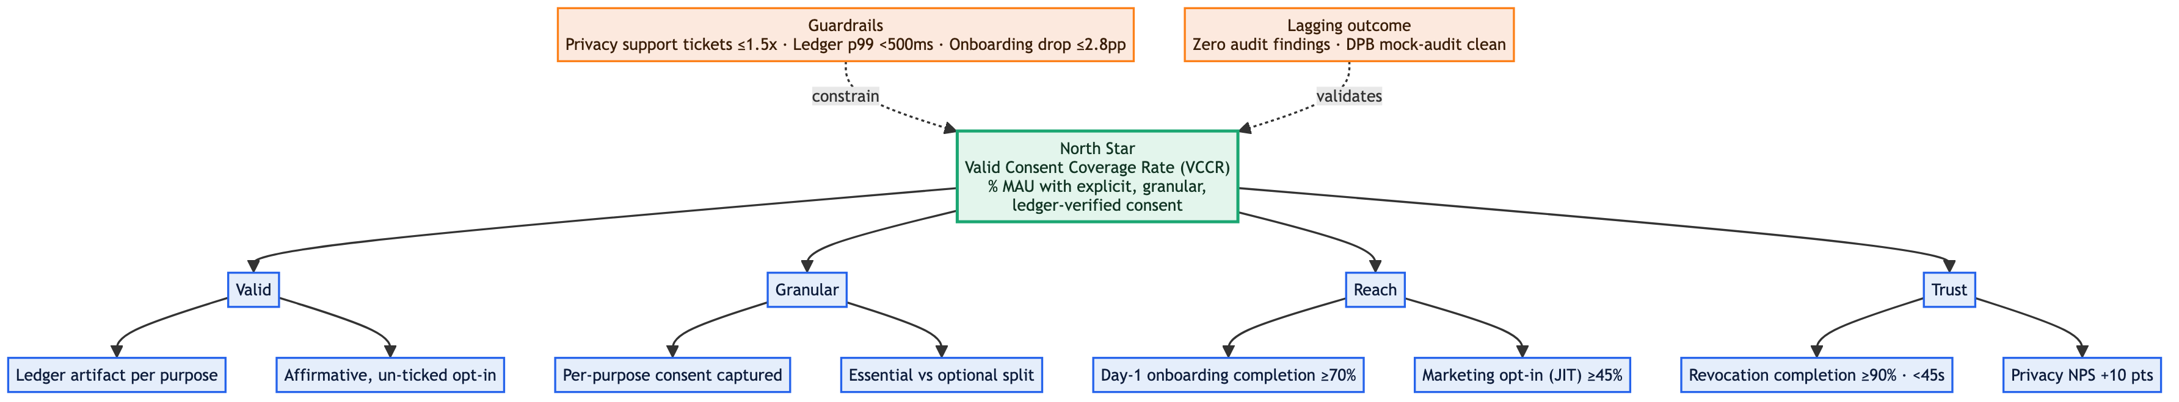
METRICS & SUCCESS CRITERIA
One North Star that fuses compliance, conversion and trust
Valid Consent Coverage Rate — high VCCR means legally protected AND users aren't bouncing.
★ NORTH STAR METRIC
SUPPORTING METRICS
Valid Consent Coverage Rate (VCCR)
Metric | Baseline | Target
Day-1 onboarding completion | 72% | ≥70% (≤2.8pp drop)
Marketing opt-in (post-JIT) | 100% bundled | ≥45% in 60 days
Consent revocation completion | n/a (email only) | ≥90% · median <45s
% of MAU with explicit, granular, unbundled, ledger-verified consent for every active processing purpose.
GUARDRAILS Privacy support tickets: ≤1.5× baseline · Ledger sync latency (p99): <500ms
SUCCESS CRITERIA
✓ Compliance: zero audit findings; passes DPB mock audit
✓ Trust: Privacy NPS +10 pts
✓ Business: onboarding within 3pp; opt-in >40%
✓ Ops: 100% real-time ledger sync, zero data loss / 30d
Target: ≥95% within 90 days
KPI framework
Swiggy × DPDP · 05 / 10
Notes:
VCCR is the only metric combining legal safety with engagement. High VCCR but onboarding drops → tighten JIT timing. Low VCCR but onboarding fine → compliance leak.

Slide 6
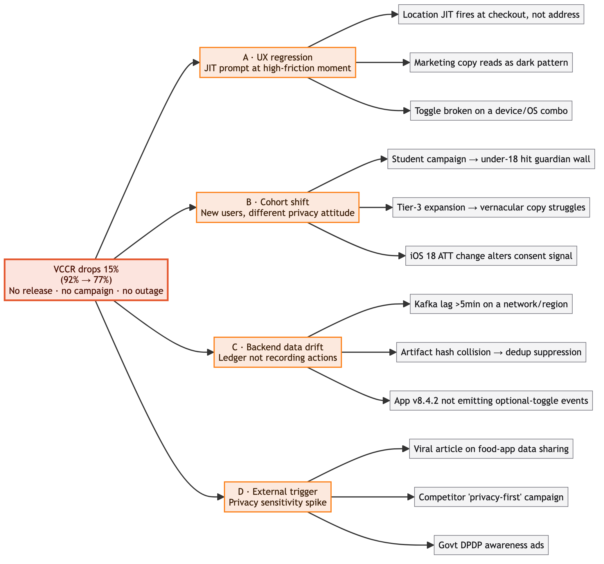
DIAGNOSTIC THINKING
If VCCR drops 15% with no release — a forensic, not a panic
Scenario: 3 weeks post-launch VCCR falls 92% → 77%. No release, campaign, or outage.
DATA ANALYSIS PLAN
— Segment drop by platform / app version / OS → isolate iOS-only vs version bug
— Funnel drop-off by consent category → marketing-only (JIT) vs uniform (cohort/external)
— Ledger event volume vs app analytics volume → backend data loss
— Correlate with acquisition source / campaign ID → cohort shift
— Social listening 'Swiggy + privacy' → external trigger
— Session recordings at consent screens → rage-click / UX confusion
ROOT-CAUSE METHOD
Five-Whys + cohort isolation. Example: opt-in fell → JIT fires at checkout → address event mis-mapped to checkout in v8.4.2 → release regression in trigger logic.
NEXT STEPS
— 0-24h: freeze rollout if <80%, verify pipeline, alert legal
— 1-7d: A/B JIT timing, hotfix regression, in-app survey
— 7-30d: re-engage incomplete consent, fix micro-copy, transparency post
Hypothesis tree + recovery playbook
Swiggy × DPDP · 06 / 10
Notes:
The hypothesis tree prevents panic; the analysis plan is a forensic checklist. Key: is it a UX bug, a backend leak, or a market shift?

Slide 7
DASHBOARD
Consent Health Command Center
Real-time monitoring of compliance, conversion and trust (mock data, 30-sec rollup).
MAIN KPI · VCCR
Day-1 onboarding
Marketing opt-in (JIT)
Ledger sync p99
Privacy tickets / wk
77.0%
55.0%
53.0%
320ms
1,240
Target 95.0% · ↓ 15.0pp vs 3 weeks ago
baseline 72% · ↓17pp
target 45% · ↑8pp
threshold 500ms
baseline 800 · ↑55%
Below target
SEGMENTATION — platform × geography × cohort
ALERT RULES
Segment | VCCR | Onboard | Opt-in | Note
iOS / Metro / New (Jun) | 68% | 48% | 58% | Highest drop; iOS 18 ATT suspected
Android / Metro / New | 82% | 62% | 52% | Within guardrail
Android / Tier-2 / All | 79% | 58% | 44% | Vernacular copy tests needed
iOS / Tier-1 / Returning | 94% | n/a | 61% | Re-consent successful
Guardian / Under-18 | 45% | 35% | 12% | Parental OTP friction high
▸ VCCR <80% >2h → P0 auto-freeze + page SRE + notify Legal
▸ Onboarding <60% >6h → P1 fallback simplified flow
▸ Ledger p99 >500ms >10m → P1 Kafka lag
▸ Privacy tickets >1.5× 3d → P2 copy review
Health dashboard · mock data
Swiggy × DPDP · 07 / 10
Notes:
This dashboard is the war room. Segmentation isolates patient-zero. Under-18 is the biggest blind spot.

Slide 8
ROLLOUT PLAN
Phased, validated, reversible — and we never A/B-test illegality
From legal foundation to full rollout with hard gates at each phase.
Phase 0 · Wk 1-3
Phase 1 · Wk 4-7
Phase 2 · Wk 8-10
Phase 3 · Wk 11-14
Legal & Design foundation
Controlled A/B
Regional pilot
Full rollout + backfill
12-lang notices · DPIA · Ledger backend
5% new users · Bangalore + Mumbai
25% · 8 cities · Guardian mode
100% new · re-consent campaign
Gate: legal sign-off · DPIA · pentest
Gate: no P0 7d · onboarding ±4pp · VCCR >85%
Gate: ledger p99 <300ms · guardian >60%
Exit: VCCR >95% · NPS +10 · audit clean
A/B TESTABLE
NEVER A/B-TESTED
VALIDATION METHODS
— JIT prompt timing
— Toggle UI pattern
— Incentive framing
— Vernacular variants (formal vs colloquial)
— Essential-data notice (legally mandated)
— Children's age gate
— Consent Ledger logging
— Quant: funnel, cohort retention, VCCR trend
— Qual: moderated tests in Hindi/Tamil/Kannada
— Legal: external DPDP mock audit every 2 weeks
— Tech: chaos test Ledger (Kafka outage → fallback queue)
Compliance shadow test: For mandatory elements run 'compliance shadow tests': new notice to 100% of a cohort vs a holdback that sees the OLD compliant notice — never a non-compliant one.
Timeline + experimentation
Swiggy × DPDP · 08 / 10
Notes:
Phase 1 is make-or-break. We test HOW to make compliance delightful, never WHETHER compliance is needed. The non-testable list is our red line.

Slide 9
RISKS & TRADE-OFFS
Honest accounting of what we trade for compliance
We know conversion will hurt and legacy data is messy — the cost of inaction is existential.
RISK REGISTER
RISK HEATMAP
Risk | Impact | Prob | Mitigation → Trade-off
Engineering complexity | High | Certain | Managed Kafka + WORM S3; 2 senior eng / 8 wks; in-memory fallback → Accept 3-wk backend extension vs lifetime liability
Business (conversion) | High | Likely | JIT incentives; first-party personalization; re-engage opt-ins → 6 mo lower ad revenue for defensible model
User friction (Tier-2/3) | Medium | Likely | Progressive disclosure; <30s consent; Quick-Start auto-deny → Small top-funnel loss for trust + retention
Edge: declines all optional | Medium | Certain (some %) | Minimal mode: manual address, no marketing, aggregated analytics, blocked sharing → Higher eng cost for privacy mode
Edge: non-cooperative guardian | Low | Possible | Limited-access order, zero retention, parent education → Lose some under-18 volume vs S.9 penalty
Edge: legacy data backfill | High | Certain | 'Trust Refresh' re-consent; purge >12mo profiles; document legitimate use → Temp. data-richness loss to cleanse liability
High prob · High impact
Conversion loss · Legacy backfill
High prob · Med impact
Eng complexity · Tier-2/3 friction
Med prob · Med impact
Guardian refusal
Low prob · Low impact
Competitor first-mover
Risk matrix
Swiggy × DPDP · 09 / 10
Notes:
This is where we prove we're not naive. Conversion will hurt, engineering is hard, legacy is a mess — trade-offs are worth it because the alternative is regulatory shutdown of data ops.

Slide 10
CONCLUSION
Privacy as a product, not a penalty
SARAL turns DPDP compliance into a competitive advantage — legal safety, business growth, user trust, at once.
Legal safety
Business growth
User trust
Zero bundled consent · verifiable ledger · parental gateway · audit-ready <2 min
Core onboarding unblocked · opt-in recovered via JIT · premium trust positioning
Plain-language multilingual notices · one-tap revocation · transparent usage
DECISION ASK Approve today: (1) 2 senior backend eng + 1 designer + 1 legal PM for 12 weeks; (2) ₹45 lakh for translation, audit & managed infra; (3) Go for Phase-1 A/B on 20 July 2026.
IMMEDIATE NEXT STEPS
Owner | Action | Due
Product | PRD for Consent Ledger + JIT trigger logic | 10 Jul
Engineering | Staging for SARAL backend + variants | 17 Jul
Legal | Complete DPIA → DPO sign-off | 15 Jul
Design | Hi-fi prototypes + vernacular copy | 12 Jul
Growth | Incentive framework for JIT opt-in | 14 Jul
DPDP isn't a deadline to fear — it's a blueprint for the most trusted food-tech platform in India. Our users' data belongs to them; their trust belongs to us.
Call to action
Swiggy × DPDP · 10 / 10
Notes:
End with energy. The ask is specific: people, money, a date. Privacy is not a cost center — it is the product.

