Slide 1
Seizure Detection using EEG
Akhil Jain – 2011CS50274
Mayank Gupta – 2011CS50283

Slide 2
Motivation
Prevalence of seizures in neo natal babies
10% detection rate
Challenge of multi-channel inputs
Need for a real-time seizure detector for clinical use

Slide 3
Method
Use of an SVM based classifier
Dataset from the Kaggle Seizure Detection Challenge
Use of mean across channels – focus on speed at the cost of accuracy
Gaussian Kernel with 21 features drawn across different domains

Slide 4
Time domain features
Line length
RMS Amplitude
Zero crossings
Minima and Maxima
Nonlinear energy
Hijorth Parameters
Activity
Mobility
Complexity
AR Model Fit

Slide 5
Frequency Domain Features
Bandwidth
Peak Frequency
Peak Power
Spectral Edge Frequency
Total Spectral Power
Intensity Weighted Mean Frequency
Intensity Weighted Bandwidth
Wavelet Energy

Slide 6
Entropy Domain Features
Spectral Entropy
Shannon Entropy
Approximate Entropy
SVD Entropy

Slide 7
Testing Paradigm
8-fold testing and validation on mean normalised feature sets
Precision and Recall – better measures of measuring the fitness of a model
Simulation of real life situations

Slide 8
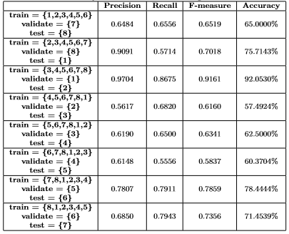
Results

Slide 9
Results (Contd.)
Mean Precision – 0.7236
Mean Recall – 0.6959
Mean F-measure – 0.7031
Mean Accuracy – 70.3785%
Comparability of Precision, Recall and Accuracy

Slide 10
Conclusions
Real-time results
Accuracy much higher than the traditional manual detection of seizures
Need for higher amounts of data

