Slide 1

Government polytechnic for women kadapa Approved by AICTE, New Delhi &Affiliated to SBTET AP
COMPUTECHIE
Half yearly Magzine
Jan-May2023
Department of
Computer Engineering
Volume - 1 issue- 2

Slide 2

Department Vision
Develop computer engineers to be technologically adept, innovative, self-motivated, responsible citizen with human values, high quality skill and to contribute significantly towards ever changing computer technologies.
Department Mission
M1:To provide opportunity to Diploma students who are capable of playing pivotal role in wide aspects of modern computer engineering.
M2:To make the students understand basic concepts underlie in computer engineering and able to apply them creatively in different fields of engineering.
M3:To train the students sensitive to the environment ,safety and economic context.
M4:To produce technically skilled students through intensive training in computer engineering tools and applications and to prepare the for professional career and further research.
GOVERNMENT POLYTECHNIC FOR WOMEN, KADAPA

Slide 3
About Department
The Department of Computer Engineering was established in the year 2008, offering “Diploma in Computer Engg” with intake 50, affiliated to SBTET, AP, Mangalagiri. The Diploma in Computer Engg Programme has a comprehensive curriculum on topics related to all aspects of Computer Hardware and Software with an emphasis on practical learning. The course structure is up-to-date and includes courses on nascent topics to equip our students with the latest developments in Computer Science and Engineering.
It has consistently fulfilled its role of producing Computer Engineers ready to meet the demands of the IT world. The department has always attracted the best of engineering girl aspirants from all over the Rayalaseema Region of Andhra Pradesh
GOVERNMENT POLYTECHNIC FOR WOMEN, KADAPA

Slide 4
Program Educational Outcomes
PEO1
To produce best diploma students as computer engineering technicians by correlating growing need of the industries in modern topics with the academic input and giving the technical knowledge for further learning and to provide better career in this field.
PEO2
To prepare the students as productive computer engineer s , possessing , supportive and leadership skills in multi disciplinary domain expertise in practical orientation , communication skills and latest developments.
PEO3
To give the depth of related skills and expertise in a single field and the ability to collaborate with other disciplines and work at the supervisory cadre.
GOVERNMENT POLYTECHNIC FOR WOMEN, KADAPA

Slide 5
PEO4
To promote the students in professionalism, by successful completion of the Diploma in Computer Engineering by empasizing field practice in industry oriented activities.
PEO5
To sensitize the students on social and economic commitment and to inculcate a nature to gaurd the values of community and protect environment
GOVERNMENT POLYTECHNIC FOR WOMEN, KADAPA

Slide 6
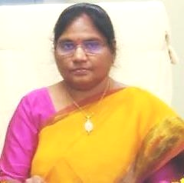
MESSAGE
PRINCIPAL’s MESSAGE
Smt . C.H.JYOTHI,
M .Tech
It gives me immense pleasure to pen a few words as prologue to the half yearly technical magazine COMPUTECHIE exclusively meant for churning out the latent writing talent which bears immense potentially of sharpening the students skills as part of their overall personality development .I congratulate all the contributors for bringing out such a beautiful magazine.
GOVERNMENT POLYTECHNIC FOR WOMEN, KADAPA

Slide 7
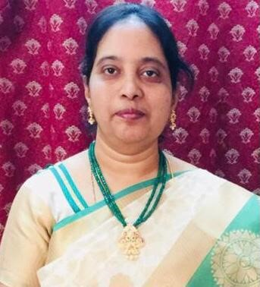
HOD’s MESSAGE
Smt.K. SUDHARANI
It is a occasion of great pride and satisfaction for the department of CME, GPW to bring out the issue of the half yearly of the Technical magazine COMPUTECHIE. It gives me immense pleasure to note that the response to the magazine has been overwhelming .The wide spectrum of articles gives us a sense of pride that our students and faculty possess creative potential and original thinking in ample measures. Each article is entertaining interesting and absorbing .I applaud the contributors for their stimulated thoughts and varied hues in articles contributed by them.
GOVERNMENT POLYTECHNIC FOR WOMEN, KADAPA

Slide 8
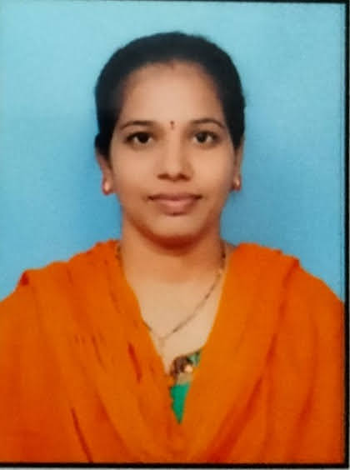

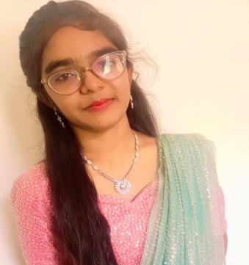
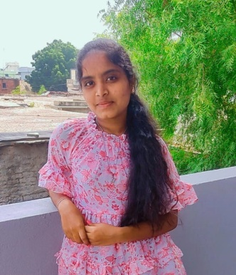
EDITORIAL TEAM
Faculty
Smt. B. Jyothsna , L/CME
SRI. Y . Venkata Prasad L/CME
STUDENTS
K. V. Sushma Reddy, DCME,II year
P. Uma Devi DCME,II year
GOVERNMENT POLYTECHNIC FOR WOMEN, KADAPA

Slide 9

FACULTY ARTICLES
CYBER SECURITY
Cybersecurity is the practice of protecting computers, servers, mobile devices, electronic systems, networks, and any digital infrastructure from unauthorized access, data breaches, theft, damage, or disruption. It encompasses various technologies, processes, and measures designed to ensure the confidentiality, integrity, and availability of information in the digital realm.
The importance of cyber security has grown significantly with the increasing reliance on digital technologies in various aspects of our lives, including businesses, healthcare, finance, communication, and even government operations. Cyber threats have evolved and continue to evolve, becoming more sophisticated and damaging. They include malware, phishing attacks, ran somware, social engineering, hacking, denial of service attacks, and insider threats.
To counter these threats, cyber security employs several layers of defense mechanisms, such as:
1. Network Security: Implementing firewalls, intrusion detection and prevention systems, and virtual private networks (VPNs) to secure networks and protect against external threats.
2. Endpoint Protection: Using antivirus software, encryption, and access controls to safeguard individual devices like computers, laptops, mobiles, and IoT devices.
3. Application Security: Developing secure software applications, regularly patching and updating them, and conducting thorough testing to prevent vulnerabilities that can be exploited by attackers.
4. Data Protection: Encrypting sensitive information, maintaining backup systems, controlling access with strong authentication mechanisms, and ensuring compliance with privacy regulations.
5. Incident Response: Developing incident response plans and protocols to effectively identify, contain, and mitigate the effects of cyber incidents, such as data breaches or system compromises.
6. User Education and Awareness: Educating users about safe computing practices, training them to recognize and report potential threats, and promoting a security-conscious culture throughout an organization.
7. Physical Security: Protecting physical infrastructure, such as servers and data centers, with measures like access controls, surveillance systems, and environmental controls.
GOVERNMENT POLYTECHNIC FOR WOMEN, KADAPA

Slide 10
HACKING
Hacking refers to unauthorized access or intrusion into computer systems, networks, or digital devices with the purpose of gaining information, manipulating data, or causing disruptions. It typically involves exploiting vulnerabilities or weaknesses in computer systems or networks.
There are several types of hacking:
1. Black Hat Hacking: This refers to hacking carried out by malicious individuals or groups with malicious intent, such as stealing personal information, financial data, or conducting cyber-attacks. It is illegal and unethical.
2. White Hat Hacking: Also known as ethical hacking, this type of hacking is done by cybersecurity professionals authorized to test the security of computer systems and networks. They identify vulnerabilities and report them to the system owners to enhance security.
3. Grey Hat Hacking: This involves hacking where the hacker does not have malicious intent but may exploit vulnerabilities without permission. These hackers often expose flaws with the intention of helping organizations improve their security, but their actions are still illegal.
4. Phishing: It involves tricking individuals into revealing sensitive information, such as passwords or credit card details, by impersonating a legitimate entity through emails, fake websites, or messages.
5. Ransomware: This involves infecting computer systems with malicious software that encrypts files, blocking access to them until a ransom is paid to the attacker.
6. Denial of Service (DoS) and Distributed Denial of Service (DDoS) Attacks: These attacks overload a computer system or network with an excessive amount of traffic or requests, causing it to become unavailable or crash.
7. SQL Injection: This involves manipulating database queries on a website to gain unauthorized access to data or exploit vulnerabilities.
8. Social Engineering: This type of hacking relies on psychological manipulation and deception to trick individuals into revealing sensitive information or performing certain actions.
GOVERNMENT POLYTECHNIC FOR WOMEN, KADAPA

Slide 11
Student’s articles
INTERNET OF THINGS
IoT, which stands for Internet of Things, refers to a network of physical devices, vehicles, appliances, and other objects that are embedded with sensors, software, and connectivity capabilities. These devices are able to collect and exchange data with each other over the internet, often without requiring human intervention.
The concept of IoT revolves around the idea of connecting these devices to create a seamless and interconnected ecosystem. The devices within this network can range from everyday objects like home appliances, wearables, and vehicles, to industrial equipment, medical devices, and infrastructure elements.
The key components of IoT include the devices themselves, sensors that enable data collection, connectivity technologies such as wireless or cellular networks, and cloud computing platforms that facilitate data processing and storage. In some cases, artificial intelligence and machine learning algorithms are also used to analyze the vast amounts of data gathered by IoT devices.
IoT has the potential to revolutionize various aspects of life and industries. In the home, IoT devices can automate tasks, provide remote control and monitoring capabilities, and enhance energy efficiency. In healthcare, IoT devices enable remote patient monitoring, smart medication management, and improved healthcare delivery. In agriculture, IoT can optimize irrigation systems, monitor soil conditions, and enhance crop yields. Industrial applications include asset tracking, predictive maintenance, and supply chain optimization.
However, the proliferation of IoT also raises concerns about privacy, security, and the ethical implications of collecting and analyzing vast amounts of personal data. Safeguarding data, ensuring interoperability be addressed to fully realize the potential benefits of IoT.
Overall, IoT is a rapidly evolving technology that has the potential to transform various industries and improve efficiency, among devices, and addressing potential vulnerabilities are important challenges that need to convenience, and sustainability in everyday life. It offers a future where connected devices seamlessly interact with each other, creating a smart and interconnected world.
GOVERNMENT POLYTECHNIC FOR WOMEN, KADAPA

Slide 12
ARTIFICIAL NEURAL NETWORK SYSTEM
An artificial neural network system is a computational model inspired by the structure and function of biological neural networks. It consists of interconnected nodes, called artificial neurons or nodes, which are organized in layers. The system takes input data and processes it through these interconnected layers to produce output.
The system is designed to learn and recognize patterns in data. It learns through a process called training, where it adjusts the strength of connections between nodes based on the input data. This allows the system to adapt and improve its ability to recognize patterns over time.
Artificial neural network systems have been used in various fields, including image and speech recognition, natural language processing, recommender systems, and more. They have shown great success in solving complex problems and are particularly useful in domains where traditional rule-based programming falls short.
Overall, artificial neural network systems have revolutionized many fields by providing powerful tools for data analysis, pattern recognition, and decision-making. They have opened up new opportunities and continue to be a rapidly evolving area of research and development.
GOVERNMENT POLYTECHNIC FOR WOMEN, KADAPA

Slide 13
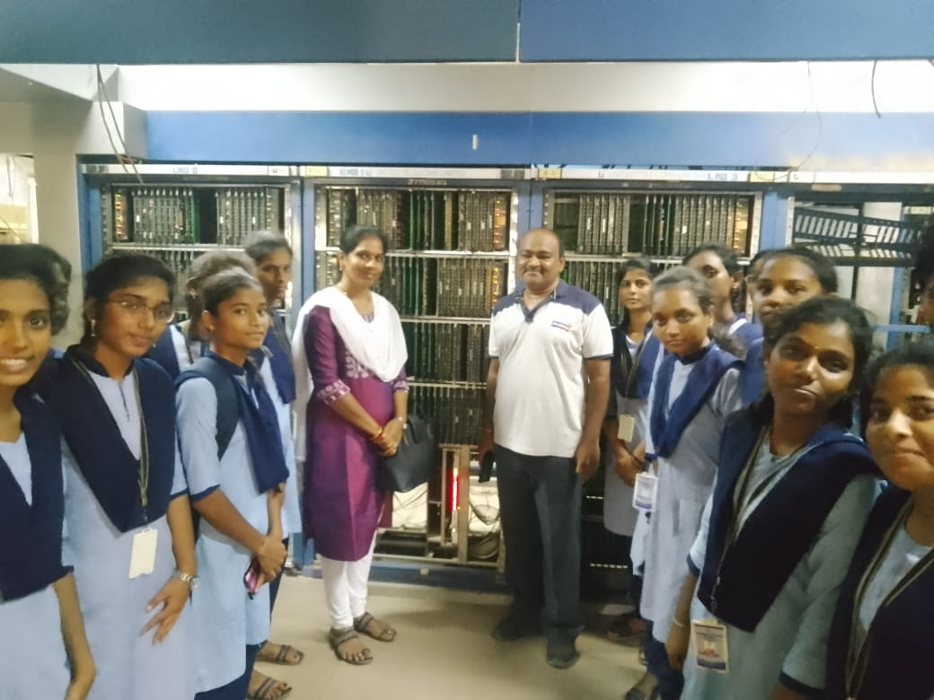
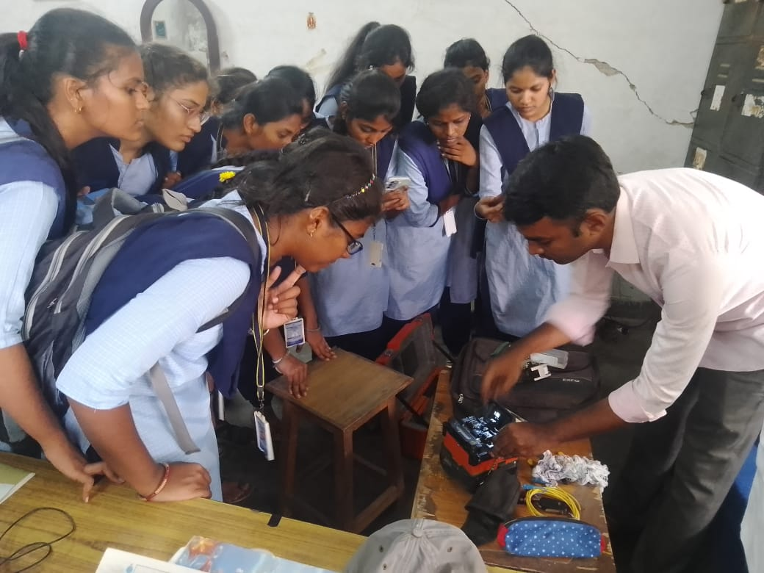
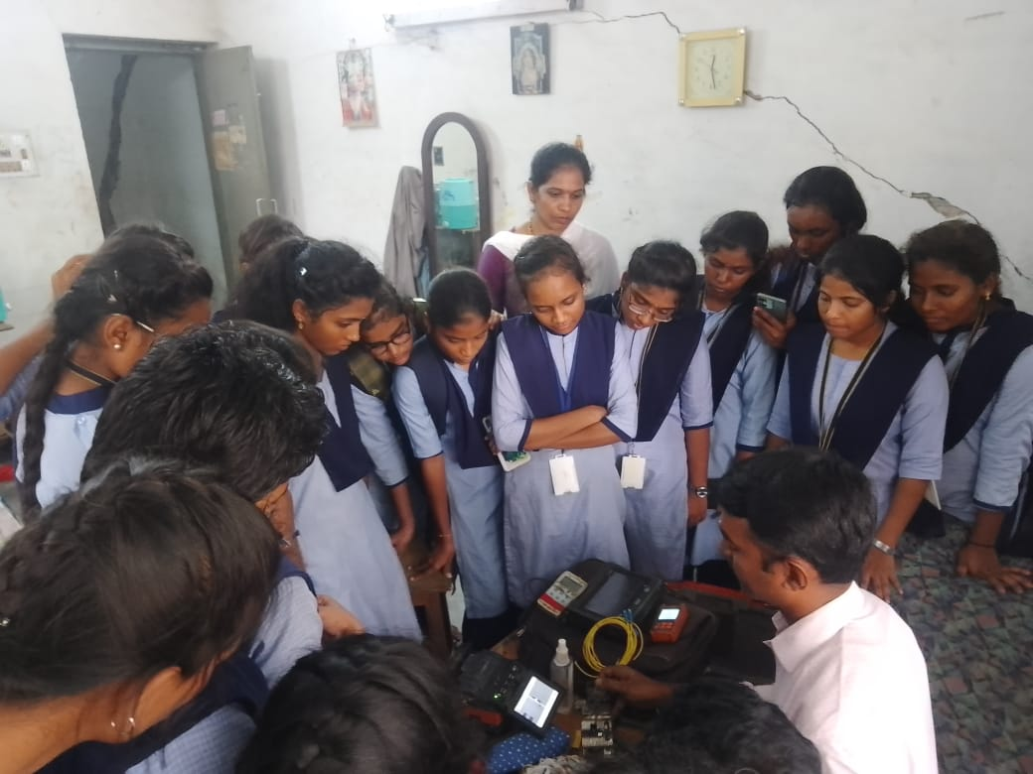
INDUSTRIAL VISIT TO BSNL OFFICE
GOVERNMENT POLYTECHNIC FOR WOMEN, KADAPA

Slide 14
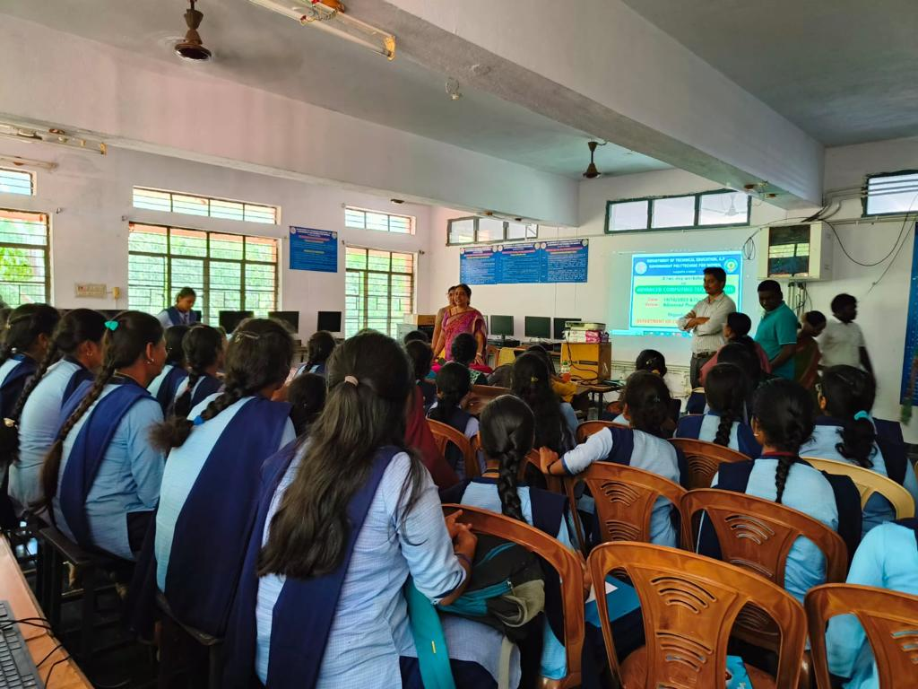
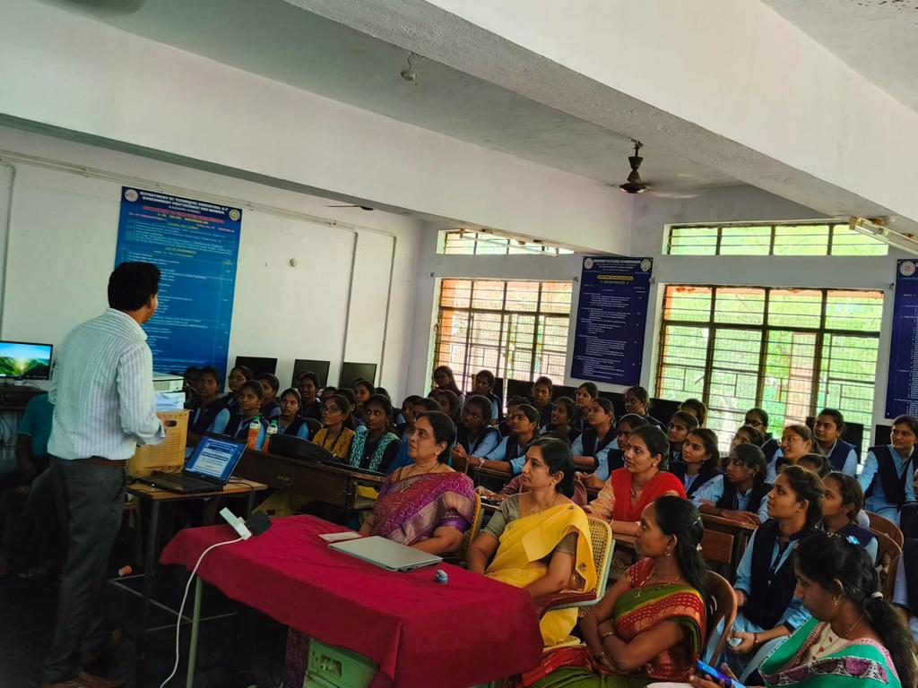
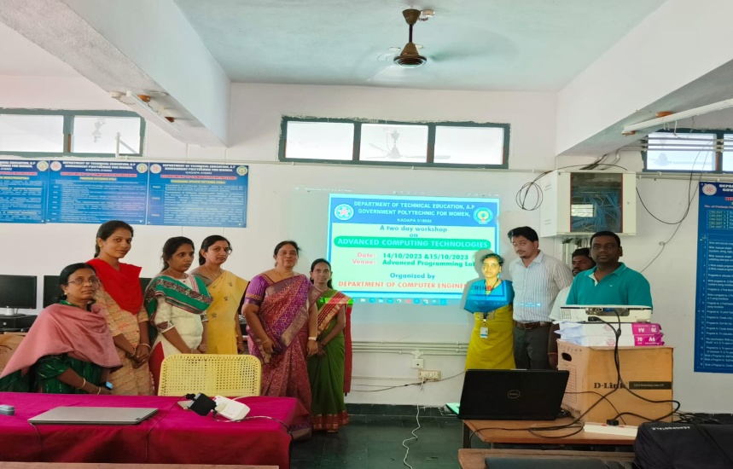
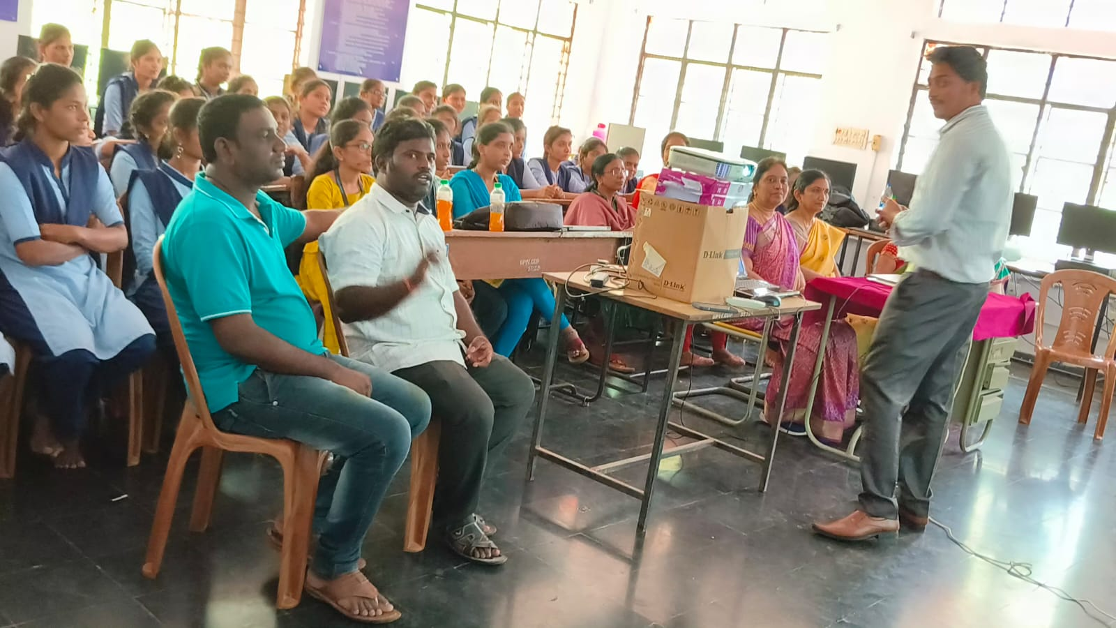
workshop
GOVERNMENT POLYTECHNIC FOR WOMEN, KADAPA

Slide 15
THANK YOU!

