Slide 1
React-Basic Building Modern Full Stack Serverless SaaS
Class # 04
StateFull Funtions Using ‘useState’

Slide 2
Creating reactproj1
Follow Steps:
Create a React app using following commands in cmd , the best practice is that you must create a project folder as named above and run cmd in the same folder
Now in command prompt run …..:\> cd..
Now run a commad in cmd as :\> npx create-react-app reactproj1
When project will be setup Run :\> cd reactproj1
Run command as :\> yarn start
Now Project is ready to run and we can edit app.js

Slide 3
useState
What is useState
There are a bunch of React hooks, but useState is the workhorse of the bunch.
The useState hook lets you add state to function components.
Every hook starts with the word “use”;
A call to useState literally lets you “use state” in a function component
With hooks, the state can be any type you want – you can useState with an array, useState an object, a number, a boolean, a string, whatever you need.
Each call to ‘useState’ reates a single piece of state, holding a single value of any type. And is perfect for local component state. & a nd a small-ish amount of it.
For a larger app, or one that you intend to scale up, you’ll probably want to augment useState with some other Advance state management solutions. Like Context? Redux? MobX? Recoil? 6 most-used libraries

Slide 4
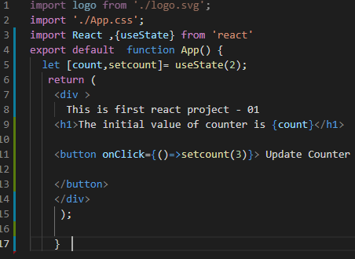
useState()
useState have two variables , one variable is used for get the value and other is used for set the value check Line no.5 in which count and setcount variables are declared for useState
The Initial value in useState(2) is given as 2
If we want to update the state we will change the value of setcount(3) and pass parameter of 3 # check line 11.
We can pass variable in setcount as setcount(count+1) so value will increase on button click
We can use post increment as count++
And pre increment as well ++count as variable inside setcout()

Slide 5
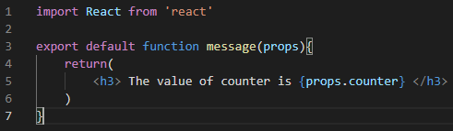
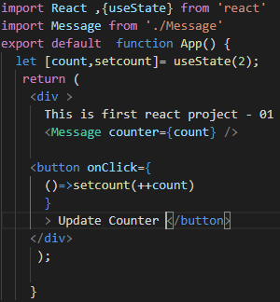
Using Props
“Props” is a special keyword in React, which stands for properties and is being used for passing data from one component to another. But the important part here is that data with props are being passed in a uni-directional flow. ( one way from parent to child)
A child Named as Message.js is created and a function message(props) is created check line 3
The property is used in line 5

Slide 6
Difference between Export and Export Default
Every function of a class must be export default and called in another class by import that class and a function
In this case we use export default App
In App.js Module
function App() { return ( <div > This is first react project - 01 </div> ); }
export default App;
How App is imported from, App.js Module in another DOM
import App from './App';
import reportWebVitals from './reportWebVitals';
ReactDOM.render( <React.StrictMode> <App /> </React.StrictMode>, document.getElementById('root’) );
If we use simple export keyword then we must use {} braces to call a function
In App.js Module
Export function App() { return ( <div > This is first react project - 01 </div> ); }
How App function is imported in App.js Module
import {App} from './App’;
Both Key Words have this kind of difference if simple export is used than {} are used in import

