Slide 1
How to read NLP papers
CQU CS 1701
NLP Group

Slide 2
Search papers and group them
Select the better paper
The reading order you should follow
Write down the notes
Make a presentation

Slide 3
Search papers and group them
By conferences
By preprint or not
By problems
By methods(models)
By dataset(text type)
By optimize methods(depends on your own idea)

Slide 4
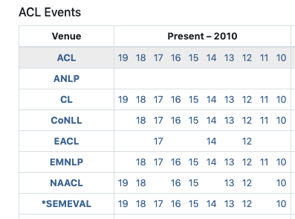
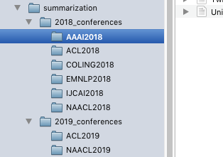
By conferences
https://www.aclweb.org/anthology/

Slide 5
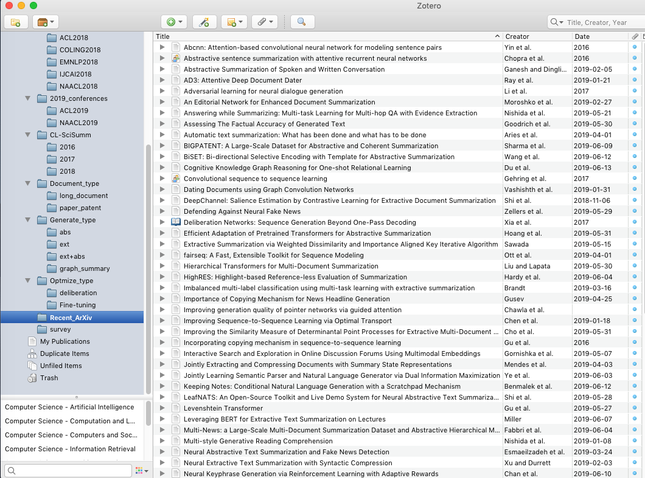
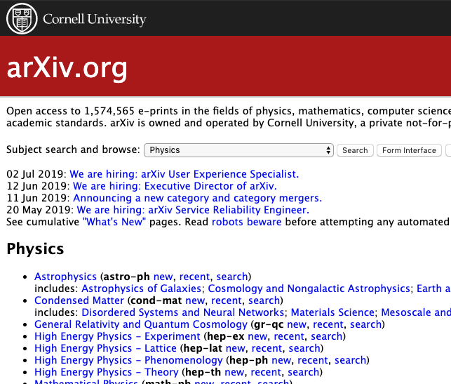
By preprint or not
https://arxiv.org/

Slide 6
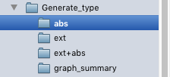
By problems
Summarization as example:
Abstractive
Extractive
Unsupervised
Graph based

Slide 7
By methods(models)
CNN
RNN
GNN
Transformer
Attention
Reinforcement

Slide 8
By dataset(text type)
DUC
LCSTS
CNN/Daily Mail
News
Science /Academic papers
Patent
Health record

Slide 9
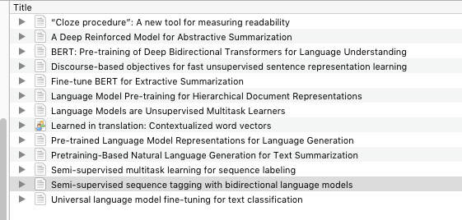
By optimize methods(depends on your own idea)
Fine-tuning
Deliberation
Dual-learning

Slide 10
Select the better paper
How could you treat a paper as a good paper?
Conferences
Relation
Citation
Influence
Code

Slide 11
Conferences
ACL
COLING
EMNLP
NAACL
AAAI
IJCAI
NIPS
ICLR2019
NLPCC
CCKS
CCIR
NLP domain
General AI
Chinese NLP

Slide 12
Relation
The most closely related paper
Example：UGC & PGC fusion
Text Generation
Q&A
Essay writing
NMT
Summarization

Slide 13
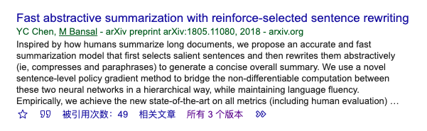
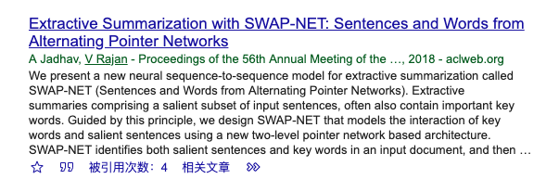
Citation

Slide 14
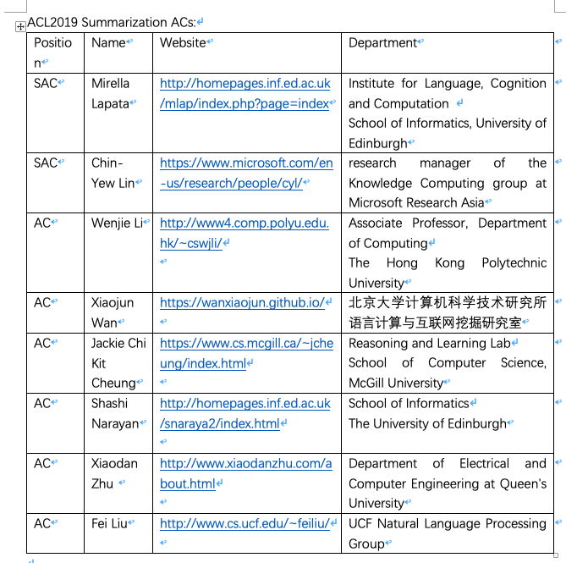
Influence

Slide 15
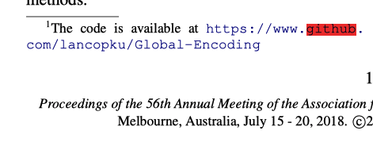
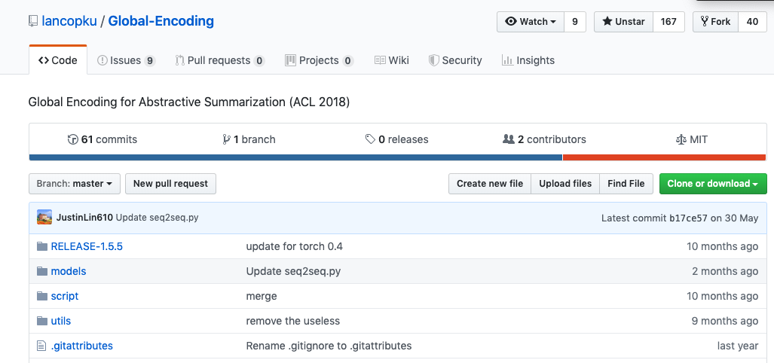
Code

Slide 16
The reading order you should follow
Abstract
Abstract + Introduction(the second half)
Experiment + Conclusion
Proposal
Do not just watch the title!

Slide 17
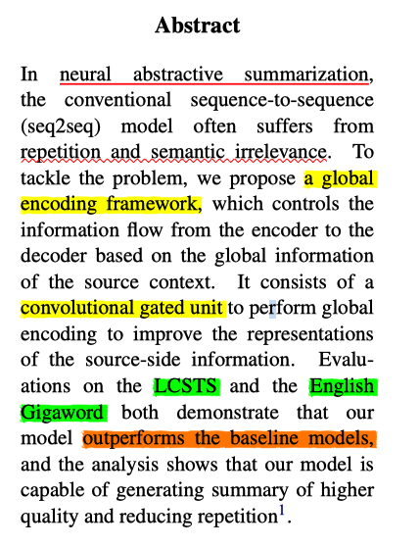
Abstract
Subarea
Problems
Proposal(mothods)
Datasets
Performance

Slide 18
Abstract + Introduction(the second half)
What if the abstract can not give enough information

Slide 19
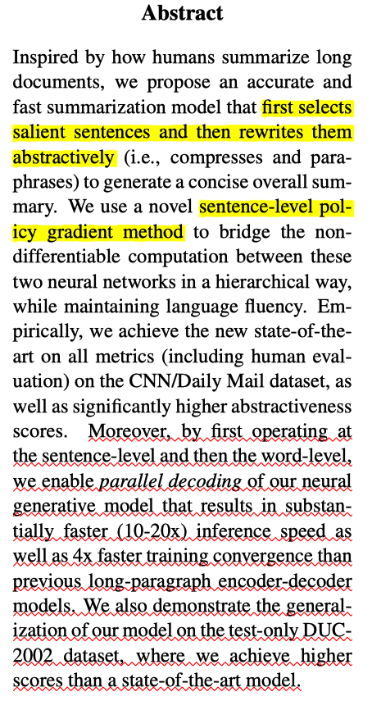
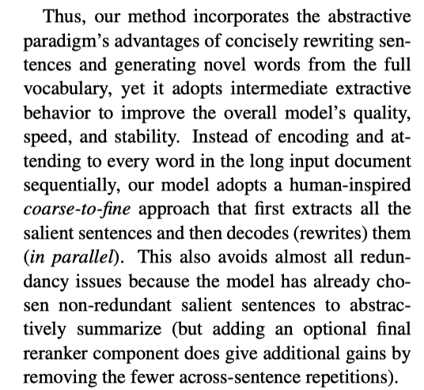
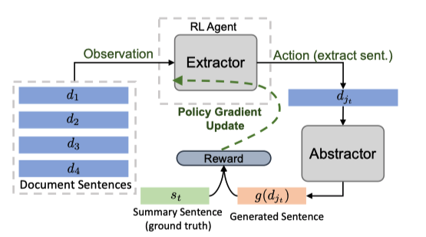

Slide 20
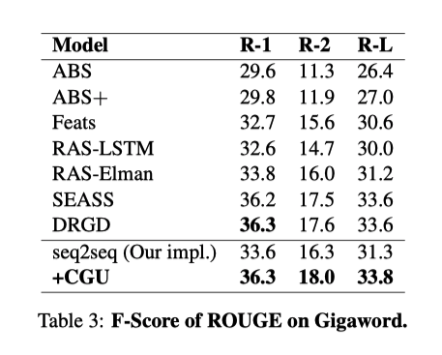
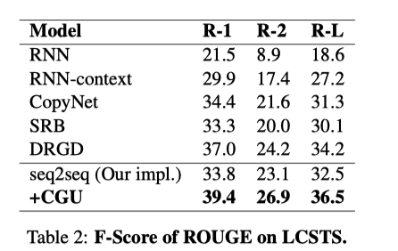
Experiment + Conclusion
Take care of the result

Slide 21

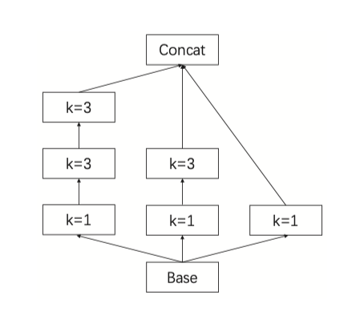
Proposal
Intensive reading
Focus on the parts below:
The most creative part
Figures(overview and detail)
Equations(How and Why)

Slide 22
Do not just watch the title!
Bottom-Up Abstractive Summarization(Two-stage)
Attention Is All You Need(Transformer)

Slide 23
Write down the notes
From(Conferences/Journals/ArXiv)
Institution
Paper
Topic
Aim
Problem to solve
Solutions
Strengths
Limitations
Datasets
Evaluation scores
Code

Slide 24
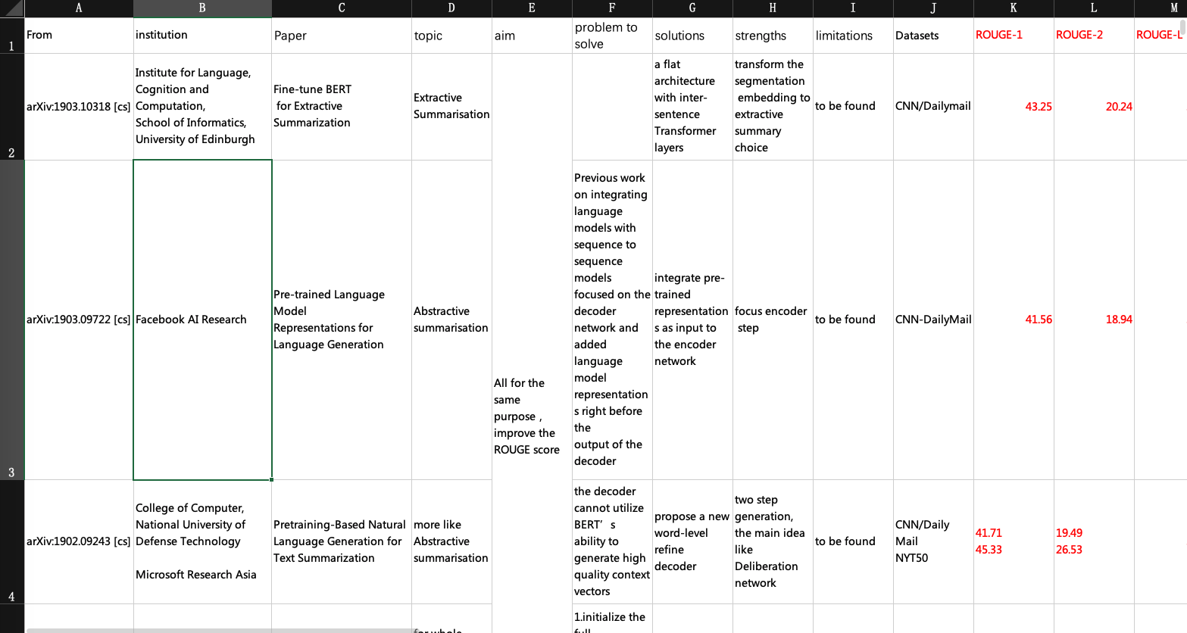

Slide 25
Make a presentation
Grasp every opportunity you can seize !!!
Group meetings
Class presentations
Other conferences of projects
Submit papers

Slide 26
How to run opensource code

Slide 27
The most significant thing——codes
README.MD
Issues
Author's email

Slide 28
The most significant thing——codes
Depends on the quality of paper and the integrity of authors.
Github is the most popular way to open source their work(some times they only release them on their web portal)
Know how to fork repositories

Slide 29
REAM.MD
Markdown file type
Requirements
Preprocessing
Training
Evaluation
Different work environment(linux/windows)

Slide 30
Markdown file type

Slide 31
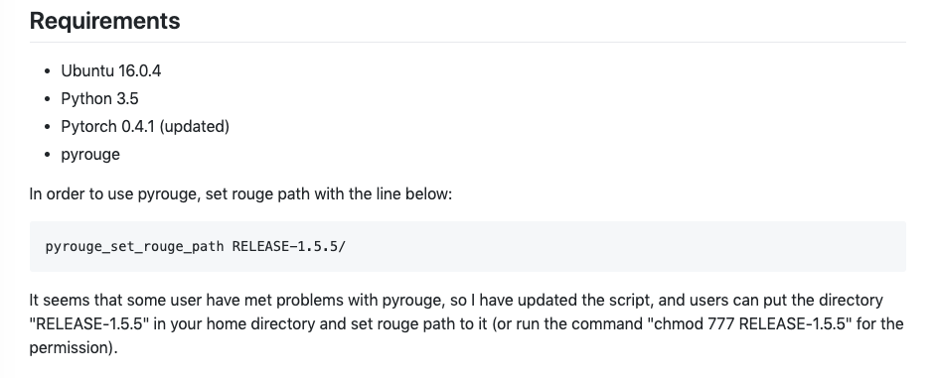
Requirements

Slide 32
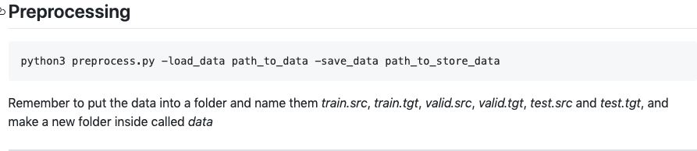
Preprocessing

Slide 33
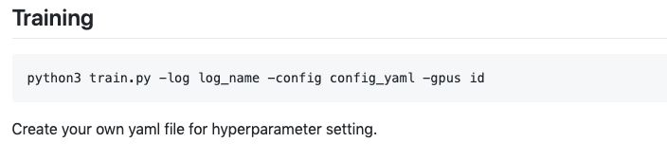
Training

Slide 34
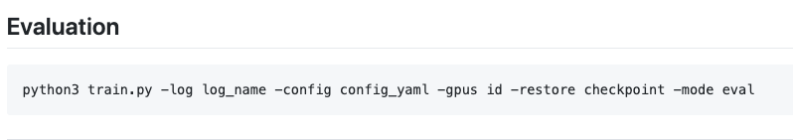
Evaluation

Slide 35
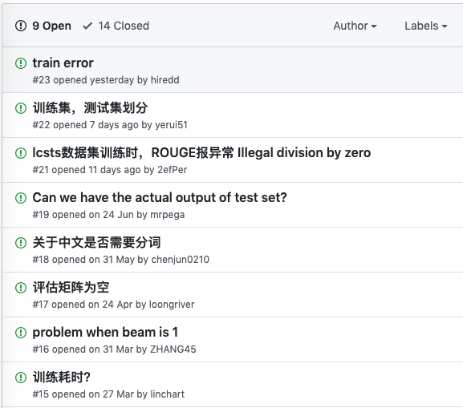
Issues

Slide 36

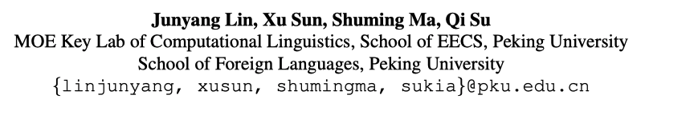
Author's email
Paper mentioned
Github shown
Web portal shown
Friends

Slide 37

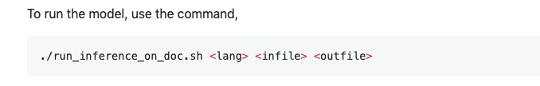
Different work environment(linux/windows)
Environment variables
Shell/BAT scripts
https://github.com/shyamupa/xling-el

Slide 38
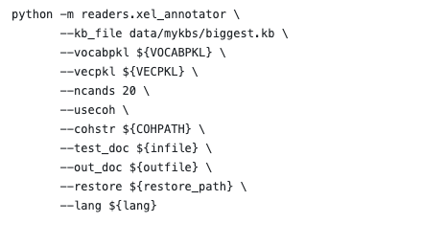
Hard way
Open .sh file and find the python calling command

