Slide 1

Battery arbitrage in power markets

Slide 2
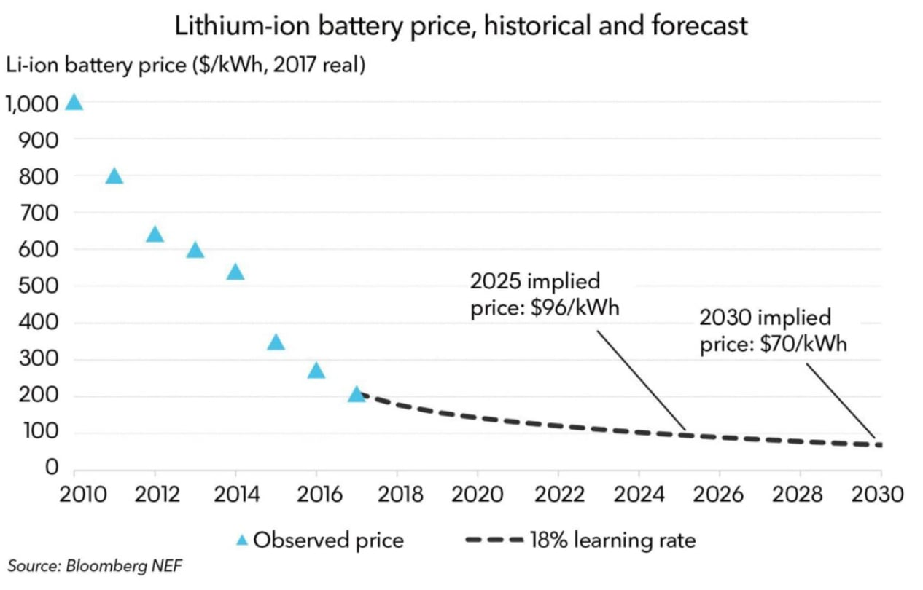
Motivation
Increasing volatility in power prices from renewable expansion.
Increases arbitrage possibilities for batteries.
Technological advancement in battery parameters, e.g. improved chage efficiency.
Fall in battery prices.
… but lag in large scale batter investments?

Slide 3
Research Question
“What innovations are necessary to make battery-storage arbitrage profitable?”

Slide 4
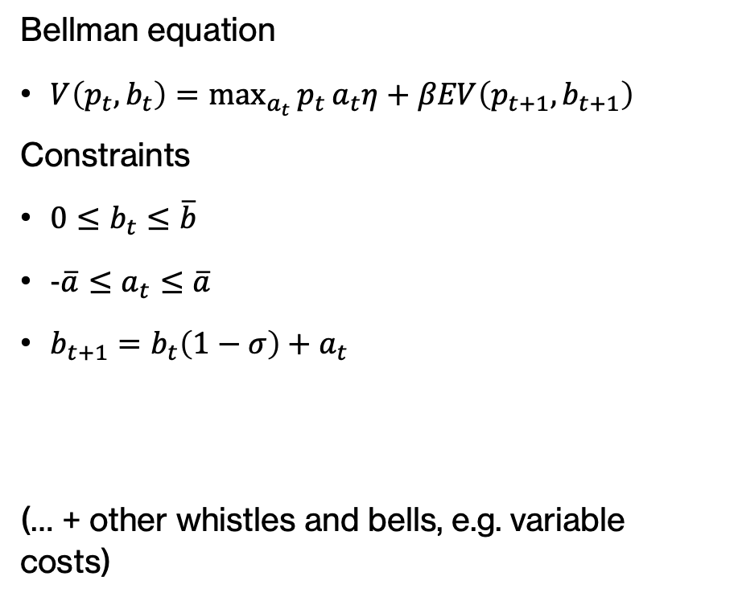
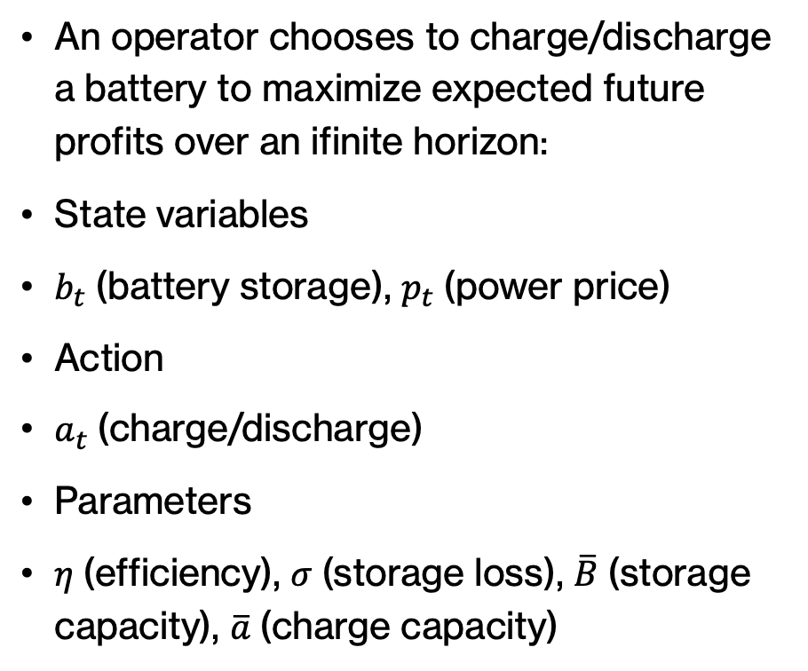
Model
An operator chooses to charge/discharge a battery to maximize expected future profits over an ifinite horizon:
State variables
$b_{t}$(battery storage), $p_{t}$(power price)
Action
$a_{t}$(charge/discharge)
Parameters
$η$(efficiency), $σ$(storage loss), $\overline{B}$(storage capacity), $\overline{a}$(charge capacity)
Bellman equation
$V\left(p_{t},b_{t}\right)=\max_{a_{t}}{p_{t}}a_{t}η+βEV\left(p_{t+1},b_{t+1}\right)$
Constraints
$0≤b_{t}≤\overline{b}$
$-\overline{a}≤a_{t}≤\overline{a}$
$b_{t+1}=b_{t}\left(1−σ\right)+a_{t}$
(… + other whistles and bells, e.g. variable costs)

Slide 5
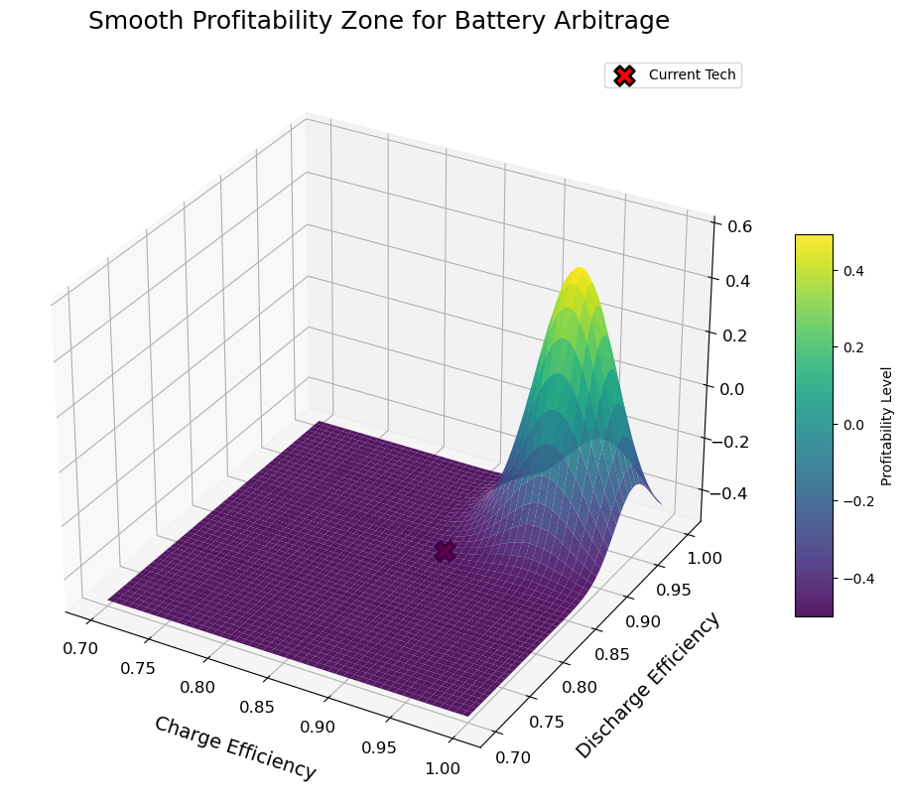
Answering the Research Question
We formulate markow transition probabilities of prices based on historical data.
To asses the profitability, we simulate the battery with new data for prices.
We asses the profit for different parameter values (fictional plot).

Slide 6
Problems?
Smaller problems
Expectations of the operator: perfect foresight or what?
Realistic representation of battery specifications vs model complexity.
Bigger problems:
Does “inner” solutions exist in charging behavior?
Can we do EGM (problems: Utility function is linear and not differentiable)?

