Slide 1
Checking SOAPY simulation
PhD meeting
Puttiwat Kongkaew
05 June 2023

Slide 2
Includes
Review of 22/05/23 meeting
This week research
Plan

Slide 3
Review of 22/05/2023 meeting
Meeting online with Tim
No progress on new thesis chapter
Skip analysis on phase screen and propagation.
Generation of interaction and control matrix looks nice. Must check performance dependence on svd.
Reconstructor converges to theoretical performance (DM fitting error)
Delay error looks promising. Must reduce error bar.

Slide 4
Review of 22/05/2023 meeting
Plan for 23/05 – 05/06/2023
  Check reconstructor performance as svd changes.
  Reduce error bar on delay analysis.
  Turbulence Temporal PSD
  Slope covariance
  Study SLODAR

Slide 5
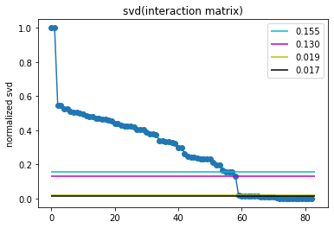
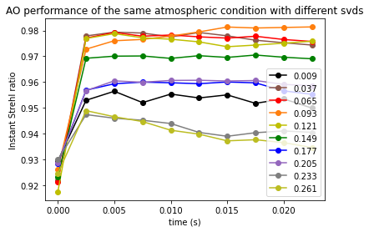
Effect of SVD on reconstructor performance
After the drop
✗
✓
✓
between
✓
✓
?
✗
✗
✗
✗
Before the drop
Suitable value ➔ any between the drop points (0.130 – 0.019)

Slide 6
Strehl ratio
Time (s)

Slide 7
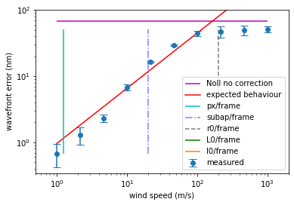
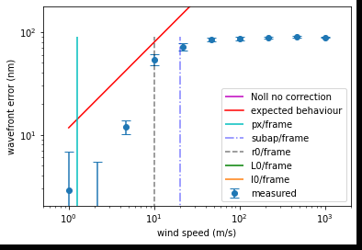
Temporal error
Frame rate = 0.0025s
R0 = 2.5cm – 75m
Max error = 1.029(d/r)^(5/3)
L0 = 8m
Lenslet Diameter = 0.4m/8 = 5cm
l0 = 1e-10 m (hard code in soapy)
Frame rate = 0.0025s
R0 = 5cm
Max error = 1.029(d/r)^(5/3)
L0 = 8m
Lenslet Diameter = 0.4m/8 = 5cm
l0 = 1e-10 m (hard code in soapy)
Coherence time instead of r0?
Plateau region is
the lower of either
Limited to r0/frame
or
Noll’s telescope size

Slide 8
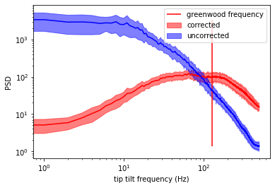
Turbulence Temporal PSD
Performance gain by AO
AO-amplified error
Frame = 0.001s
Total time = 1s
R0 = 5cm
L0 = 10m
Tel = 0.4m
Nxsub = 8
Pxlspersubap = 16
dm gain = 1
Vbar5/3=15.11m/s
Vmin = 5m/s
Vmax=34.53
Tau0=1.04ms
Fmax=1/2pixeltime
pixel time = 0.4m/16/8/5m/s
= 0.625ms
max frequency = 1/(2*pxtime)
= 1/(2*0.625ms) = 800Hz
Correct units??
AO correction
Starting to see noisy region?

Slide 9
Greenwood frequency
Corrected
Uncorrected
Power spectral density
Tip/tilt frequency (Hz)

Slide 10
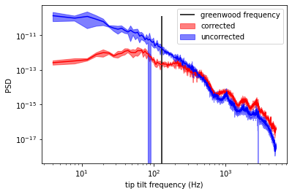
Turbulence Temporal PSD
Usual FT limit
Calculation limit
Can be fix by
Frame rate
Frame = 0.0001s
Total time = 0.25s
R0 = 5cm
L0 = 10m
Tel = 0.4m
Nxsub = 8
Pxlspersubap = 16
dm gain = 1
Vbar5/3=15.11m/s
Vmin = 5m/s
Vmax=34.53
Tau0=1.04ms
Correct units??
Pixel shift limit
Atm Layers
= Not what happen
Physically
Can be fix by
reducing pixel scale
What happen here?
L0 frequency
Nyquist frequencies of each layer

Slide 11
Turbulence Temporal PSD
Usual FT limit
Calculation limit
Can be fix by
Frame rate
Frame = 0.0001s
Total time = 0.25s
R0 = 5cm
L0 = 10m
Tel = 0.4m
Nxsub = 8
Pxlspersubap = 16
dm gain = 1
Vbar5/3=15.11m/s
Vmin = 5m/s
Vmax=34.53
Tau0=1.04ms
Correct units??
subap shift limit
Atm Layers
= is what ao see
So this is legit still.
L0 frequency
subap frequencies of each layer

Slide 12
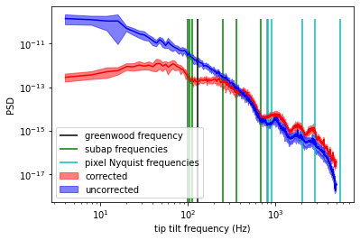
Turbulence Temporal PSD
Usual FT limit
Calculation limit
Can be fix by
Increase frame rate
Frame = 0.0001s
Total time = 0.25s
R0 = 5cm
L0 = 10m
Tel = 0.4m
Nxsub = 8
Pxlspersubap = 16
dm gain = 1
Vbar5/3=15.11m/s
Vmin = 5m/s
Vmax=34.53
Tau0=1.04ms
Correct units??
error
subap shift limit
= is what ao see
So this is legit still.
Pixel shift limit
- Not what happen
physically
- Can be fix by
reducing pixel scale

Slide 13
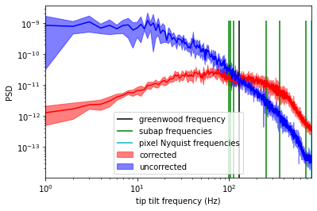
Turbulence Temporal PSD
Usual FT limit
Calculation limit
Can be fix by
Increase frame rate
Frame = 0.000625s
Total time = 1s
R0 = 5cm
L0 = 10m
Tel = 0.4m
Nxsub = 8
Pxlspersubap = 16
dm gain = 1
Vbar5/3=15.11m/s
Vmin = 5m/s
Vmax=34.53
Tau0=1.04ms
correct
Correct units??
subap shift limit
= is what ao see
So this is legit still.
Pixel shift limit
- Not what happen
physically
- Can be fix by
reducing pixel scale

Slide 14
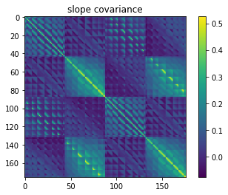
Slope covariance
Need to reshape covariance to pupil shape for better analysis
nIters = 1000, loopTime=0.0025, scrnHeights=[20km],
windDirs = 90, r0=0.05, windSpeeds = 17.94m/s, L0=10m,
Tel=0.4m, subapFOV=16”, nxSubaps=8, pxlsPerSubap=16,
GSPosition = [0,1”] & [0,-1”]
WFS1 x
WFS1 y
WFS2 x
WFS2 y
drop over larger distance on the same wfs
shift by the distance because 1&2 pointing on different direction
No correlation on independent axis
WFS1 x
WFS1 y
WFS2 x
WFS2 y

Slide 15
What am I doing again?
Usually slodar is in open loop
Solar mcao have data in close loop
Solar ao want to have slodar measurement along with it
Why solar ao wants slodar measurement?
  Profiling has more details in elevation
  Do literature research on this
That’s why it has to be pseudo open loop
Slodar in pseudo open loop
Pseudo-open loop = close loop slope + dm shape
In mcao

Slide 16
Note
Im confident with soapy now
Now the slodar test run / study in open loop
  Check with people
Research why am I doing this/importance
Compare slodar in open loop vs pseudo open loop
  Pseudo open loop
Slodar without propagation → general cases
Slodar with propagation in atmosphere → open loop → Ryan
Slodar with propagation in atmosphere and dms → pseudo open loop

