Slide 1

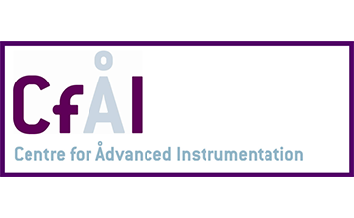
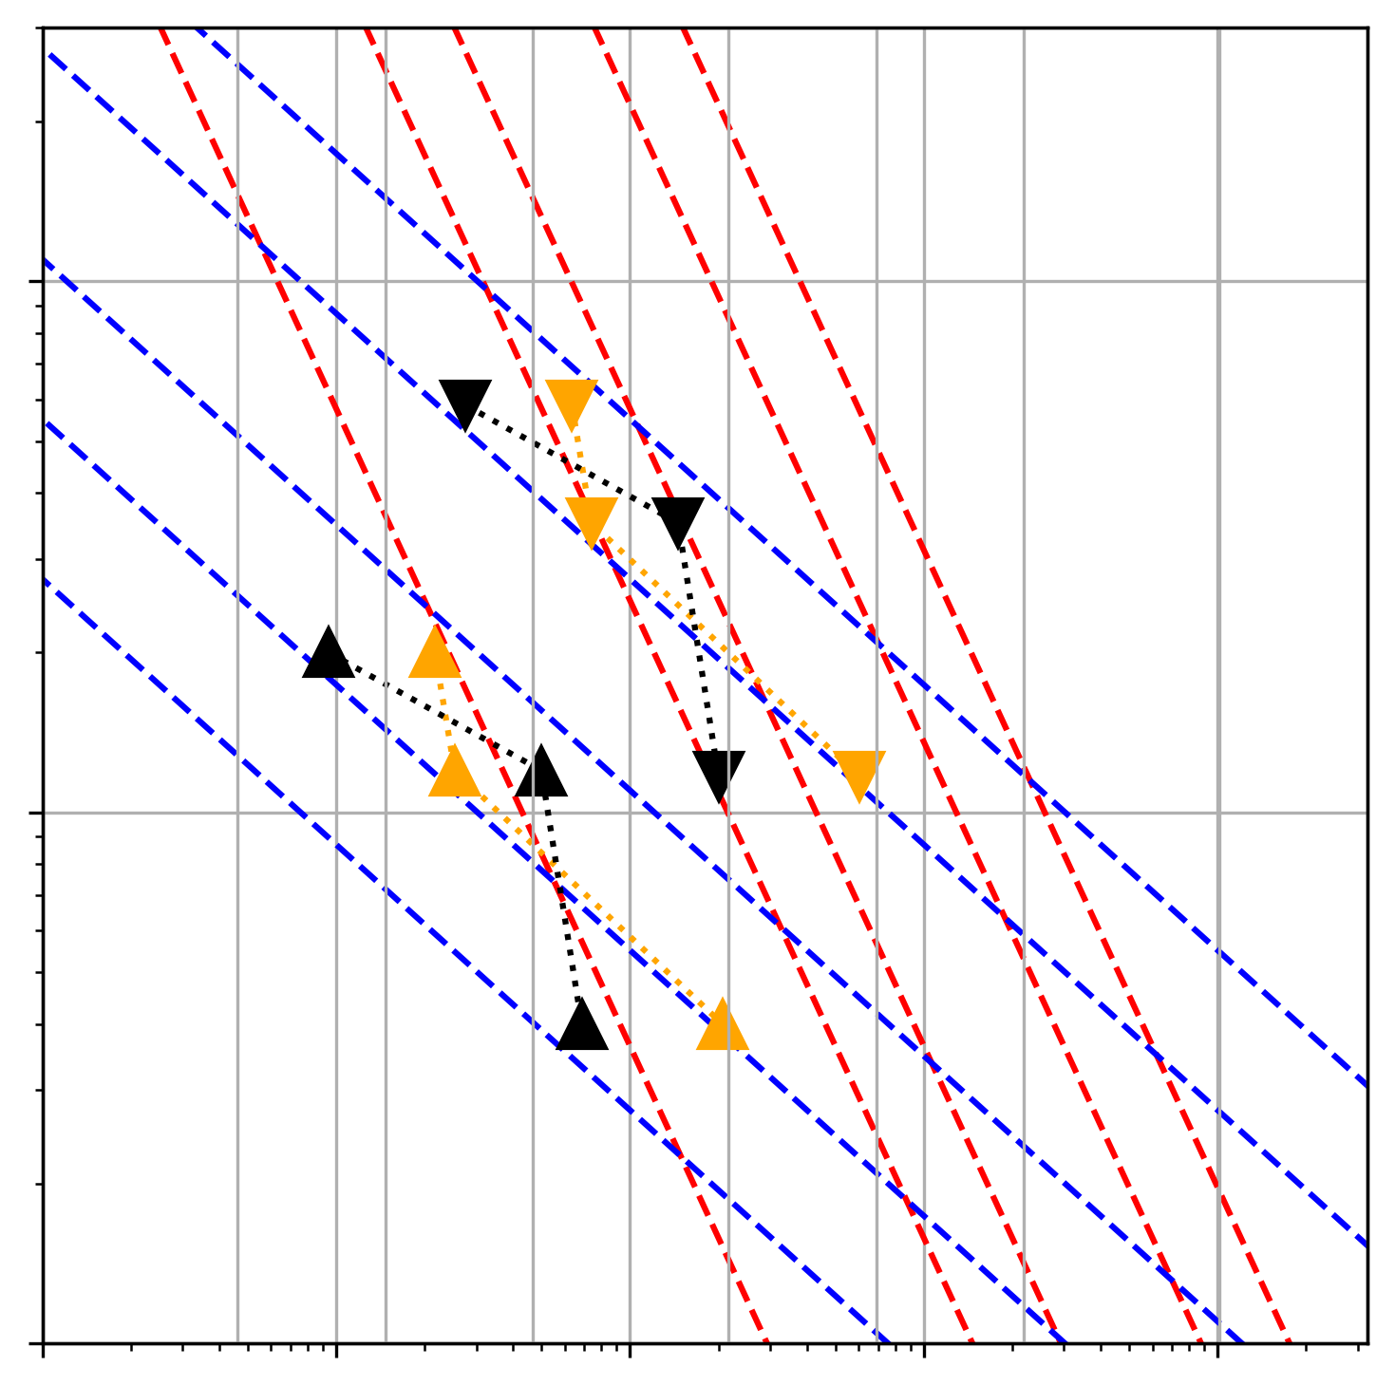
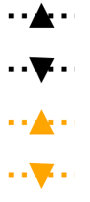
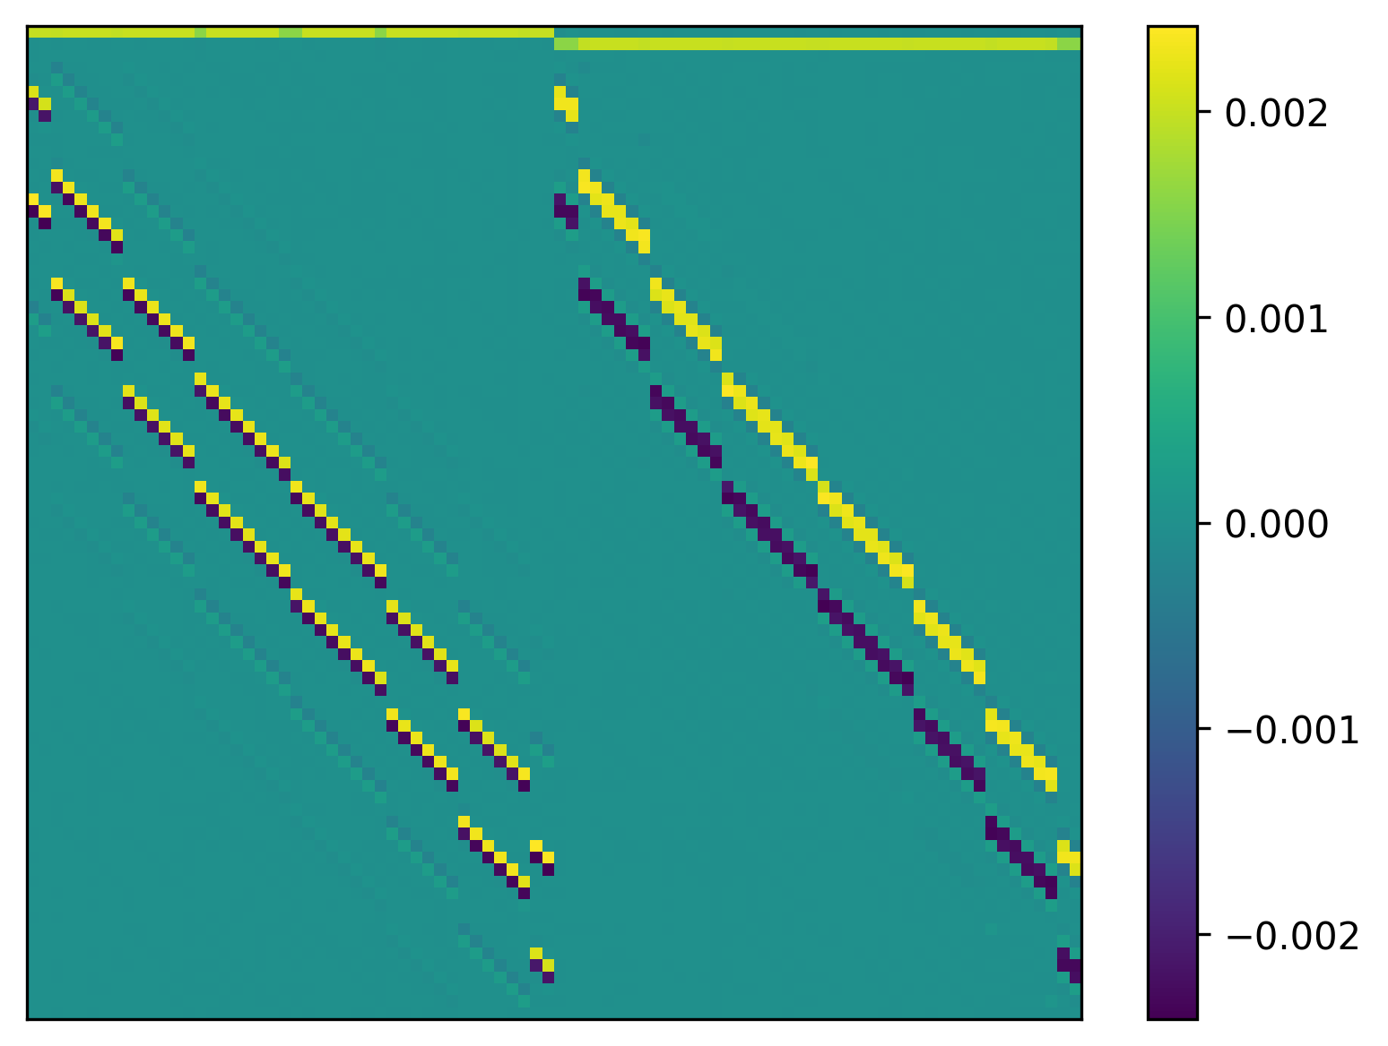
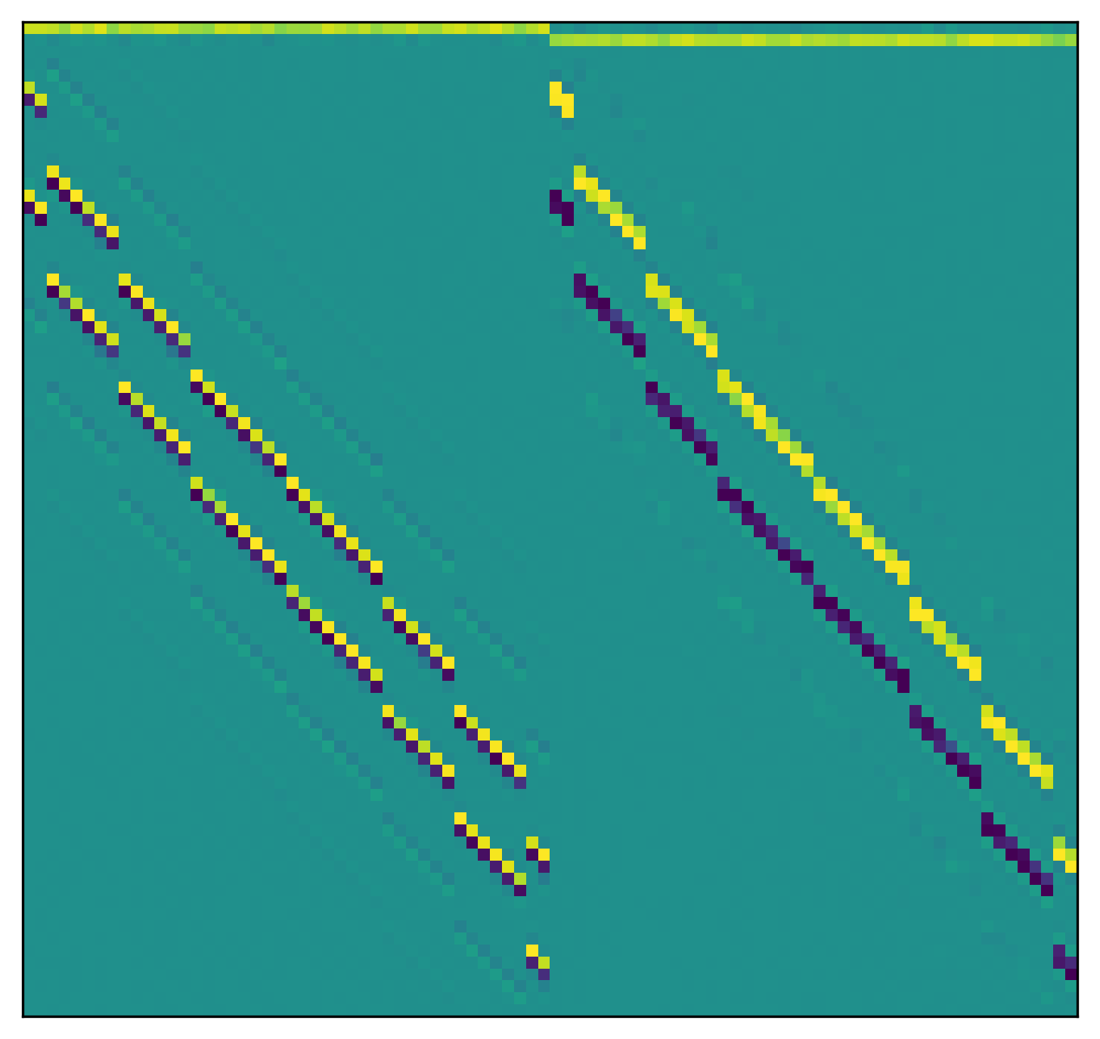
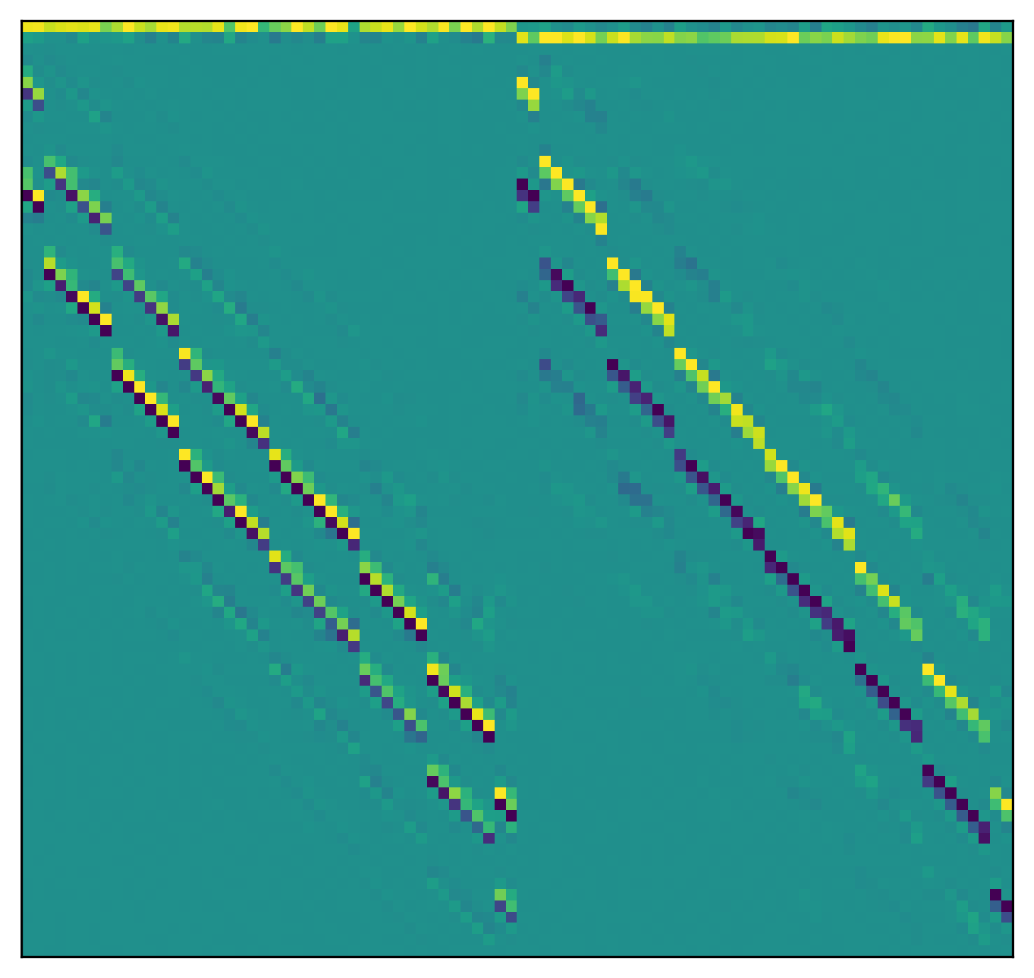
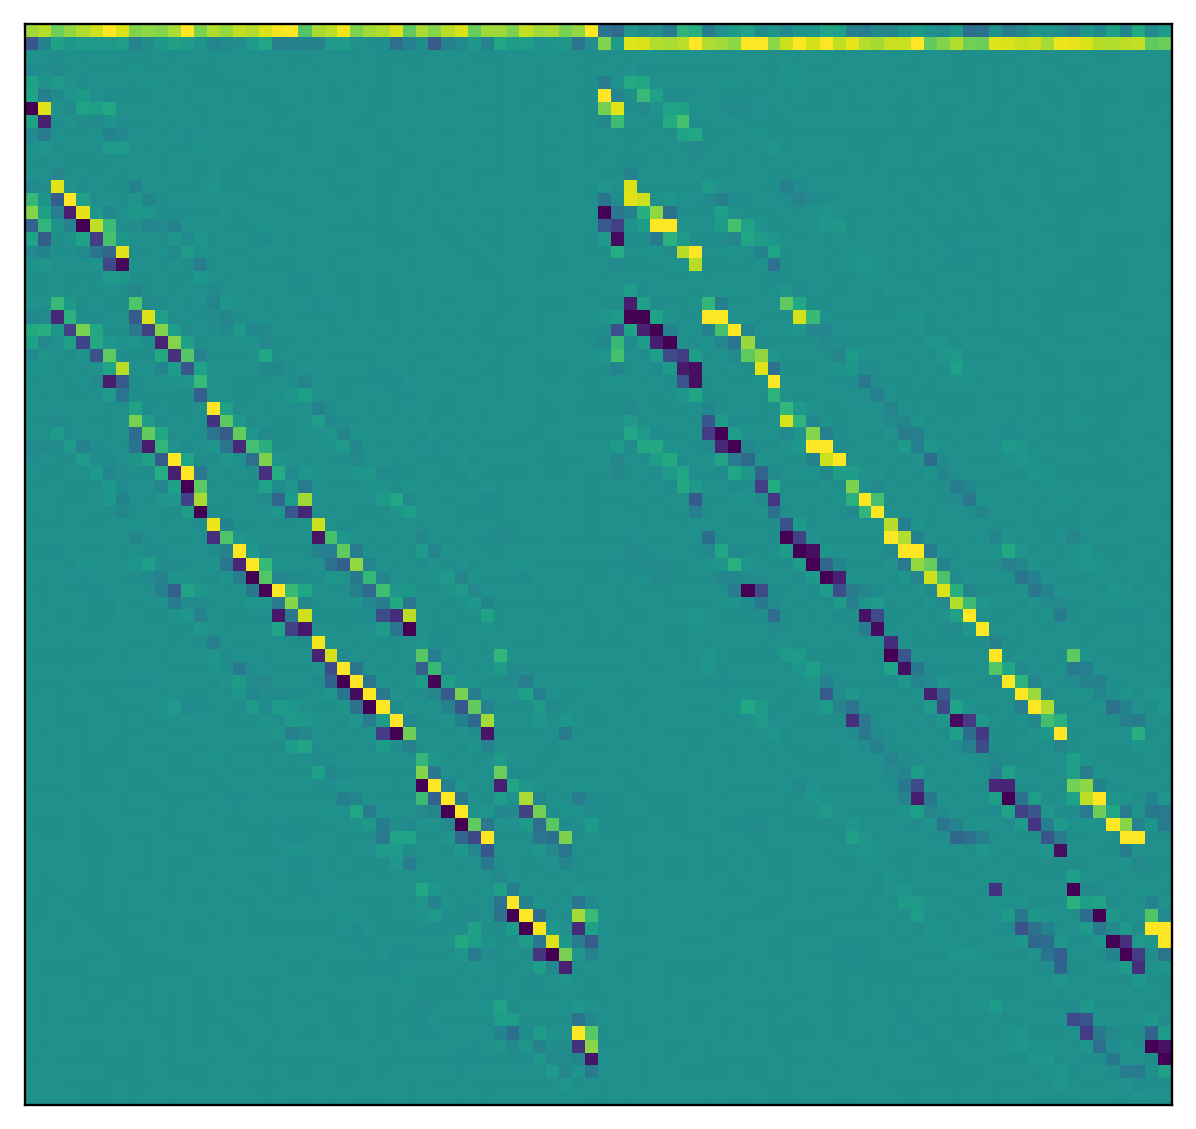
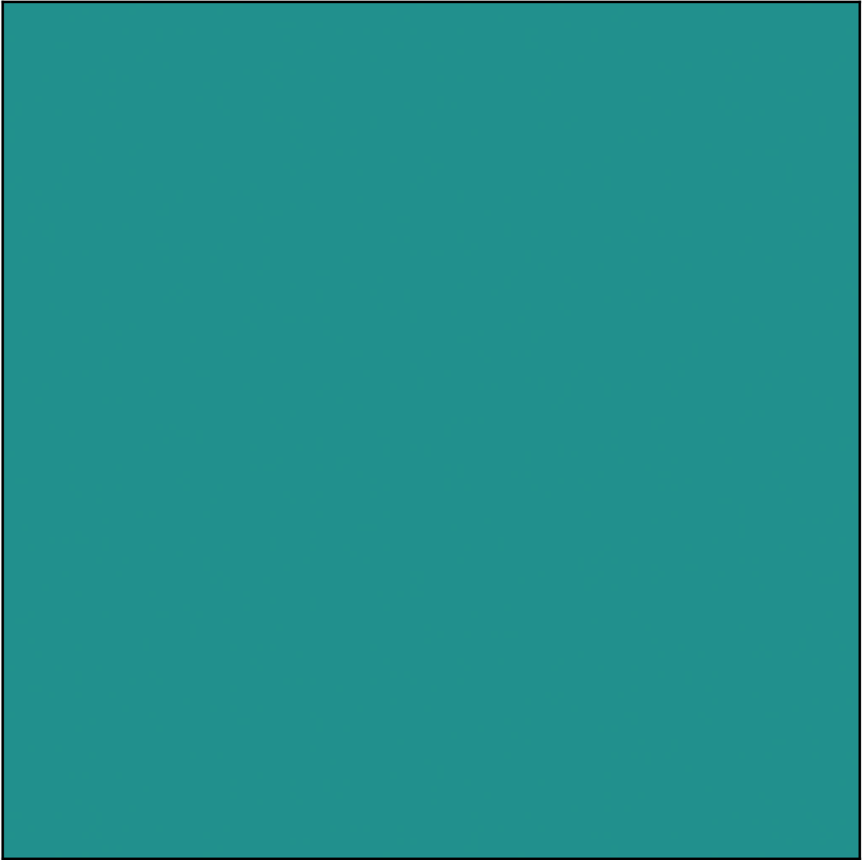

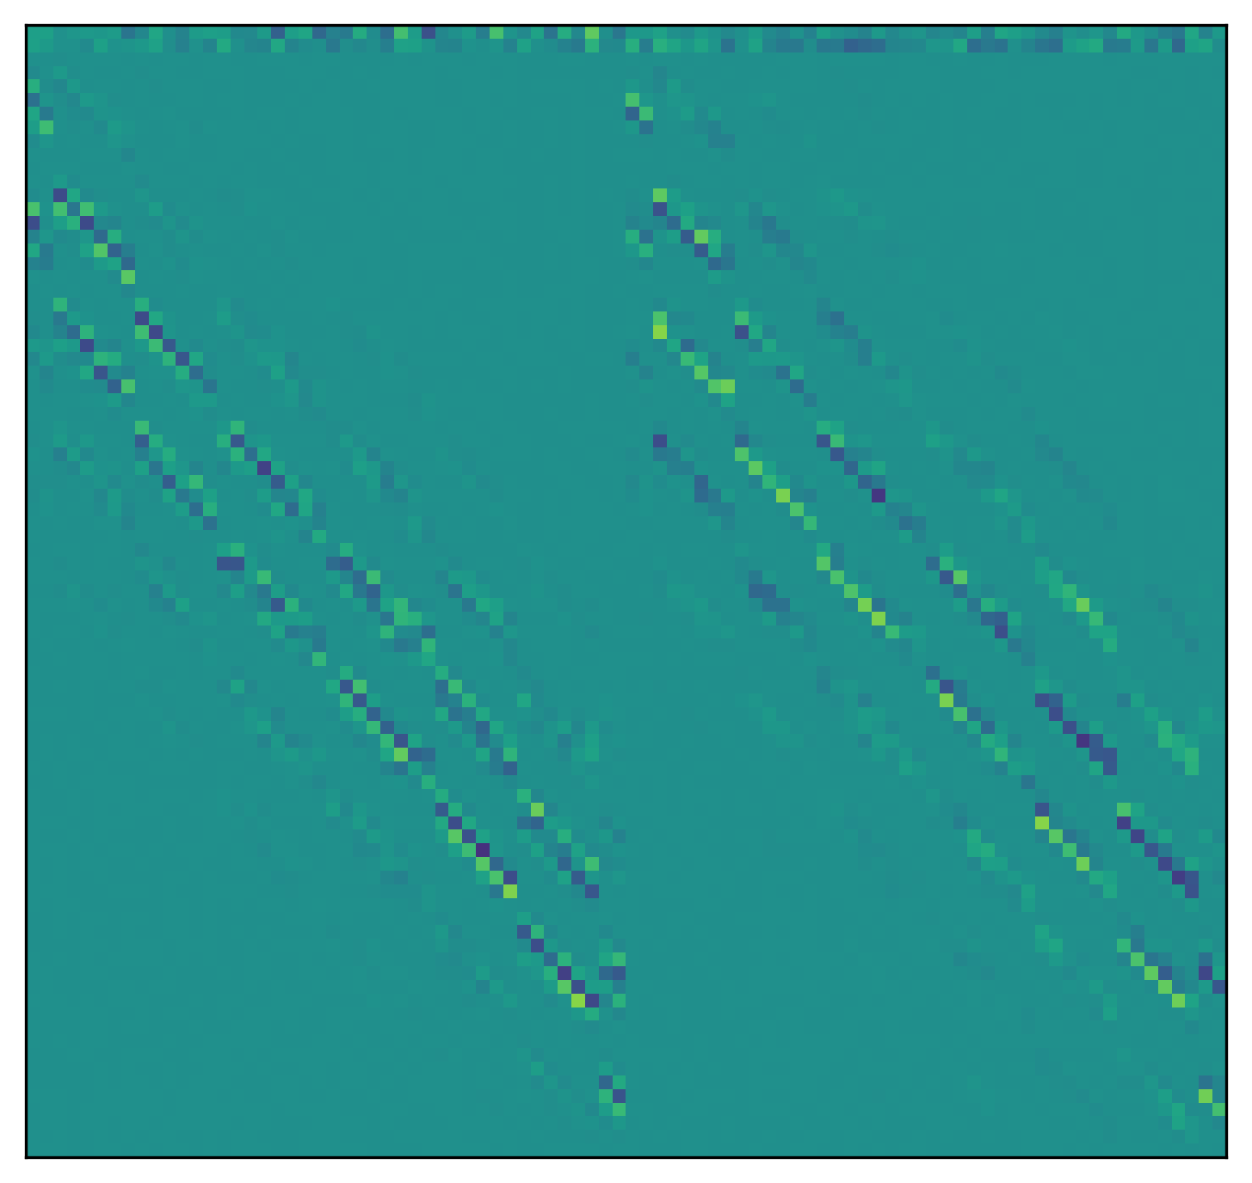
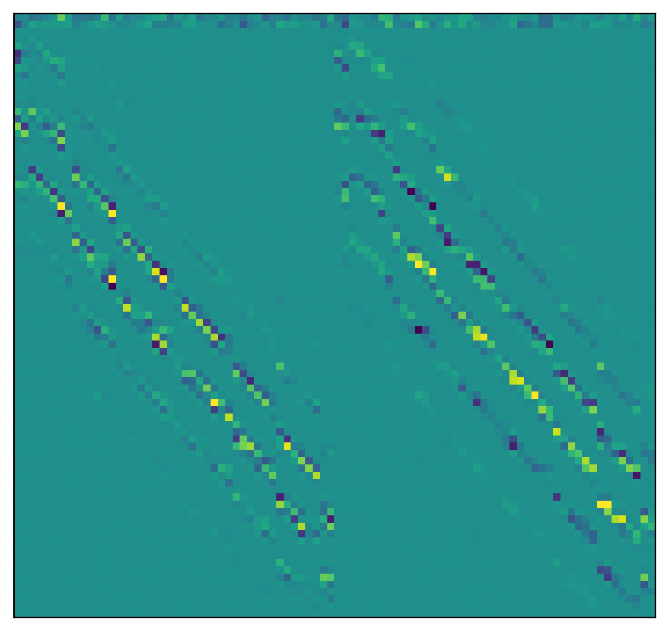
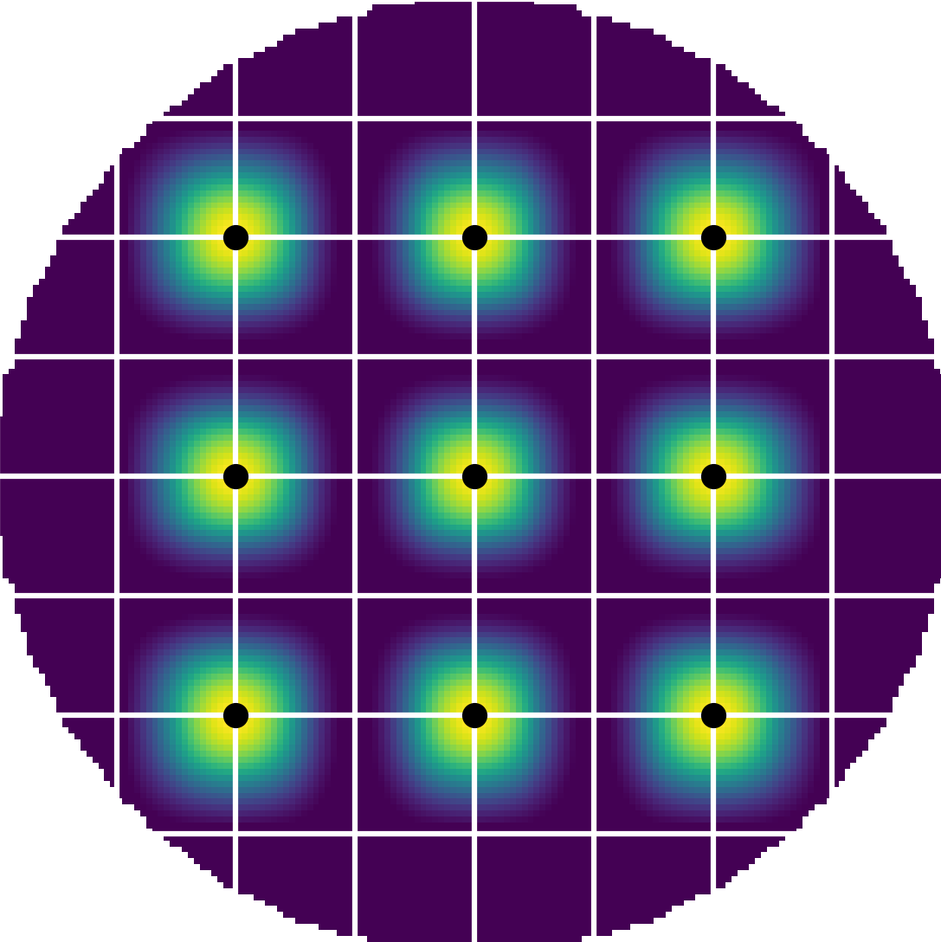
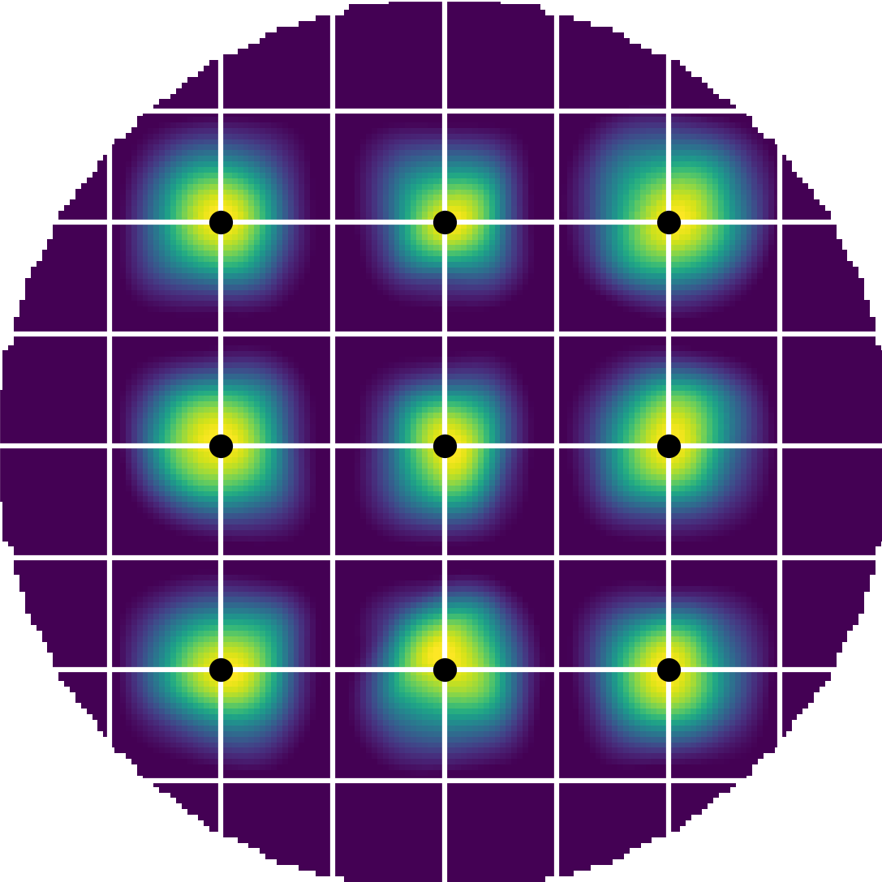
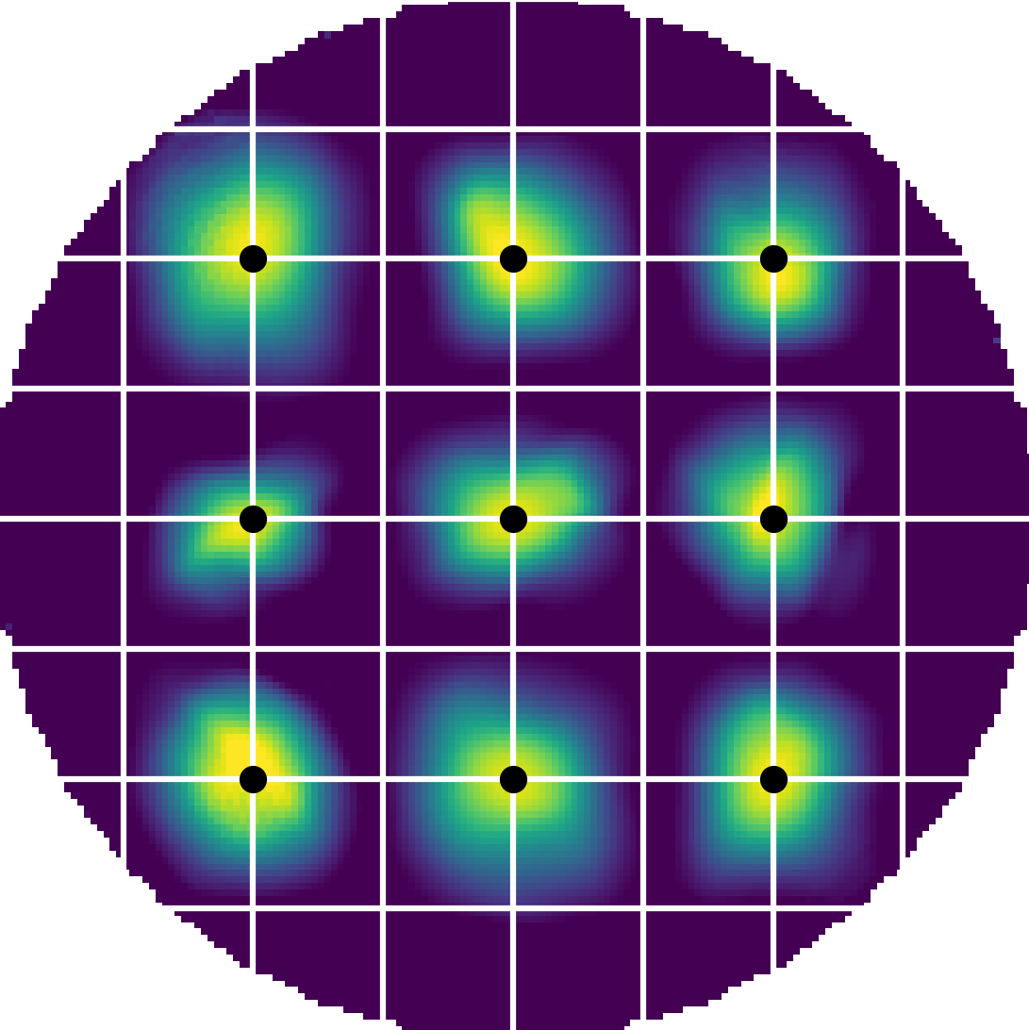
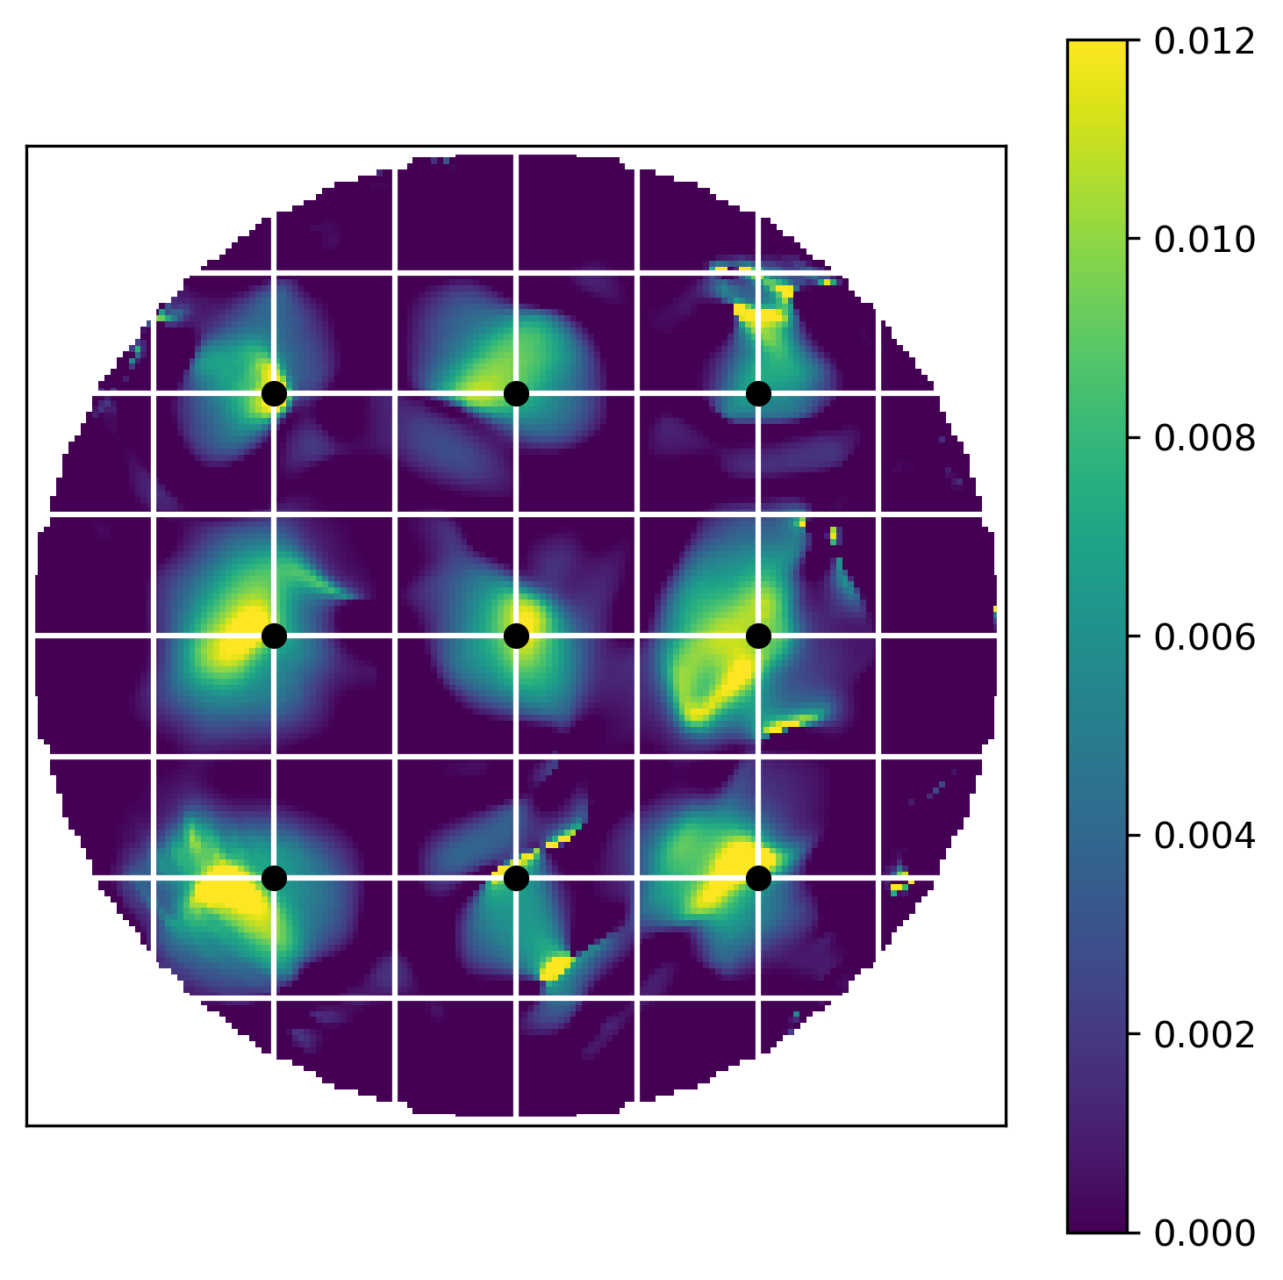
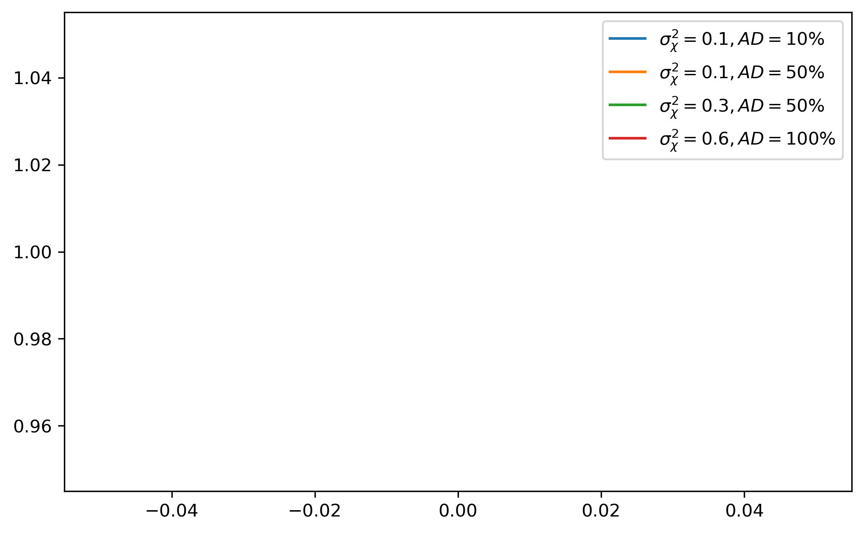
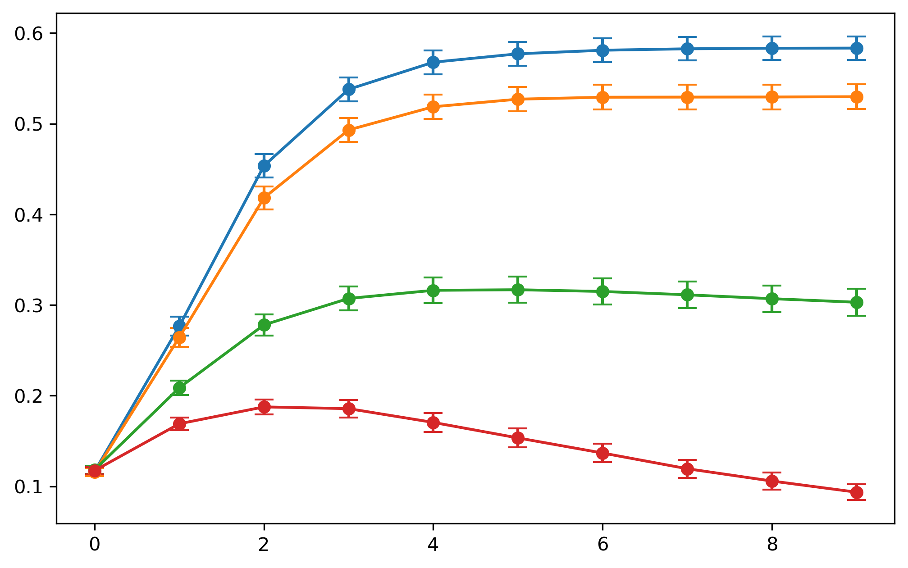


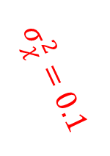





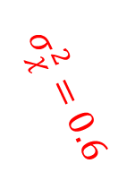



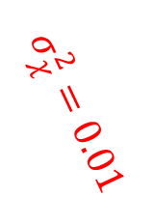



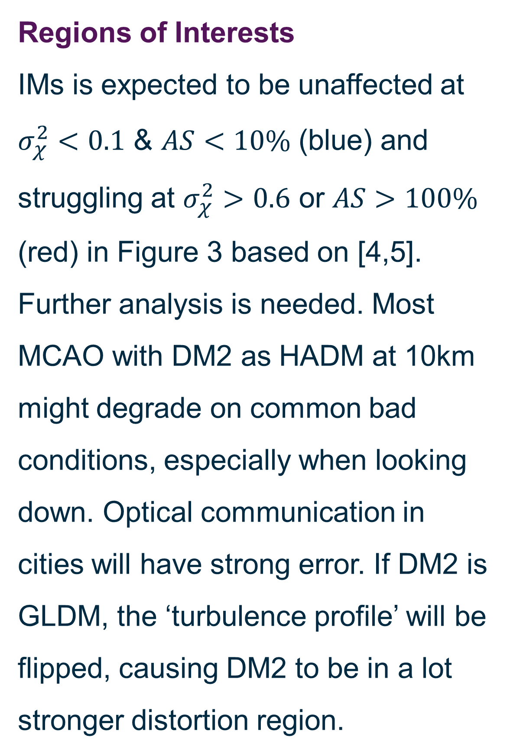

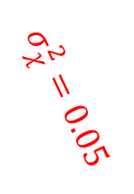






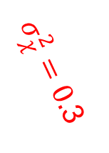


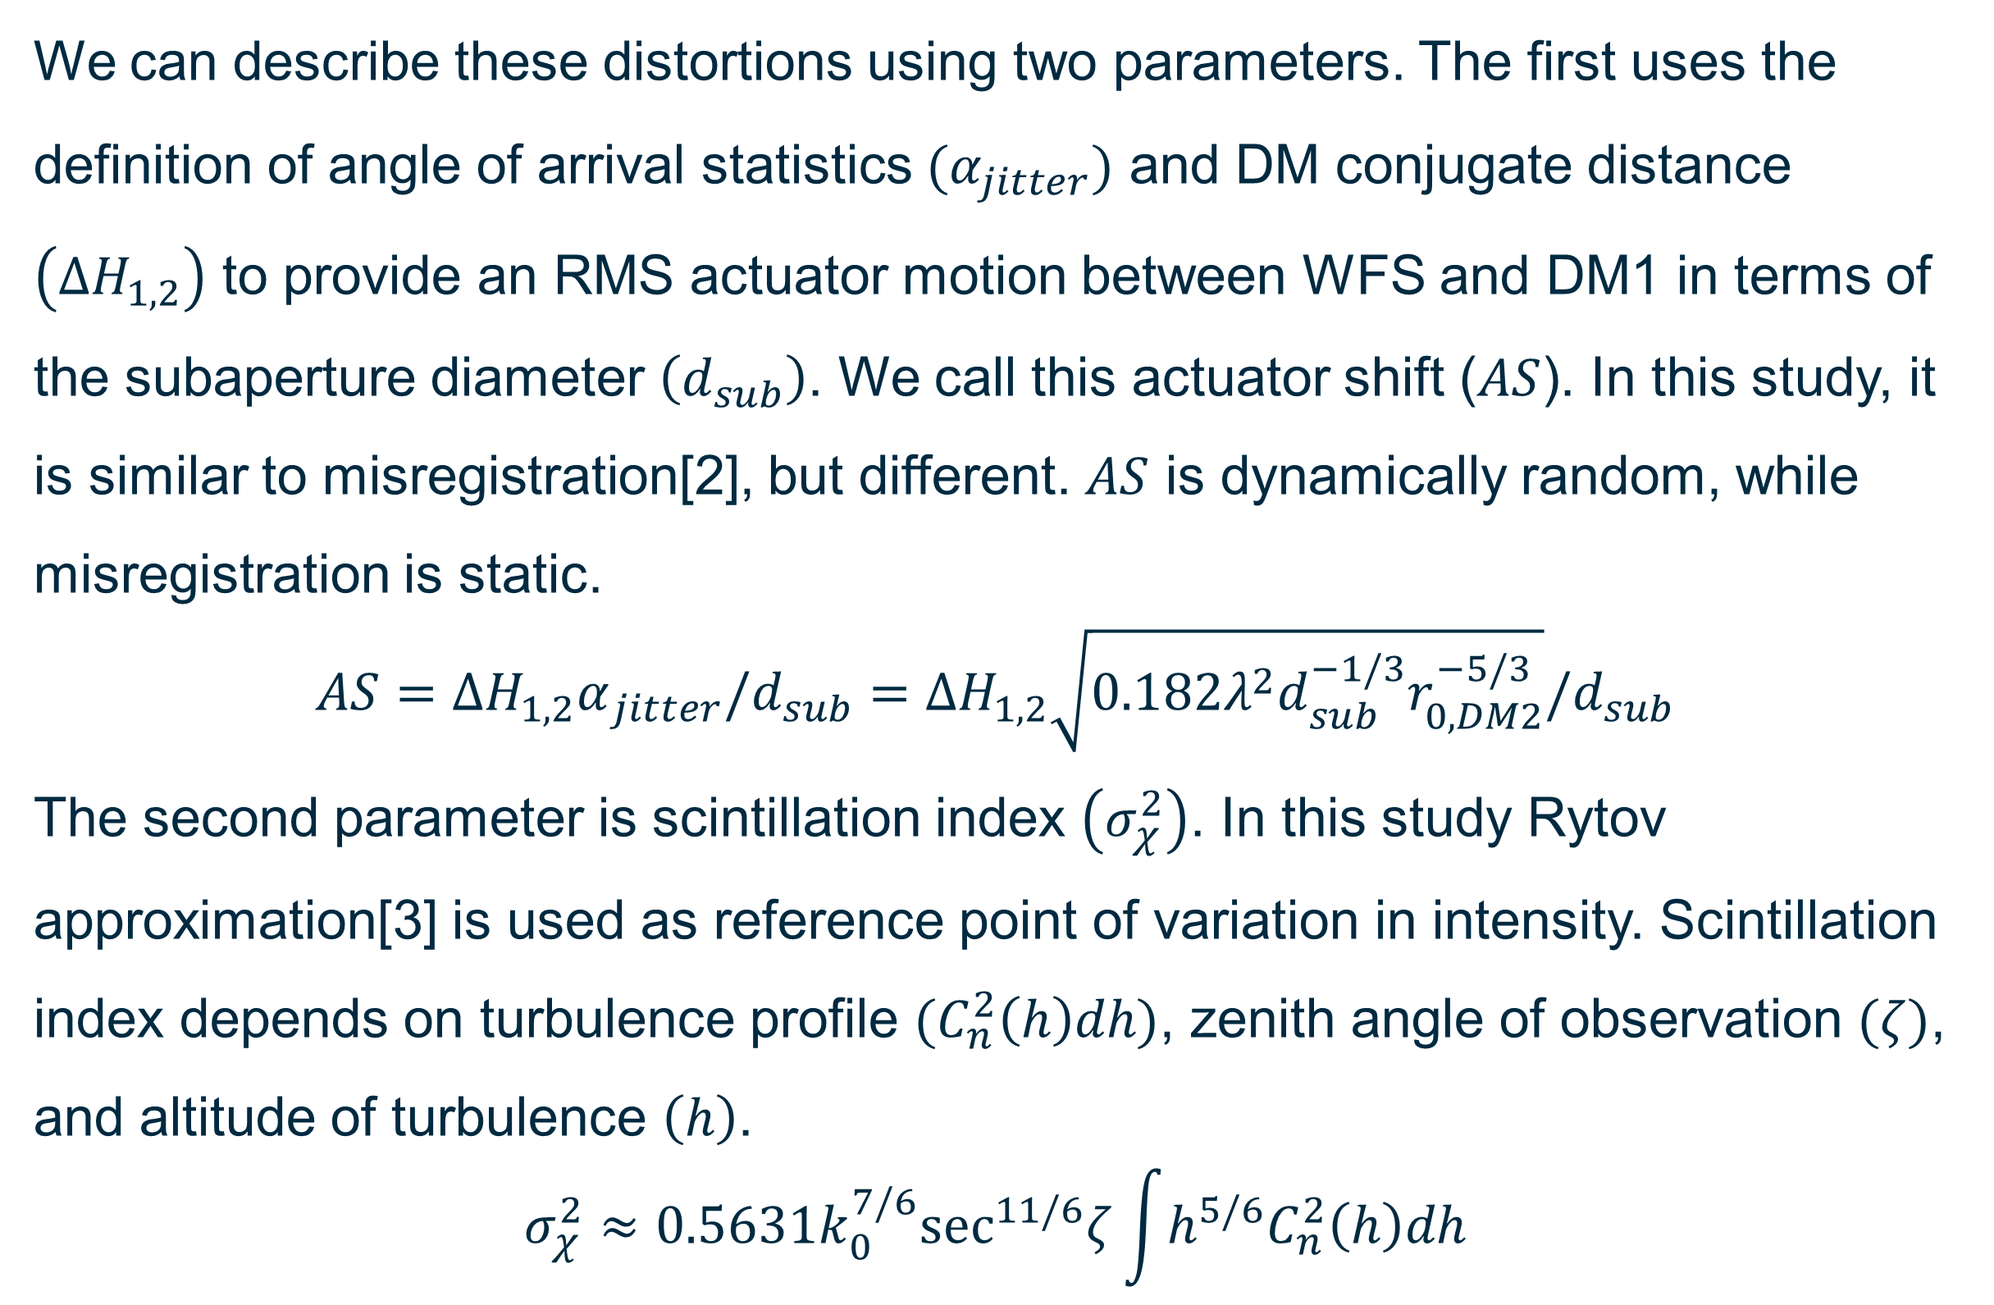


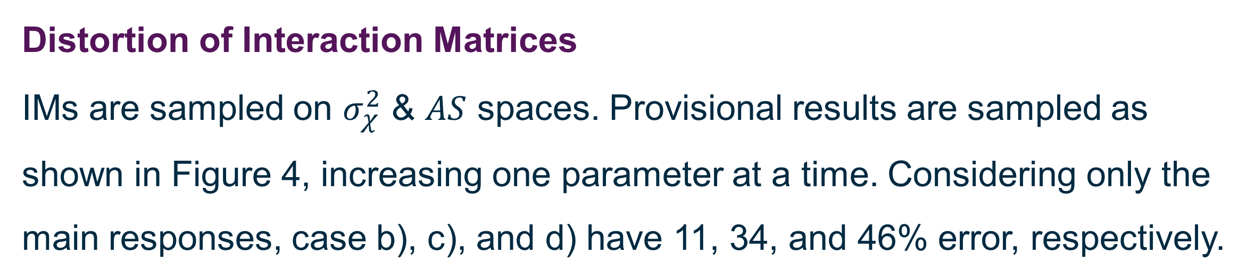
Distortion of Visible Daytime Multi-Conjugate Adaptive Optics Control
Puttiwat Kongkaew, Timothy Morris, James Osborn
Centre for Advanced Instrumentation (CfAI), Department of Physics, Durham University, UK
Email: puttiwat.kongkaew@durham.ac.uk
ABSTRACT: Daytime wide-field optical observations, including solar telescopes and optical communications, experience strong turbulence and scintillation. Such condition may cause control problems in MCAO due to DM distortions. Consider an MCAO configuration with two DM. When MCAO control is ‘active’, the second DM in the path distorts images and control of the first DM. Scintillation and statistical shift of DM’s actuators as detected by WFSs are hypothesized to be major sources of errors. An end-to-end Monte Carlo simulation is chosen as the mode of study. Interaction matrices of the first DM conjugated to ground are measured through the active second DM conjugated to high altitude, inverted to control matrices, and used in AO control. To single out control error only the first DM and its turbulence layer are active during the control test.
Problem
Multi-conjugate AO system utilizes several deformable mirrors in series to provide correction over a wide field. In strong turbulence conditions this can introduce optical distortions between the wavefront sensors and deformable mirrors that can impact performance[1]. Here we investigate how distortion of interaction (and therefore control) matrices (IM&CM) by an intermediate deformable mirror can impact AO system performance with optical propagation effects between DMs and WFS included. We provide some initial system and atmospheric boundary conditions in which this situation may be encountered.
Regions of Interests
IMs is expected to be unaffected at $σ_{χ}^{2}<0.1$ & $AS<10\%$ (blue) and struggling at $σ_{χ}^{2}>0.6$ or $AS>100\%$ (red) in Figure 3 based on [4,5]. Further analysis is needed. Most MCAO with DM2 as HADM at 10km might degrade on common bad conditions, especially when looking down. Optical communication in cities will have strong error. If DM2 is GLDM, the ‘turbulence profile’ will be flipped, causing DM2 to be in a lot stronger distortion region.
5
2
1
0.5
$$r_{0} (m)$$
0.2
0.1
0.05
0.02
0.01
$$σ_{χ}^{2}=0.1$$
$$σ_{χ}^{2}=0.6$$
100
$$σ_{χ}^{2}=0.01$$
$$σ_{χ}^{2}=0.05$$
$σ_{χ}^{2}=0.$3
$$hsecζ (km)$$
10
AS = 100%
Night, $ζ=0^{∘}$
AS = 50%
Night, $ζ={70}^{∘}$
Day, $ζ=0^{∘}$
AS = 5%
AS = 10%
AS = 20%
Control Matrix distortion
During MCAO system calibration, an IM is a measure that links the response of each actuator in the system to the WFS. In the presence of large static aberrations or a large phase correction on the intermediate DM (DM2 in Figure 1) the geometry between DM1 and the WFS can become distorted, introducing errors in the CM.
1
Day, $ζ={70}^{∘}$
$${10}^{−15}$$
$${10}^{−14}$$
$${10}^{−13}$$
$${10}^{−12}$$
$${10}^{−11}$$
$$C_{n}^{2}secζdh (m^{1/3})$$
Figure 3: Shows region of AO operations expected to have negligible (blue shaded) and strong distortion (red shaded). Values are calculated for 5cm-subaperture geometry at 500nm. X-axis shows turbulence strength being corrected by DM2. Y-axis shows altitude difference between DM1 and DM2. Contour plots of scintillation indices and relative actuator shift are overlaid. Turbulence profiles of the stronger 3rd Quartile from 24hSHIMM data at Paranal [6] both during the night and the day and looking up and down are shown for comparison.
Atmosphere
Calibration (flat DM2)
Operation (non-flat DM2)
Distortion of Interaction Matrices
IMs are sampled on $σ_{χ}^{2}$ & $AS$ spaces. Provisional results are sampled as shown in Figure 4, increasing one parameter at a time. Considering only the main responses, case b), c), and d) have 11, 34, and 46% error, respectively.
Telescope
WFS subaperture
DM1
DM1 actuator
DM2
WFS spot
a) $σ_{χ}^{2}$ = 0, AS = 0%
b) $σ_{χ}^{2}$ = 0.1, AS = 10%
c) $σ_{χ}^{2}$ = 0.1, AS = 50%
d) $σ_{χ}^{2}$ = 0.3, AS = 50%
WFS
Figure 1: Sketch showing the Fried geometry between DM1 actuators and WFS when DM2 is held flat e.g. during calibration (left), and during operation when geometry becomes distorted by DM2 (right).
1
We can describe these distortions using two parameters. The first uses the definition of angle of arrival statistics $(α_{jitter})$ and DM conjugate distance $\left(ΔH_{1,2}\right)$ to provide an RMS actuator motion between WFS and DM1 in terms of the subaperture diameter $\left(d_{sub}\right)$. We call this actuator shift ($AS$). In this study, it is similar to misregistration[2], but different. $AS$ is dynamically random, while misregistration is static.
$$AS={ΔH_{1,2}α}_{jitter}/d_{sub}=ΔH_{1,2}\sqrt{0.182λ^{2}d_{sub}^{−1/3}r_{0,DM2}^{−5/3}}/d_{sub}$$
The second parameter is scintillation index $\left(σ_{χ}^{2}\right)$. In this study Rytov approximation[3] is used as reference point of variation in intensity. Scintillation index depends on turbulence profile $(C_{n}^{2}\left(h\right)dh)$, zenith angle of observation $(ζ)$, and altitude of turbulence $\left(h\right)$.
$$σ_{χ}^{2}≈0.5631k_{0}^{7/6}\sec^{11/6}ζ\int{h^{5/6}C_{n}^{2}\left(h\right)dh}$$
IM
0
IM Difference
-1
Figure 4: Distorted interaction matrices from DM1 (top) and the difference from the non-distorted interaction matrices (bottom) for increasing scintillation indices and relative actuator shift (AS) to SHWFS subaperture size. Simulations used 5cm-subapertures at 500 nm.
Closed-loop results on static turbulence
Figure 5 shows the corrected instantaneous Strehl ratio when distorted and undistorted control matrices are used to control the SCAO correction of a static phase screen with an r₀ of 5cm. As expected, AO correction degrades with increasing stronger distortions.
Method
To model this effect, we have implemented an AO simulation incorporating optical propagation between DMs and WFS. Figure 2 shows the effect of optical propagation of DM1 phase at the WFS through operating DM2. Actuator shift has been increased by varying the propagation distance between DM2 and DM1. As a side effect, scintillation also increases.
Conclusion
The impact of distortion and propagation effects on nighttime AO performance is not normally considered, but becomes a dominant error source for solar and optical communication where Rytov numbers> 0.3 can be observed. MCAO control with strong distortion has no correction, as expected. MCAO with HADM as DM2 at 10-20km on a general bad day at good site will have approximately 10% degradation on Strehl ratio. Question arises: if DM2 is a GLDM, would it be much worse? Can distorted IMs be updated?
$σ_{χ}^{2}$ = 0, AS= 0%
$σ_{χ}^{2}$ = 0.08, AS = 10%
$σ_{χ}^{2}$ = 0.15, AS = 20%
$σ_{χ}^{2}$ = 0.32, AS = 50%
1
$σ_{χ}^{2}$ = 0.0, AS = 0%
$σ_{χ}^{2}$ = 0.3, AS = 50%
References
[1] Marcos A. van Dam, Yolanda Martín Hernando, Miguel Núñez Cagigal, Luzma M. Montoya, "Overcoming the effect of pupil distortion in multiconjugate adaptive optics," Proc. SPIE 11448, Adaptive Optics Systems VII, 114480P (13 December 2020); https://doi.org/10.1117/12.2560873
[2] Hardy, J. W., [Adaptive Optics for Astronomical Telescopes], Oxford University Press (1998)
[3] Sasiela, R. J., [Electromagnetic Wave Propagation in Turbulence: Evaluation and Application of Mellin Transforms, 2nd Ed.], SPIE Press (2007).
[4] Barchers, J. D., Fried, D. L., Link, D. J., Tyler, G. A., Moretti, W., Brennan, T. J., and Fugate, R. Q., “Performance of wavefront sensors in strong scintillation,” in [Adaptive Optical System Technologies II ], Wizinowich, P. L. and Bonaccini, D., eds., 4839, 217 – 227, International Society for Optics and Photonics, SPIE (2003).
[5] Hardy, J. W., [Adaptive Optics for Astronomical Telescopes], Oxford University Press (1998).
[6] R Griffiths, L Bardou, T Butterley, J Osborn, R Wilson, E Bustos, A Tokovinin, M Le Louarn, A Otarola, A comparison of next-generation turbulence profiling instruments at Paranal, Monthly Notices of the Royal Astronomical Society, Volume 529, Issue 1, March 2024, Pages 320–330, https://doi.org/10.1093/mnras/stae434
0
0.6
$σ_{χ}^{2}$ = 0.1, AS = 50%
$σ_{χ}^{2}$ = 0.6, AS = 100%
Figure 2: Phase of DM1 actuator pokes at 500nm at the WFS with 5 cm subapertures through active DM2 which is correcting 5cm-r0 turbulence for increasing relative actuator shift (AS) to SHWFS subaperture size. Phase are normalized to poke values.
0.5
DM1 and DM2 is conjugated to ground and altitude, respectively. Distorted IMs are measured by ‘calibrating’ DM1 through a random static DM2 applying Kolmogorov turbulence with only spatial frequency lower than half frequency of SHWFS. Then DM1’s distorted IMs are tested to correct 5cm-r₀ ground turbulence with flatten DM2. WFS with 5cm subaperture.at 500nm is used.
Strehl
0.4
0.3
0.2
0.1
Loop Iteration #
Figure 5: Mean instantaneous Strehl ratio from using distorted interaction matrices of DM1 to correct static 5cm-r0 turbulences. Error bar shows standard error of the mean from 100 simulations.

