Slide 1
Checking SOAPY simulation
PhD meeting
Puttiwat Kongkaew
22 May 2023

Slide 2
Includes
Summary of two week ago
Interaction & Control matrix
DM
Temporal error
Plan for next week

Slide 3
Summary of two week ago
Still writing a chapter of thesis: IG-tilt
Discussed on the next research topic
  Theme?: MCAO with propagation effect: Solar & communication
  The first topic was measuring turbulence in one line-of-sight.
  Next: more line of sight ➔ turbulence profiling.

Slide 4
Summary of two week ago
Long target: compare MCAO between with and without propagation effect
Short target: get soapy MCAO up and running
To do list
  Write thesis chapter
  Set SOAPY in daytime turbulence
    Infinite phase screen doesn’t always generate high enough resolution. There are solutions, but I have not tested.
  Set propagation in SOAPY
    SOAPY has it, but I am not confident if it will satisfy constraints. If not this can be implemented later.
  Test SOAPY without propagation effect (Starting last week)

Slide 5
Interaction & control matrix
WFS = IM * DM
DM = CM * WFS
CM = pseudo-inverse(IM)
Something around here.

Slide 6
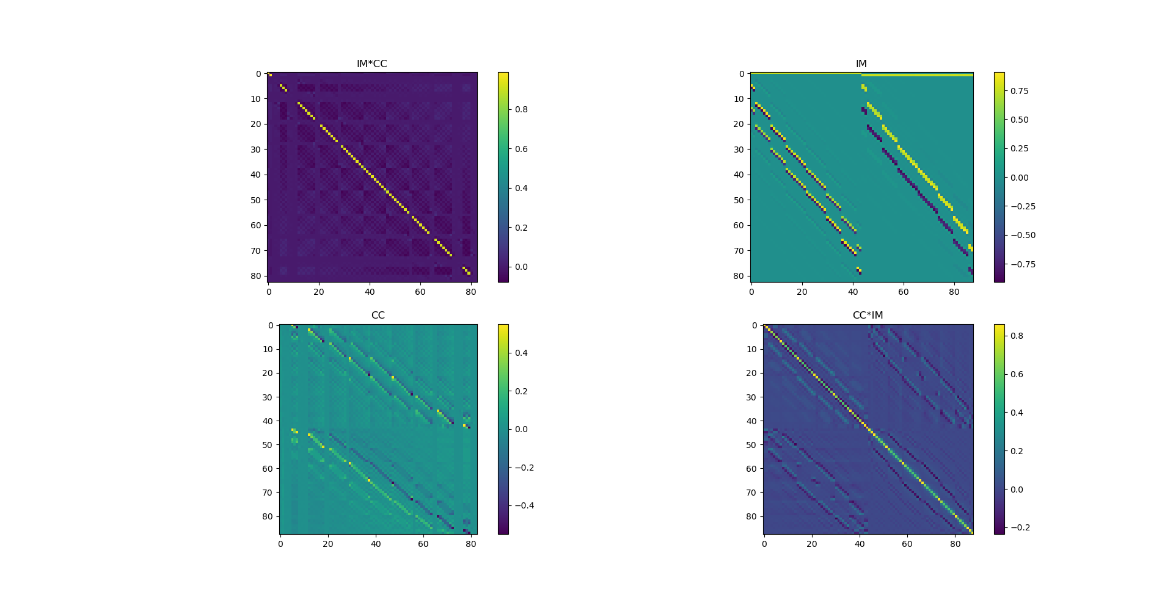
Interaction & control matrix
Find out what’s the unit
Generating interaction matrix with SOAPY
Poking 1 DM actuator/mode
get 1 ‘row’ of IM from WFS
Try to have max value
at 1 by changing iMatValues
Using Fried geometry
1 tip/tilt & 1 high order

Slide 7
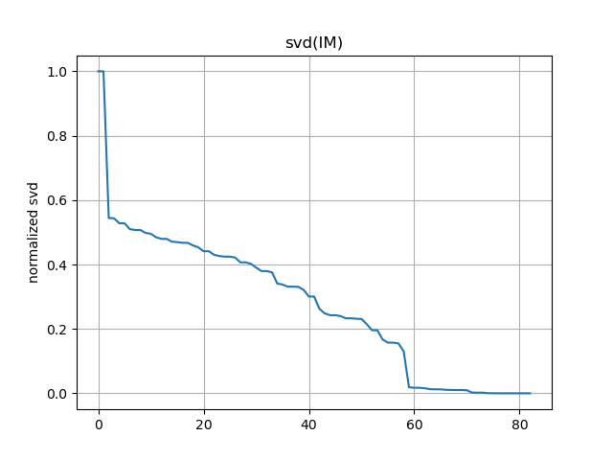
Interaction & control matrix
Suitable svd range
Control matrix is a pseudo-inverse of interaction matrix
Depend on singular value decomposition (svd)
SVD varies for different matrices

Slide 8
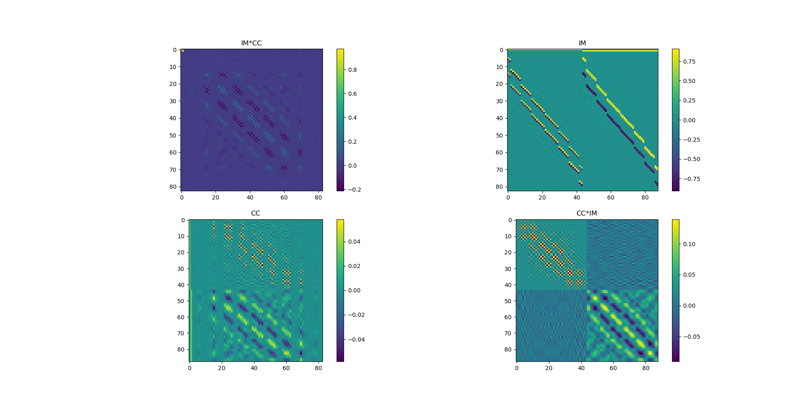
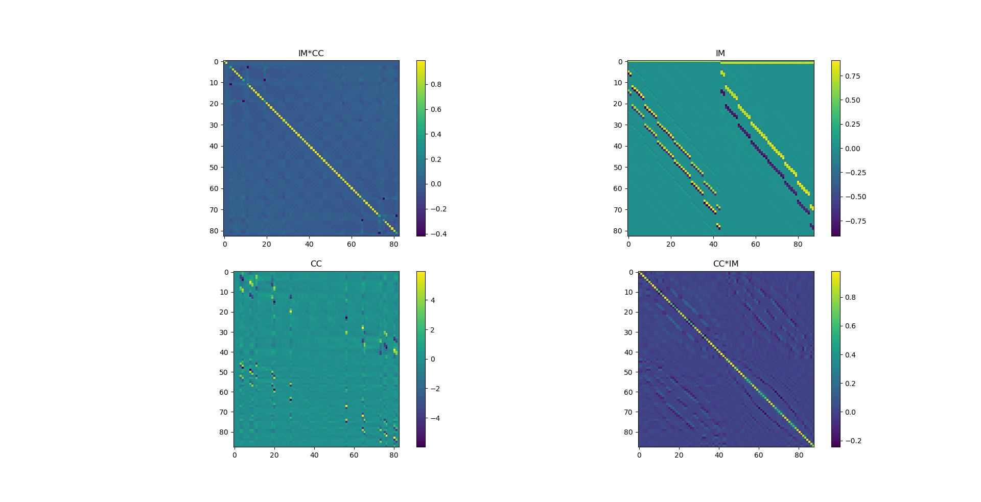
Interaction & control matrix
Bad svd values
Too low (0.01)
Too high (0.5)

Slide 9
Interaction & control matrix
Good svd (0.12)
IM & CC is pronounced.
IM*CC looks similar to I.

Slide 10
DM performance
In condition which other sources of errors are negligible, DM error will show up
  0 wind speed
  run aoloop for long time until performance is converging some value.
  Good enough WFS set up with high flux
  Fix DM, WFS, svd
  Vary r0, measure instant Strehl ratio which it converges to
  Compare to theory

Slide 11
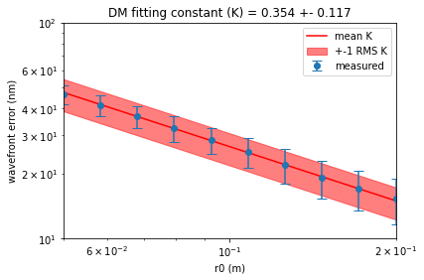
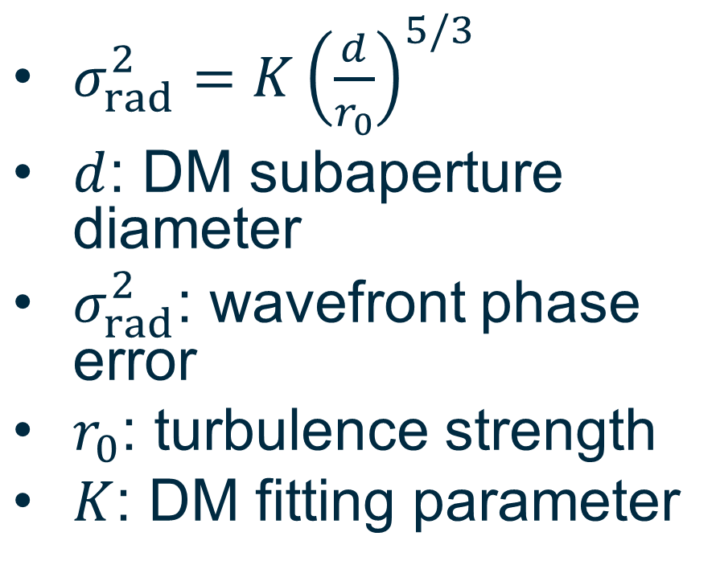
DM performance
r0=5cm
Weaker turbulence
$σ_{rad}^{2}=K{\left(\frac{d}{r_{0}}\right)}^{5/3}$
$d$: DM subaperture diameter
$σ_{rad}^{2}$: wavefront phase error
$r_{0}$: turbulence strength
$K$: DM fitting parameter
When turbulence is stronger than DM spacing,
the error becomes higher than Kolmogorov-like.
Supposedly becauseWFSerror becomes larger.

Slide 12
DM performance
Control system works, as in it converges.
  Is it ‘converging’ properly? – to be tested.
DM performance matches its theoretical performance in Kolmogorov-like turbulence.

Slide 13
Temporal error
Set condition when other source of error is negligible.
  Fix large r0 but not too large
  Fix large L0 to be Kolmogorov-like
  Supposedly good SHWFS with high flux
  Vary wind speed.
  High control gain
  Measure long exposure Strehl ratio

Slide 14
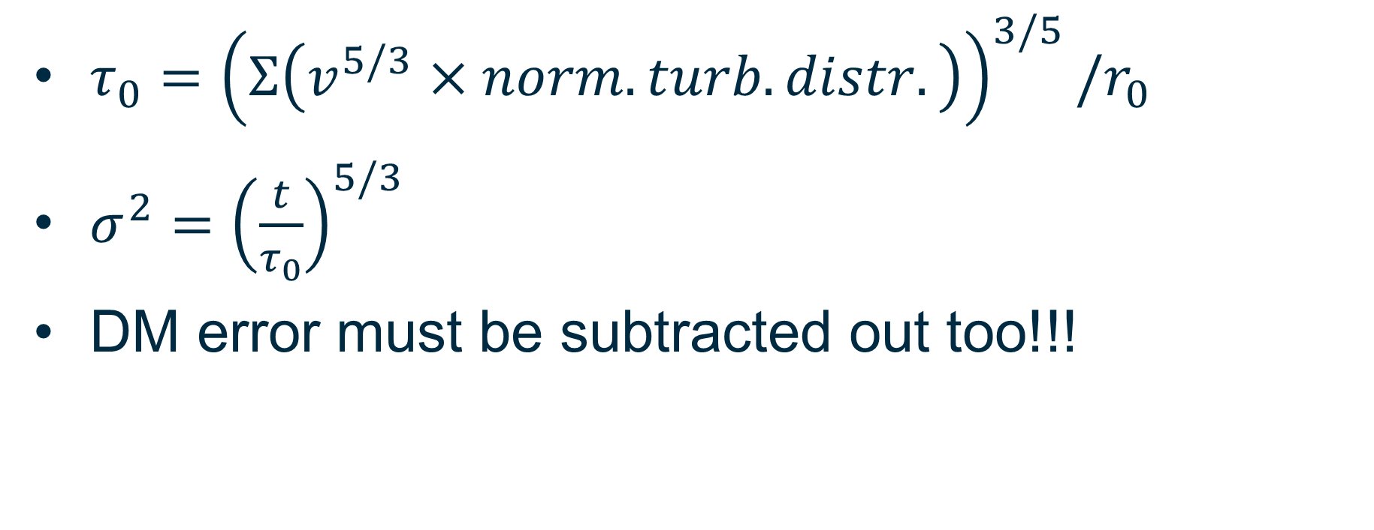
Temporal error
$τ_{0}={\left(Σ\left(v^{5/3}×norm. turb. distr.\right)\right)}^{3/5}/r_{0}$
$σ^{2}={\left(\frac{t}{τ_{0}}\right)}^{5/3}$
DM error must be subtracted out too!!!

Slide 15
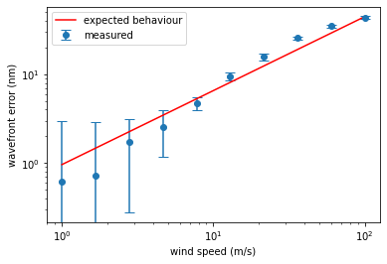
Temporal error
DM fitting error is already taken out.
Telescope/frame also r0/frame
Pixel/frame
L0/frame
Subaperture/frame

Slide 16
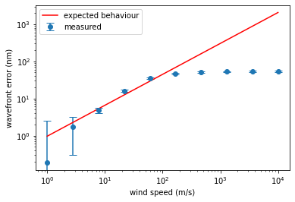
Temporal error
DM fitting error is already taken out.
Frame rate = 0.0025s
R0 = 5cm??
0.65(d/r)^(5/3)
Telescope/frame also r0/frame
Pixel/frame
Subaperture/frame
L0/frame
Note down condition for each graph next time.
No AO correction
= noll’s no correction
error
the flatten is caused by averaging effect
from r0 rather than the telescope frame
Down here?

Slide 17
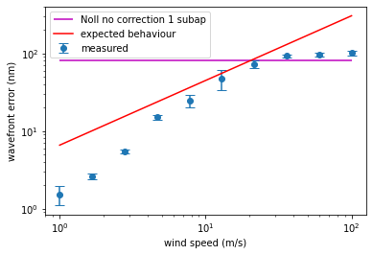
Temporal error
DM fitting error is already taken out.
Frame rate = 0.0025s
R0 = 5cm
1.029(d/r)^(5/3)
Subaperture&r0/frame
Pixel/frame
Note down condition for each graph next time.
No AO correction
= noll’s no correction
Error per subaperture
the flatten is caused by averaging effect
from r0 rather than the telescope frame
Down here?

Slide 18
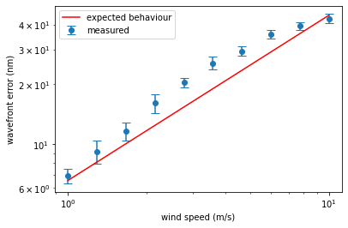
Temporal error
DM fitting error is already taken out.
Telescope/frame also r0/frame
Pixel/frame
Subaperture/frame
L0/frame
0.5r0/frame
Change loop time
= change tau0 and stuff
= not the same condition
= not a proper way to zoom in graph

Slide 19
Other sources of error?
Have not test SOAPY’s SHWFS error
slopes temporal PSD
Effect of varying svd on Strehl ratio
Grab and analyze slopes
  Tip/tilt vs time series ➔ PSD(tip/tilt vs time) ➔ tip/tilt frequencies
  Slope covariance ?
  TIM B & RICHARD WILSON SLODAR papers
  Time series of 30s for half meter subap

