Slide 1
Userspace Linux on the BeagleBone
Thema der Arbeit
Guillaume Quéré
WS 20011/2012

Slide 2
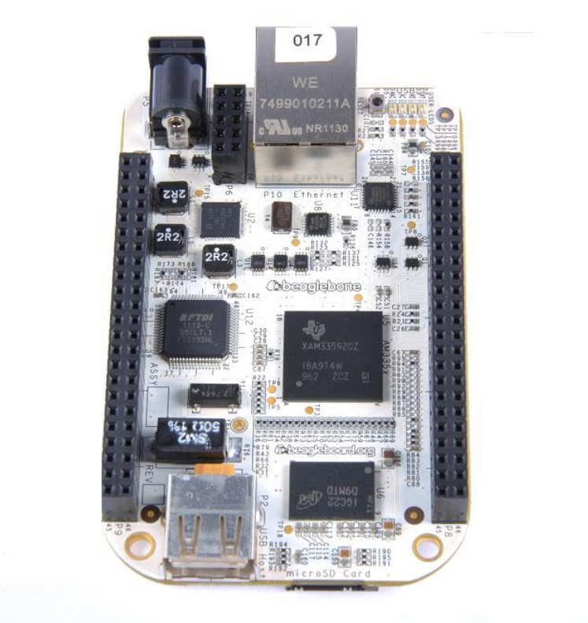
BeagleBone
BeagleBone
  AM3359
    720MHz
  256MB DDR2
  USB, ethernet
  PWM, Timers, LCD
  UART, I²C, SPI, CAN
  ~1W idle
  40 g, 12*5 cm^2
  ~70 pins
          (picture credit : BB SRM)

Slide 3
Intro

Slide 4
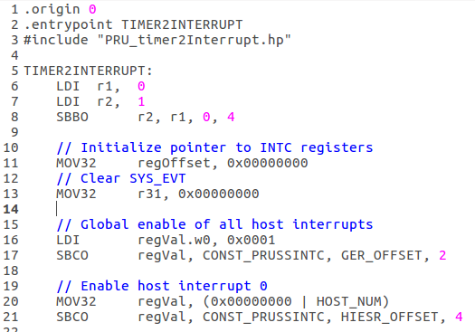
Virtual filesystem
Sysfs interface
  Virtual filesystem
  /sys/class ...
Immediate alternatives :
  Direct register access
  PRUSS : Programmable Real-Time
    (picture credit: Uncle Joe from beagle list)

Slide 5
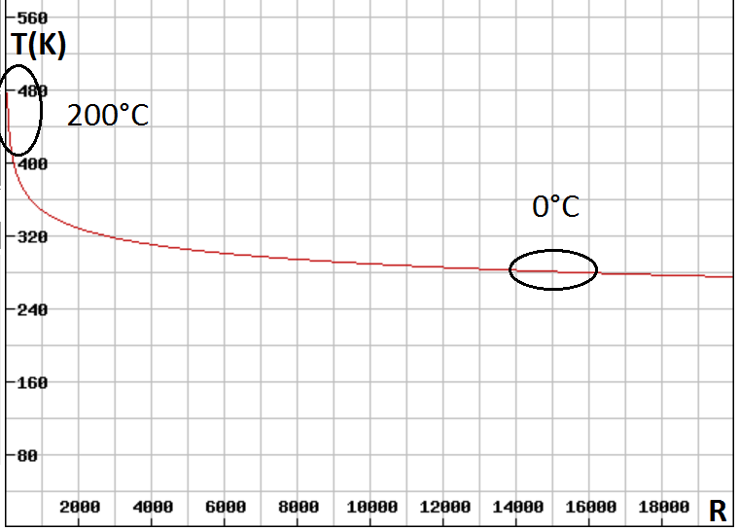
Realisation : D/A conversion
Thermistor
Steinhart and Hart's Law
Implications
Overall precision

Slide 6
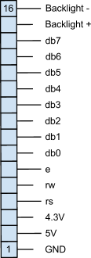
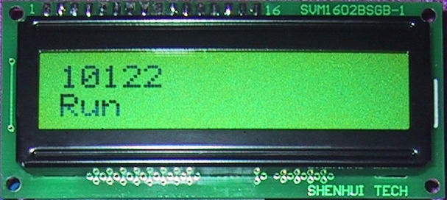
GPIO : Communication
Usual Applications
  I²C, SPI … need voltage converter !
HD44780 Controller
  Parallel device
  Usually, 2 rows of characters
Timings for the HD44780
  Commands vs Data

Slide 7
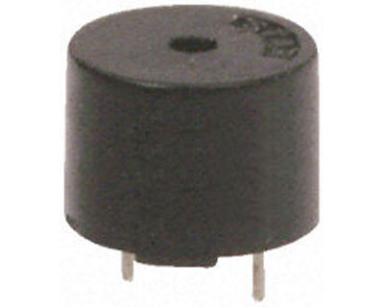
PWM
Usual applications
  IR, heating systems, dimmers, servomotors ...
Enabling the PWM on BeagleBone :
  Mmap system clock registers
  Enable sysclock
  Set correct MUX
  Set duty, frequency, run

Slide 8
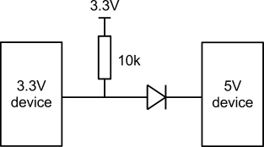
Interrupts
Make a GPIO pin trigger an interrupt
  Export pin
  Set edge
  Reset event set
  Check for event poll(2)
  Reset event set
  …
IR program :
  Add timestamps
    gettimeofday();

Slide 9
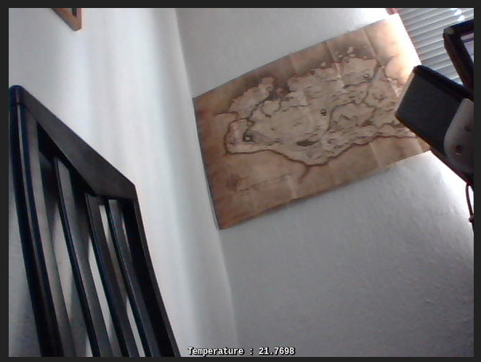
Video over http (with overlay)
Usual way
  V4l (Video for Linux) + C API for images (SDL ...)
Here :
  2 instances of mjpeg-streamer
  + ImageMagick conversion in the middle
  = overlay apply
Immediate drawbacks :
  2 fps
  15% CPU consumption
Alternative : YUYV !

Slide 10
Database operations
Usually, MySQL
Here, SQLite
  Very different architecture
  Lightweight
  Simple API
Database C API functions :
  sqlite3_open / sqlite3_close // open / close
  sqlite3_prepare // prepare AND execute !
  sqlite3_step // get 1 line
  sqlite3_exec // execute

Slide 11
CGI Scripts

Slide 12
Conclusion

