Slide 1

EMOJI USAGE ON TWITTER
GIO AGUILA, GRIFFIN BISHOP,
ALEX O’BRIEN, MICHAEL TAYLOR

Slide 2
BACKGROUND
Emoji comes from the Japanese words for “picture” + “character”
Originated in Japan in the late 1990’s, popularity exploded with iPhone
Quickly adopted on Android and Facebook Messenger
Now widely used on Twitter, Snapchat, etc.

Slide 3
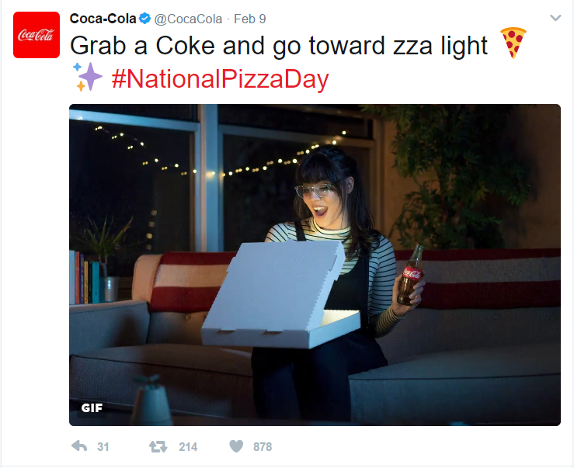
BUSINESS PROBLEM
Which emoji are used in the most popular tweets, and how does the inclusion of emoji contribute to their popularity?
Valuable to businesses trying to relate to younger potential customers
Businesses generally have low social media expertise and their marketing can seem out of place

Slide 4
DATA COLLECTION
Used the Twitter Streaming API to collect tweets from the Northeast region, focusing on English and tweets related to memes

Slide 5
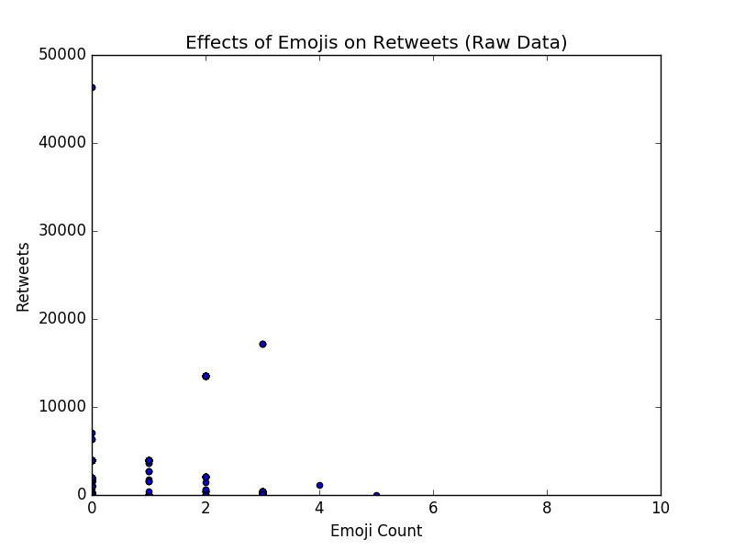
RESULTS

Slide 6
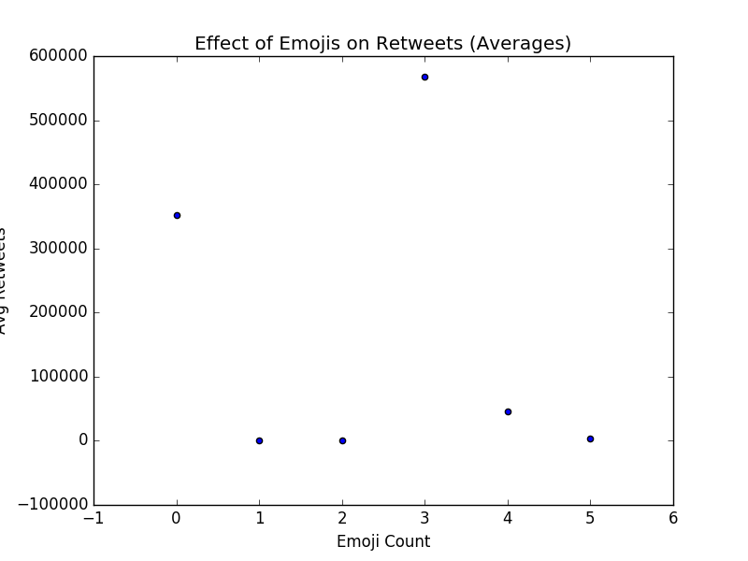
DATA EXPLORATION

Slide 7

CONCLUSION
Magic number of emojis: 3

