Slide 1



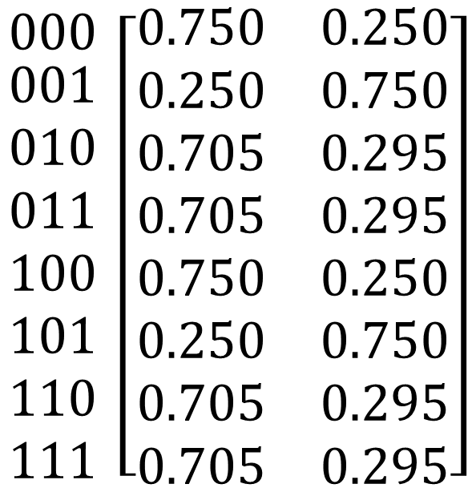





$$z$$
$$0 1$$
$$x$$
$$wxy$$
$$\begin{matrix}000 \\ \begin{aligned}001 \\ 010 \\ 011 \\ 100 \\ 101 \\ 110 \\ 111\end{aligned}\end{matrix} \left[\begin{aligned}\begin{matrix}0.750 & 0.250\end{matrix} \\ \begin{matrix}0.250 & 0.750\end{matrix} \\ \begin{matrix}0.705 & 0.295\end{matrix} \\ \begin{matrix}0.705 & 0.295\end{matrix} \\ \begin{matrix}0.750 & 0.250\end{matrix} \\ \begin{matrix}0.250 & 0.750\end{matrix} \\ \begin{matrix}0.705 & 0.295\end{matrix} \\ \begin{matrix}0.705 & 0.295\end{matrix}\end{aligned}\right]$$
$$y$$
$$z$$
$$z$$
$$z$$
0.250
0.750
0.705
0.295

