Slide 1
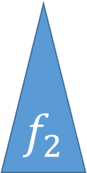






$$x$$
$$x$$
$$x$$
$$f_{1}$$
$$f_{2}$$
$$f_{1}$$
$$f_{2}$$

