Slide 1

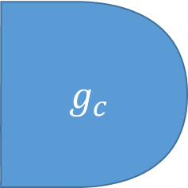

$$g_{c}$$
$$g_{a}$$
$$g_{b}$$

