Slide 1
The TCP/IP Model
7. Application
6. Presentation
5. Session
4. Transport
3. Network
2. Data Link
1. Physical
4. Application
3. Transport
2. Internet
1. Network Access
Notes:
TCP/IP along-side the OSI model
Much simpler representation
-doesn’t help with ideas like SSL/TLS
Will try to remember to use the TCP/IP model in references

Slide 2
Counting in Hex
Decimal | Hex
1 | 1
2 | 2
3 | 3
4 | 4
5 | 5
6 | 6
7 | 7
8 | 8
Decimal | Hex
9 | 9
10 | A
11 | B
12 | C
13 | D
14 | E
15 | F
16 | 10
Notes:
More than 10 numbers. Arabic numerals (decimal) has 10
Use alphabet A-F to make up the difference
After F, start over at 1-0

Slide 3
Counting in Binary
Decimal | Hex | Binary
1 | 1 | 0001
2 | 2 | 0010
3 | 3 | 0011
4 | 4 | 0100
5 | 5 | 0101
6 | 6 | 0110
7 | 7 | 0111
8 | 8 | 1000
Decimal | Hex | Binary
9 | 9 | 1001
10 | A | 1010
11 | B | 1011
12 | C | 1100
13 | D | 1101
14 | E | 1110
15 | F | 1111
16 | 10 | 00010000
Notes:
Binary counting is awkward at first
Kind of calm and relaxing
Mostly memorize 0-F conversions

Slide 4
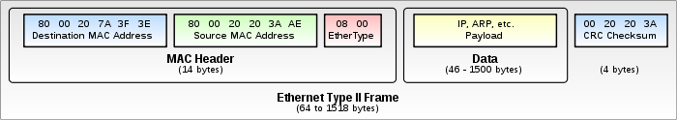
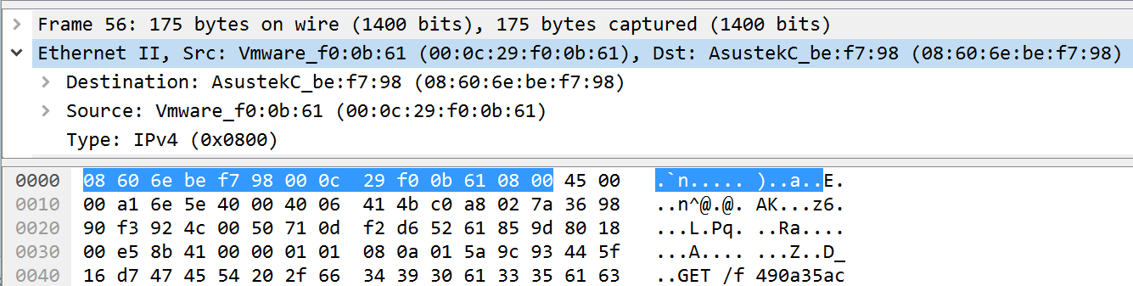
Ethernet Headers – Network Access Layer
Source: https://en.wikipedia.org/wiki/Ethernet_frame
Notes:
Not relevant in most forensics, most attacks, or most engineering issues

Slide 5
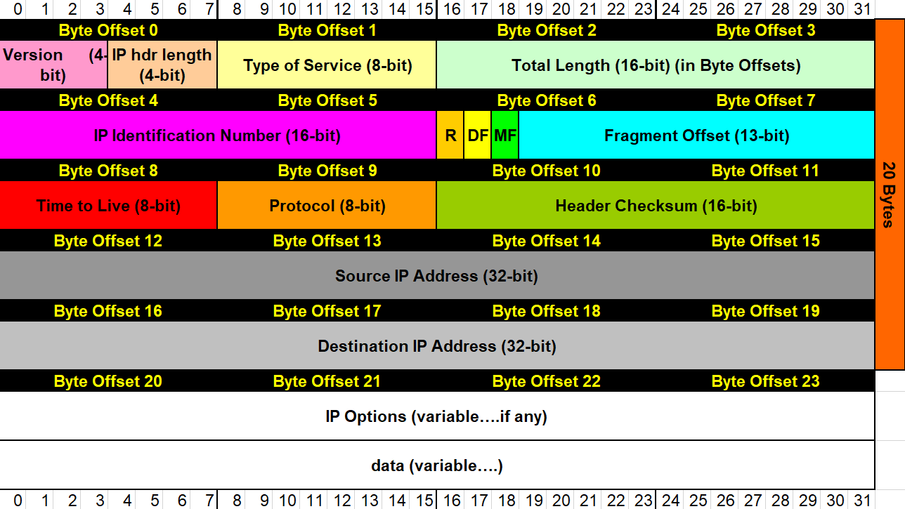
IPv4 Header – Internet Layer
http://wiki.gnhlug.org/twiki2/pub/Www/IpReference/Packet_Headers_Subnet_Breakdown.xls
Notes:
Mention fragmentation – covering if time permits
IP header length multiplied by 4 for length in bytes
Type of Service – aka differentiated services for ECN
TTL Router that changes it to 0 discards
Protocol field – determines transport-layer protocol
IP options – not common
Checksum just detects corruption – not discussing

Slide 6
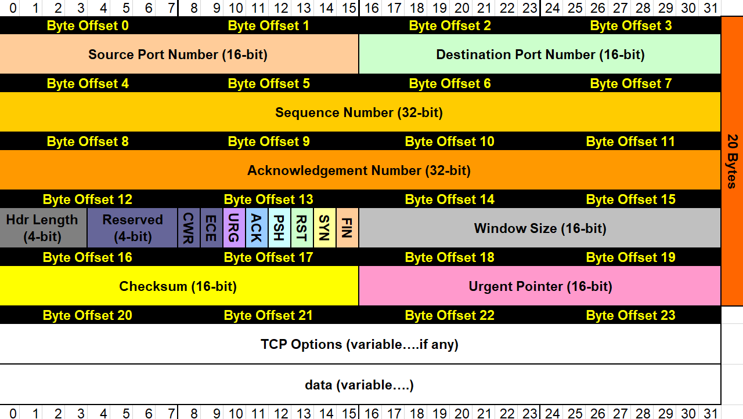
TCP Header
http://wiki.gnhlug.org/twiki2/pub/Www/IpReference/Packet_Headers_Subnet_Breakdown.xls
Notes:
Cover TCP flags
Mention TCP Options
Sequence number controls which conversation
Acknowledgement number controls where we are in conversation

Slide 7
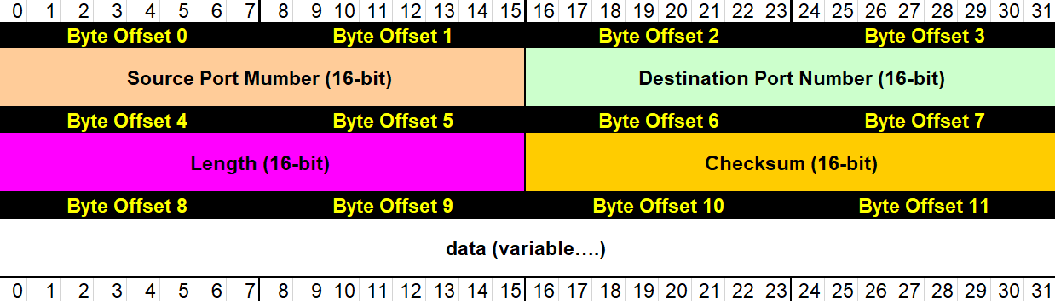
UDP Header
http://wiki.gnhlug.org/twiki2/pub/Www/IpReference/Packet_Headers_Subnet_Breakdown.xls

Slide 8
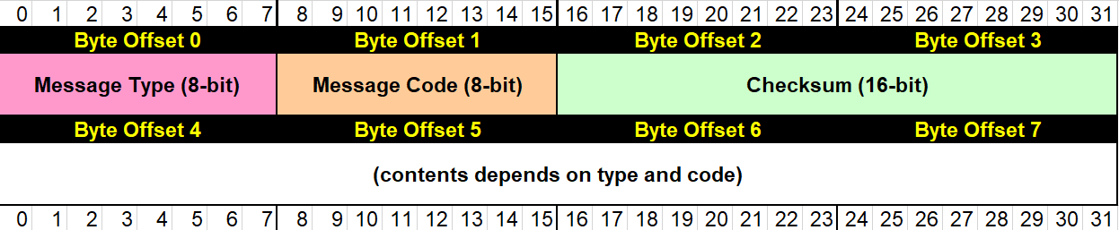
ICMP Header
http://wiki.gnhlug.org/twiki2/pub/Www/IpReference/Packet_Headers_Subnet_Breakdown.xls

Slide 9
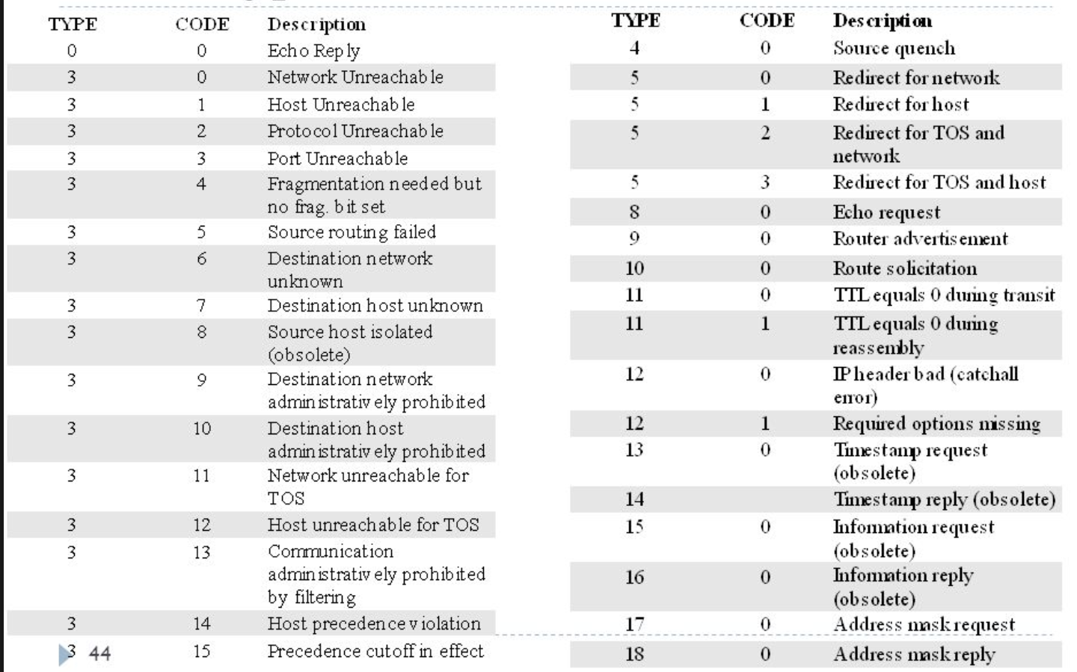
ICMP Header
http://slideplayer.com/slide/6252793/

Slide 10
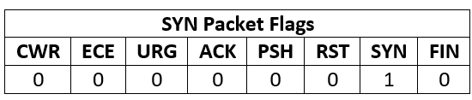
TCP Flags (Byte 13)
Byte 13 in the TCP header contains control flags
Help manage the TCP conversation

Slide 11
Translate - tr
Replaces single character
tr ‘a’ ‘b’ : replace a with b
tr -s ‘ ‘ : squeeze repeating characters
tr -d ‘:‘ : delete character
Very handy before cut

Slide 12
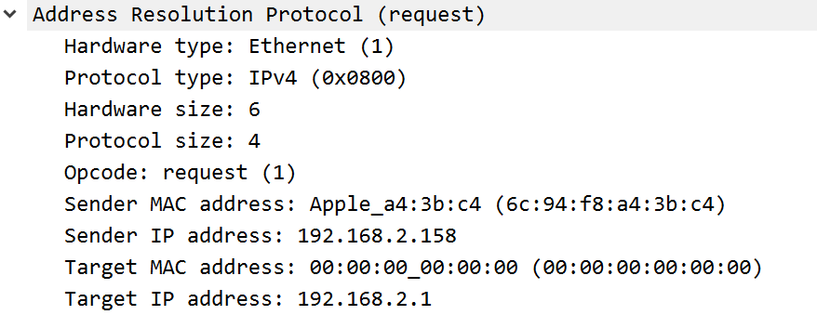
Address Resolution Protocol (ARP) Format
Hardware Type (Word)
Protocol Type (Word)
Hardware Size
(Byte)
Protocol Size
(Byte)
Opcode
(Word)
Sender MAC
(6 Bytes)
Sender IP
(4 Bytes)
Target
MAC
(6 Bytes)
Target IP
(4 Bytes)

Slide 13
Common External Ports
Good egress filtering should block most external traffic
Permitted traffic should go through an intermediary
TCP:80 (HTTP)
TCP:443 (SSL)
UDP:123 (NTP)
Should be blocked
UDP:53 (DNS)

Slide 14
Common Internal TCP Ports
22 (SSH)
445 (SMB)
88 (Kerberos)
135 (DCE/RPC)
389 (LDAP)
636 (LDAPS)
993 (IMAPS)

Slide 15
Common Internal TCP Ports
80 (HTTP)
443 (HTTPS)
8080 (Alternate HTTP)
8443 (Alternate HTTPS)
Ephemeral ports (RPC)

Slide 16
Common Internal UDP Ports
53 (DNS)
5355(LLMNR)
123(NTP)

Slide 17
Alerts
Many sources
Intrusion Detection System
Intrusion Prevention System
Web Application Firewall
Signatures are not always great
Places to start
Use the source port

Slide 18
Continued Analysis
Work forward for post infection
Find binary files for analysis
Identify command and control traffic
Work backward to find the origin
Often starts with legitimate sites

Slide 19
Useful Techniques
Wireshark display filters
dns || http.request.full_uri || ssl.handshake.certificate
Find “odd” URLs
Long alphanumeric strings that are not words
Directed outside of domain
Use “referer” to work backwards
Find redirection call in calling page (URL string)

Slide 20
Automated Tools
Virustotal.com
Binaries or pcaps
Sandboxes
https://zeltser.com/automated-malware-analysis/

