Slide 1
Knowledge Check - Answers
Convert CAFE to decimal – C=12, A=10, F=15, E=14
12(16³)+10(16²)+15(16¹)+14(16⁰) =
12*4096+10*256+15*16+14 = 51966
Convert 7A69 to binary – 0111 1010 0110 1001
What is the high order nibble of the low order byte in binary?
0110
What is the low order nibble of the high order byte in hex?
A

Slide 2
Knowledge Check - Answers
What ICMP type and code indicate a ping response?
Type 0, code 0
What two bytes start most IPv4 packets?
0x4500
What ICMP type might indicate a traceroute?
Type 11
What are the sets of flags in a normal TCP 3-way handshake?
SYN, SYN-ACK, ACK
What are the two common methods of terminating a TCP connection?
FIN, RST

Slide 3
Knowledge Check - Answers
Find SYN-ACK packets
tcp[13]=0x12
Find packets with a source port of 80
src port 80
udp[0:2]=80 || tcp[0:2]=80
Find packets with all TCP flags set
tcp[13]=0xff
Find all UDP packets with a destination port of 123
udp[2:2]=123
udp && dst port 123
Find all type 3 code 3 ICMP packets
icmp[0]=3 && icmp[1]=3

Slide 4
Practical Exercise – Fragmentation Answers
frags.pcap
Why might only 1 host have responded to the ICMP echo request?
Fragmented ICMP blocked by Google, but not by local router
frags2.pcap
What was the server’s response code?
301
What URL was probably requested?
www.google.com

Slide 5
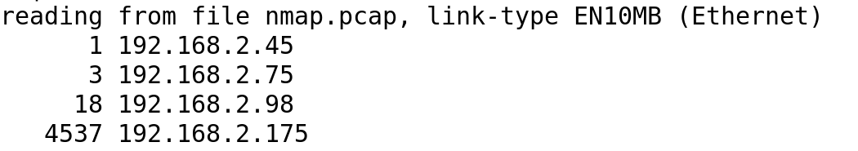
Practical Exercise – Scanning Answers
nmap.pcap
Which host was performing scanning?
192.168.2.175
tcpdump -r nmap.pcap -nn 'tcp[13]=0x02' | cut -f3 -d' ' | cut -f1-4 -d '.' | sort | uniq -c | sort -n

Slide 6
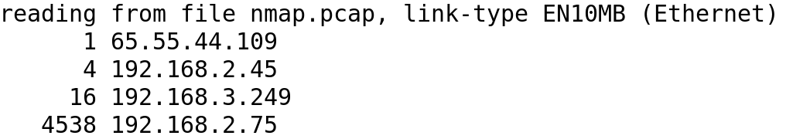
Practical Exercise – Scanning Answers
nmap.pcap
Which host was the scan target?
192.168.2.75
tcpdump -r nmap.pcap -nn 'tcp[13]=0x02' | cut -f5 -d' ' | cut -f1-4 -d '.' | sort | uniq -c | sort –n

Slide 7
Practical Exercise – Scanning Answers
nmap.pcap
How many TCP ports were scanned?
1000
sudo tcpdump -r nmap.pcap -nn 'tcp[13]=0x02 && src host 192.168.2.175 && dst host 192.168.2.75'| cut -f 5 -d' ' | cut -f5 -d'.'| cut -f1 -d':' | sort | uniq | wc –l
How many UDP ports were scanned?
30
sudo tcpdump -r nmap.pcap -nn 'udp && src host 192.168.2.175 && dst host 192.168.2.75'| cut -f 5 -d' ' | cut -f5 -d'.'| cut -f1 -d':' | sort | uniq | wc -l

Slide 8
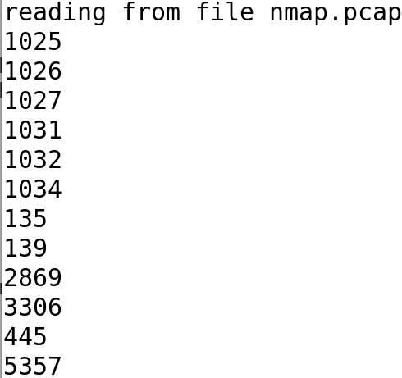
Practical Exercise – Scanning Answers
nmap.pcap
Which TCP ports were open?
1025,1026,1027,1031,1032,1034,135,139,2869,3306,445,5357
sudo tcpdump -r nmap.pcap -nn 'tcp[13]=0x12 && dst host 192.168.2.175 && src host 192.168.2.75'| cut -f 3 -d' ' | cut -f5 -d'.'| cut -f1 -d':' | sort | uniq

Slide 9
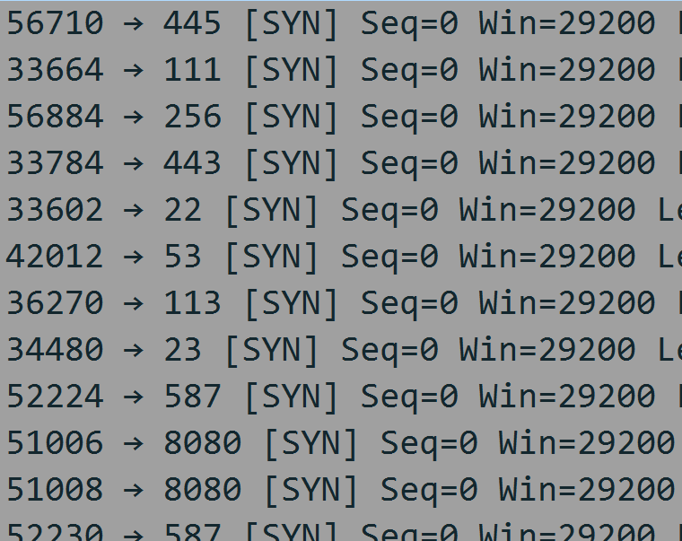
Practical Exercise – Scanning Answers
nmap.pcap
What may have caused the scan behavior after 12:04:10?
Firewall enabled that does not reset connections

Slide 10
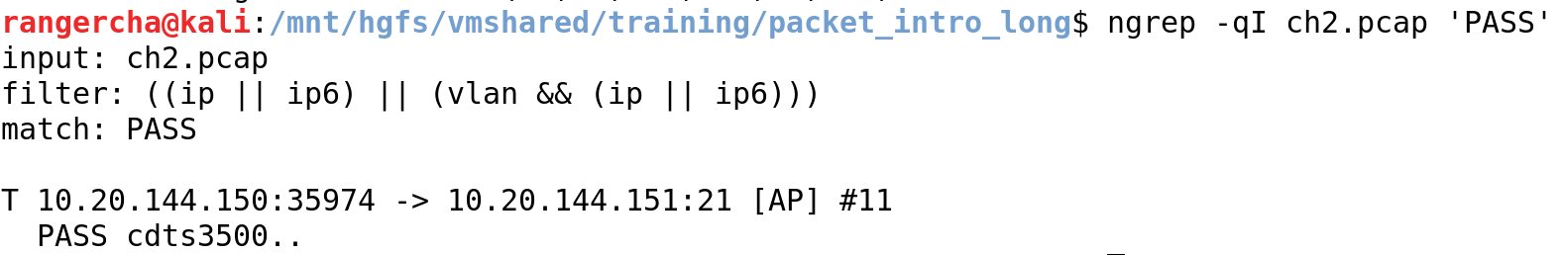
ch2.pcap (from root-me.org)
Find the FTP password
ngrep for PASS

Slide 11
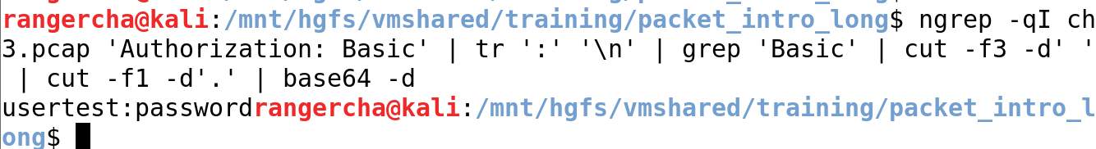
ch3.pcap (from root-me.org)
Find the twitter password
ngrep -qI ch3.pcap 'Authorization: Basic' | tr ':' '\n' | grep 'Basic' | cut -f3 -d' ' | cut -f1 -d'.' | base64 –d

Slide 12
2015-03-24-traffic-analysis-exercise.pcap (from malware-traffic-analysis.net)
IP address of the infected host
192.168.122.200
Which server is probably legitimate, but compromised?
forums.pelicanparts.com
What redirection techniques does this exploit kit use?
Script tag injection
What types of exploits were served?
Adobe Reader, Flash, Java, Silverlight

Slide 13
sansholidayhack2013.pcap (from SANS holiday hack challenge, 2013)
What are the MACs and IPs of the machines that ARP cache poison? Is it successful?
00:0c:29:f7:f4:9a - 10.21.22.253 - successful
10.25.22.252 - unsuccessful
What are the IPs of the systems that were port scanning?
10.25.22.252,10.21.22.253,10.25.22.253
tcpdump -nn -r sansholidayhack2013.pcap 'tcp[13]=0x02' | cut -f3,5 -d' ' | tr ' ' '.' | cut -f1-4,6-10 -d'.' | sort | uniq -c | sort -rn
tcpdump -nn -r sansholidayhack2013.pcap 'tcp[13]=0x14' | cut -f5 -d' ' | cut -f1-4 -d'.' | sort | uniq -c | sort -n

Slide 14
sansholidayhack2013.pcap (from SANS holiday hack challenge, 2013)
What systems and protocols did the scans discover?
tcpdump -nn -r sansholidayhack2013.pcap 'tcp[13]=0x12 && (dst host 10.25.22.252 || dst host 10.21.22.253 || dst host 10.25.22.253)' | cut -f3 -d' ' | sort | uniq

Slide 15
sansholidayhack2013.pcap (from SANS holiday hack challenge, 2013)
10.16.11.5.110 | 10.25.22.22.80 | 165.254.158.56.80 | 208.80.154.234.80
10.21.22.22.502 | 10.25.22.23.80 | 173.194.43.47.443 | 208.80.154.240.80
10.21.22.23.502 | 10.25.22.250.80 | 192.190.173.45.80 | 216.22.25.175.80
10.21.22.24.502 | 10.25.22.30.80 | 192.204.3.75.80 | 54.230.49.239.80
10.21.22.253.1225 | 10.25.22.58.4444 | 199.7.57.72.80 | 63.245.217.36.80
10.2.2.2.8081 | 10.25.22.58.445 | 208.80.154.224.80 | 69.16.175.10.80
72.167.239.239.80 | 74.125.226.239.443 | 82.103.140.42.443 | 74.125.226.228.80

Slide 16
sansholidayhack2013.pcap (from SANS holiday hack challenge, 2013)
72.21.195.198.443 | 74.125.226.242.443 | 10.25.22.22.44818
72.21.203.211.80 | 74.125.226.251.80 | 165.254.138.136.80
72.21.214.3.443 | 74.125.22.82.80 | 208.80.154.225.80
72.21.215.52.80 | 81.169.180.37.443 | 69.195.141.178.443
74.125.226.199.443 | 81.169.180.37.80 | 82.103.134.102.80

Slide 17
sansholidayhack2013.pcap (from SANS holiday hack challenge, 2013)
What account was used in an attack over the SMB protocol?
ernie

Slide 18
packet_intro.pcap
What are the max and minimum SSL/TLS versions supported by 192.168.2.122?
Max: TLS 1.2
Min: TLS 1.0

Slide 19
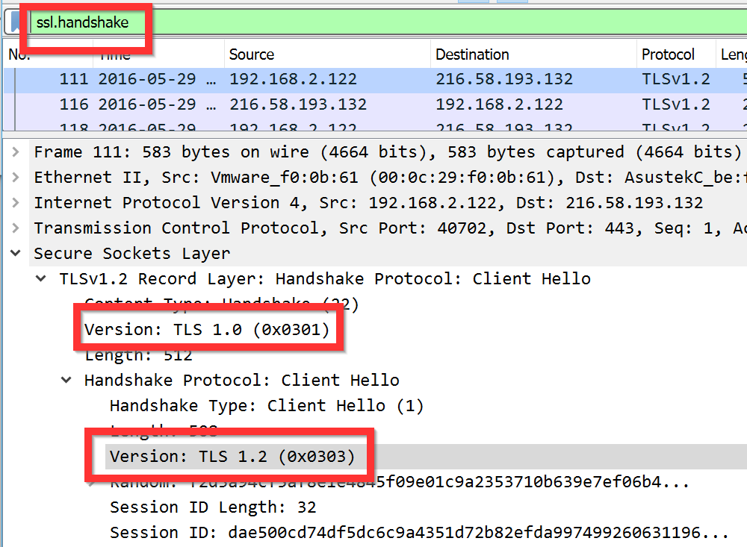
packet_intro.pcap

Slide 20
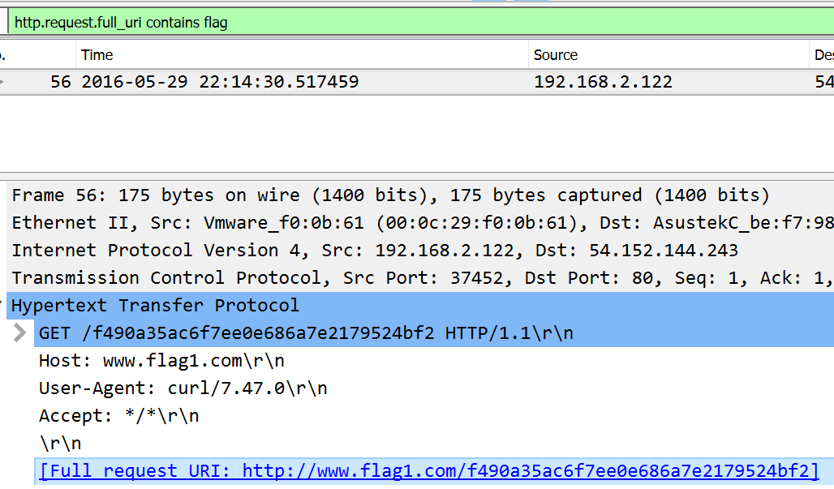
packet_intro.pcap
Flag 1
http.request.full_uri contains “flag”

Slide 21
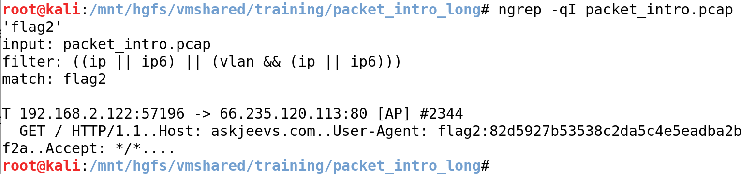
packet_intro.pcap
Flag 2
ngrep -qI packet_intro.pcap ‘flag2’

Slide 22
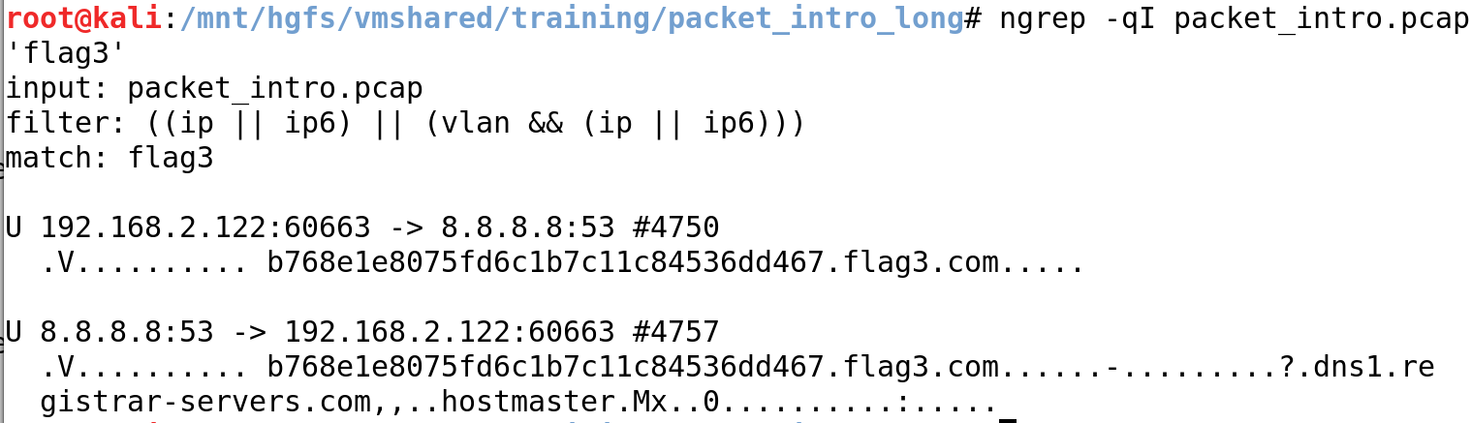
packet_intro.pcap
Flag 3
ngrep -qI packet_intro.pcap 'flag3'

Slide 23
packet_intro.pcap
Flag 4
echo "flag" | base64
ngrep -qI packet_intro.pcap 'ZmxhZ’
ngrep -qI packet_intro.pcap 'ZmxhZ' | grep 'ZmxhZ' | tr -s ' ' | cut -f3 -d' ' | cut -f2- -d'=' | base64 -d

Slide 24
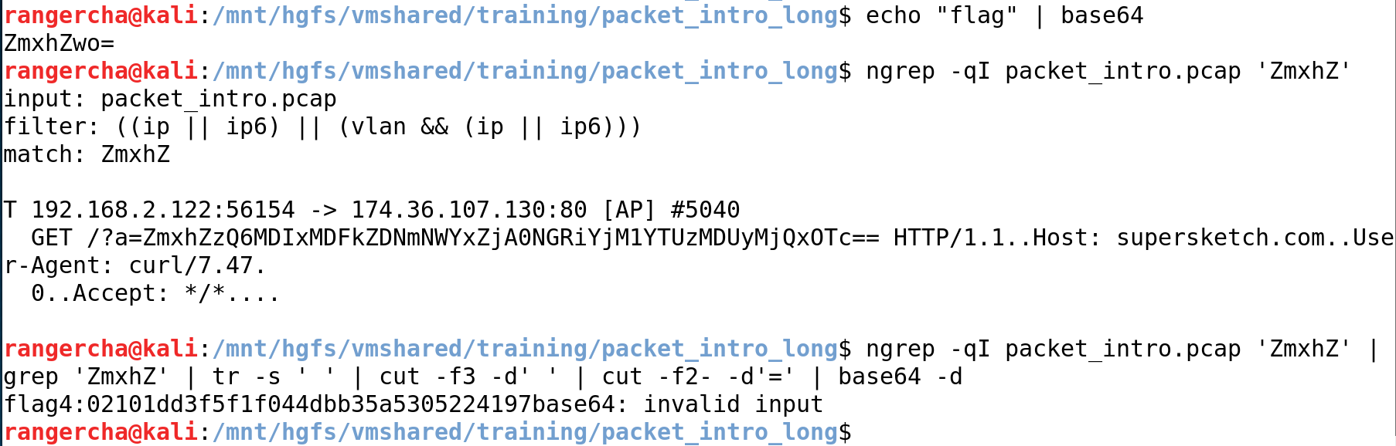
packet_intro.pcap

Slide 25
packet_intro.pcap
Flag 5
echo "flag5" | xxd -ps
ngrep -qI packet_intro.pcap '666c616735’
printf "666c6167353a6436386663373231646133316565663932663565373939616466643534653139" | xxd -r -p

Slide 26
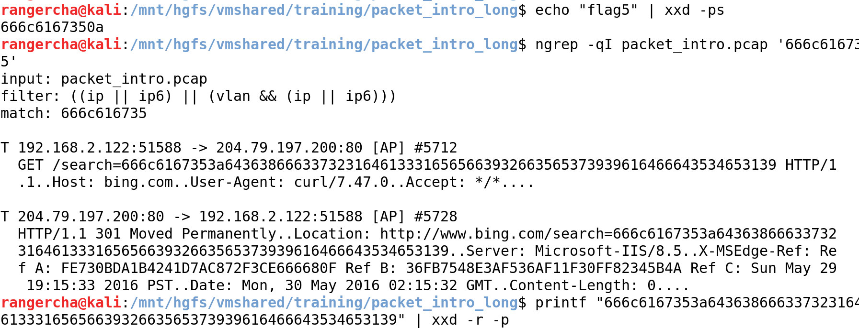
packet_intro.pcap

Slide 27
packet_intro.pcap
Flag 6
tshark -r packet_intro.pcap -T fields -e icmp.type -Y 'icmp' | xargs printf '%x' | xxd -r -p

Slide 28
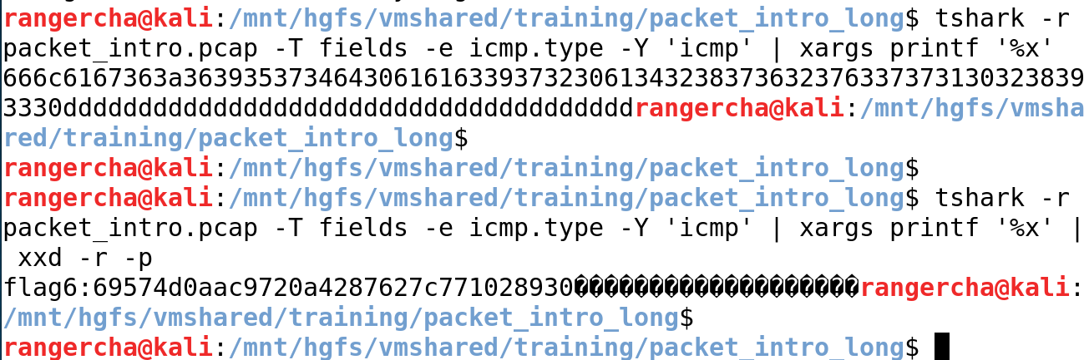
packet_intro.pcap

Slide 29
packet_intro.pcap
Flag 7
tcpdump -r packet_intro.pcap -nnA 'icmp' | grep '\.\.' | cut -f4 -d'-' | grep -v '@\.\.\.\.\.\.z' | tr -d '\n'

Slide 30
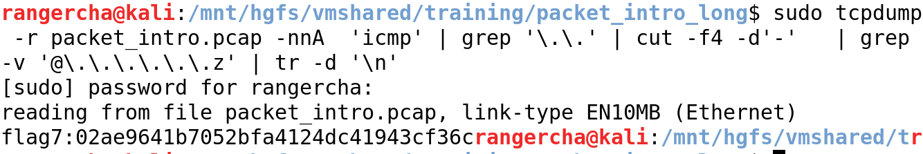
packet_intro.pcap

