Slide 1


Microsoft Azure
Colin McCunney
Glenn Rice

Slide 2
Overview
Our purpose was to find a program within Microsoft Azure that would allow us to clean and transform our data using some form of SQL or KQL code.
After transforming and cleaning our data we wanted to somehow visualize it within Azure and add it to our GitHub Repos.
We hoped to use something besides Power BI since we were both already familiar with the program. Also, we wanted to incorporate SQL or some other code somehow.

Slide 3
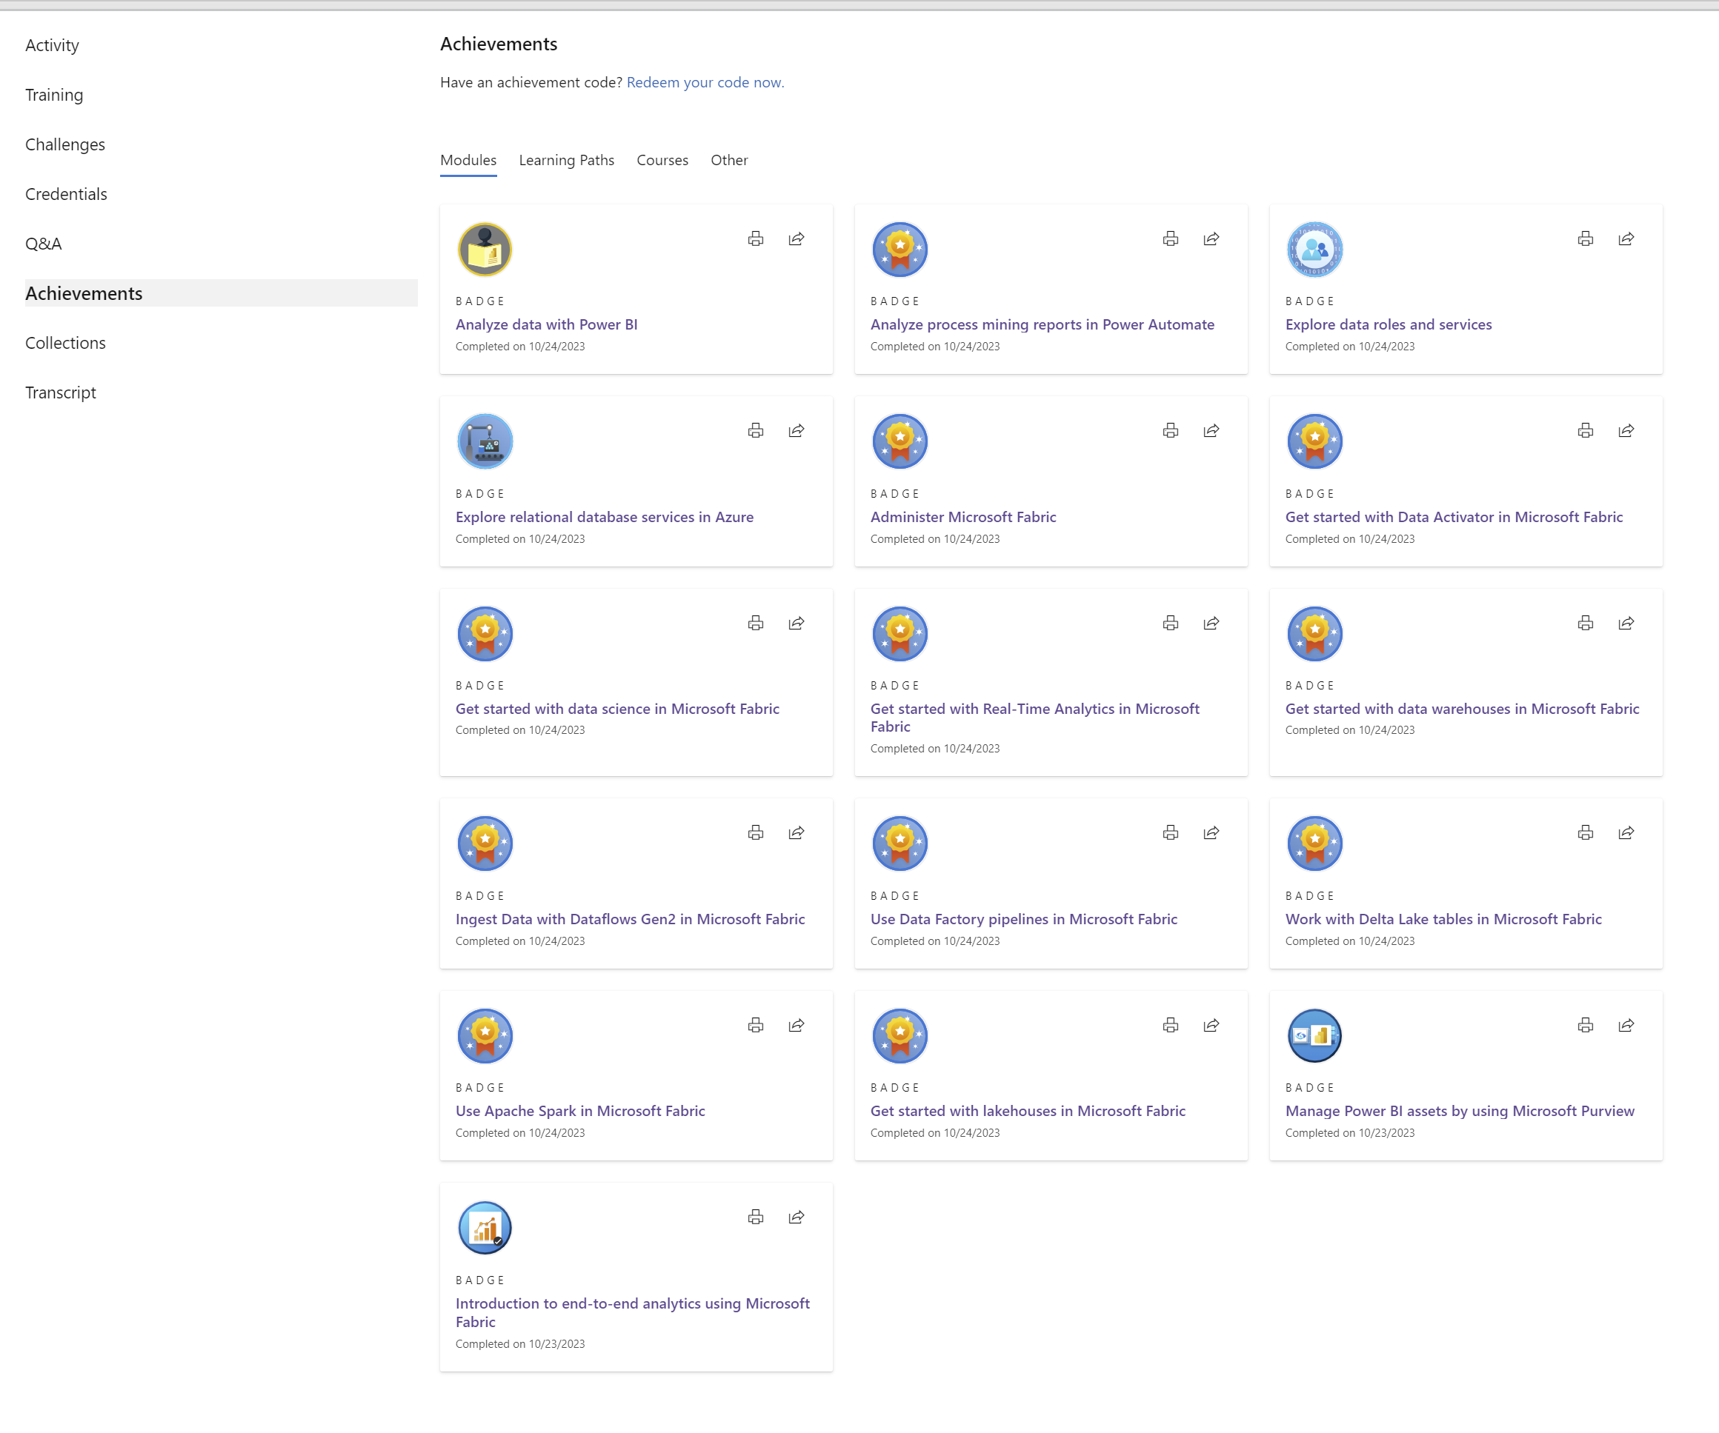
Colin’s Training
The plan for my training was to gain a strong level of understanding of what Azure Fabric was and what it could be used for.
Fabric can be described as an all-in-one analytics solution for businesses that covers everything from data movement to data science, Real-Time Analytics, and business intelligence.
Unfortunately, following my training it was uncovered that Fabric wouldn’t be a good tool to use for modeling my data.

Slide 4
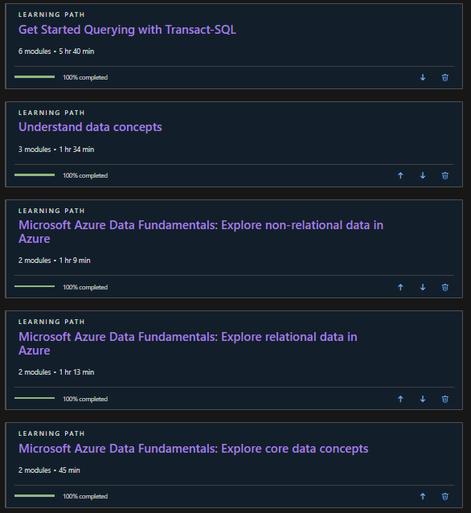
Glenn’s Training
The plan for my training was to gain a strong level of understanding of what Azure was and what it did, so I took courses on understanding fundamentals of Azure, and then I learned about relational databases and non-relational databases.
Next, I wanted to use the knowledge that I gained from training with Azure and relational/non-relational databases to start querying with Transact-SQL. With T-SQL I can manipulate datasets and create data frames with good visualizations to go along with that.

Slide 5
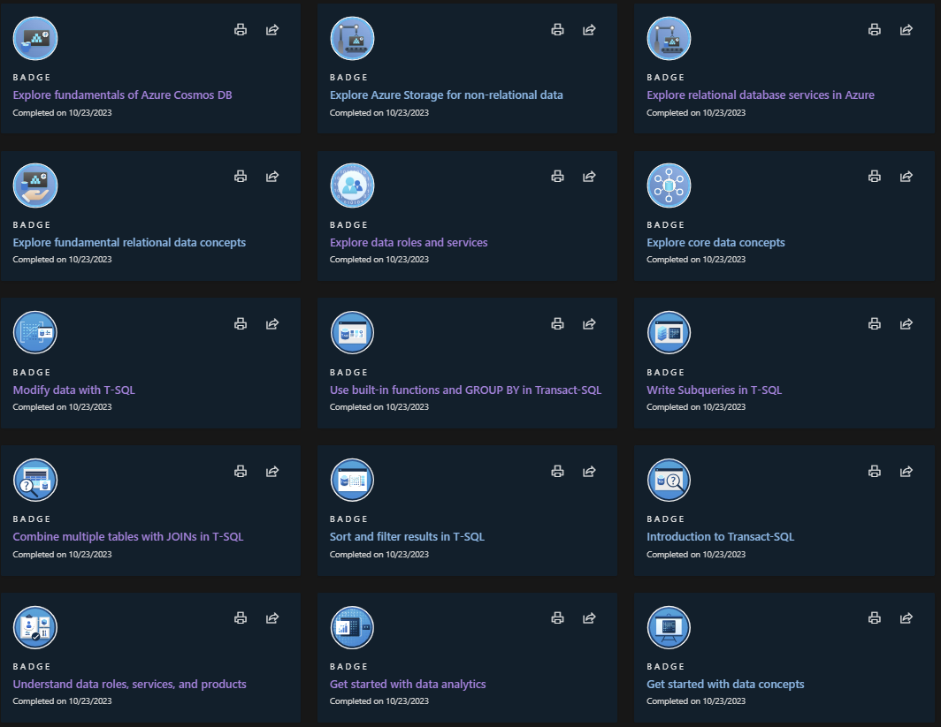
Glenn's Training
These are the various training badges that I earned from the training that I completed. This achievements set me up with a good foundation to try to navigate through Azure, and then possibly write some queries with Transact-SQL

Slide 6
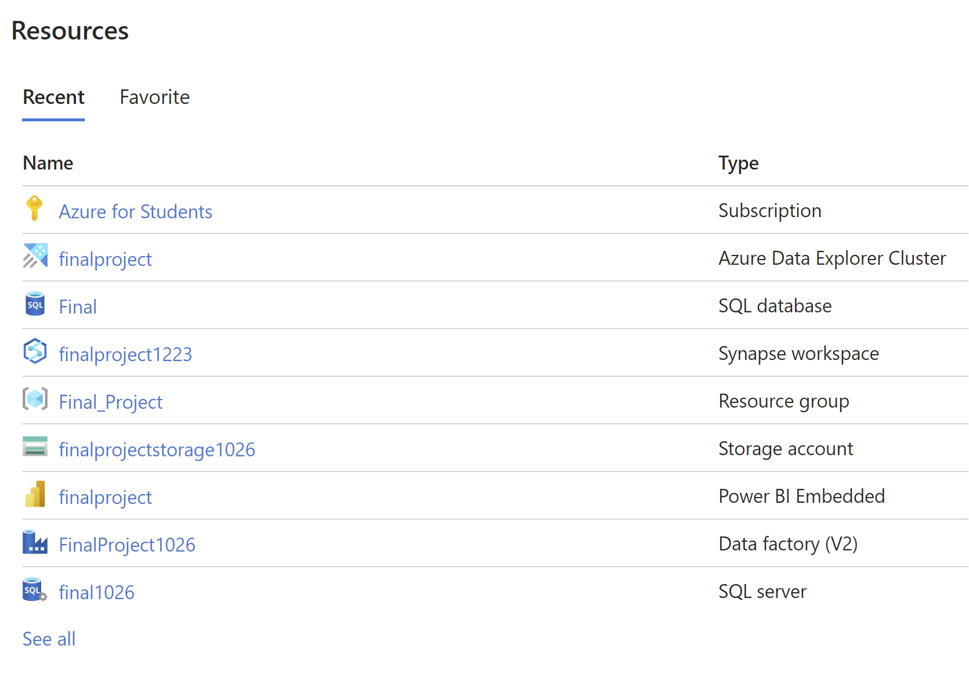
Attempt 1 (Colin)
As is shown to the left, I tried multiple different Azure applications.
First, I tried a SQL server to hopefully model my data in some way using SQL.
Next, I tried a data factory which required me to create a blob storage. I was able to figure this part out using ChatGPT which told me a blob storage was what I needed to create to import my Excel document.
I then tried a Synapse workspace since the data factory didn’t allow me to code and model my data.
All of these applications required me to use some of my student credits which usually hovered around a couple cents an hour.
Lastly, I tried a SQL database because ChatGPT gave me that application as another potential solution, however, once I entered the program I was unable to model or transform my data despite what ChatGPT gave me.
I also tried to do some training on some of these applications to hopefully help me, however, I learned that Data Explorer using Data Clusters might just be the superior way to model my data.

Slide 7
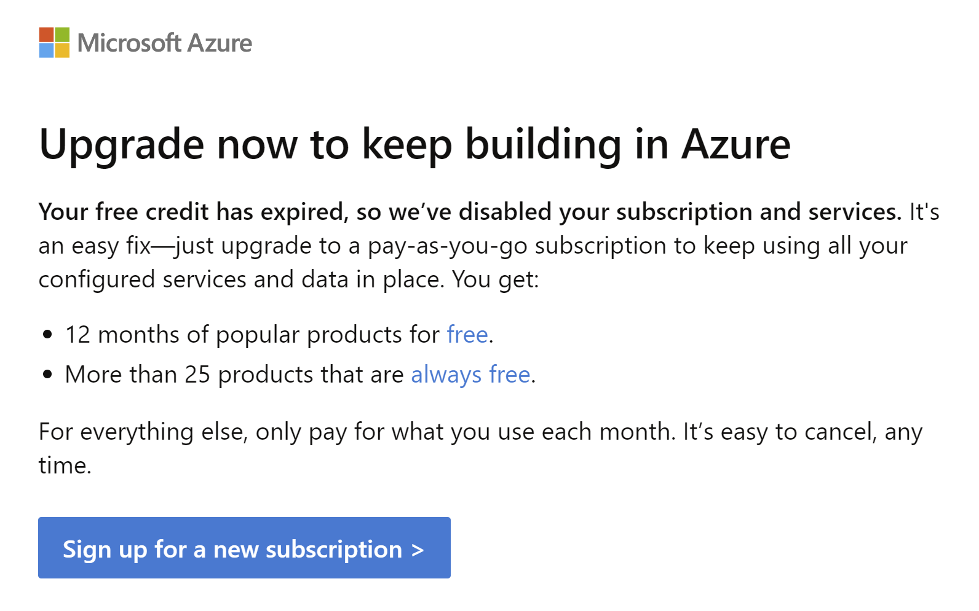
Attempt 2 (Colin)
Following my first attempt in Data Azure I was quite optimistic about being able to use KQL along with ChatGPT to model my data. However, I received this message notifying me that my student account was suspended.
However, I created another account and continued using Data Explorer since it was free to create a cluster. However, I wouldn’t be able to continue using the other applications like SQL database and Data Factory since those cost some of my student credits.

Slide 8
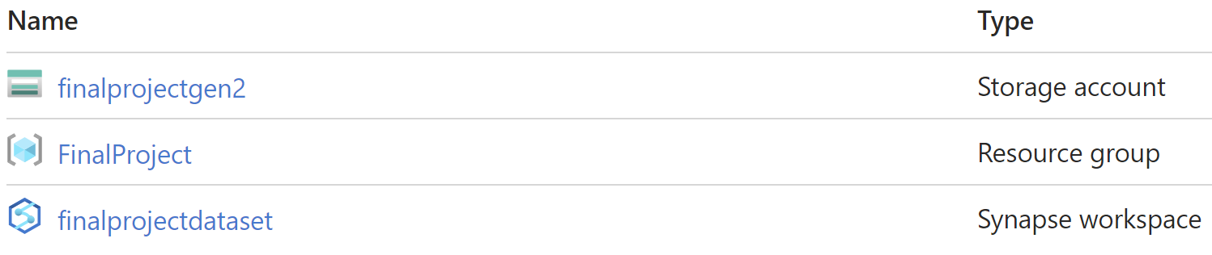
Attempt 3 (Glenn)
Resource Group – The first thing that I did was create a resource group. My idea was to use the resource group as a place to store all of the different files that I am trying to use
Storage Account – First, I had to use credits to initially open a storage account, and was able to successfully upload our dataset after a few attempts. The next step in the plan was to work on the dataset through data explorer, as there is an "open in explorer" tab, but I was receiving an error so I was not able to use a Storage account.
Synapse Workspace – I uploaded our dataset to a synapse workspace to see what tools I could use to make visualizations. I initially wanted to create a dedicated SQL pool to code some data frames and then make visualizations, but I could not access it because my type of subscription (student) did not support that service.

Slide 9
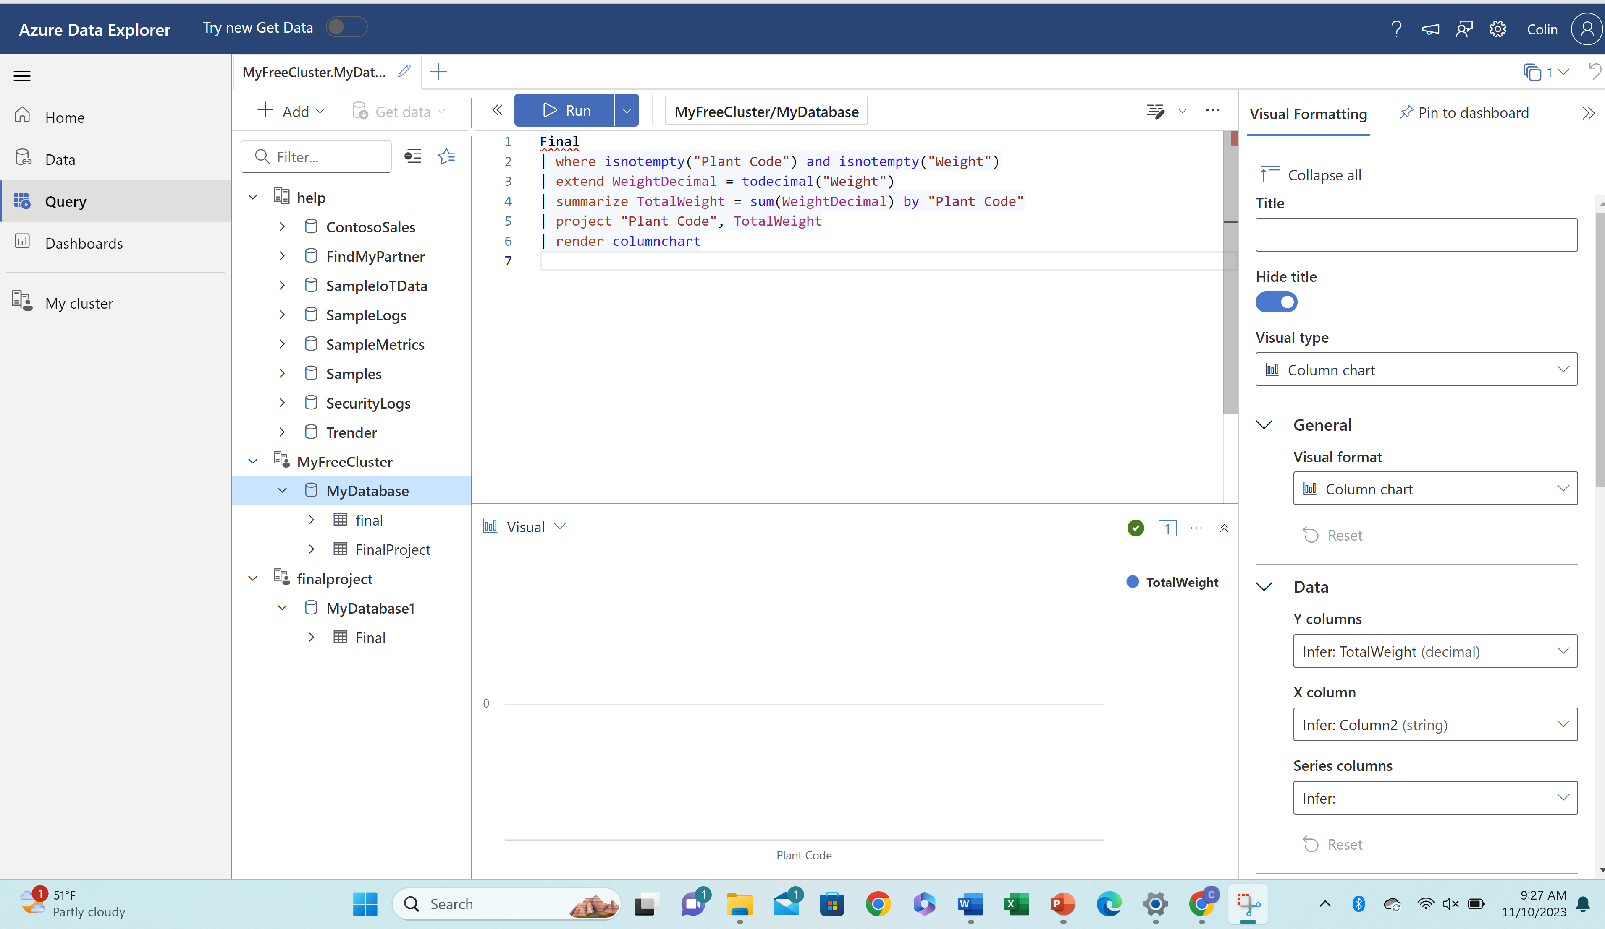
Data Explorer
Glenn and I attempted to use Data Explorer which uses KQL to model our data. On the next slide, we will show how ChatGPT helped write some of our code.
We ingested our data as it’s called into Data Explorer and then tried to remove duplicates and transform our string into an integer so we could sum it. Then we tried to render it into a column chart.
In the photo above it appears to have worked since it returned no errors, however, it wasn’t like uploading our data for some reason.

Slide 10
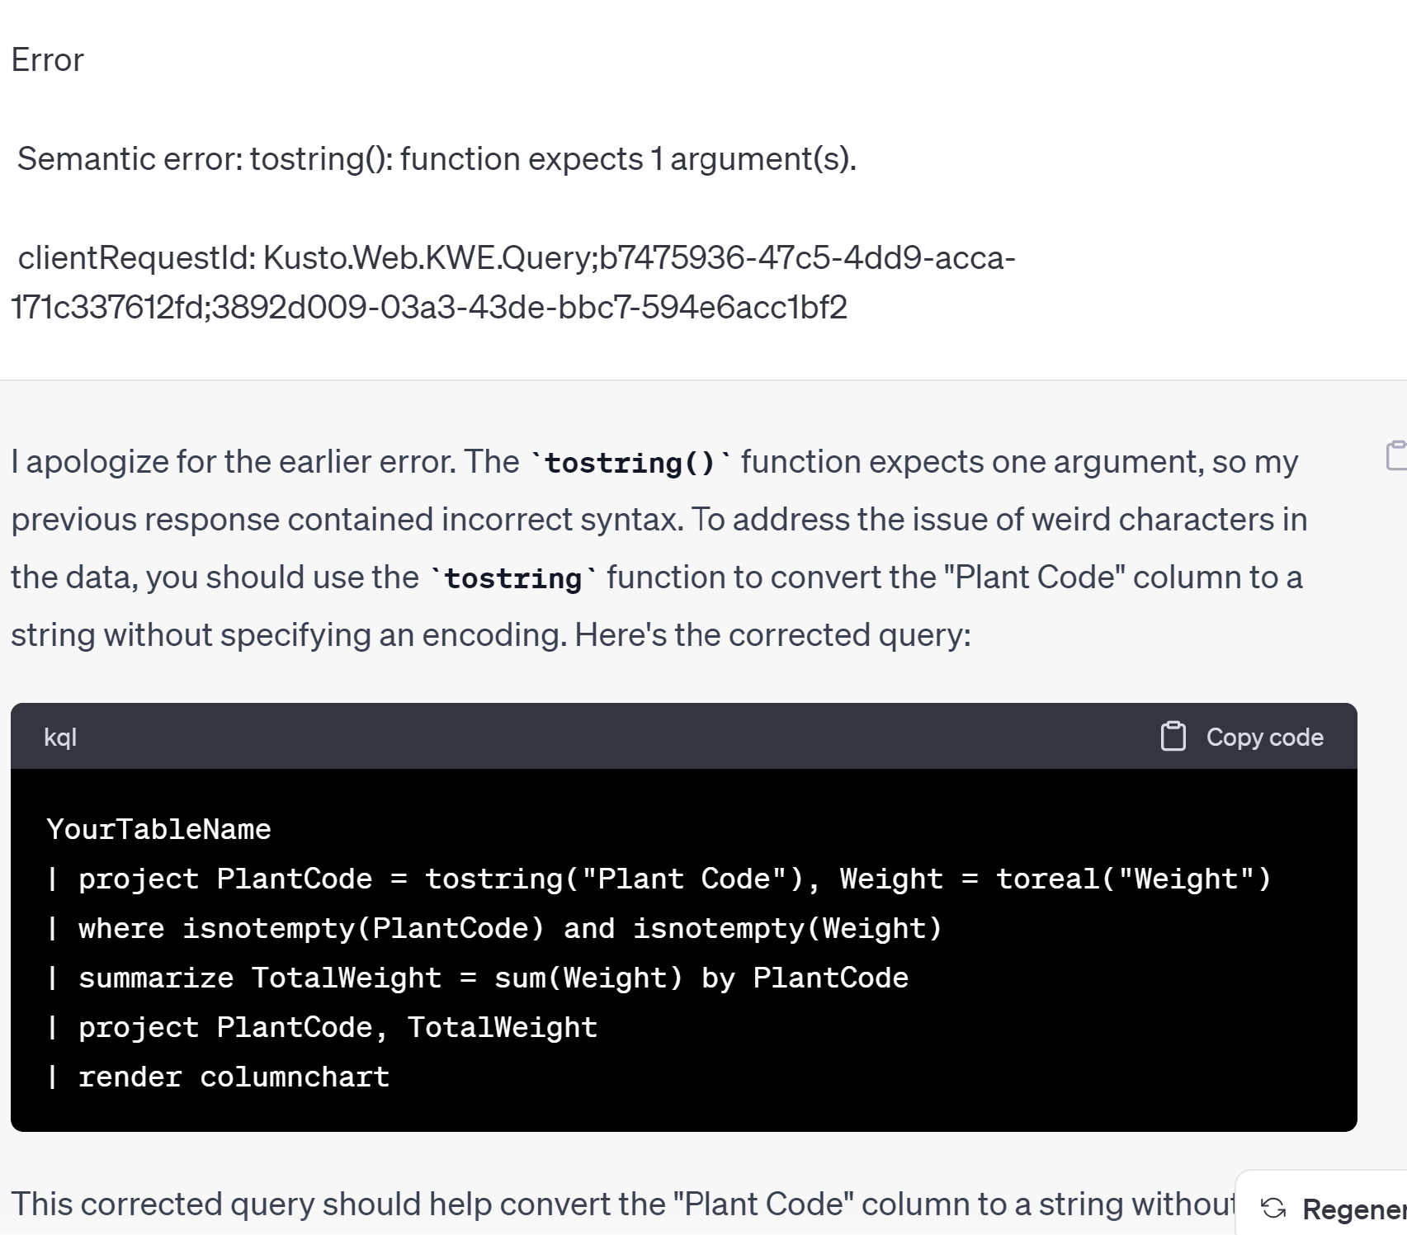
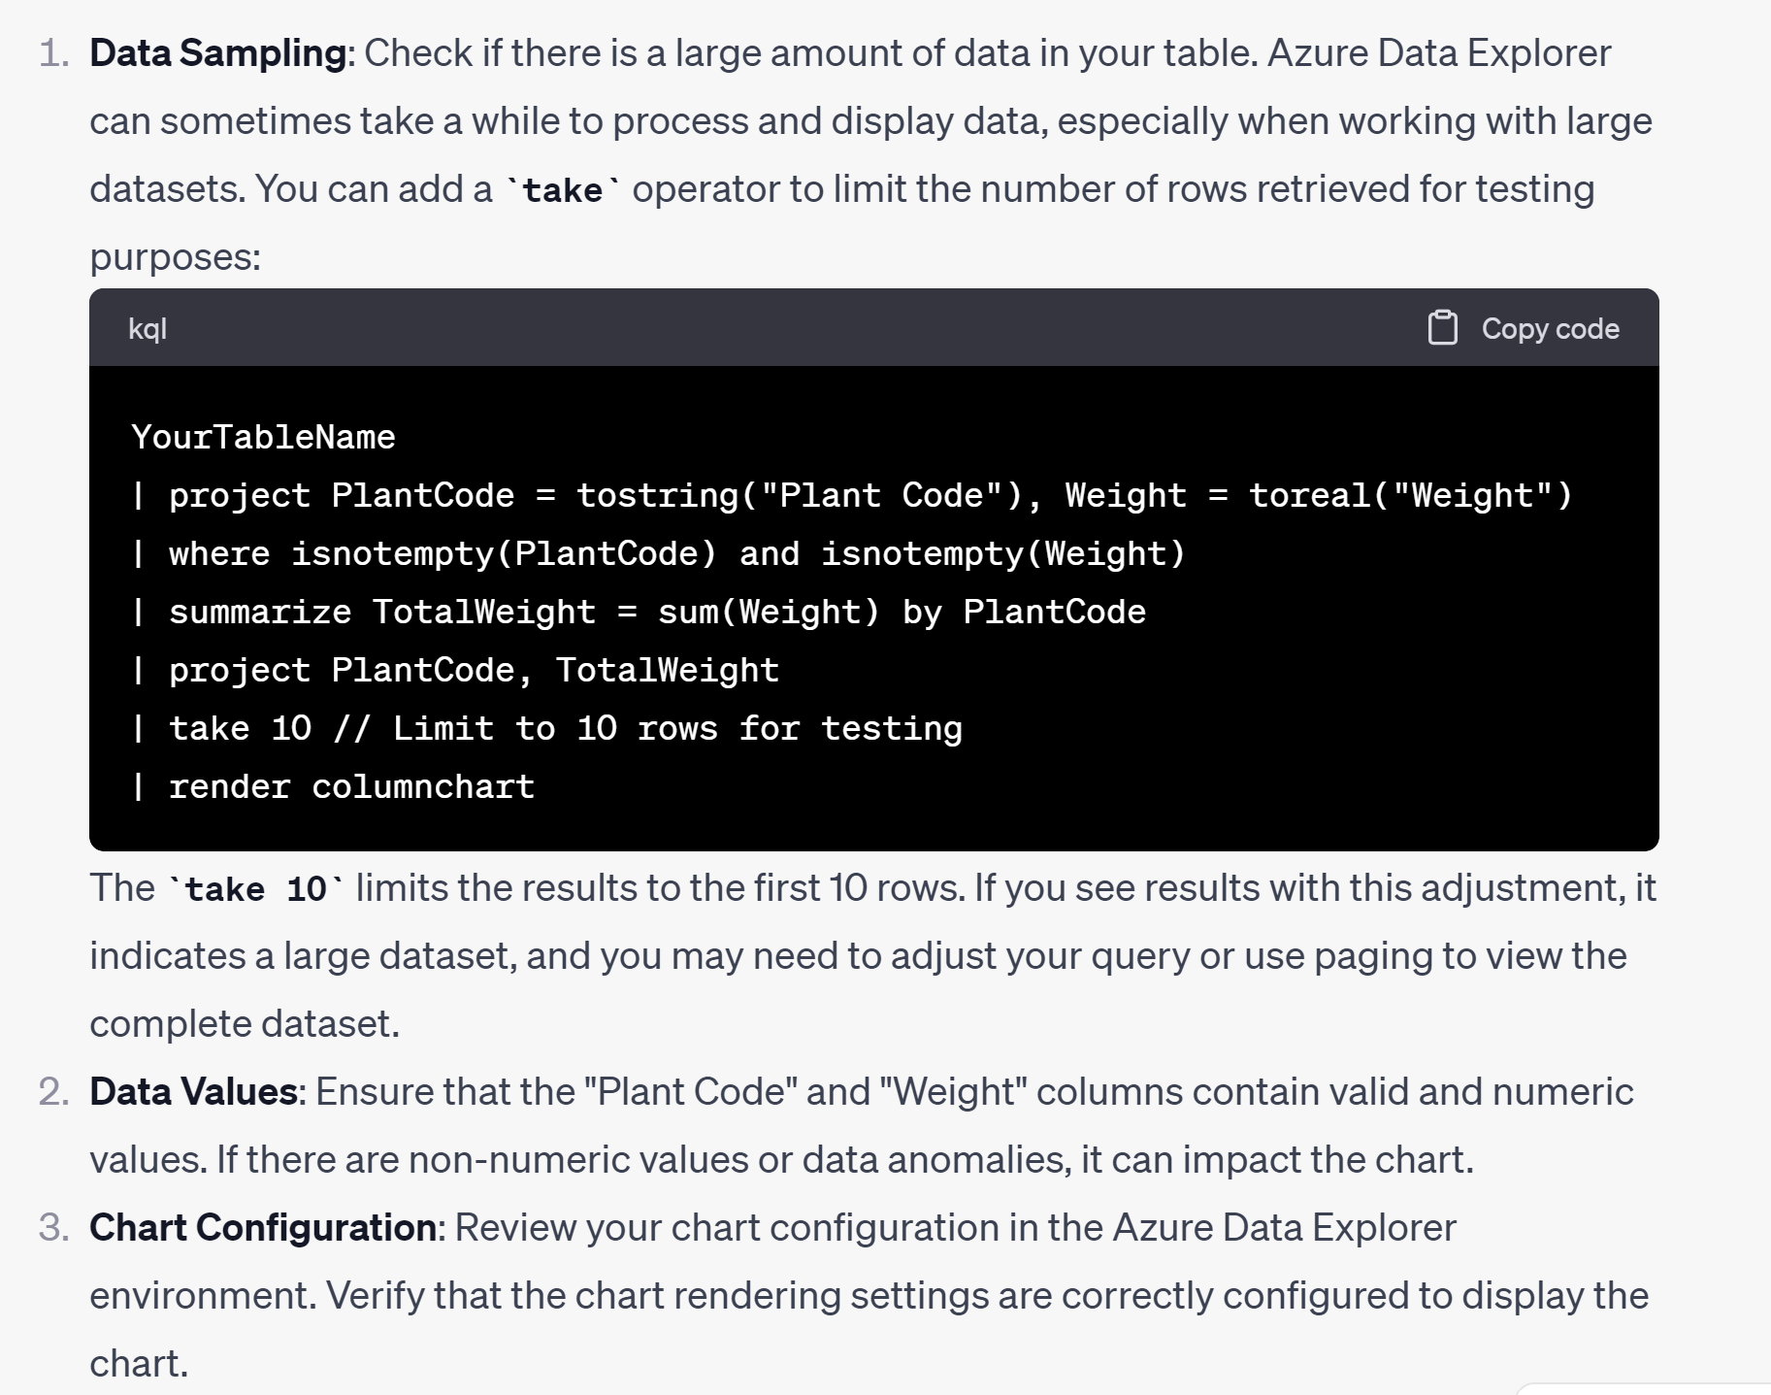
Data Explorer (ChatGpt)
We attempted to use ChatGPT to help facilitate the coding aspect of KQL.
However, we kept getting errors from Data Explorer so we started inputting these errors back into ChatGPT which would return an updated code. However, this usually resulted in more errors, or, the error not even being fixed.

Slide 11
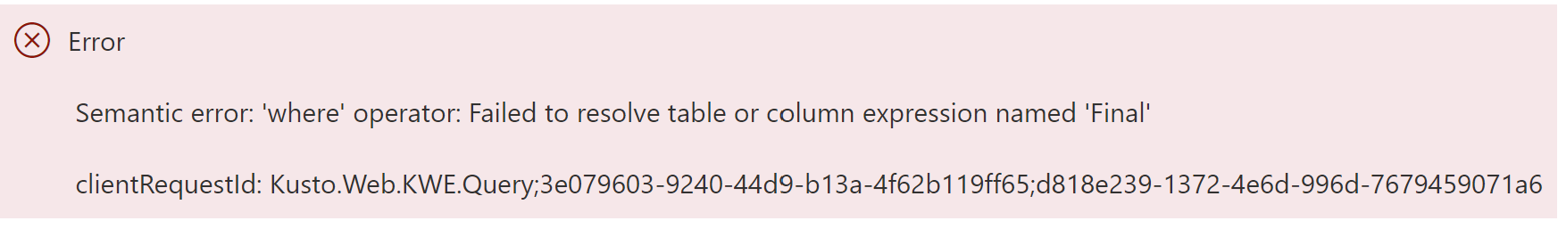
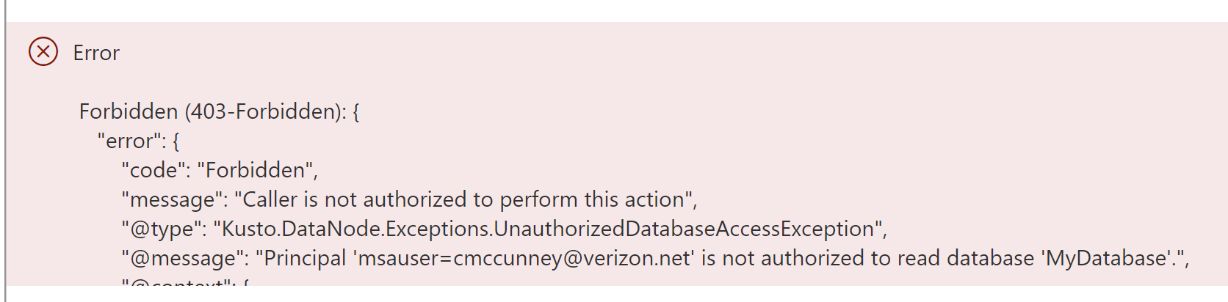
Why it didn’t Work
We were getting a few errors in Data Explorer which are some of them are shown below. Along with those errors we get errors that showed the wrong data type being used. We attempted to resolve this by converting our data type using KQL code.
Along with this, Data Explorer was having a difficult time importing our data, I tried once again to use ChatGPT to help solve this, however, it couldn’t figure out the problem.

Slide 12
Conclusion
We attempted to use multiple Microsoft Azure applications to help transform, clean and visualize our data.
However, we were unable to properly code in KQL in Data Explorer while also not being able to access our data once we ingested it into Data Explorer.
We will continue to try new options and methods in Data Explorer in our free time to hopefully have a few visualizations and code to use in our GitHub Repo.

Slide 13
Added Note
Friday morning before this was due, I attempted to log back into Data Explorer and try once more to run the KQL code, however, my account was suspended even more. This meant that I couldn’t even run anything in Data Explorer anymore.
I tried creating a new account, however, even that wouldn’t work since it wanted my credit card information.
I’ve shown the error message below.

Slide 14
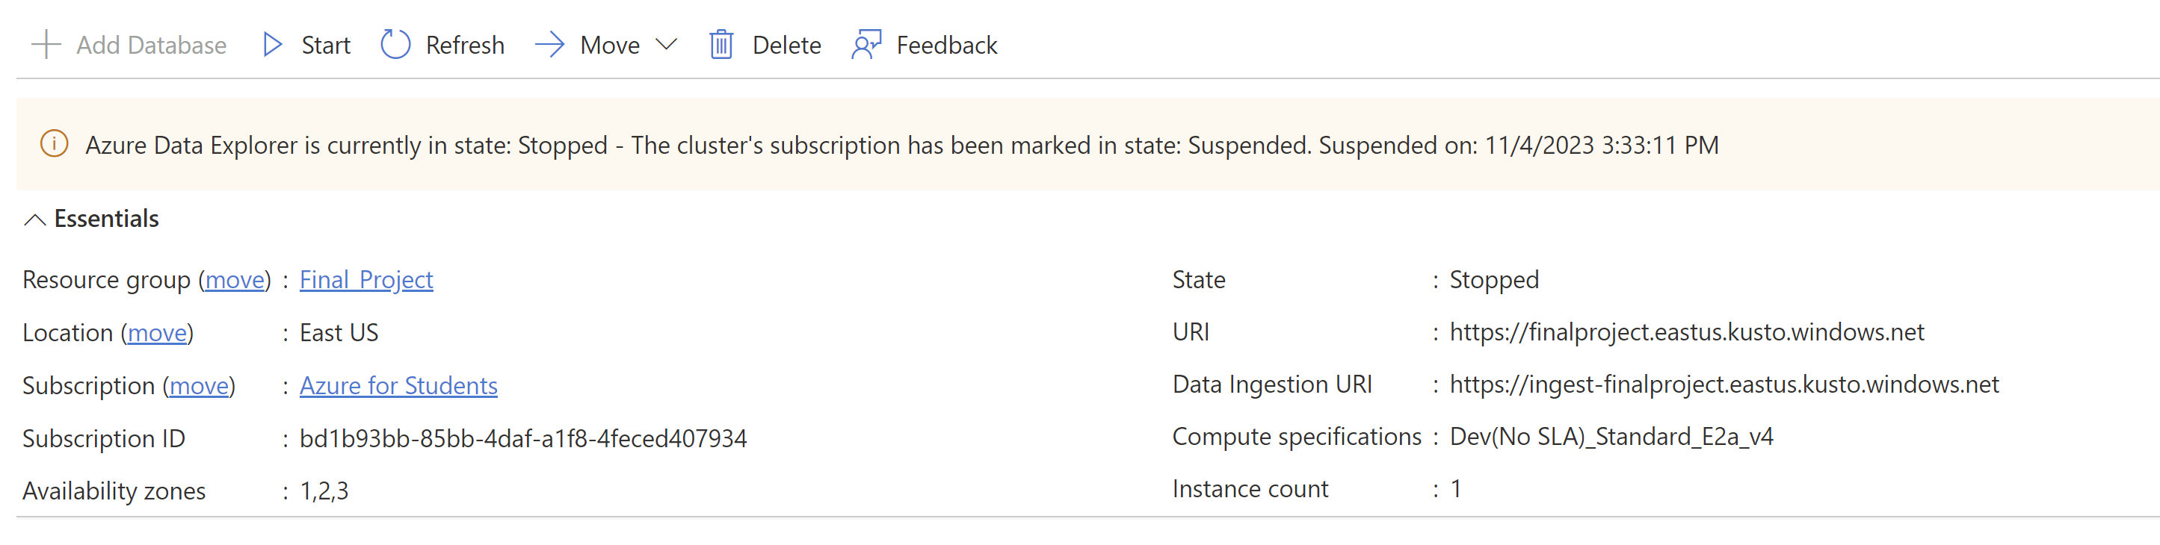
Another Added Note
Many of the applications we attempted to use we were unable to go back into to retrieve screenshots and information since they were blocked with this error message shown below. Therefore, we had to rely on our memory of those applications to help explain our process.

