Slide 1

Vel Tech Rangarajan Dr. Sagunthala R&D Institute of Science and Technology
School of Computing
Department of Computer Science and Engineering
10211CS224 / FULL STACK APPLICATION DEVELOPMENT (JAVA)
PROJECT REVIEW : MILESTONE PROJECT – 2
Date: 20-04-2026
SMART CAMPUS EVENT MANAGEMENT SYSTEM
SDG: 4 – Quality Education
Presented By:
G RAAJIDHA – VTU26488 – 23UECS0719
Courses Handling Faculty:
Dr. S . HEMAMALINI – M.E., Ph.D

Slide 2
INTRODUCTION
The Smart Campus Event Management System is a web-based application designed to manage college events efficiently.
In many institutions, event management is handled manually, leading to errors and delays.
This project aims to digitalize the process of event creation, registration, and management.
Students can view upcoming events and register online.
Administrators can manage event details and track registrations.
The system improves accuracy, reduces paperwork, and saves time.
It provides a user-friendly interface for both students and admins.
Overall, it enhances campus event coordination and participation.
1
2
3
4
5
6
7
8
9

Slide 3

PROBLEM STATEMENT
In many colleges, event management is not fully automated and depends on manual processes.
This leads to inefficiency, data loss, and difficulty in tracking registrations.
Students face issues in knowing event details and registering on time.
Administrators struggle to manage large volumes of data manually.
There is no centralized system to monitor event participation.
This results in poor coordination and reduced efficiency.
Hence, a need arises for a reliable and automated system.
The system should simplify event management and improve accuracy.
1
2
3
4
5
6
7
8
9

Slide 4
OBJECTIVE(S)
To design and develop a web-based system for managing campus events and registrations.
To implement an efficient platform for event creation, registration, and tracking.
1
2
3
4
5
6
7
8
9

Slide 5
PROPOSED SYSTEM
Provides an online platform for event management
Enables admin to add, update, and delete events
Stores data securely in a database
Reduces manual work and errors
Improves communication between students and admin
Tracks registrations and available seats
Ensures better organization and efficiency
1
2
3
4
5
6
7
8
9

Slide 6
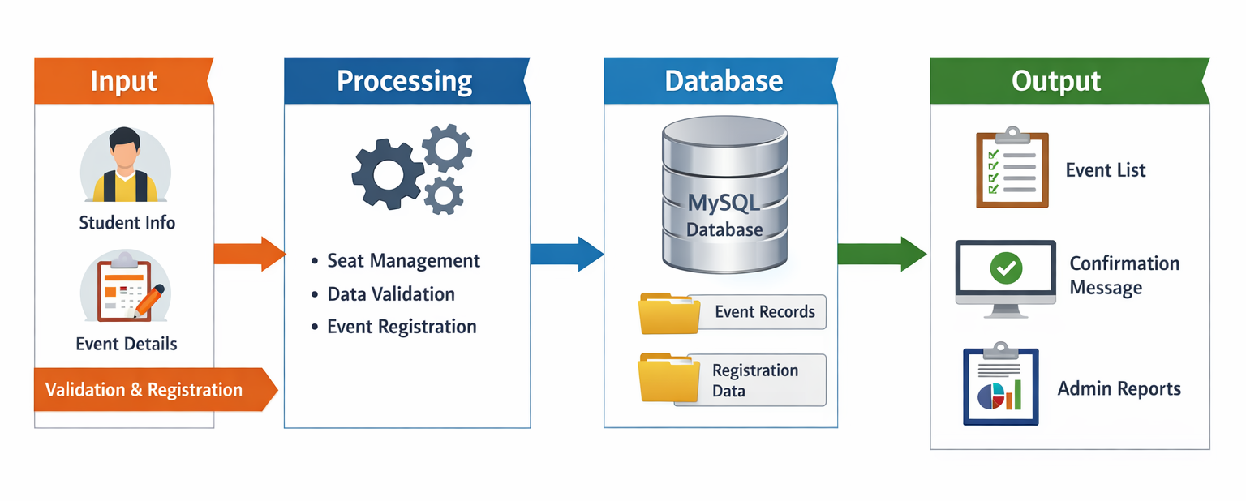
PROPOSED SYSTEM ARCHITECTURE
Explaination:
Input: Student details, event details
Processing: Validation, registration, seat management
Database: MySQL stores events and registrations
Output: Event list, registration confirmation, admin reports
1
2
3
4
5
6
7
8
9

Slide 7
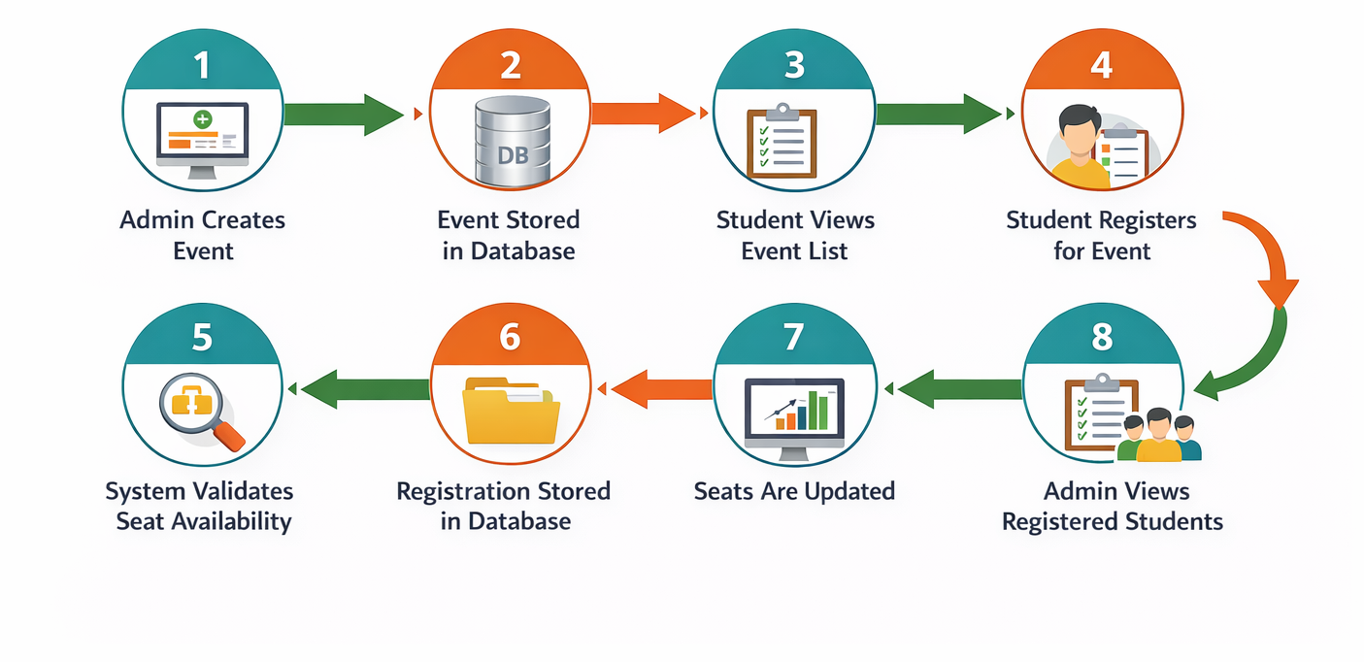
WORKFLOW
1
2
3
4
5
6
7
8
9

Slide 8
TECHNOLOGIES USED
Frontend: HTML, CSS, Thymeleaf
Backend: Spring Boot (Java)
Database: MySQL
Tools: VS Code, Maven
Hardware Requirements: Minimum 4GB RAM, i3 Processor
Software Requirements: JDK 8+, MySQL Server, Web Browser
1
2
3
4
5
6
7
8
9

Slide 9
MODULE DESCRIPTION
Module 1: Event Management
Admin can create, update, and delete event details.
Module 2: Student Registration
Students can register for events with validation and seat checking.
Module 3: Database Management
Handles storage and retrieval of event and registration data.
Module 4: Admin Monitoring
Admin can view registered students and event participation.
1
2
3
4
5
6
7
8
9

Slide 10
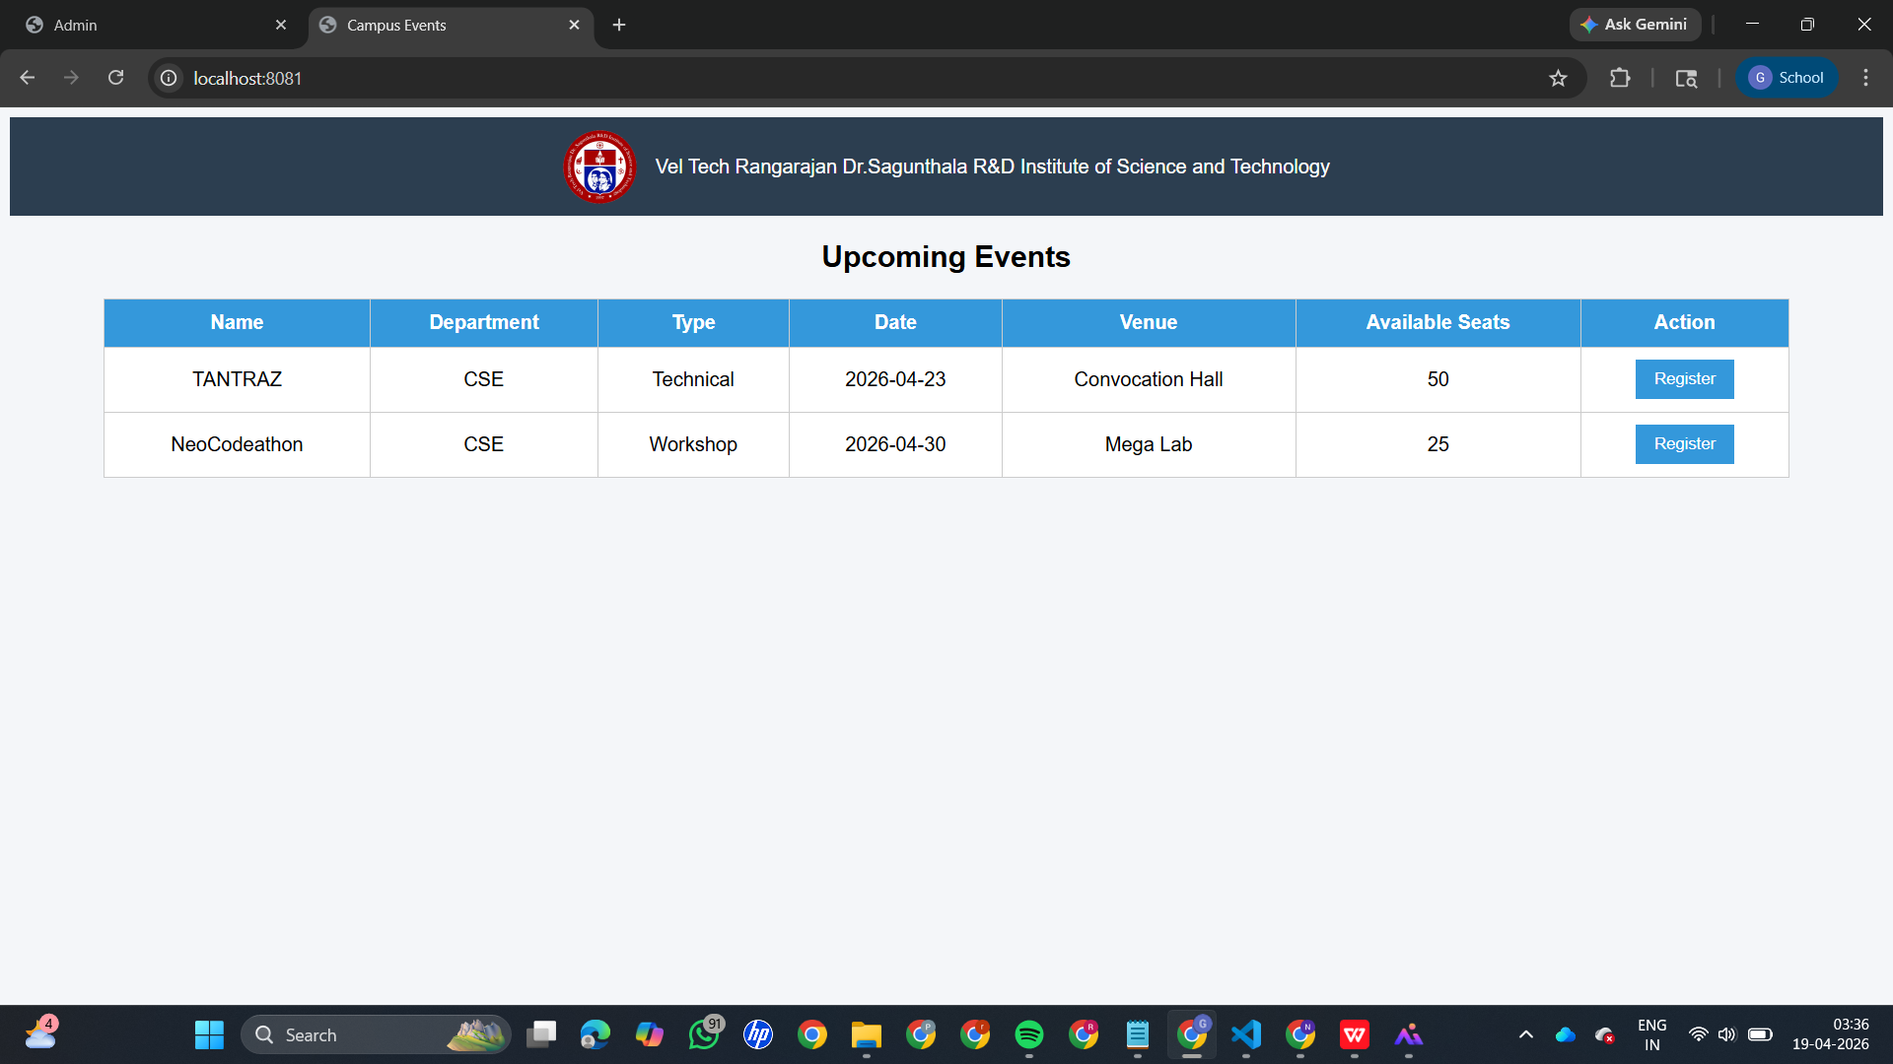
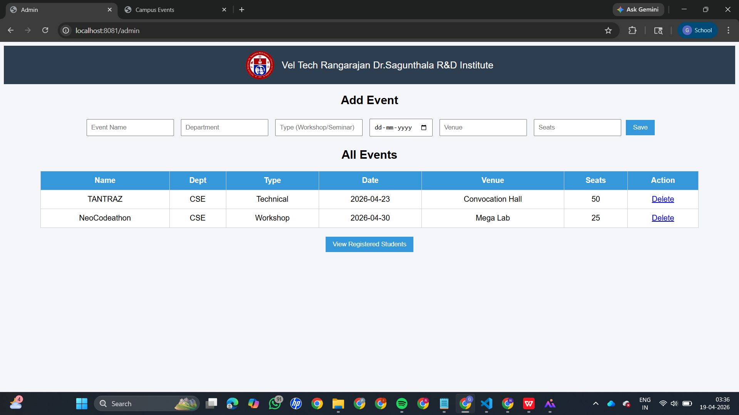
IMPLEMENTATION SCREENSHOTS
Home Page:
Displays list of events available for students.
Admin Page:
Allows admin to add and manage events.
1
2
3
4
5
6
7
8(A)
9

Slide 11
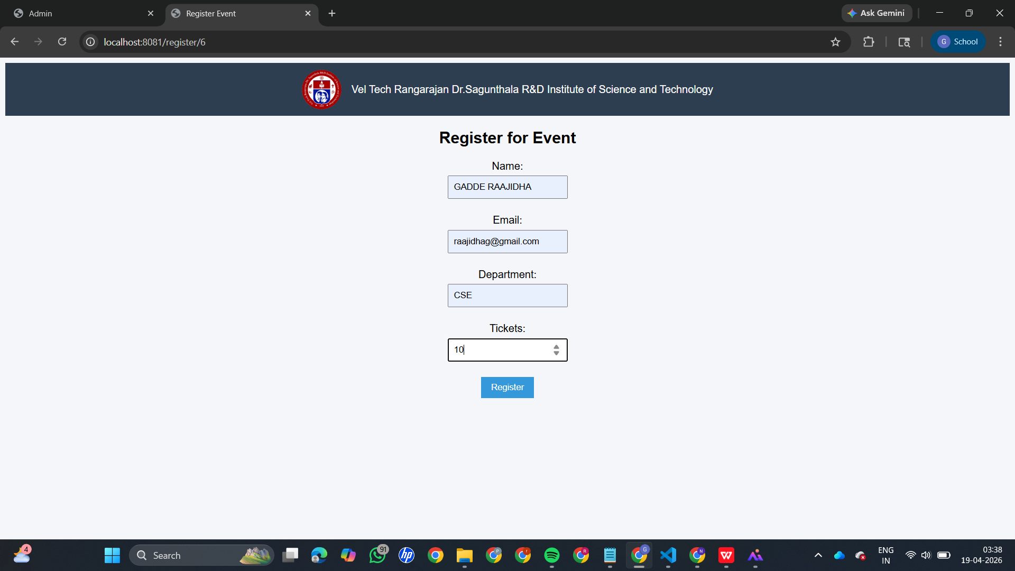
IMPLEMENTATION SCREENSHOTS
Registration Page:
Students fill details to register for events.
.
1
2
3
4
5
6
7
8(B)
9

Slide 12
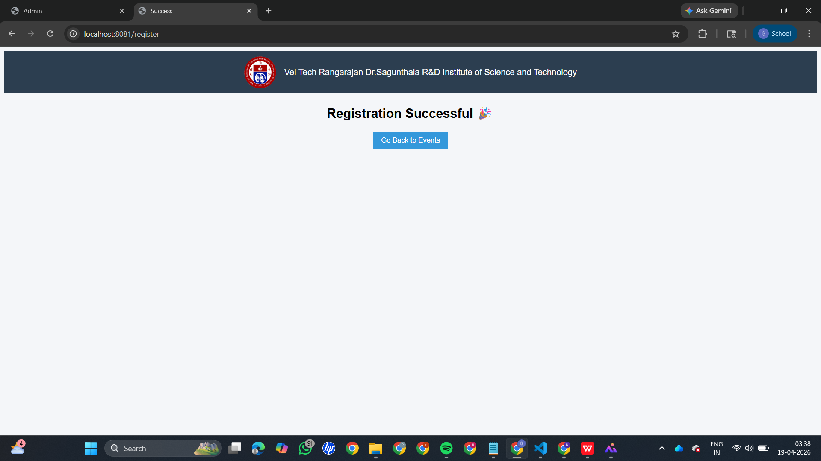
IMPLEMENTATION SCREENSHOTS
Output Page:
Shows successful registration confirmation.
1
2
3
4
5
6
7
8(C)
9

Slide 13
ADVANTAGES & LIMITATIONS
Advantages:
Reduces manual work
Improves accuracy
Easy to use interface
Centralized system
Saves time
Limitations:
Requires internet connection
Basic security (can be improved)
Limited to campus-level usage
1
2
3
4
5
6
7
8
9

Slide 14
Thank you

