Slide 1

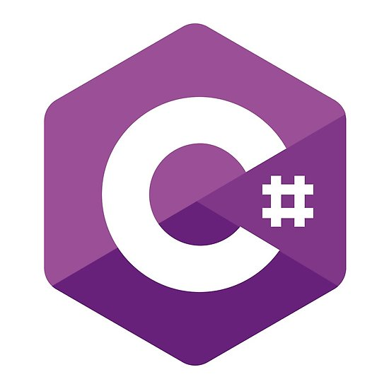


Dotnet Interop

Slide 2

Who Am I?

Slide 3


Who Am I?
Adam Parker
Software Consultant at Opencast Software
.Net all of Career
Notable Achievements
Creating this talk
Learning PowerPoint Animations for this talk
Not Much Else

Slide 4

What is Interop?
Microsoft’s Definition
“Interoperability enables you to preserve and take advantage of existing investments in unmanaged code. Code that runs under the control of the common language runtime (CLR) is called managed code, and code that runs outside the CLR is called unmanaged code. COM, COM+, C++ components, ActiveX components, and Microsoft Windows API are examples of unmanaged code.”
My Definition
“Using Libraries from other languages in your project in the DotNet ecosystem”

Slide 5
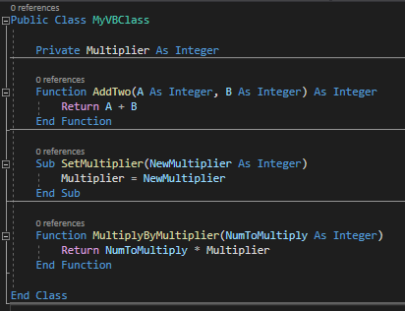
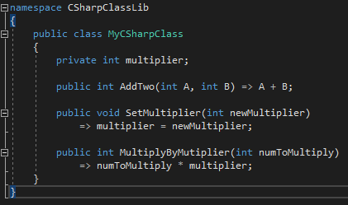
Visual Basic And C#

