Slide 1


Slide 2




Dotnet Interop

Slide 3

Who Am I?

Slide 4


Who Am I?
Adam Parker
Software Consultant at Opencast Software
.Net most of Career
Notable Achievements
Creating this talk
Learning PowerPoint Animations for this talk
Not Much Else

Slide 5
What’s in the talk?
Quick look at the work ‘Interoperability’
Object-Oriented to Object-Oriented
Featuring C# and Visual Basic
Object-Oriented – Functional
Featuring C# and F#
When it Works well
When it doesn't work well (more often than you might think)

Slide 6

What is Interop?
Microsoft’s Definition
“Interoperability enables you to preserve and take advantage of existing investments in unmanaged code. Code that runs under the control of the common language runtime (CLR) is called managed code, and code that runs outside the CLR is called unmanaged code. COM, COM+, C++ components, ActiveX components, and Microsoft Windows API are examples of unmanaged code.”
My Definition
“Using Libraries from other languages in your project”

Slide 7
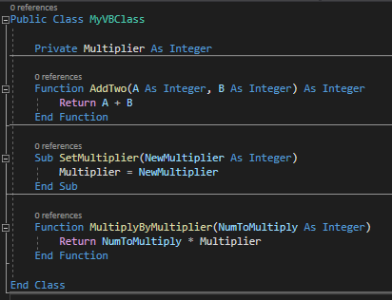
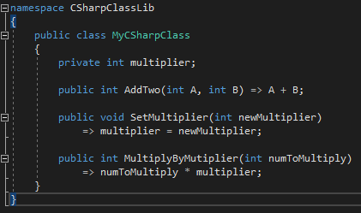
Visual Basic And C#
Notes:
Both 17, VB could be crushed down to 12

Slide 8
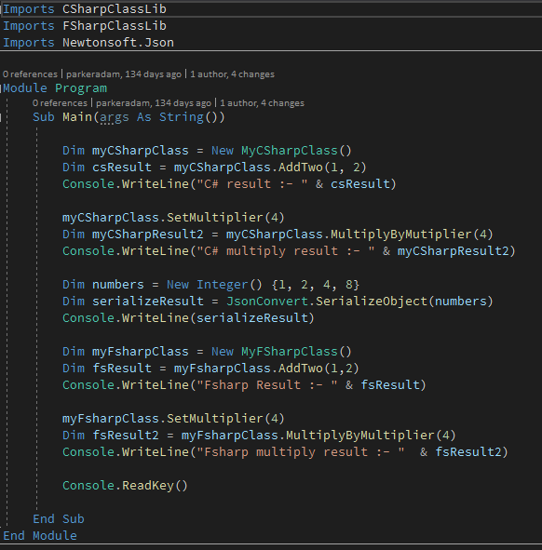
Visual Basic And C#

Slide 9

But what About F#?
Discriminated Unions
Options
Higher Order Functions
Modules
Records
Sequences

Slide 10
Things that work well

Slide 11

Namespaces and Modules
Namespaces allow using statements just like C# namespaces
Modules Expose themselves as Static Classes

Slide 12


Values and Records
Values are exposed as static fields on class.

Slide 13
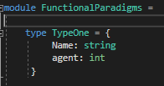
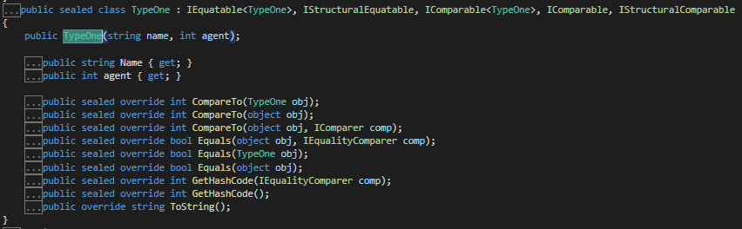
Values and Records
Values are exposed as static fields on class.
Records generate a read-only class with only a full parameter constructor.

Slide 14

Seq, Array and Lists
Arrays work as expected
Seq get exposed as IEnumerable

Slide 15

Functions!
Functions will work as long as they don’t accept other functions as parameters (more on this later)

Slide 16

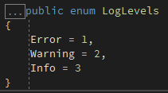
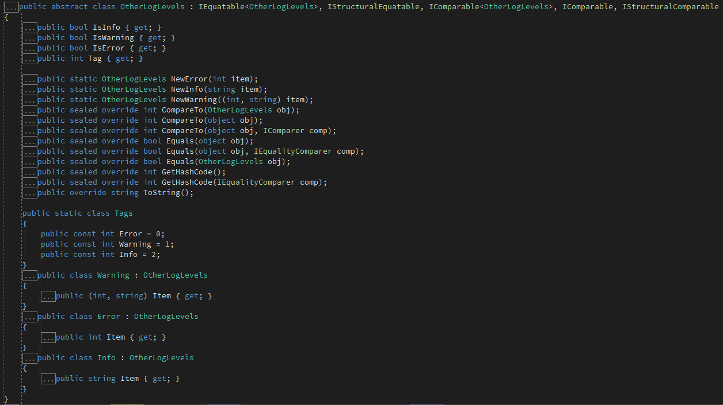

Discriminated Unions
If Discriminated Unions only have numbers, compiles to enum.
If Discriminated Union uses types, creates a abstract class which has methods for creating sub-types

Slide 17

Unit
If a function returns Unit, compiles down to return void
If used as a parameter, use null

Slide 18
Things that work not so well

Slide 19
Lists
Lists in F# are different to C# Lists, this may cause some confusion.
You can import FsharpList<T> type from Fsharp.Core Nuget package.
Or just use IReadonlyCollection

Slide 20
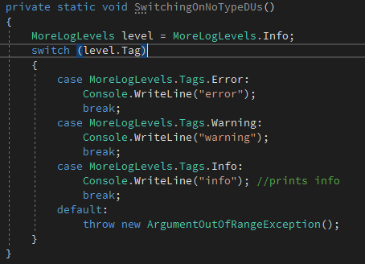

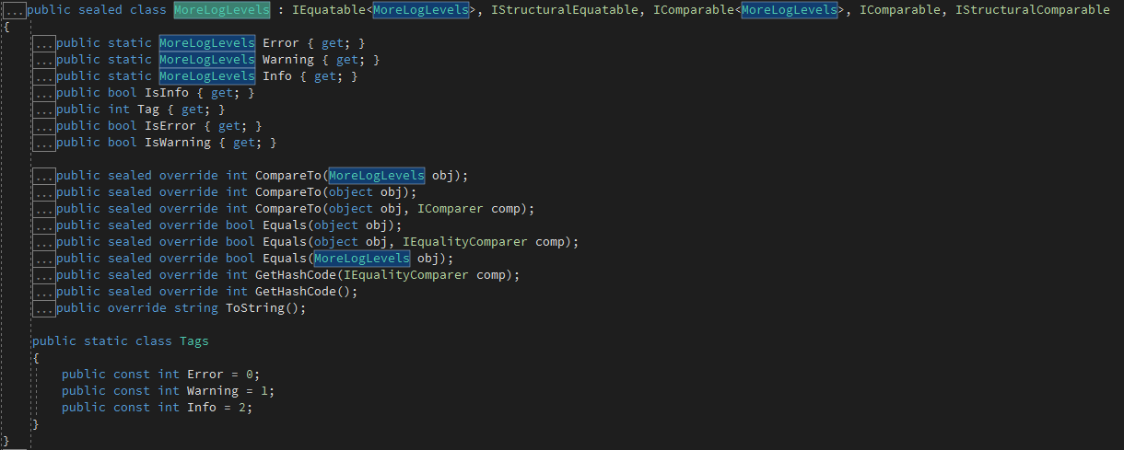
Discriminated Unions
If we don’t provide a type, DU’s don’t play so well.

Slide 21

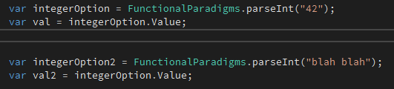

Options
Options allow you to get the value and work as expected.
None simply returns as null therefore making it unsafe

Slide 22
Things that should work

Slide 23

Functions
If a function takes another function, we have problems.

Slide 24
So what’s the point?

Slide 25
What’s the point?
As we’ve seen in the VB/C# demo, using libraries
Database
Http
Functional core – Imperative shell
Functional/F# / Domain

Slide 26
Resources
https://parkeradam.home.blog/
https://connelhooley.uk/blog/2017/04/30/f-sharp-to-c-sharp#discriminated-unions
https://sharplab.io

