Slide 1




Dotnet Interop

Slide 2

Who Am I?

Slide 3


Who Am I?
Adam Parker
Software Consultant at Opencast Software
.Net all of Career
Notable Achievements
Creating this talk
Learning PowerPoint Animations for this talk
Not Much Else

Slide 4
What’s in the talk?
Quick look at the work ‘Interoperability’
Object-Oriented to Object-Oriented
Featuring C# and Visual Basic
Object-Oriented – Function
Featuring C# and F#
When it Works well
When it doesn't work well (more often than you might think)

Slide 5

What is Interop?
Microsoft’s Definition
“Interoperability enables you to preserve and take advantage of existing investments in unmanaged code. Code that runs under the control of the common language runtime (CLR) is called managed code, and code that runs outside the CLR is called unmanaged code. COM, COM+, C++ components, ActiveX components, and Microsoft Windows API are examples of unmanaged code.”
My Definition
“Using Libraries from other languages in your project in the DotNet ecosystem”

Slide 6
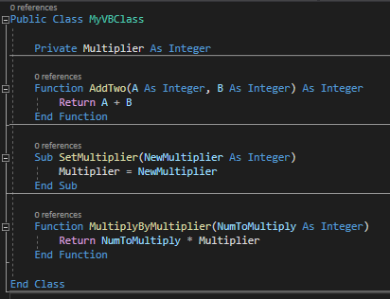
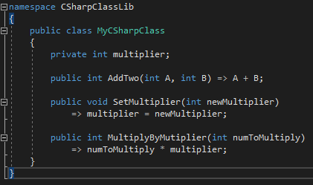
Visual Basic And C#

Slide 7

But what About F#?
Discriminated Unions
Options
Higher Order Functions
Modules
Records
Sequences

Slide 8
Things that work well

Slide 9

Namespaces and Modules
Namespaces allow using statements just like C# namespaces
Modules Expose themselves as Static Classes

Slide 10


Values and Records
Values are exposed as static fields on class.
Records generate a read-only class with only a full parameter constructor.

Slide 11
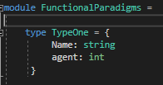
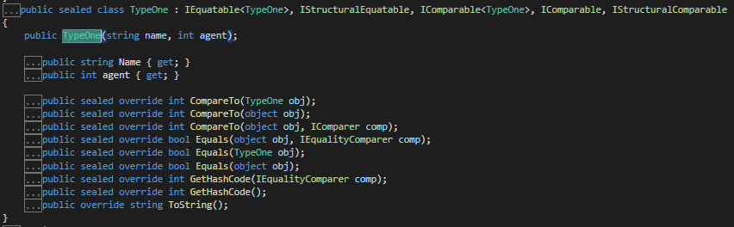
Values and Records
Values are exposed as static fields on class.
Records generate a read-only class with only a full parameter constructor.

Slide 12

Seq, Array and Lists
Arrays work as expected
Seq get exposed as IEnumerable

Slide 13

Functions!
Functions will work as long as they don’t accept other functions as parameters (more on this later)

Slide 14

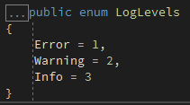
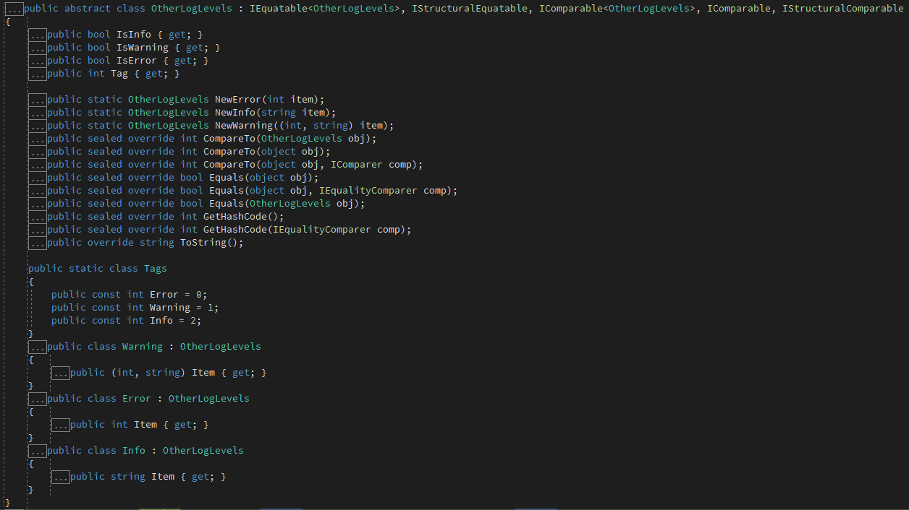

Discriminated Unions
If Discriminated Unions only have numbers, compiles to enum.
If Discriminated Union uses types, creates a abstract class which has methods for creating sub-types

Slide 15

Unit
If a function returns Unit, compiles down to return void
If used as a parameter, use null

Slide 16
Things that work not so well

Slide 17
Lists
Lists in F# are different to C# Lists, this may cause some confusion.
You can import FsharpList<T> type from Fsharp.Core Nuget package.
Or just use IReadonlyCollection

Slide 18
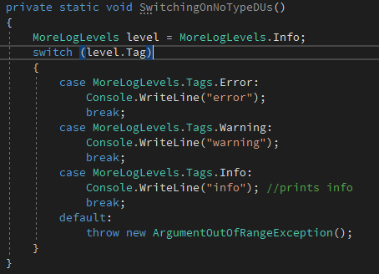

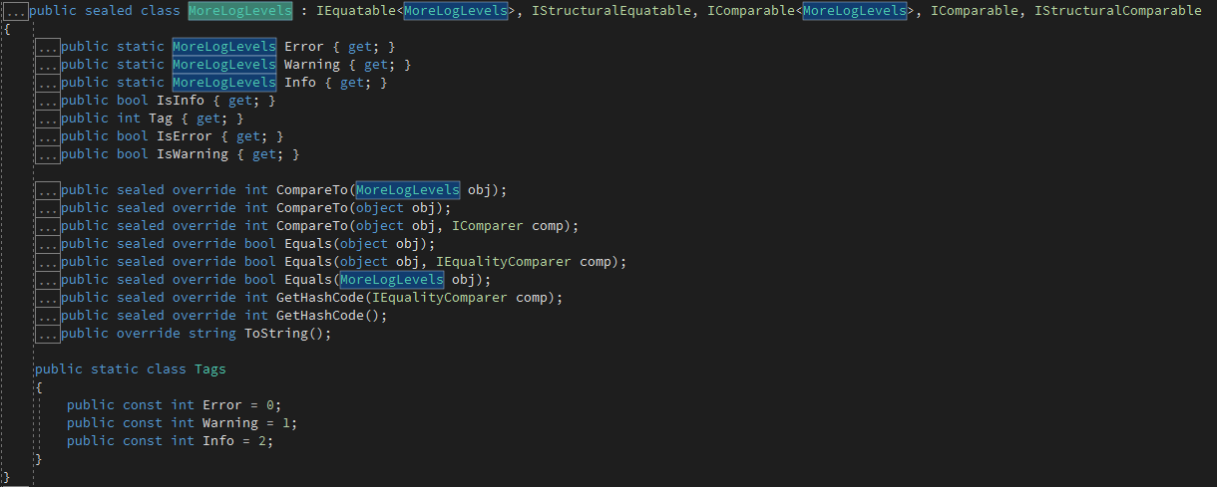
Discriminated Unions
If we don’t provide a type, DU’s don’t play so well.

Slide 19

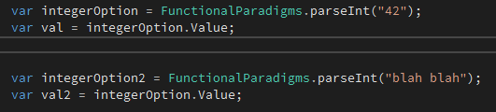

Options
Options allow you to get the value and work as expected.
None simply returns as null therefore making it unsafe

Slide 20
Things that should work

Slide 21

Functions
If a function takes another function, we have problems.

Slide 22
Resources
https://parkeradam.home.blog/
https://connelhooley.uk/blog/2017/04/30/f-sharp-to-c-sharp#discriminated-unions
https://sharplab.io

