Slide 1
WELCOME

Slide 2
Group Members
Md Rabbi Hossain [ 17142241(4)407 ]
Abdul Alim [ 17142241(4)438 ]
Maksudul Haque [ 17142241(4)403 ]

Slide 3

Presentation on E-commerce website (icchee.com)

Slide 4
Introduction
What is E-commerce
Talking about our system

Slide 5
What is E-commerce
E-commerce is the activity of electronically buying or selling of products on online services or over the Internet.
E-commerce is also known as electronic commerce or internet commerce.
These business transactions can be done in four ways: Business to Business (B2B), Business to Customer (B2C), Customer to Customer (C2C), Customer to Business (C2B)

Slide 6
About Our System
We are create a E-commerce website using WordPress.
We use WooCommerce for the making online shop.
WooCommerce is the world’s most popular open-source eCommerce solution.
We use “Astra” theme for this store

Slide 7
Features of icchee.com
Menu
Catalog Browsing Category List Product List
Product Browsing Product Review Related Product
Cart
Checkout

Slide 8
Advantages of E-commerce
Faster buying/selling procedure, as well as easy to find products.
Buying/selling 24/7.
More reach to customers, there is no theoretical geographic limitations.
Low operational costs and better quality of services.
No need of physical company set-ups.
Easy to start and manage a business.

Slide 9
Disadvantages of E-commerce
Unable to examine products personally
Not everyone is connected to the Internet
There is the possibility of credit card number theft
Mechanical failures can cause unpredictable effects on the total processes

Slide 10
Our Website Interface

Slide 11
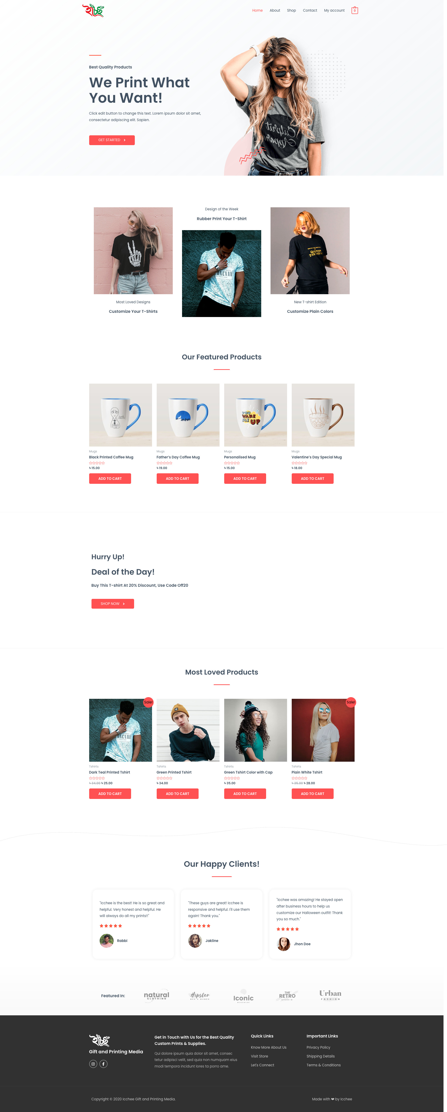
Homepage

Slide 12
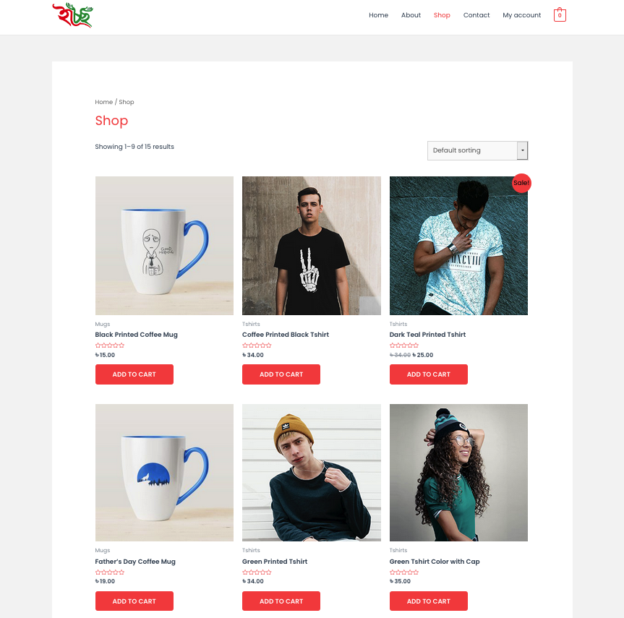
Shop Page

Slide 13
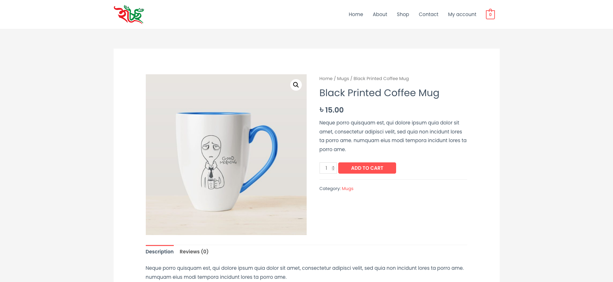
Single Product Page

Slide 14
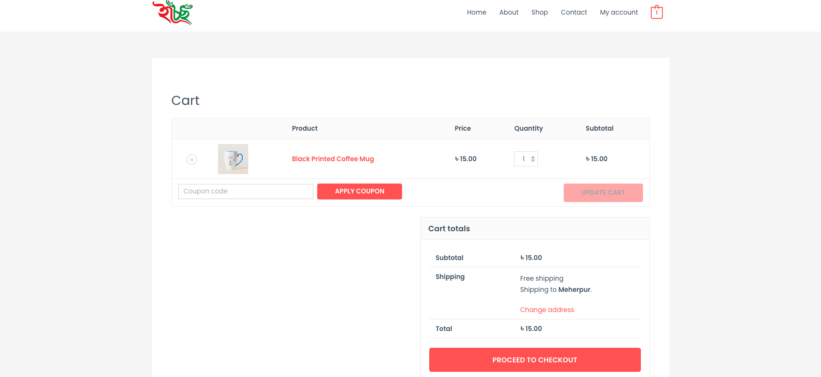
Cart Page

Slide 15
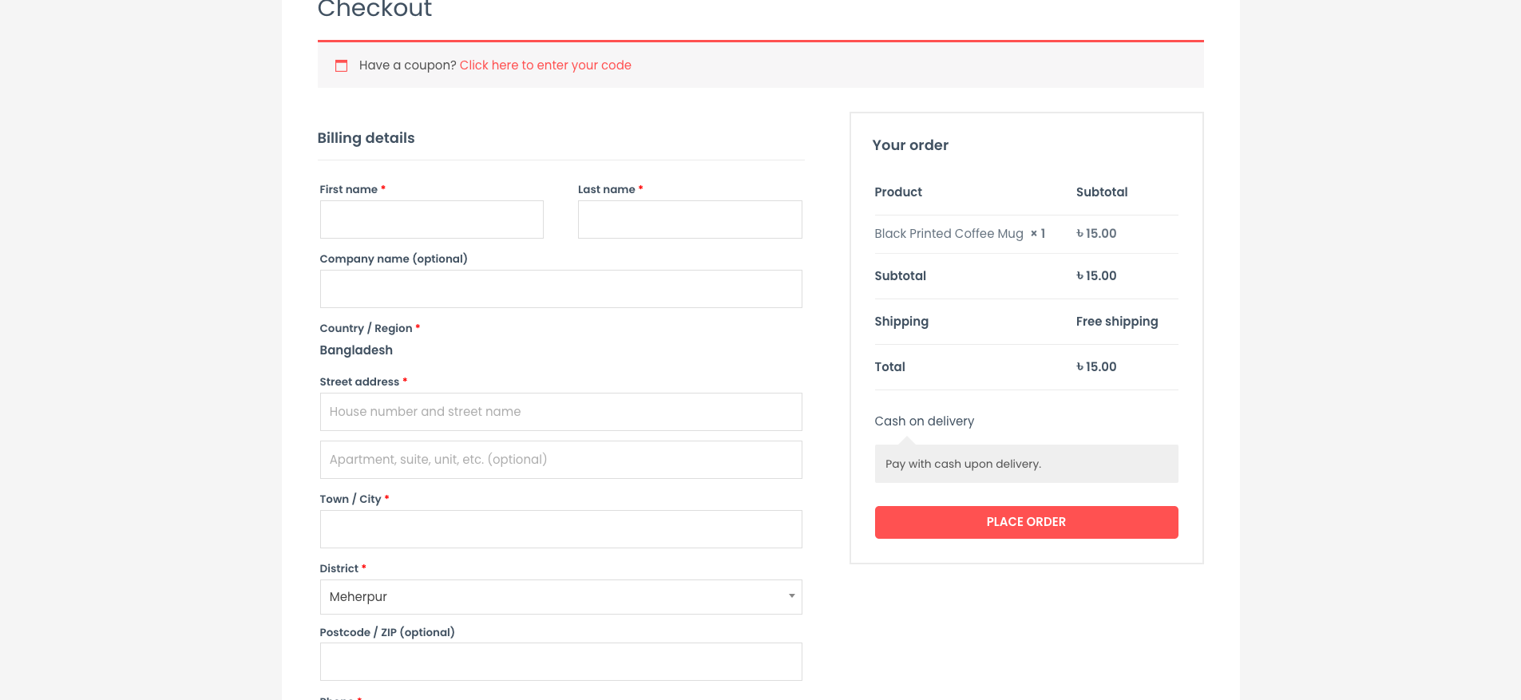
Checkout page

Slide 16
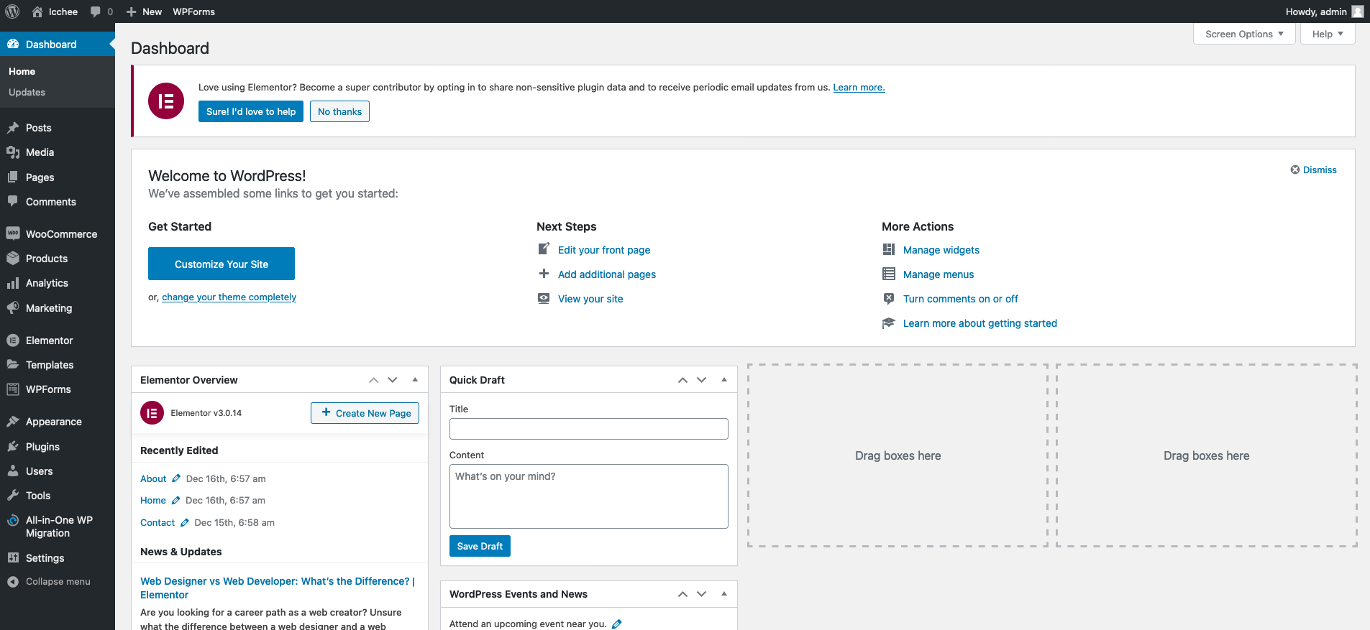
Admin Panel

Slide 17
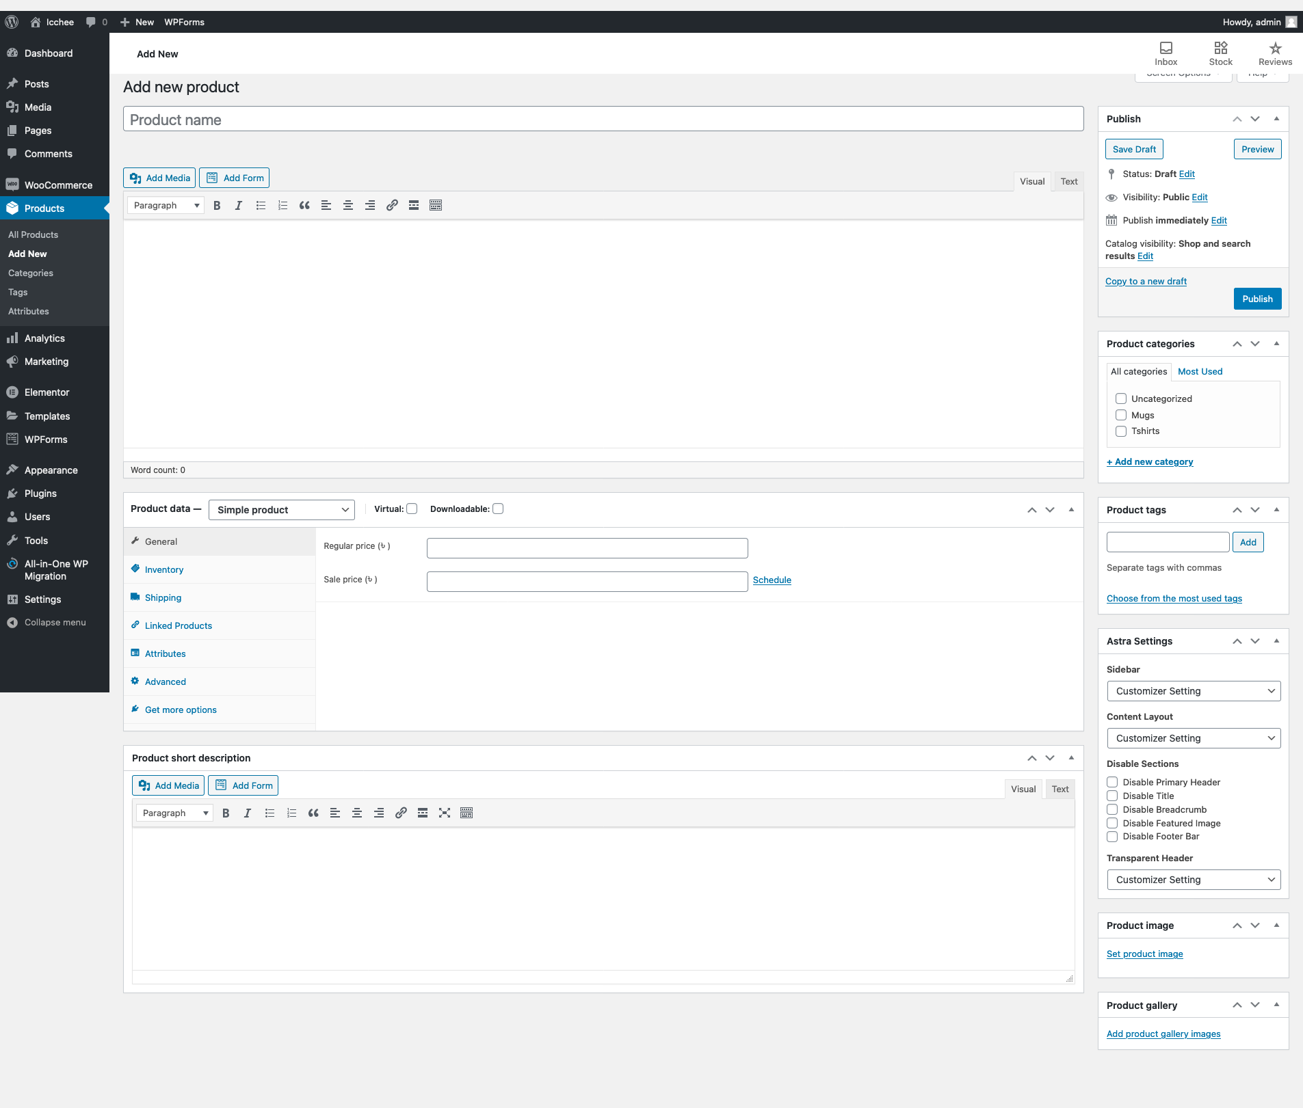
Add a new Product

Slide 18
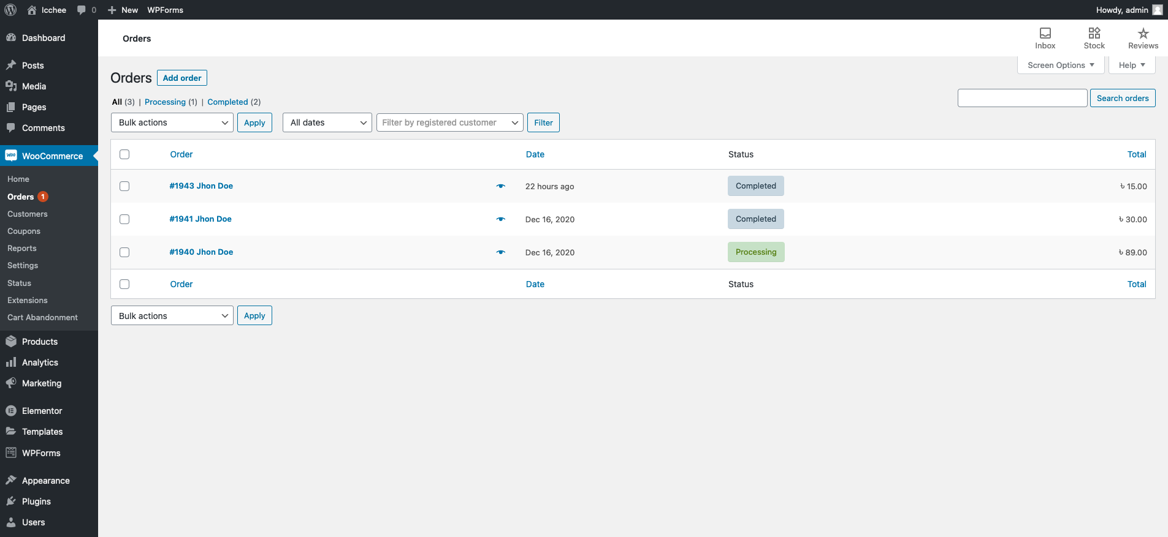
Customer Orders

Slide 19
Any Question ?

Slide 20
Thank you!

