Slide 1
Quali CloudShell + Robot Framework

Slide 2
List of artifacts
Github repo: https://github.com/graboskyc/BasicCloudShellRobot
Docker image: https://hub.docker.com/r/graboskyc/qualicsrobot/
Running:
Build Ubuntu Linux VM
apt-get install docker.io
docker run -t -i -d -p 2222:22 --name qsrobot graboskyc/qualicsrobot
Edit config.json file for IP of Quali Server

Slide 3
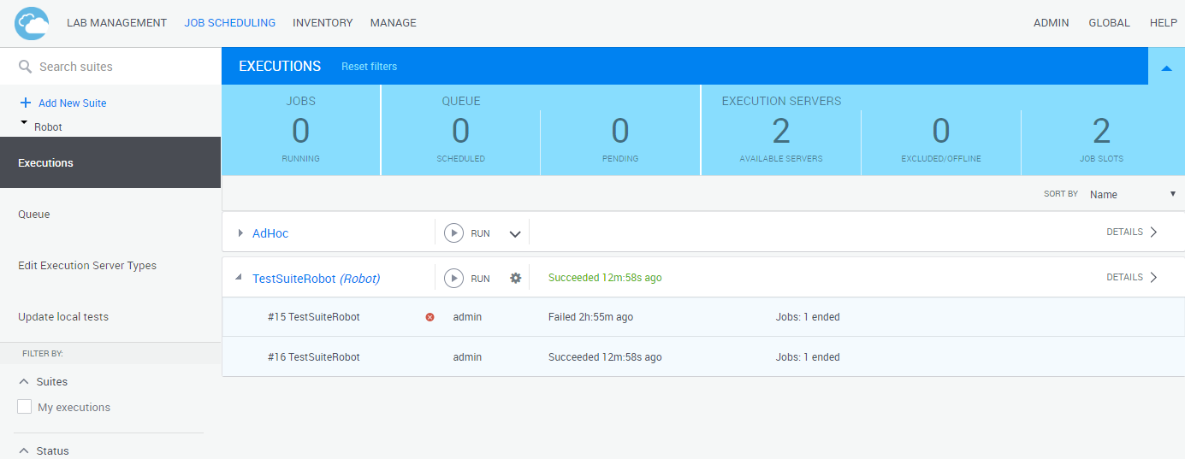
Running robot job suite
Drop down switch for TestShell/Robot
Just hit run

Slide 4
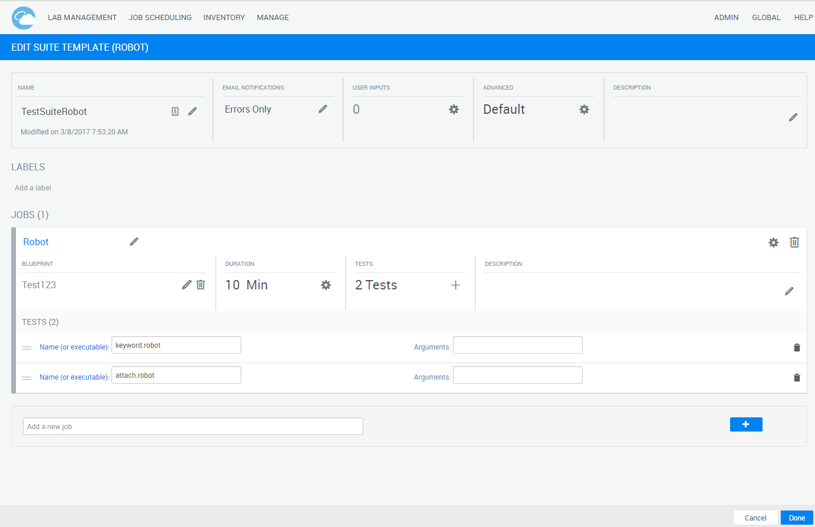
Customizing robot suite
Name of robot test
Attaches logs to CS

Slide 5
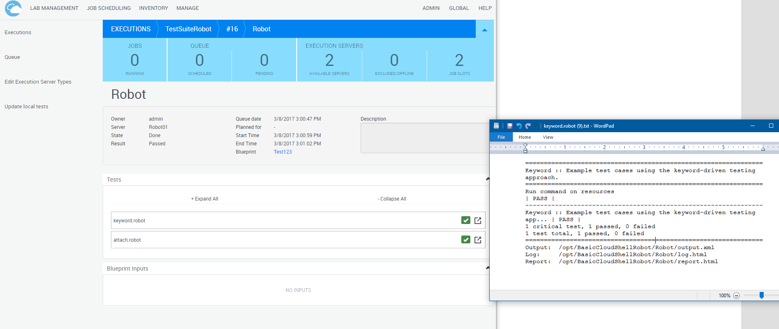
Results (1)
Record of time, etc
Exe log (robot output)
Test passed

Slide 6
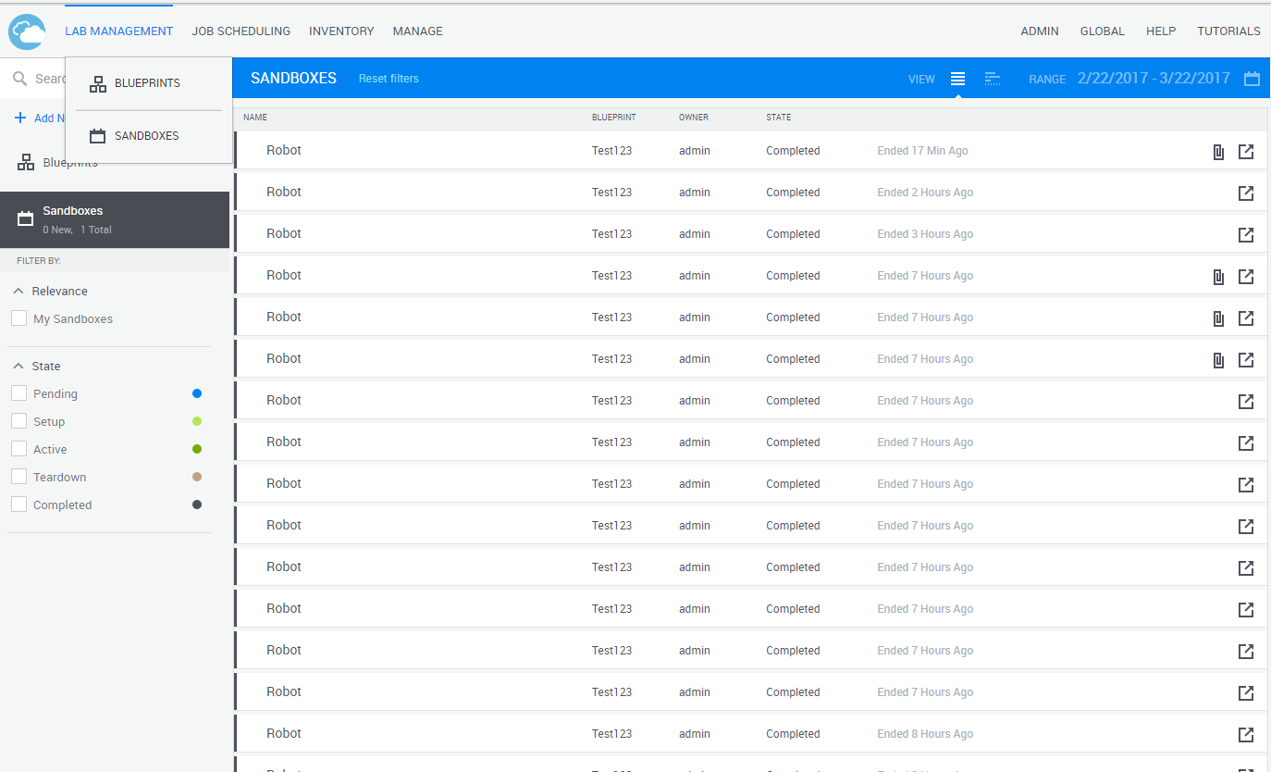
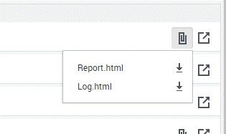
Results (2)
Robot report attached at end
Each run is in a sandbox
Multiple logs

Slide 7
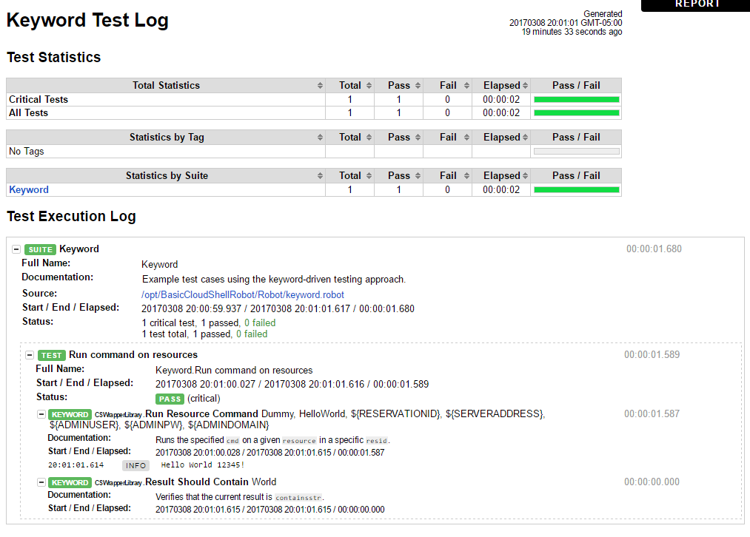
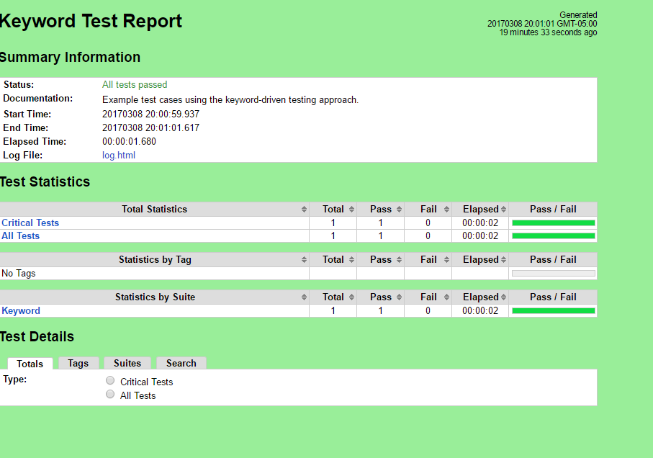
Results (3) – robot report

Slide 8
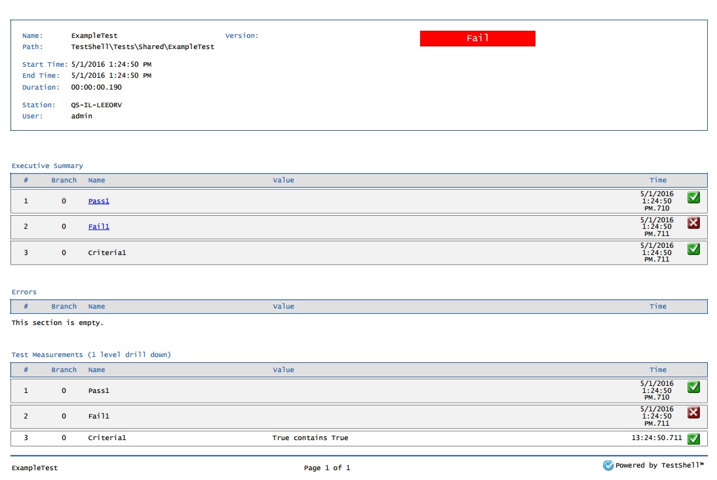
Results (4) – report if Studio

Slide 9
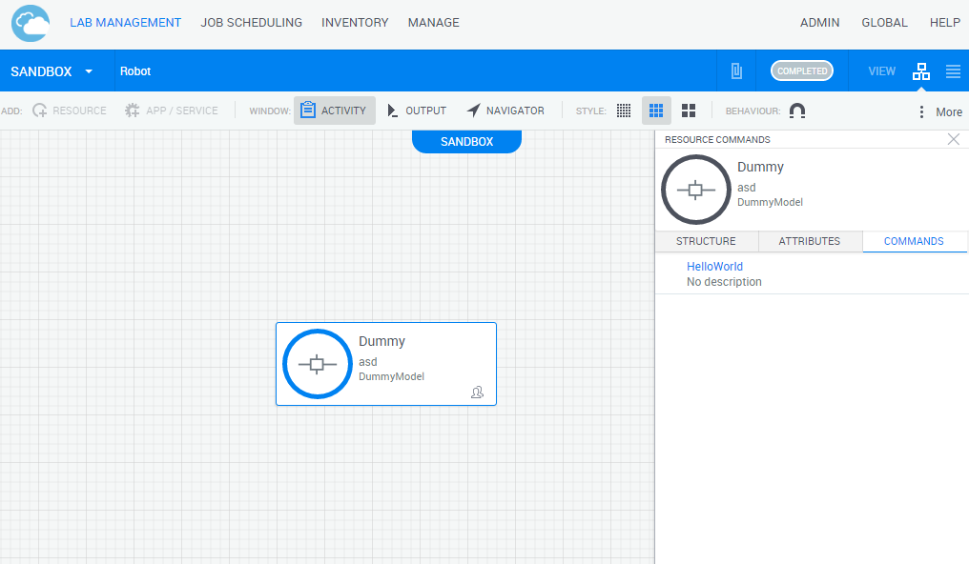
Sample sandbox
Commands in shell
Any resource

Slide 10
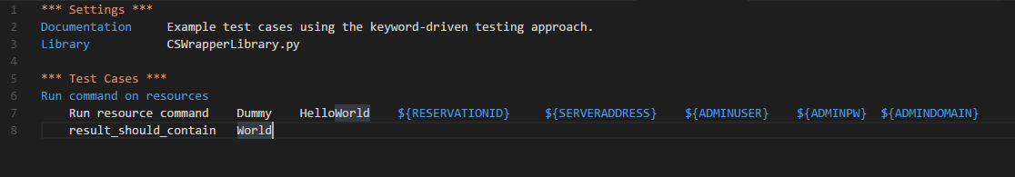
Sample robot test
This is the actual test itself in Robot…
Note that what we do is run the resource command (in the sandbox) called “HelloWorld” on the resource named “Dummy” and the rest is boilerplate.
That returns some string from the device under test (Dummy) and we are making sure that string contains the word “World” – this is our pass/fail criteria (albeit simple here)

