Slide 1
SV Analysis using all 10 Poplar Branches
Paul Grabowski
12/17/2018

Slide 2
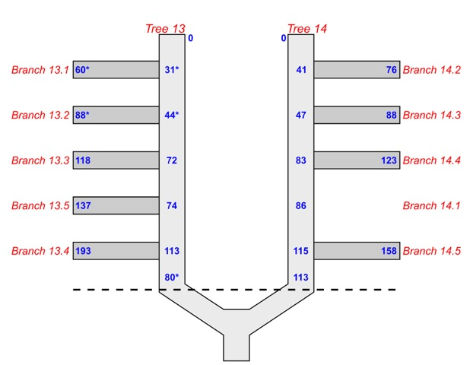
Branch 13.4 and 14.1 Omitted Because They May be Epicormic Branches
Original Diagram
Updated Diagram

Slide 3
What happens if include 13.4 and 14.1?
SV Filtering:
8-mer cutoffs
Mononucleotide: 70%
Binucleotide, one type: 50%
Binucleotde, two types: 60%
Distance between SVs: 1kb
Genotype calling parameters:
Het allele ratio: >0.25
Hom allele ratio: <0.05
Genotype score parameters:
Estimated error: 0.032
Estimated mean penetrance of hets: 0.35
Size cutoff: Keep SVs > 32bp
Motivations:
Branch 13.2 has elevated number of unique homozygous Ref genotypes
Branch 14.3 has elevated number of unique heterozygous genotype
Goal:
Do either 13.4 or 14.1 look like they could be sample-switched with 13.2 and/or 14.3
Do either 13.4 or 14.1 have elevations in homozygous or heterozygous genotypes similar to 13.2 or 14.3
Approach:
Compare results using all 10 branches to results omitting 13.4 and 14.1
use same SV filtering criteria for both analyses

Slide 4
General Stats
Omitting 13.4 and 14.1
Including 13.4 and 14.1
Total SVs: 15,538
Variable SVs: 821
Tree 14 SVs: 114
Branches: 14.2, 14.3, 14.4, 13.5
Tree 13 SVs: 4
Branches: 13.1, 13.2, 13.3, 14.5
Total SVs: 12,892
Variable SVs: 583
Tree 14 SVs: 19
Branches: 14.2, 14.3, 14.4, 14.1, 13.5
Tree 13 SVs: 1
Branches: 13.1, 13.2, 13.3, 14.5, 13.4

Slide 5
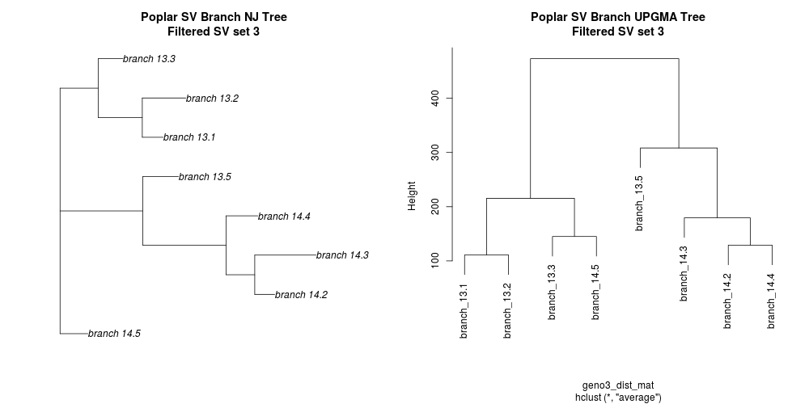
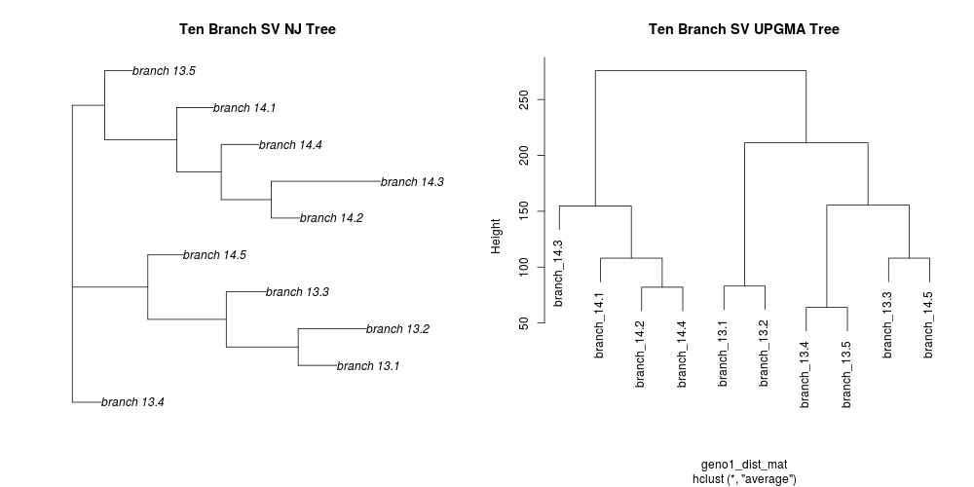
Sample Relationships
Omitting 13.4 and 14.1
Including 13.4 and 14.1
Take-Home:
Branch 13.4 and 14.1 do NOT look like they are sample switches with 13.2 or 14.3
Branch 14.5
Branch 13.5

Slide 6
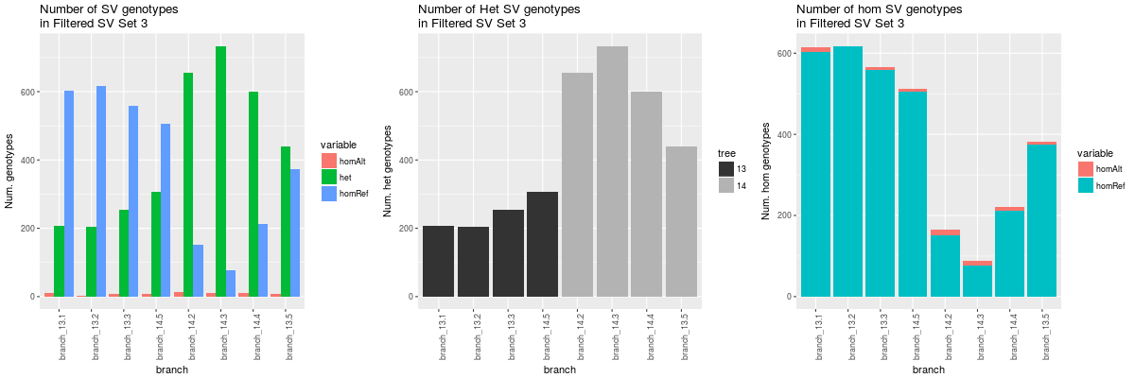
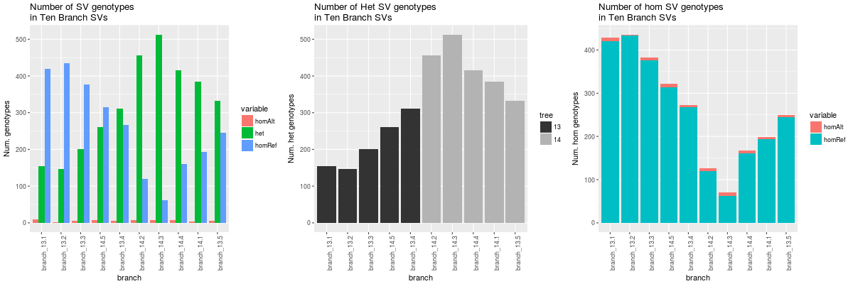
Genotype Tallies
Omitting 13.4 and 14.1
Including 13.4 and 14.1
Branch 14.5
Branch 13.5
Take-home:
Numbers of genotypes in 13.4 and 14.1 fit into the pattern of genotype numbers going up/down each tree

Slide 7
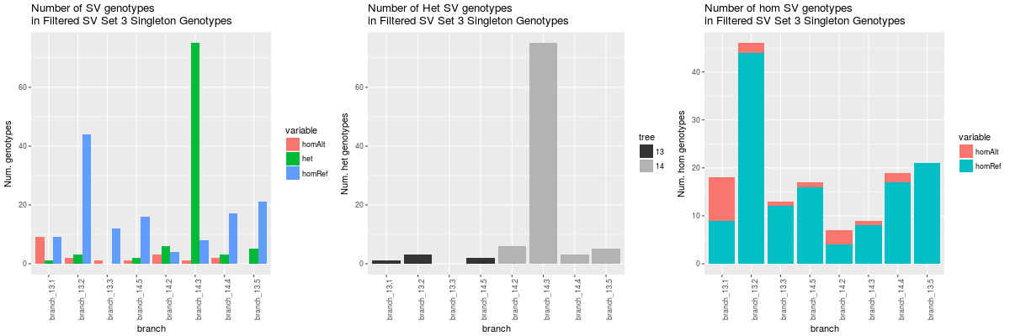
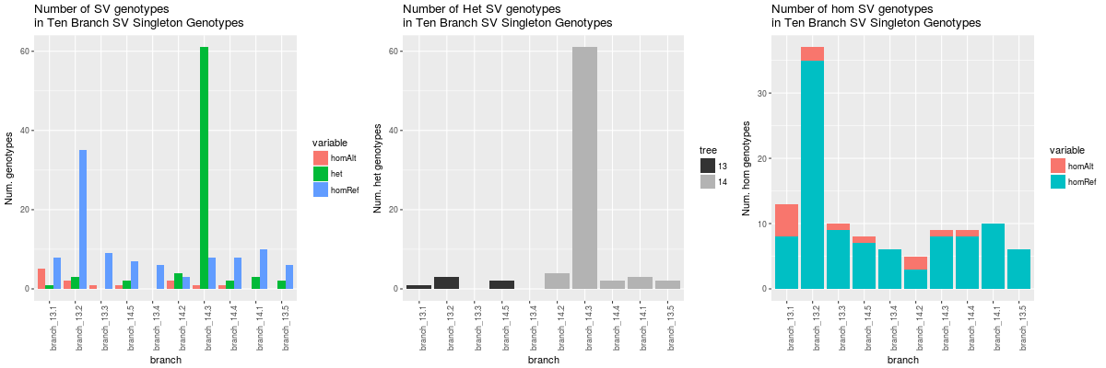
Singleton/Unique Genotype Tallies
Omitting 13.4 and 14.1
Including 13.4 and 14.1
Branch 14.5
Branch 13.5
Take Homes:
13.2 still has elevated unique RR SVs
14.3 still has elevated unique RA SVs
13.4 nor 14.1 have elevated unique SVs

